Slide 1
TMDL of Nutrients for Lake Nockamixon, PA
Public Meeting
January 30, 2003
Conshohocken, PA

Slide 2
Objectives
General overview of TMDL program
Present TMDL analysis for Lake Nockamixon
Receive feedback

Slide 3
Presentation Format
Introduction & General TMDL Program – Pennsylvania DEP
TMDL Analysis and Results – Tetra Tech
  Describe problem
  Outline technical approach
  Describe results and TMDL allocations
Q & A

Slide 4
What is a TMDL?
A Total Maximum Daily Load (TMDL) is the amount of pollutant loading that a waterbody can assimilate and meet our water quality standards.
The TMDL process is a planning tool to help states develop pollution reduction goals that will improve impaired waters to meet water quality standards.

Slide 5
The Watershed Management Cycle
A stream/watershed assessment
Waterbodies that are impaired are put on the 303(d) list.
TMDL Scheduled.
The TMDL is completed to address the impairments.
Implementations are developed.
Remediation activities
The watershed will be re-surveyed.

Slide 6
Legal Background
Section 303(d) of the Federal Clean Water Act
  States must identify, list and prioritize all waters where technology-based treatment requirements will not attain and/or maintain applicable water quality standards.
  Total Maximum Daily Loads (TMDLs) must be established for these waters to ensure attainment of water quality standards.

Slide 7
DEP Plan of Action
Assess all unassessed streams within 10 years
Assess 100 significant lakes within 10 years
Establish TMDLs for the 1996 303(d) listed waters (575 segments) – in 10 years for Non-AMD; 12 years for AMD
Also, prepare TMDLs for newly listed waters (403 in 1998)

Slide 8
The Assessment Process
One of Pennsylvania’s objectives is to assess every stream in the Commonwealth.
Unassessed Waters biological surveys
  Macro-invertebrates
  Habitat and the watershed landscape
  Chemical analysis

Slide 9
Unassessed Waters Action Summary through Year 2002
Pennsylvania Total Miles of Streams: | 83,161 miles
Assessed: | 52,889 miles (63.6%)
Supporting uses: | 44,504 miles
Impaired: | 8,385 miles

Slide 10
Current Categories for TMDL Development in PA
Non-Point Source Impairment
Lakes
Point Source Impairments
Fish Consumption Advisories
Acid Mine Drainage

Slide 11
TMDL Development Procedure
Delist if
demon-strated
TMDL
Submittal
Components
I. Problem Understanding
1. Waterbody characterization
2. Water quality standards & target limit
3. Impairment analysis
4. Source Assessment
1. Problem Understanding
2. Water Quality Standards / Targets
3. Source Assessment
II. Technical Approach
1. Model selection
2. Source loading analysis
3. In-stream analysis
4. Model testing
5. Source response evaluation (optional)
3. Summary of Technical Approach
III. Allocation Analysis
4 Loading Capacity/TMDL
5. WLA
6. LA
7. MOS
8. Seasonality
IV. Monitoring & Implementation
1. Monitoring plan
2. Implementation plan addressing reasonable assurance
9. Monitoring
10. Implementation
V. Public Review and Comment
1. Public notice
2. Post draft TMDL (via web and hard copy by request)
3. Public meeting (optional)
4. Response to comments
11. Public Participation
VI. Submittal to EPA
12. Submittal Letter

Slide 12
Problem Understanding
Lake Location: Bucks County, PA
Watershed encompasses about 46,700 acres in Bucks County
Major land uses
    Forest – 63%
    Agricultural/Hay/Pasture – 25%
Lake
    Surface Area – 1450 acres
    Storage Volume – 39,900 acre feet

Slide 13
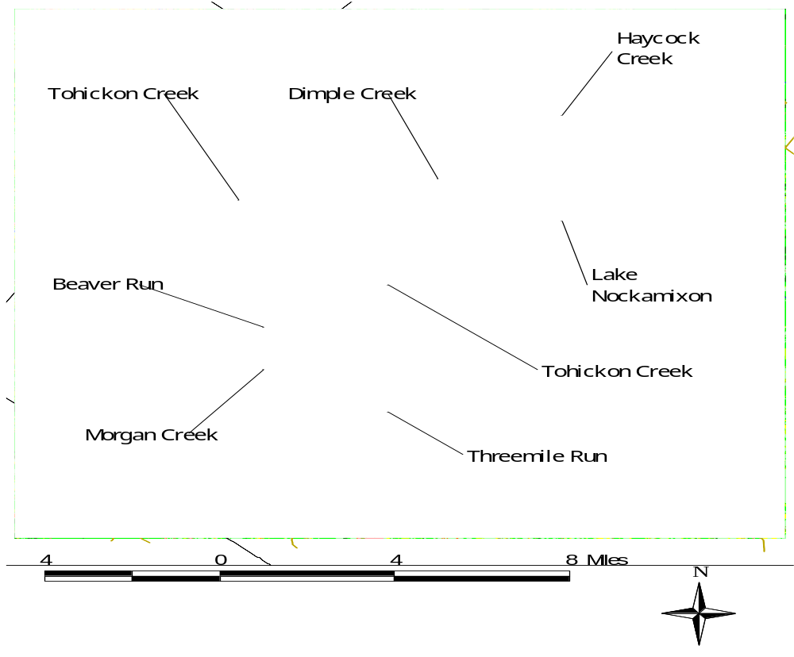

Slide 14
Problem Understanding
Point Sources
    16 NPDES permits in watershed
      4 facilities have not yet been constructed
      1 facility closed

Slide 15
Problem Understanding
303(d) listing
Listing Basis – Lake classified as hypereutrophic from Clean Lakes Project (Phase I & II) and Trophic Status Index studies by Pennsylvania DEP

Slide 16
Problem Understanding
Eutrophication – Process of gradual accumulation of sediment and nutrients that causes high algal production and decreased water quality such as:
    Decreased clarity, aesthetic displeasure
    Low dissolved oxygen and aquatic life impacts
    Decreased recreational opportunities
    Foul odors, taste problems
    Ecosystem alterations

Slide 17
Problem Understanding
Trophic States
    Oligotrophic- good clarity and water quality
    Mesotrophic- moderate clarity and water quality
    Eutrophic- poorer clarity and water quality
    Hypereutrophic- floating algae, very poor clarity and water quality, fish kills
Chlorophyll-a used as indicator of trophic state

Slide 18
Problem Understanding
Designated Uses: warm water fishes, potable water supply, industrial water supply, livestock water supply, wildlife water supply, irrigation, boating, fishing, water contact sports, and aesthetics, designated trout fishery
Water Quality Standards – No numeric water quality criteria for nutrients, only general narrative criteria
Water Quality Target – Achieve meso-eutrophic status based on achieving in-lake chlorophyll-a concentrations of 10 ug/l
  Chlorophyll-a is easy to measure, is a valuable surrogate for algal biomass, and is desirable as a water quality target because algae are either the direct (nuisance algal blooms) or indirect (high/low dissolved oxygen, pH, and high turbidity) cause of most problems related to excessive nutrient enrichment (US EPA, 1999(a)).

Slide 19
Problem Understanding
Impairment confirmation –
      Bucks County Conservation District water quality reports (1996 – 2000) confirm continued elevated chlorophyll-a and eutrophic status
      Pennsylvania DEP Trophic Status Index studies (1999 – 2001) confirm elevated chlorophyll-a levels and eutrophic status
      Phosphorus limited

Slide 20
Technical Approach
Consider phosphorus loading processes from precipitation driven, overland sources
Account for point source phosphorus loadings and other sources such as groundwater, septic systems, and stream bank areas
Consider nutrient dynamics such as nutrient limitation, partitioning, and sedimentation
Diverse land uses in moderate size watershed

Slide 21
Technical Approach
Linked watershed/in-lake water quality model
  Watershed model - ArcView Generalized Watershed Loading Function (AVGWLF)
      Developed by Penn State specifically for Pennsylvania
      Simulates runoff and nutrient loadings from watershed of variable size and land uses, considers septic systems and groundwater, and incorporates point sources
      Driven by climatological data such as daily rainfall and temperature
      Has been used for EPA approved TMDLs throughout Pennsylvania including TMDLs of Nutrients and sediment for Conewago Creek, Conodoguinet Creek, Quittapahilla Creek, and North Branch Mahantango Creek.

Slide 22
Technical Approach
In-lake water quality model – BATHTUB
      Developed by U.S. Army Corps of Engineers
      Incorporates nutrient loadings from tributaries, direct point sources, and nonpoint sources
      Considers nutrient limitation, nutrient partitioning, nutrient cycling, and nutrient sedimentation kinetics
      Capable of predicting in-lake, nutrient water quality responses to various nutrient loading scenarios
      Has been used for EPA approved TMDLs in West Virginia including TMDLs of phosphorus and sediment in Bear Lake, WV and Ridenour Lake, WV

Slide 23
Technical Approach
Watershed and in-lake water quality models calibrated and validated to observed data
Linked watershed/water quality model used to perform source loading analysis and determine in-lake water quality response
Used to calculate total allowable load of phosphorus to lake that ensures a seasonal chlorophyll-a average of 10ug/l

Slide 24
Technical Approach
Reductions of phosphorus loading will help:
    Reduce chlorophyll-a concentrations
    Improve trophic status
    Lead to improved water quality
    Lead to improved water clarity, aesthetics
    Decrease likelihood of algal blooms and macrophyte growth

Slide 25
Allocation Analysis
TMDL = ΣWLA + ΣLA + MOS
    WLA = wasteload allocations
    LA = load allocations
    MOS = margin of safety

Slide 26
Allocation Analysis
Point sources - all point sources already meeting 0.5 mg/l concentration for phosphorus discharge
Nonpoint sources - diverse land uses
  Forest – represent natural background
  Groundwater – difficult, if not impossible to control
  Urban/Unpaved roads/transitional – less than 3.5% of total phosphorus load to lake
  Agriculture/hay & pasture/streambank – focus of allocation analysis

Slide 27
Allocation Analysis
Equal Marginal Percent Reduction (EMPR)
    Baseline analysis – each discharge is evaluated independently against water quality target
    Multiple discharge analysis – cumulative impact of all discharges is evaluated against water quality target

Slide 28
Allocation Analysis (lbs/month)

Slide 29
Allocation Analysis (lbs/month)

Slide 30
Allocation Analysis

Slide 31
Allocation Analysis

Slide 32
Allocation Analysis

Slide 33
The data and all supporting information used to develop the proposed TMDL are available from the Department. To request a copy of the proposed TMDL and an information sheet, contact:
Jennifer Fields, P.E., Section Chief, Permits Section
Pennsylvania Department of Environmental Protection
Southeast Regional Office
Lee Park Suite
555 North Lane
Conshohocken, PA 19428 phone: (610)-832-6094 email: jefields@state.pa.us
Written comments will be accepted at the above addresses and must be postmarked by February 12, 2003. The TMDLs can also be viewed and printed on this Website:http://www.dep.state.pa.us/watermanagement_apps/tmdl/

