Slide 1
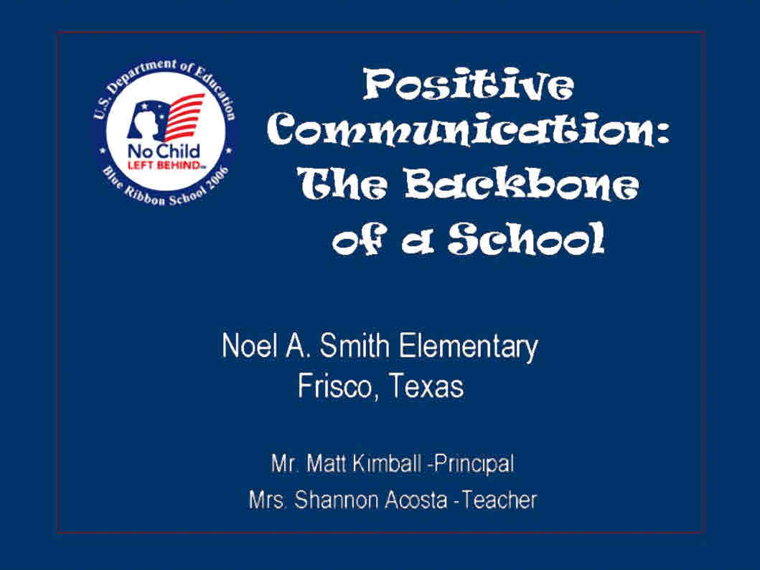

Slide 2
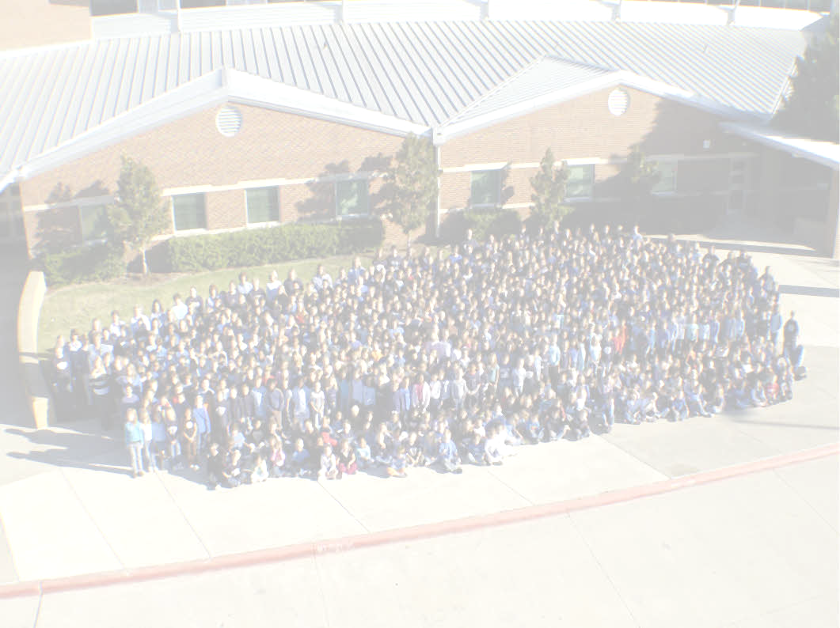
School Facts of Noel A. Smith Elementary
Staff & Students
780 Students
60 Staff Members
Location
Frisco, Texas
Fastest growing district
Staff Characteristics
Average years of experience is 10.3 years on the Smith campus
More than 41% of the staff has 11+ years of experience
Assessments
1) TAKS Testing
5th Grade – Reading, Math, and Science
4th Grade – Writing
3rd Grade – Reading & Math
2) Other Assessments
Math TEKS Checks for all grade levels
Benchmarks for 2nd – 5th
K-2nd Reading Assessments

Slide 3
Components of Communication
Non-Verbal Components
Posture
Body Movements
Proximity
Muscle Tension
Facial Expression
Attire
Eye Movement
Verbal Components
Pitch/tone
Volume
Inflection
Pace
Words

Slide 4

Communication
Barriers
Hearing vs. Listening
Becoming Defensive
Assumptions
Negative Presuppositions
Lack of Clarity/Misunderstanding
E-Mail

Slide 5
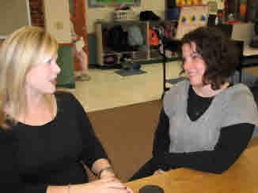
Paraphrasing Says…
I am interested and want to listen
I am concerned and empathize
I want to fully understand
We are a team

Slide 6

Paraphrasing Can…
Summarize
Reflect feeling/emotion
Clarify
Acknowledge
Shift “Gears”
Give the speaker a chance to ensure their message is being heard and understood
Provide think time
Encourage reflective processing

Slide 7

Paraphrasing Map
Paraphrasing expresses empathy
Paraphrasing acknowledges and clarifies
Paraphrasing summarizes and organizes key concepts and/or concerns
Paraphrasing shifts to focus or conclude the conversation

Slide 8


Slide 9
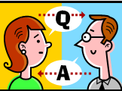
Probing & Inquiring
Creates Clarity
Develops specificity in a conversation
Provides “wait time”
Allows speaker to hear themselves
Permits speaker to solve problem
Allows for metacognition
Maintains focus
Expands or shifts conversation

Slide 10


Good Questions…
Have multiple responses
Assume the positive
Gain clarity and specificity
Shift thinking
Encourage risk-taking

Slide 11
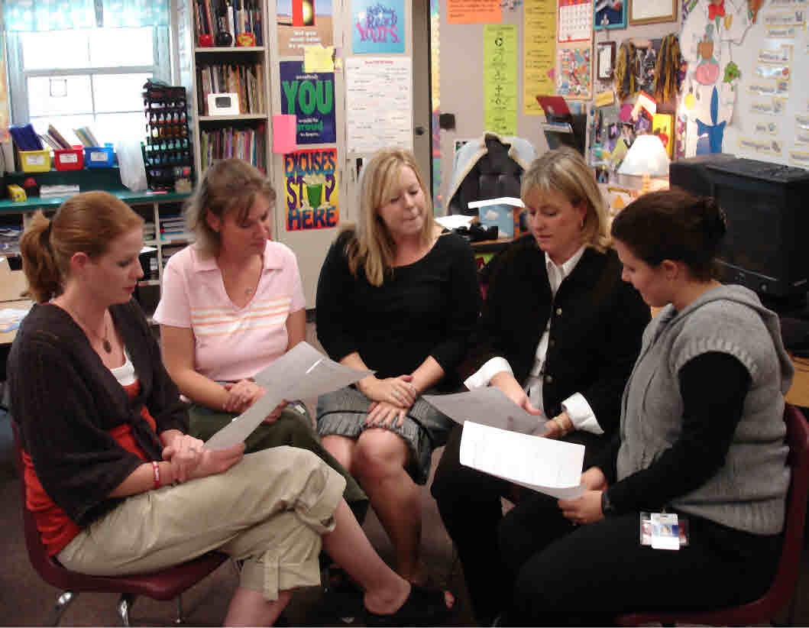
Training Teachers
Initial Training
  1-3 hours minimum
Paraphrasing practice
  15-20 minutes/month
Follow-up Training
  1 hour minimum
Paraphrasing & Questioning Practice
  15-30 minutes/month
Reflection
  30 minutes minimum

Slide 12
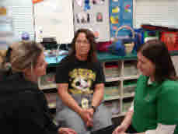
Staff Development Activities
Paraphrasing in groups of three
Teachers paraphrase written dialogue samples
Paraphrasing in groups of two
Reflect after parent conferences

Slide 13
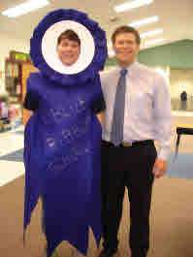
Summary Points
Key Points
Communication can make or break a school
Good communication = active listening
Active listening requires practice
Challenges
Developing comfort level
Embracing something new
Make it your style
Time to practice

