Slide 1
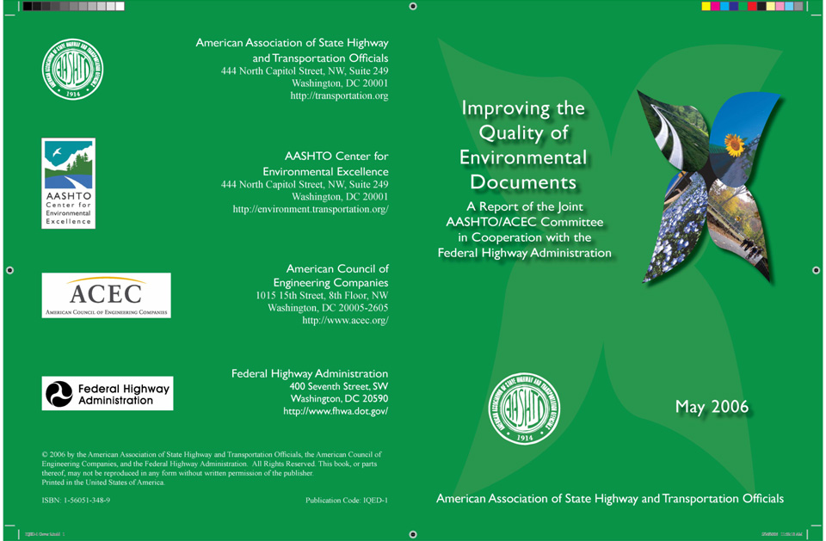

Slide 2
What is the AASHTO/ACEC/FHWA Initiative on Improving the Quality of NEPA Documents?
Initiated in 2003
Three teams – Quality and Clarity of NEPA Documents, Legal Sufficiency and Education
Report covers the work and recommendations of the first two teams
Education Team work being coordinated with the Environmental Competency Workgroup
Report offers recommendations on:
Making documents more effective, engaging and useful for the public and decision-makers
Improving the quality and legal adequacy of NEPA documents
Report is intended as a resource, not official guidance

Slide 3
Quality and Clarity of NEPA Documents Task Team
Team Leader Carol Lee Roalkvalm Washington State DOT
Don Cote FHWA Resource Center
Frank Danchetz ARCADIS
Brent Jensen Utah DOT
Hal Kassoff Parsons Brinkerhoff
Bob Esenwein Turner Collie & Braden
Jim Horrocks Horrocks Engineering
Lindsay Yamane Parametrix, Inc.
Amy Phillips BNA (editorial support)

Slide 4
Reported Problems with NEPA Documents
Too large, wordy, repetitive, complex and cumbersome
Lack of consistency in format and approach
Lack of coherent story – no logical progression
Too much “legalese” versus writing for the public
Too much focus on “the look” of the document versus usability for decisions
Lack of communication among multiple authors
Example – A University of Illinois study found that a majority of citizens had no better understanding of a project after reading the EIS document than they had before reading it

Slide 5
Documents Used by the Task Team
NCHRP Project 25-25 (01) – Synthesis of Data Needs for EA and EIS Documentation – A Blueprint for NEPA Document Content
Washington State DOT’s Reader Friendly Document Tool Kit
Caltrans’ North and Central Regions Style Guide for Environmental Documents
Other Resources and Document Examples

Slide 6
Core Principles for Quality NEPA Documents
Reader can easily understand the purpose and need
Describe how each alternative would meet the project goals
Discuss the strengths and weaknesses of each alternative
Keep it as brief as possible
Use concise writing
Use effective graphics and visual elements
Discuss issues in proportion to their significance
Ensure that documents meet all legal requirement
…. But in a way that is easy to follow for regulators and technical reviewers

Slide 7
Application of the Core Principles
Effective use of the scoping process is key
Effective scoping, properly documented, can support the decision to limit the amount of detail in the NEPA document
Can explain why particular issues were highly developed or only minimally discussed in the document
Document must be straightforward in presenting the facts as they are
Document MUST NOT be an advocacy piece for the project or a particular alternative

Slide 8
Supporting Quotes from CEQ Regulations
“Most important, NEPA documents must concentrate on the issues that are truly significant to the action in question, rather than amassing needless detail” 40 CFR Sec. 1500.1(b)
“…., it is not better documents but better decisions that count. NEPA’s purpose is not to generate paperwork – even excellent paperwork – but to foster excellent action” 40 CFR Sec. 1500.1(c)
“Environmental impact statements shall be written in plain language …… so that decision-makers and the public can readily understand them” 40 CFR Sec. 1502.8

Slide 9
Striking the Balance Between Legal Requirements and Reader Friendliness
Identify and Explain Key Assumptions
Describe Methods Used to Develop Data
Use Effective Visuals to Present Key Results
Do Not Just Summarize the Data – Analyze It
Document Compliance with Key Regulatory Requirements
Provide Overview of Major Project Issues
Systematically Review Data to Ensure Internal Consistency

Slide 10
Benefits of Applying the Core Principles
Quality NEPA documents achieve the goals of public involvement and regulatory compliance BETTER DECISIONS
Helps project proponents:
Demonstrate accountability and build trust
Engage the public, decision-makers and regulatory agencies into meaningful dialogue about the project
Document agency decision-making
Avoid lawsuits (or provide solid basis for defending them)

Slide 11
Blueprint Components
Document + Main + Appendices
Summary Body & Technical
Reports

Slide 12
Document Summary
Why the project is needed
What alternatives were considered
How the alternatives affect the environment
Rationale for selecting the preferred alternative (at least in the FEIS)
Emphasizes key issues and environmental and community concerns
Summarizes all the key aspects of the EIS
May be the only part that is widely read

Slide 13
Main Body
Purpose and Need
Alternatives Considered
Environmental Resources, Impacts and Mitigation
Combines the Affected Environment and Environmental Consequences of a “traditional” NEPA document
Public Comments and Agency Coordination
Section 4(f) Chapter
Can be included in the appendix and summarized in the main body if 4(f) issues are not significant, i.e., no use of a 4(f) resource
Comparison and Selection of Alternatives
Needs to address the most common shortcoming of NEPA documents – that they are rich in data but fail to “tell the story” of what the data mean and how they led to the selection of the preferred alternative

Slide 14
Appendices and Technical Reports
A place for voluminous supporting material
Offers the opportunity to “de-clutter” the main body of the document
Includes information important to support analyses and conclusions in the main body
May include 4(f) if issues are not significant

Slide 15
Document Preparation Process and Production Techniques
Report makes recommendations on managing the document preparation process
Recommends the assignment of an “editor-in-chief”
Discusses production software selection, graphics, photos, etc.
Chapter 4 offers suggestions on advanced techniques and alternative formats

Slide 16
Summary
Tell the story in a way that is understandable to a broad audience
Use plain language summaries of technical analyses
Keep it concise – higher page count does not equal improved quality
Put detailed technical analyses in the appendix
Provide a clear path of logic with a consistent thread
Make it clear how decisions are reached or will be reached
Don’t burden the document and the reader with irrelevant detail
Include discussion of environmental benefits as well as impacts

