Slide 1

CTB – CPC – CSD Collaboration
Dr. Robert Livezey
3rd CTB Science Advisory Board
August 28-29, 2007

Slide 2
Areas of Collaboration
Climate product requirements:
  Changes to existing products
  Process for identifying new products
  Policy development
Customer feedback:
  Resolving existing policies limitations
  Incorporating customer feedback into product development and design
  Identifying common practices
Outreach:
  Standard Outreach Materials
  CDPW
  CPASW

Slide 3
Climate product requirements
Current Collaboration:
  CSD supports customer evaluation of NWS climate products:
    2004 CFI Survey
    Different outreach activities
  CSD provides input to CTB Science team
Future CTB-CSD-CPC collaboration:
  Identify improvements to existing products
  Develop process for identifying new products
  Leverage CTB for research to operations process
Policy Development
  Review existing policies
  Develop new policies for climate operations

Slide 4
Customer Feedback
NOAA current policies require use of pre-approved questions in collecting customer feedback. Problems:
  Many questions are misinterpreted
  The form is used for spam mail
  Analysis is manual and labor intensive
The customer feedback could be collected at the prototype stage of product development

Slide 5
Customer Feedback
L3MTO example
Product prototype stage included internal feedback with 60 responses, 12 users and 48 NWS staff
Potential applicability
  Who are the users?
  Users’ potential level of scientific comprehension
Clarity of definitions
  Is probabilistic information understood?
  Opinion on usage of selected terms: names of categories (EC, BNA)
Informational appeal
  Completeness of information
  Clarity
  Easiness in navigating
Aesthetic appeal
  Clarity of graphs
  Use of appropriate graph types
  Use of appropriate design tools: color, layout, etc.
Notes:
Bolded section is elaborated more in the next two slides

Slide 6
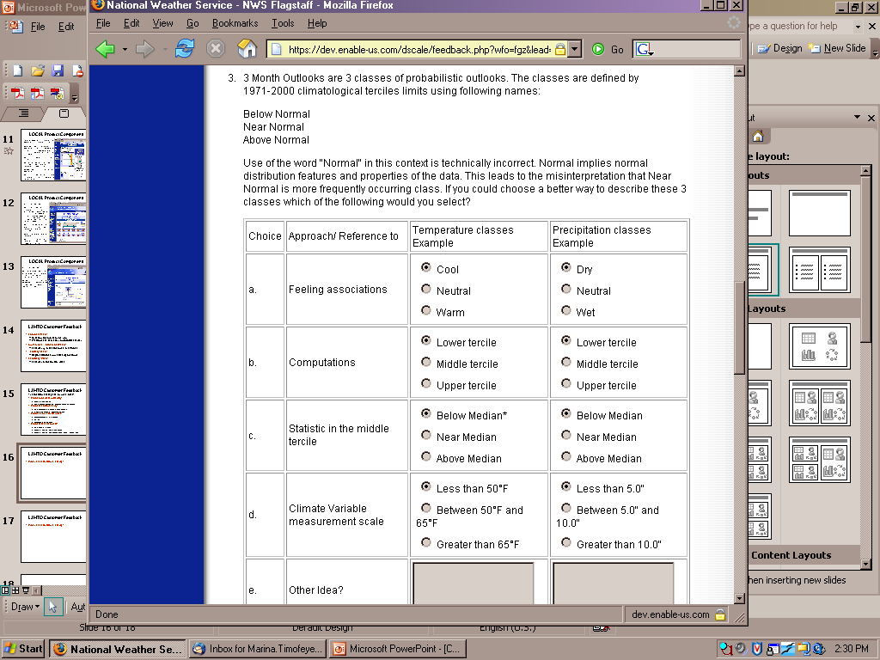
Customer Feedback
L3MTO example
Most frequent selection: “Feeling association”
Decision:
  At this time (small sample of respondents) keep BNA in combination with “Climate variable measurement scale”
  Initiate discussion with partners

Slide 7
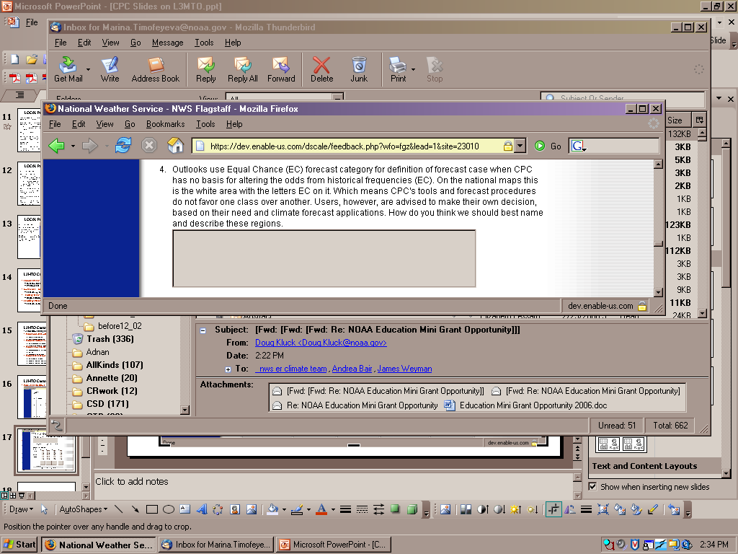
Customer Feedback
L3MTO example
EC is OK to many respondents, but a fair number indicated this is confusing and better terminology should be considered
Other suggestions: Uncertain; Unknown Chances; No Skill; No Clear Signal; Even Chance or Likelihood; Indeterminate Forecast; No Forecast Signal; Neutral; No Clear Trend; No Forecast; No Indication; No Discernable Forecast; Neither (neither above or below normal)

Slide 8
Customer Feedback
Areas for Collaboration:
    CPC/CSD develop product prototype
    CPC/CSD formulate questionnaire
    CTB Grant Program supports product test and customer feedback
Requirements for collaborative effort:
  CPC and CSD product development focal points work together for tasks 1 & 2
  CTB affiliates provide questionnaire distribution, feedback collection, analysis and recommendations

Slide 9
Outreach
Standard Outreach Materials:
  Climate products need appropriate outreach support materials:
    Product information and web ”Help” buttons
    Public fact sheets
    WFO fact sheets
    Talking points
Climate Diagnostics and Prediction Workshop:
  Session on Application of Climate Forecast Products and User Requirements targeting climate services issues

Slide 10
Outreach
Climate Predication Applications Science Workshop (CPASW)
Annual meeting
  Since 2005, CTB has been represented in a special session
Audience: Climate applications researchers, climate product producers, and users
Meeting goals:
  Identify new climate prediction applications research
  Build climate service community
  Assess impacts of climate forecasts on environmental-societal interactions
  Provide feedback to producers of climate products on user requirements
6th CPASW : March 4-7, 2008, Chapel Hill, NC

Slide 11
Summary
Future CTB-CSD-CPC collaboration
Identifying climate product requirements, including:
  CTB leveraged for research to operations process
Customer feedback:
  CTB Grants Program supports product test and customer feedback
  CTB affiliates provide feedback collection, analysis and recommendations
Outreach:
  CTB should continue to have more visibility at all NWS climate outreach activities

