Slide 1
The OSQR Process
Meant as a guide to help you through the peer review challenges

Slide 2
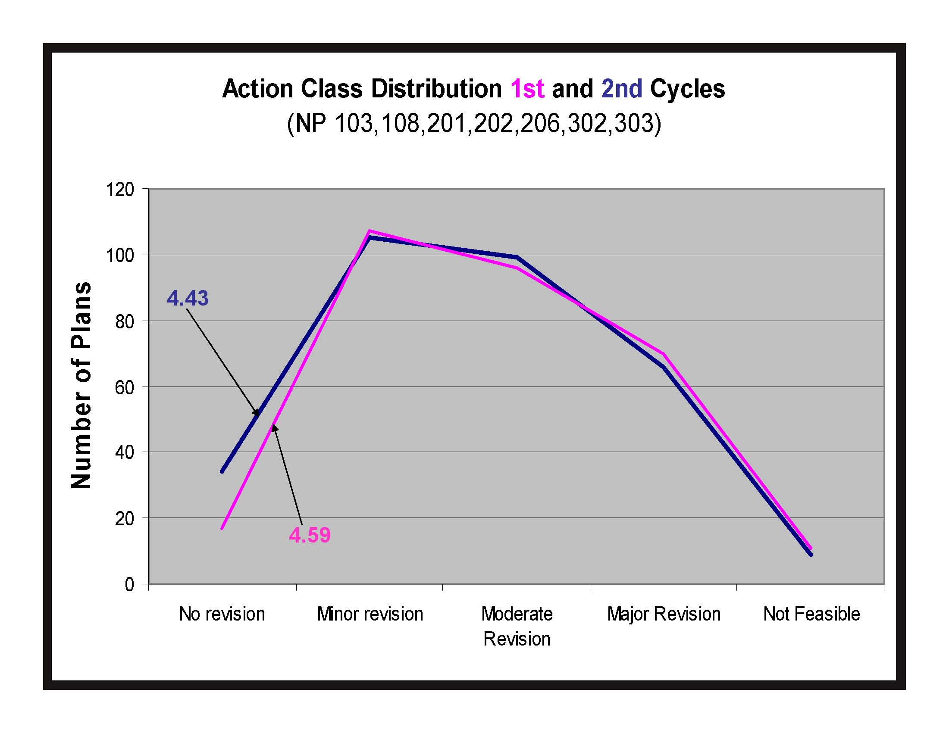
Problem: Scores have been lower in the second five year cycle

Slide 3
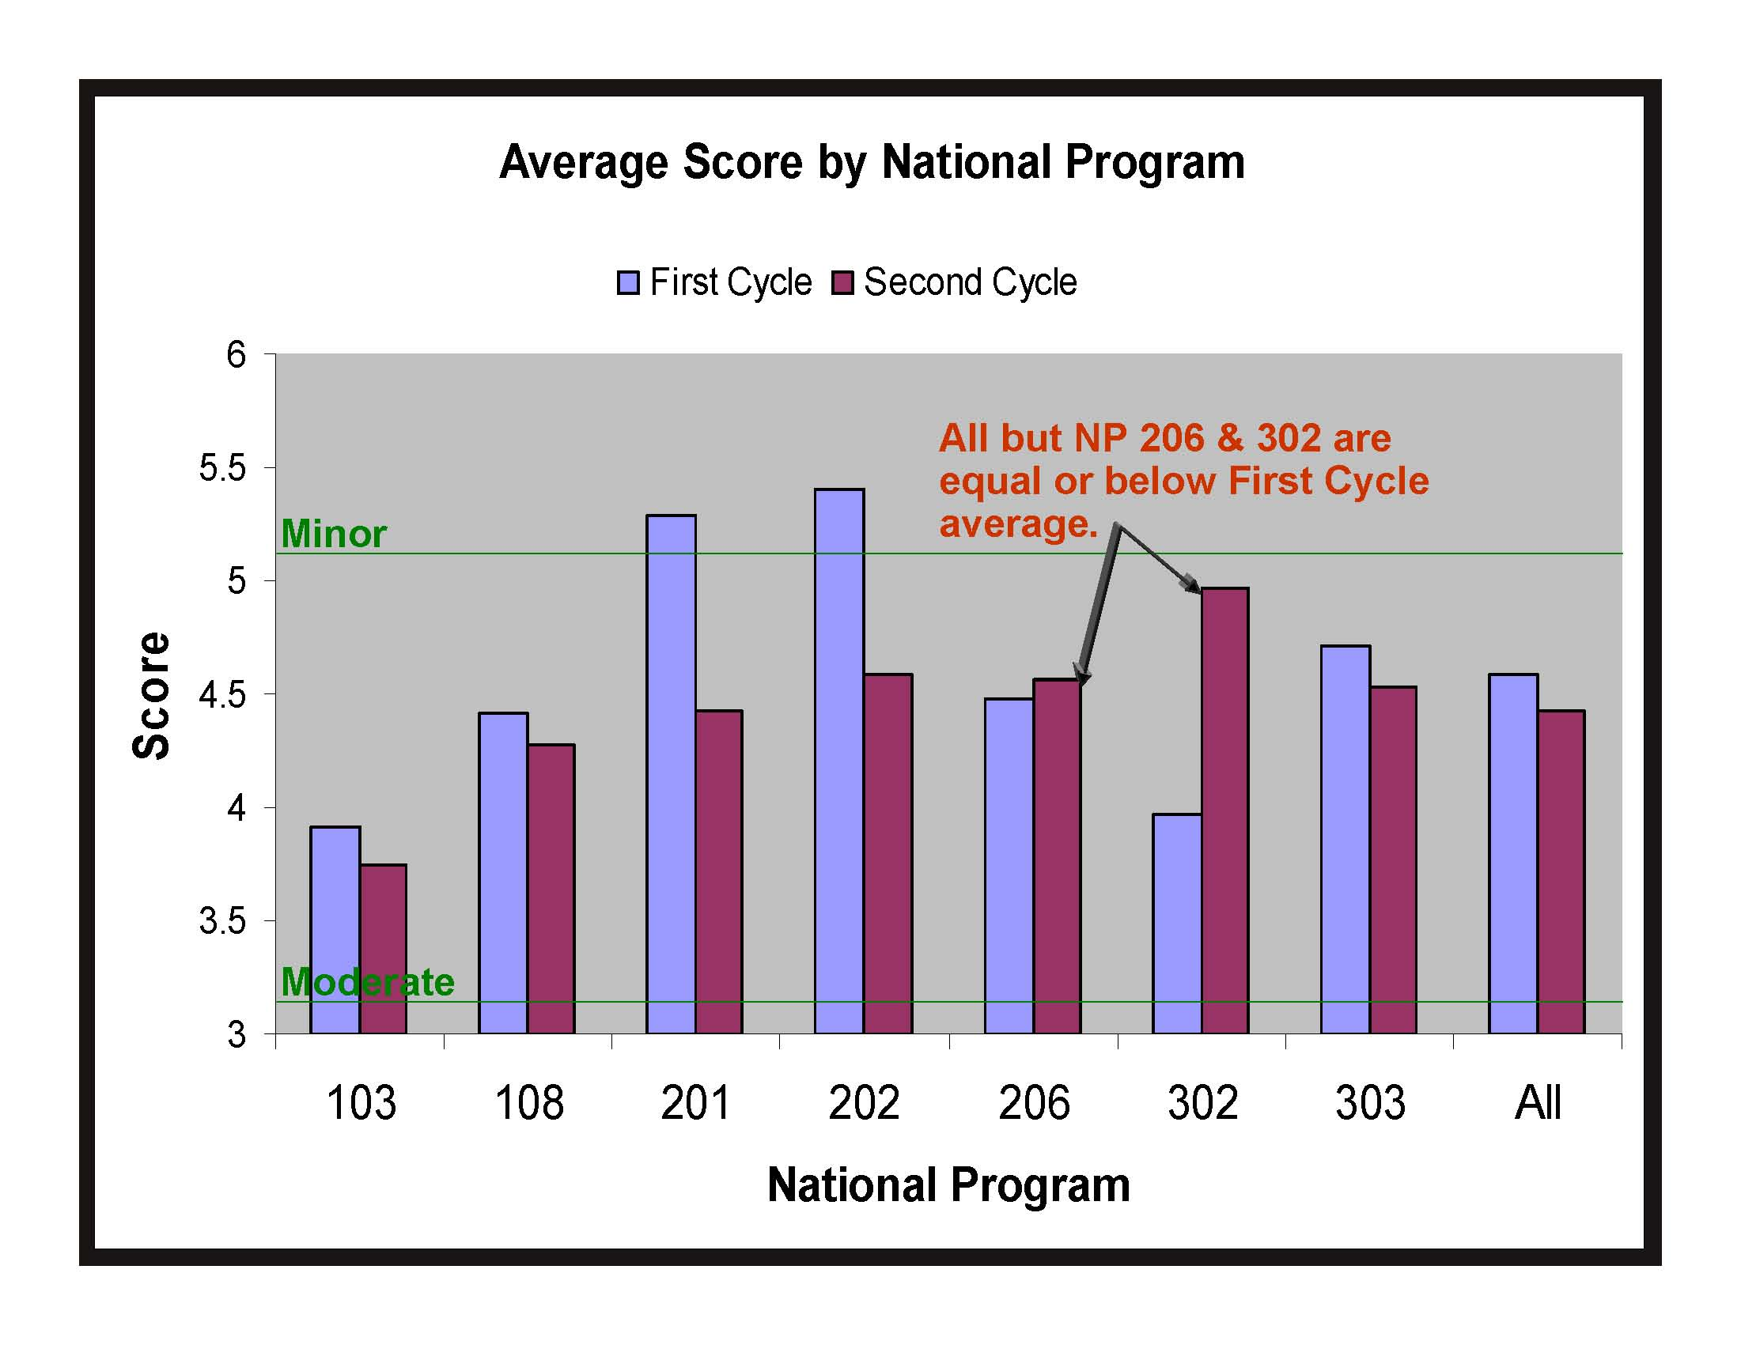

Slide 4
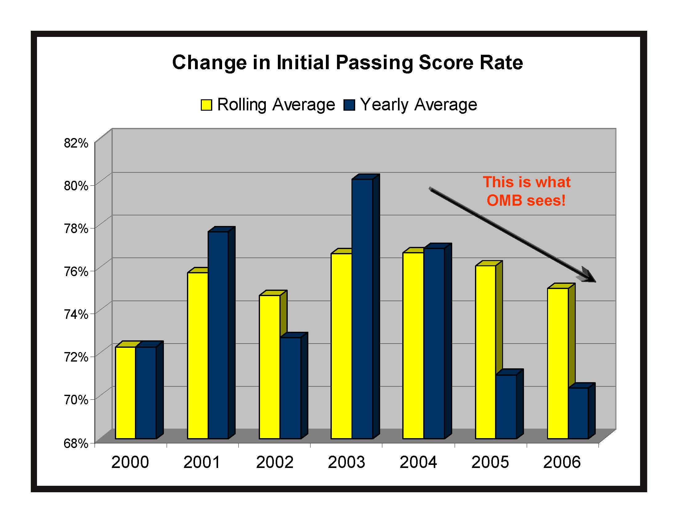

Slide 5
Recent Observations from the OSQR Staff
Panel members feel they spend more time reviewing the project plan than the scientists spent developing it.
Why can’t ARS scientists write a testable hypothesis?
Vacancies–scientists need to tell the panel how the vacant position will contribute to the project’s objectives.
What impact have OSQR reviews had on the quality of our science?
Why have scores stayed the same?
  Culture of ARS has not made the change
  Lack of ownership by our scientists in the process
  Project plans do not represent the scientists’ best effort
  Lack of science clarity, i.e. “stove piped”

Slide 6
Project plans begin and end with the project team (lack of ownership).
The team needs to write the plan as a narrative for their peers not something to try and impress their bosses (NPS & AD).
Literature review should be written as a gap analysis; the team is the best one to fill in the gaps.

Slide 7
Getting There
OSQR Goal
Initial review at Moderate or above for 85% by 2011
How to achieve it
Problems that can be caught with internal review
Flawed science
Weak write-up
Poorly proofread
Lack of clarity
This is everyone’s issue
      Ownership at all levels (real internal review)
      Cooperation among all levels (all working to best plan)
      Poor quality plans impact all!

Slide 8
COOPERATION BETWEEN ALL LEVELS
DURING PROJECT PLAN PREPARATION PROCESS
INTERNAL REVIEW
(Getting it right the first time)
EXTERNAL REVIEW
AREA OFFICE NATIONAL PROGRAM
STAFF
Internal dialogue
and cooperation
is essential
OSQR OUTSIDE REVIEW PANELS
RESEARCH TEAM
Review is a dialogue:
Panel Recommendations
and ARS Responses

Slide 9
Where does Area Office review?
1. Program Direction and Resource
Allocation Memo (PDRAM)
2. Project Plan Outline (PPO)
Objectives, hypotheses, general approach, outcomes agreed
upon by all parties (Research Team, NPS, Area Office).
3. Project Plan
Internal review is essential. Be sure this is well-written,
logical, and clear.
4. Response to review (especially if objectives change)

Slide 10
What to look for
Cohesive objectives
  Plans should explain how objectives fit together. Schematics or diagrams are helpful.
Proofreading
  Errors leave panel wondering if anyone cares!
Poor hypotheses
  A frequent complaint. We involve Mark West. Don’t just restate objectives.
Unnecessary hypothesis
  If it’s not hypothesis driven…don’t force it
Weak introductory pages (marketing the research)
Panel reviewers should see what, why, how, and expected results in brief in the first few
pages (before the Background section).
Difficult to follow narrative
  The text should expand increasingly in detail through each section in document using common themes from the beginning.
Milestones
Incomplete responses to recommendations
Serious consideration of recommendations may prevent failure during re-review.
(continued)

Slide 11
What to look for (continued)
THE HUMAN ELEMENT
Predicting failure
Language Project Plan or Responses implying one cannot fulfill objectives (lack of funding, personnel, etc.)—the panel may agree!
“Dirty Laundry” or irritation
Signs of disgruntlement picked up on by Panel either in the Project
Plan or Responses. Even if the review is discouraging, work to support the process. Don’t air grievances in your project plan! Treat like responding to manuscript reviewers.
Format over Content
Readability trumps format!
Dogged adherence to format rules which may confound an easy
reading plan narrative. Many are sticklers for the “rules” but may be misinterpreting some items meant to be a guide not a requirement. For some plans altering the format can improve the flow narrative. This a case of one size not fitting all. Obtain examples of Project Plans from your Area.

Slide 12
What Panels tell us
Hypotheses should be well constructed and appropriate
  Don’t force a hypothesis when it’s not justified.
Objectives should be clear, focused, and complementary
  Provide more explanation of relevance when disparate objectives
  appear in the same project plan. (Work out issues with NPS in PPO)
3. Over-long literature reviews
Keep literature pertinent to the objectives and problem addressed.
Focus on the information gaps research will address.
Better documentation of methods/procedure
Explain why certain methods have been chosen, provide more details on what will be done, clarify statistical tests to be used.
5. More details on who does what
  Show percent effort of both SY’s and external collaborators, as well as
  number and commitment of support staff that will be involved with a
  project. A diagram can help here.
(Continued)

Slide 13
What Panels tell us (Continued)
Provide better documentation of timelines for objectives
Specify work already in progress.
7. Collaborations are important
Some projects would benefit from additional collaborations (within and outside of ARS), especially when important expertise is missing.
Better Documenting of Collaborations
Letters; should include details on who the collaborator is, what they will do, resources, timeline, etc. Explain in text, confirm in letter.
Contingency Statements
These show you have considered potential new directions.
10. Plans should be readable!
Assure the plan presents a clear, logical narrative based upon the theme(s) set at the beginning of the document and then expanded throughout.

Slide 14
Recent Questions
Document Length
Limited in the original plan submission
NO page limits for revisions…but clarity is most important, not bulk!
Preparation of Panelists
Panelists receive extensive preparation: 60-90 minute orientation online, printed reviewer guidelines, 30-45 minute briefing at the beginning of their meeting. They tell us they are better prepared than for any other review.
Objectives
Changes to objectives in revision, or review comments on them, must be discussed with NPS. Typically, panels are concerned when objectives and proposed execution don’t match.
Schedule overruns (e.g., when PDRAM is late)
Time is taken from NPS review, not plan development.
Are panels more rigorous?
Short answer: yes. Because in the first cycle they appeared to have been generally more lenient, knowing it was a first time for many.

