Slide 1


Assessment Of Collaboration for Incident Response Preparedness

Slide 2
Project Background
Problems with firewood movement (EAB)
  Indicative of larger problems with collaborative systems, protocols and processes
Charge from APHIS OA
Collaborative approach (AWG)
September to January timeframe

Slide 3
Introduction
APHIS and States:
  Strategic alliance and collaboration needed for response preparedness
  Successful but recently stretched (END/Hurricanes)
  Numbers increasing/complexity increasing
  Concerns raised
  This assessment examined expectations vs reality

Slide 4
Methodology
Surveys
Interviews
Listening Sessions
Focus Group Interviews
Collaboration Continuum (Scale 1-7)

Slide 5
Communities
Animal Health
  VS, State Animal Health, WS, State F&W
Plant Health
  PPQ, BRS, State Plant Health
All Hazards
  AC, VS, SART
General Support
  APHIS OA, LPA, Offices of Secretaries (includes Communication)

Slide 6
Findings
Focus on State and APHIS counterparts yet others mentioned:
  LPA
  DHS
  Foresters
  SEMA
  Public health
  Industries
Collaboration is complex

Slide 7
Findings
OA
SDA
SACS
SART
LPA
Example: Collaboration on Animal Health Emergency Preparedness
AVIC
SAHO
WSSD
F&W
DNR

Slide 8
Findings
People have different ideas and language about collaboration which affect the effectiveness of communication, activities and the results of the collaboration
State and APHIS collaboration is an imperative for incident response preparedness but neither APHIS nor State expectations about the needed levels are being fully met

Slide 9
Findings
Strong APHIS and State internal collaboration is needed to guide and support successful strategic alliances
States and APHIS collaborate effectively, particularly where there are strong communication and relationship building skills; when these are lacking productivity and progress suffers

Slide 10
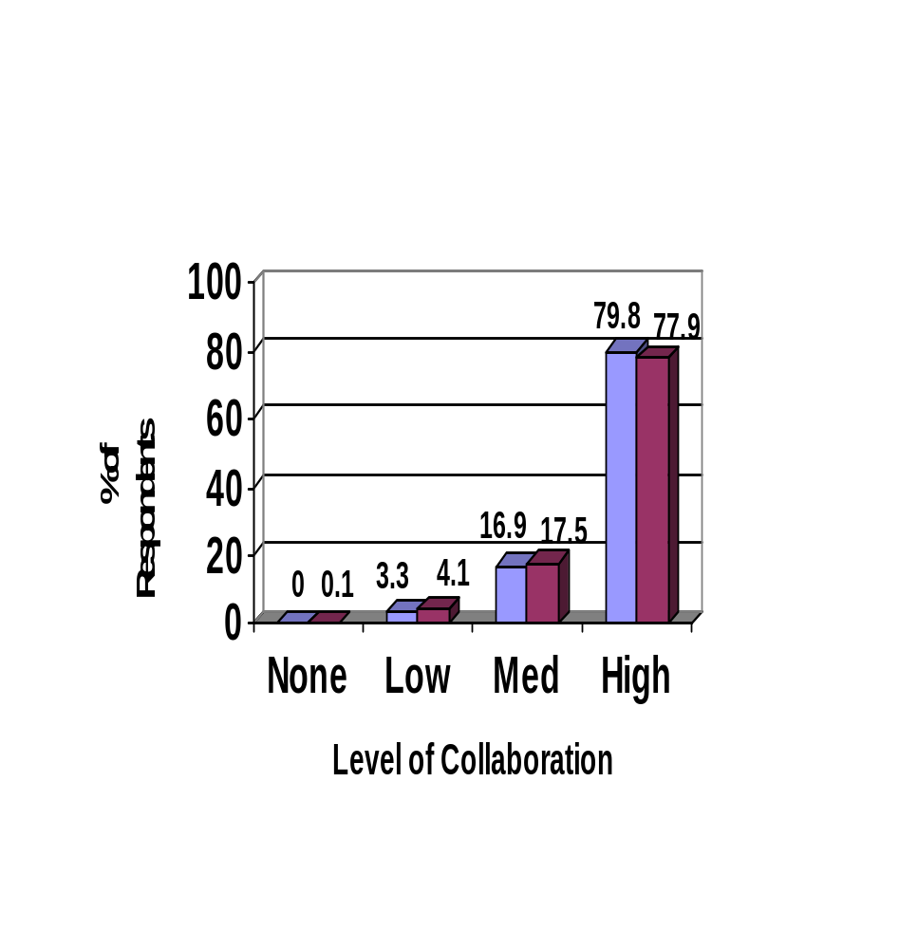
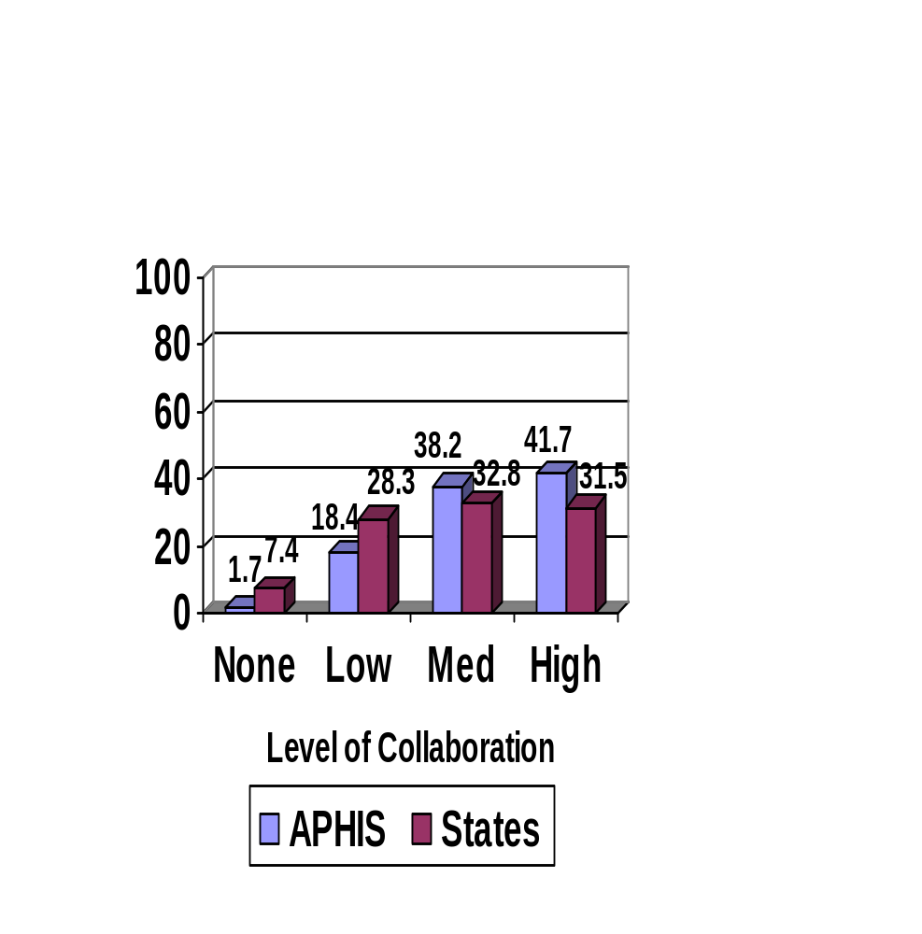
Findings: Ideas and Language
Expectations
Current Perception of Reality
Figure 1: Comparison of APHIS and State Views

Slide 11
Findings: Ideas and Language
Example: Views of good collaboration on plans
  We provided comments
  They gave us comments
  We reviewed their plan
  We each have our own plan
  We sat at the table together to work on the plan
Even counterparts express inconsistent views

Slide 12
Findings: Ideas and Language
Most agree collaboration is important but to collaborate well, need to understand each others’:
  Expectations
  Frame of reference
Need to take time to talk to each other about how you are going to collaborate

Slide 13
Findings: Ideas and Language
Literature:
  Focus less on defining the business plans and more on how you’ll work together
  -- Harvard Business Review November 07

Slide 14
Findings: Imperative Not Met
Expectations
Current Perception of Reality
Figure 1: Comparison of APHIS and State Views

Slide 15
Findings: Imperative Not Met
Need simultaneous communication
Lack of clarity of roles and responsibilities:
  Writing, AEC, all hazards, evacuation and sheltering
Need for communication protocols that are followed consistently:
  Exist at all? Need to be in writing

Slide 16
Findings: Imperative Not Met
Inconsistent plans
  No templates, no approval process
Cumbersome cooperative agreement process
Test exercise programs
  Not enough, focus is on disasters not pests, not joint effort, not on other FADs; only AI, too many

Slide 17
Findings: Internal Needed Too
Collaboration with State Ag Secretaries
State communication with APHIS Regions and HQ:
  Effective: State level manager left out
  Ineffective: Joint call for autonomy and empowerment
Perception of LPA not up to expectations:
  COSDA agreement (1 hour)
  Support for communication infrastructure

Slide 18
Findings: Internal Needed Too
APHIS Guidance: State view
  Best: Accuracy
  Worst: Timeliness
  Better during an incident than in preparation
APHIS Guidance: APHIS view
  Best: Accuracy (lower ratings than States)
  Worst: Timeliness
  Better from Regions than HQ

Slide 19
Finding: Internal Needed Too
Need APHIS help with national consistency
General frustration about timeliness of & clarity of roles and responsibilities
  General finding (everyday work and preparedness related—both need clarity)
  Especially true of animal evacuation and sheltering especially regarding AC & VS roles
  General clarity in all hazards
    Parameters, mechanism for response
    AEC vs ESF 11 coordinators

Slide 20
Findings: Internal Needed Too
Literature:
  Spend as much time on managing internal stakeholders as on managing the relationship with your partner
      -Harvard Business Review November 2007

Slide 21
Findings: Communication &
Relationships
High levels of collaboration due to communication and relationships
Expectations not met because of communication and relationships
Notes:
See keys to communication and relationships

Slide 22
Findings: Communication &
Relationships
Important for good organizational practices to support communication and relationships
  Written down, for example:
    Plans for responding to all hazards emergencies (includes R&R for animal evacuation and sheltering)
    Clarify R&R for ICS in plant health incidents
  Simultaneous communication protocols
  Regional, HQ communication protocols
  Co-location options
  Collaboration success breeds success

Slide 23
Findings: Communication &
Relationships
Literature:
  The personal is as important as the procedural
      -American Journal of Evaluation (Utilizing Collaboration Theory to Evaluate Strategic Alliances)

Slide 24
Recommendations: Goals
Resolve firewood issue
Clarify & document roles (everyday work, incident response, all hazards response)
Institute good organizational practices

Slide 25
Recommendations: Goals
Develop mechanism for issues to be raised, addressed and tracked
Develop, document and monitor communication principles
Create a culture of collaboration

Slide 26
Recommendations: Getting Started
Resolve firewood issues:
  Address questions
  Provide regular updates
  Adopt practices to ensure does not occur again
Clarify and write down R&R:
  Everyday work
  Incident response
  All hazards response (evacuation and sheltering)

Slide 27
Recommendations: Getting Started
Institute simultaneous sharing of information:
  Among APHIS HQ, Regions, State-level Managers, State Secretaries and Agency Managers
  Protocols developed and shared
Reaffirm protocol for public release of information:
  Document and share uniformly
  Include info on exceptions and how to handle

Slide 28
Recommendations: Getting Started
Develop guidelines for Incident Response Preparedness:
  APHIS and States should discuss what guidelines are needed
  Develop with input from States
  Share formally and uniformly
AMT create liaison for States; liaison should:
  Catalog past issues
  Bring them to closure
  Document lessons learned
  Have direct access to program staffs and AMT

