Slide 1
Asset Management at
Seattle Public Utilities
Scott Haskins
Deputy Director
Seattle Public Utilities
May 5-6 Working Session

Slide 2
The Questions
1. What is Asset Management at SPU?
2. Why Asset Management at SPU?
3. How did SPU get started with AM?
4. What are the features of AM at SPU?
5. What results have been achieved at SPU?

Slide 3
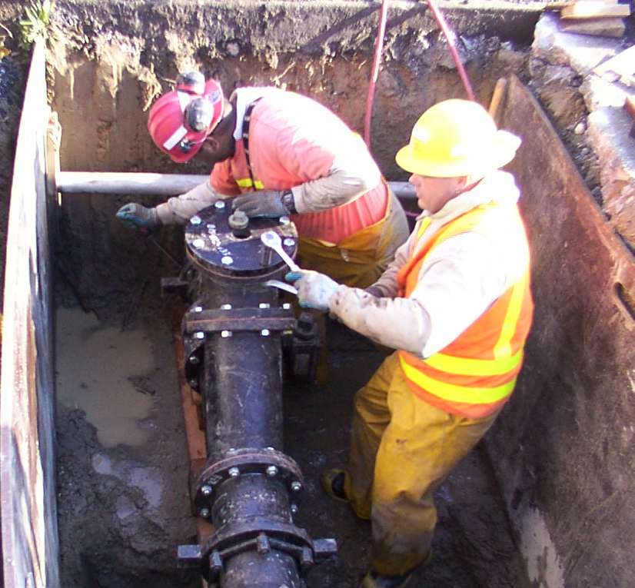
What is Asset Management at SPU?
Meeting agreed customer and environmental service levels while minimizing life cycle costs.

Slide 4
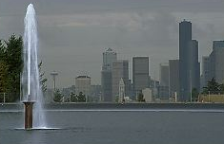
Why Asset Management at SPU?
Rate increases averaged 6% per year during 1990’s
Sharp increases in O&M, capital spending since 1990’s
Worsening financial conditions beginning in late 1990’s
  reliance on debt
  use of cash reserves
  weakening debt service
  coverage

Slide 5
Need more reasons?
aging infrastructure
inadequate information on condition
need for more informed decisionmaking
need for more clarity and consistency regarding service levels
develop a more stable rate/budget path
tackle the increasing costs of infrastructure
protect public health and safety
improve customer service

Slide 6
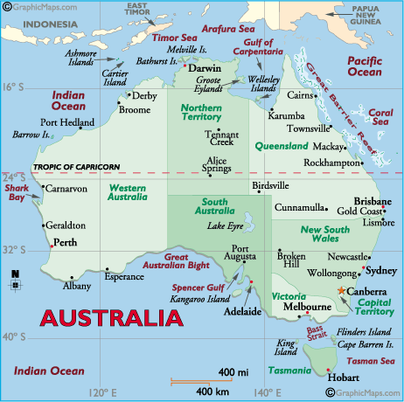
How did SPU get started with AM?
Learn from the best
Fit best practices into our needs
Asset management approach to investment decisions and operations
Employee development and accountability
Change the culture

Slide 7
What are the features of AM at SPU?
customer and environmental service levels
risk assessment and quantification
life cycle costs
triple bottom line
asset data and data systems
specifiers and service providers
Strategic Asset Management Plans
Asset Management Committee
Asset Maintenance Agreements
benchmarking

Slide 8

What results have been achieved with AM at SPU?
reduce operations and maintenance budgets by ten percent
productivity levels have increased
reduced CIP by about $150 million – or fifteen percent
staffing has been reduced over the past two years by eight percent.
utility rates have been reduced in comparison to earlier planned levels
cash reserves have increased
projects are being financed with less reliance
on debt

Slide 9
What results have been achieved with AM at SPU?
projects are being financed with less reliance on debt
productivity has increased and service levels have been maintained
the organizational culture has permanently changed
asset management initiatives are integrated into SPU’s Strategic Business Plan and budget
capital investment decisions are made based on life cycle financial, social, and environmental costs and benefits
more clarity around roles, responsibilities, decisionmaking authority, and accountability

