Slide 1
This presentation is for illustrative and general educational purposes only and is not intended to substitute for the official MSHA Investigation Report analysis nor is it intended to provide the sole foundation, if any, for any related enforcement actions.

Slide 2
Coal Mine Fatal Accident 2003-15
Operator: Cody Mining Company, Inc.
Mine: # 1 Mine
Mine I.D. No. 15-17373
Accident Date: June 13, 2003
Classification: Explosives
Location: District 6, Floyd Co., Kentucky
Mine Type: Underground
Employment: 12
Production: 150 tons/day
Seam Height: 32 inches
Mining Method: Conventional (Solid Blasting)
GENERAL INFORMATION

Slide 3
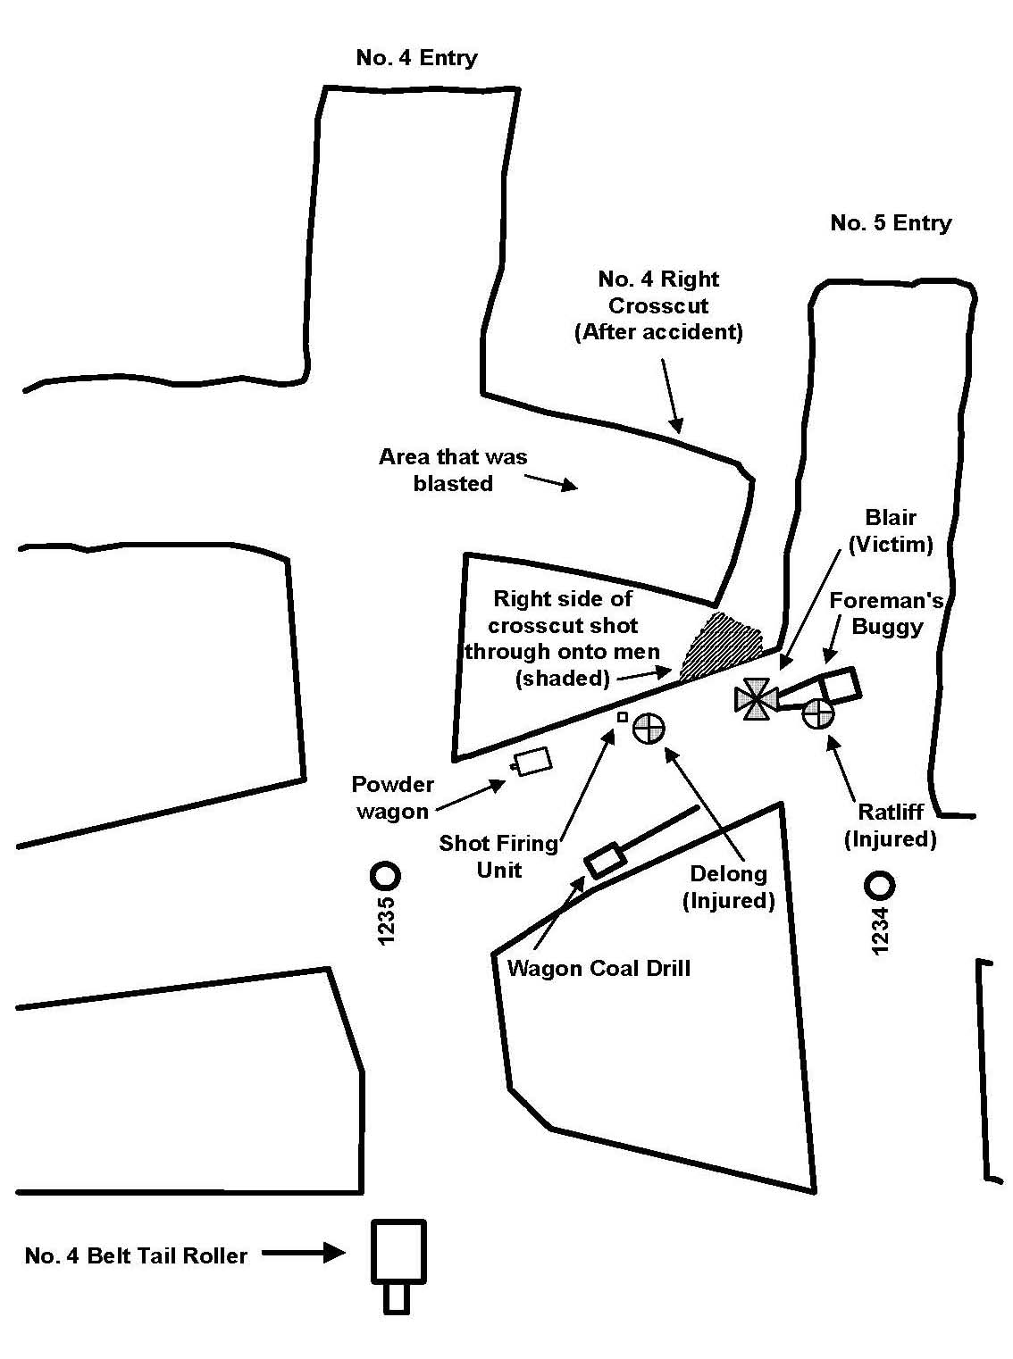
Coal Mine Fatal Accident 2003-15
A 21-year-old Coal Drill Helper with 2-yrs total mining experience was fatally injured when the working face of a crosscut was blasted into the next outby crosscut.
Two other miners were also injured in this accident, one of them seriously.
The victim and his co-workers had retreated to the last open crosscut to set off the shot when the accident occurred.
Coal Drill Helper (Victim)
OVERVIEW
Supt. (Injured)
Shot Firer (Injured)

Slide 4
Coal Mine Fatal Accident 2003-15
The entries & crosscuts of the working section were driven off-centers, resulting in the 4 Right crosscut blasting into the outby crosscut.
The cause of the accident was the failure to maintain proper sight lines and centers, the failure to conduct adequate preshift examinations, and excessive entry and crosscut widths.
Coal Drill Helper (Victim)
OVERVIEW
Supt. (Injured)
Shot Firer (Injured)

Slide 5
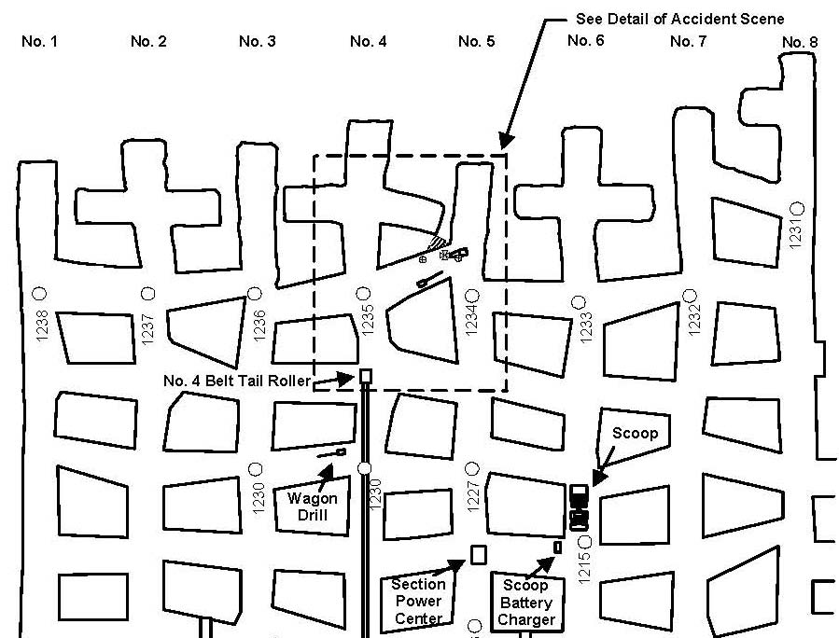
Coal Mine Fatal Accident 2003-15
ACCIDENT DETAILS
Upon arriving on the section, the Superintendent and Coal Drill Helper started drilling in the 1 Entry working face while others used scoops to load coal from the 6 Left face.
Prior to the accident, the following additional working faces were also drilled for blasting: 2 Left Crosscut, 2 Entry, 2 Right Crosscut, 3 Entry, 4 Left Crosscut, 4 Entry, and 4 Right Crosscut.

Slide 6
Coal Mine Fatal Accident 2003-15
At approximately 12:30 p.m., 3 working faces in the 4 Entry were ready to be blasted.
The Shot Firer detonated the 4 Right Crosscut after receiving the “all clear” signal from the Supt., who had also been performing duties as drill operator.
The shot broke through into the outby crosscut where the Shot Firer, Supt., & Coal Drill Helper were located.
ACCIDENT DETAILS
Coal Drill Helper (Victim)
Supt. (Injured)
Shot Firer (Injured)

Slide 7
Coal Mine Fatal Accident 2003-15
ACCIDENT DETAILS
The Shot Firer crawled over to the 6 Entry to obtain help from the roof bolting crew.
A Roof Bolting Machine Operator responded to the accident site, where he found that the Coal Drill Helper had been fatally injured and that the Superintendent was seriously injured.
Other miners also responded and the surviving injured miners were transported to the surface.

Slide 8
Coal Mine Fatal Accident 2003-15
The mine used the method of “shooting off the solid” (drilling and blasting without using a cutting machine to create a kerf) to break coal from the working faces.
With this method, coal remains confined in all directions from the loaded drill hole, except toward the working face.
Typically, loaded blast holes are timed to detonate in a sequence so that other free faces are created during the blast, which allows the coal to be broken and cast out from the face.
However, when drill holes are detonated near an adjacent opening, an additional free surface is available for releasing energy from the shot.
Additional care must therefore be taken when approaching adjacent mine openings to ensure that the blast of a face is designed properly so that it does not shoot into an adjacent area or back side of the face where persons may be present.
BLASTING METHODS

Slide 9
Coal Mine Fatal Accident 2003-15
Coal Drill Helper (Victim)
Shot Firer (Injured)
BLASTING METHODS
Supt. (Injured)
An excessive amount of explosive was used in the holes drilled for blasting, which further increased the danger of shooting into an adjacent area.
A non-permissible coal drill, equipped with a 12’ auger, was being used to drill blast holes into the working faces.
The 12’ hole depth placed the explosive charge close to an adjacent mine opening, permitting the unplanned release of energy from the detonated explosives into the area occupied by the injured miners.

Slide 10
Coal Mine Fatal Accident 2003-15
Poor mining practices resulted in excessive mining widths, undersized pillars, misaligned openings, accidental cut-throughs, and other violations.
Sightlines or other effective directional control methods were not being used to maintain the projected direction of mining. Numerous openings were mined as much as 25º off their projected center lines.
The 4 Right Crosscut working place was mined 14-16º to the right of its projected center line, while the last open crosscut was mined from 24-28º to the left of its projected 90º angle off 4 Entry.
The 4 Right Crosscut working place was blasted continuously from the right side of the face during the mining cycle, resulting in the crosscut being progressively mined to the right of center with each shot.
Wider mine openings also reudced pillar dimensions. Entry and crosscut widths exceeded the maximum of 20’ permitted by the approved roof control plan at numerous locations on the working section, where widths of up to 25’ were measured.
Mining widths at the accident site were 21’6” in the 4 Right Crosscut working place and 20’ in the last open crosscut where the victims were located during the accident.
MINING PRACTICES

Slide 11
Coal Mine Fatal Accident 2003-15
Preshift examinations failed to identify obvious hazardous conditions, some of which had existed for extended periods of time.
Although the preshift books were completed, no DTIs were found underground to demonstrate that any examination was performed.
The preshift records did not identify obvious hazardous conditions:
  Excessive opening widths
  Undersized pillars
  Misaligned openings
  Indications that persons were regularly working and traveling inby permanently supported roof.
The pre-blasting check, required by 75.1325, was similarly inadequate. After observing a scoop leave the section loading point, the Superintendent gave the “all clear” signal to the Shot Firer to blast the 4 Right Crosscut, while he and the Coal Drill Helper were in the adjacent crosscut.
EXAMINATIONS

Slide 12
ROOT CAUSE ANALYSIS
Causal Factor: A sightline or other method of directional control to maintain the projected direction of mining was not being used.
Corrective Action: Mine management should ensure that a sightline or other methods of directional control is utilized in all entries, rooms, and crosscuts to maintain proper centers and direction of mining.
Coal Mine Fatal Accident 2003-15

Slide 13
ROOT CAUSE ANALYSIS
Causal Factor: Adequate preshift examinations were not being conducted.
Corrective Action: The person conducting the preshift examination should ensure that all areas of the mine where miners work or travel are examined. Any hazardous conditions found should be properly recorded in the record book along with the action taken, or the area should be posted with a conspicuous danger sign to prevent access until the condition has been corrected. The person conducting the preshift examination should certify by initials, date and time that the examination was made.
Coal Mine Fatal Accident 2003-15

Slide 14
ROOT CAUSE ANALYSIS
Causal Factor: Persons were not removed to an area free from the hazards associated with blasting activities.
Corrective Action: All persons should leave the blasting area and each immediately adjacent working place where a hazard would be created by the blast, to an area that is around at least one corner from the blasting area and a qualified person should ascertain that all persons are a safe distance from the blasting area.
Coal Mine Fatal Accident 2003-15

Slide 15
ROOT CAUSE ANALYSIS
Causal Factor: Numerous entries and crosscuts had been mined from 20’6” to 25’ wide.
Corrective Action: Entries and crosscuts should be driven in accordance with the approved roof control plan. Additional roof support should be installed where widths exceed the parameters specified in the approved roof control plan.
Coal Mine Fatal Accident 2003-15

Slide 16
CONCLUSION
The fatal accident was the result of poor mining practices, inadequate or lacking mine examinations, use of a coal drill with a 12-foot drill auger, and improper blasting procedures.
No sightline or directional controls were used. Hazardous conditions were not recorded and there was no indication found underground (date, time, and initials) that required examinations had been conducted.
Persons were not removed from areas subject to blasting hazards.
Contributing to the accident was a management system and philosophy which permitted miners to work under unsupported roof; permitted development, without correction, of excessive widths of entries and crosscuts; and caused alteration of the accident scene.
Coal Mine Fatal Accident 2003-15

Slide 17
ENFORCEMENT ACTIONS
104(d)(1) Citation for a violation of 30 CFR 75.203(b)
A sightline or other method of directional control to maintain the projected direction of mining was not being used on the working section.
The third cut being mined from the 4 Right crosscut had been prepared for blasting and, when the explosives were detonated, the right corner of the 4 Right crosscut shot into the last open connecting crosscut.
The failure to maintain proper sightlines or other method of directional control contributed to the accident.
  This was a mine-wide practice in that numerous crosscuts throughout the mine were driven as much as 25º off center.
Coal Mine Fatal Accident 2003-15
Note: Violation Descriptions may be paraphrased for clarity in this presentation.

Slide 18
ENFORCEMENT ACTIONS
104(d)(1) Order for a violation of 30 CFR 75.360(b)
Issued for failure to conduct adequate preshift examinations on the working section in that several obvious hazardous conditions existed that contributed to the accident.
Those hazards included crosscuts being mined off the projected centers due to a failure to use a sightline or other means of directional control on the working section, and entry and crosscut widths in excess of that specified in the approved roof control plan.
There were no hazardous conditions recorded in the preshift book on the day of the accident.
No DTIs were found at any location in the mine, which indicates that, as a practice, preshift examinations were either inadequate or omitted altogether.
Failure to conduct adequate preshift examinations contributed to the accident.
Coal Mine Fatal Accident 2003-15
Note: Violation Descriptions may be paraphrased for clarity in this presentation.

Slide 19
ENFORCEMENT ACTIONS
104(d)(1) Order for a violation of 30 CFR 75.1325(c)
Issued for failure to ascertain that all persons had been removed to a safe location prior to blasting.
The Shot-Firer, Coal Drill Operator, and Coal Drill Helper were at the last open crosscut when the face of the 4 Right crosscut was blasted. When the explosives were detonated, the right corner of the 4 Right crosscut shot into the last open connecting crosscut where the miners were located.
This practice was a contributing factor to the accident.
Coal Mine Fatal Accident 2003-15
Note: Violation Descriptions may be paraphrased for clarity in this presentation.

Slide 20
ENFORCEMENT ACTIONS
104(d)(1) Order for a violation of 30 CFR 75.203(e)(1)
Numerous entries and crosscuts on the working section had been mined from 20’6” to 25’ wide.
No additional roof support had been installed in these wide areas.
The approved roof control plan requires that entries and crosscuts be driven no more than 20’ in width.
The wide entries and crosscuts, in conjunction with mining off centers, reduced the size of the coal pillars, which contributed to the accident.
This practice demonstrates aggravated conduct on the part of the mine operator.
Coal Mine Fatal Accident 2003-15
Note: Violation Descriptions may be paraphrased for clarity in this presentation.

Slide 21
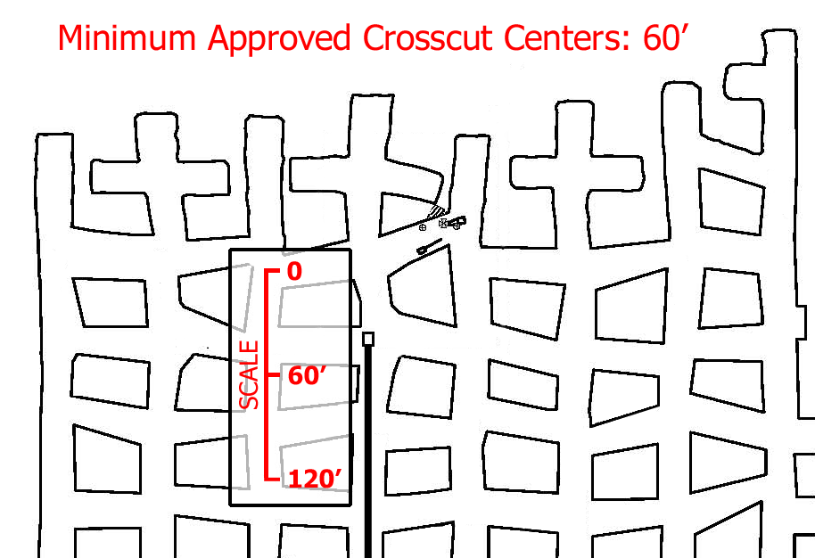
ENFORCEMENT ACTIONS
104(d)(1) Order for a violation of 30 CFR 75.220(a)(1)
The operator was not complying with the approved roof control plan.
Crosscuts in all 8 entries of the working section were driven on centers of 30-40’.
The approved roof control plan specifies minimum crosscut centers of 60-80’.
The reduced crosscut centers reduced the size of the pillars, contributing to the accident.
Coal Mine Fatal Accident 2003-15
Note: Violation Descriptions may be paraphrased for clarity in this presentation.

Slide 22
ENFORCEMENT ACTIONS
104(d)(1) Order for a violation of 30 CFR 75.1319
More than 3 pounds of explosive was loaded into holes drilled into the faces of 3 Entry, 4 Entry, 4 Left Crosscut, and 4 Right Crosscut.
The detonation of an excessive amount of explosive in the aforementioned faces was a contributing factor to the accident.
Coal Mine Fatal Accident 2003-15
Note: Violation Descriptions may be paraphrased for clarity in this presentation.

Slide 23
ENFORCEMENT ACTIONS
104(a) Citation for a violation of 30 CFR 50.12
Prior to MSHA’s investigation, the accident scene was altered when a non-permissible drill involved in the accident was moved from the accident scene to another location outby the working section.
The Click’s wagon drill, which was equipped with a 12’ drill auger, had been moved from the accident scene outby approximately 150-180’.
Evidence, in the form of blood spatters covering the frame of the drill, indicates that the drill was in the last open crosscut when the accident occurred. The 10-5 SO cable, which supplied 220VAC power to the Click’s drill, had been freshly cut on both ends.
Coal Mine Fatal Accident 2003-15
Note: Violation Descriptions may be paraphrased for clarity in this presentation.

Slide 24
BEST PRACTICES
Check centers frequently to ensure that entries and crosscuts are being mined as projected.
Conduct thorough examinations to ensure that hazardous conditions are promptly identified, reported, and corrected.
Ensure that all persons are a safe distance from the blasting area before detonating the shot.
Frequently review approved plans with supervisors and miners to ensure compliance with required parameters.
Ensure that miners are properly trained in, and comply with, safe blasting procedures.
Coal Mine Fatal Accident 2003-15

