Slide 1
User Group Presentation –
Release 2.19
(No Meeting)

Slide 2
Added feature in this PPT Presentation
NOTE:
Hyperlinks have been added to this Power Point presentation for easier navigation between the Overview section at the beginning and the rest of the slides. You must view this presentation as a “Slide Show” in order to utilize the hyperlinks.

Slide 3
Overview – Release 2.19 Highlights
Black font – Click on Ticket Number to see Screen Shot in Presentation
Brown font – No Screen Shot in Presentation
GLOBAL CHANGES
  A "Date Assigned” column was added to all Workflow History displays to show when task was sent to user (Ticket 21928)
  A "Cancel" button was added to the Public Search pages to allow user to return to the login screen for Grants Online (Ticket 24982)
  The problem with missing Project Titles on some notifications was resolved. (Ticket 28027)
INBOX and ACCOUNT MANAGEMENT Tabs
  The available roles for the Send Group Notifications feature of the "Send Message“ link under the Inbox tab and for the "My Delegations" feature under the Account Management tab are now limited to Recipient roles when the person logged in is a Recipient. (Ticket 22671)
RFA Tab
  The Application Package details page was redesigned for a cleaner look. (Tickets 23205 and 26413)
  The remaining "Done" links on RFA creation pages have been changed to blue buttons for consistency with the rest of the user interface. (Ticket 23205)
  The problem with the pop-up warning message when clicking the "Save" button on the FFO details page was fixed. (Ticket 24022)
  The "Notify Recipients" task must now be started before the Approve option becomes available on the "Minimum Requirements Checklist" task. (Ticket 24705)
  NEXT PAGE

Slide 4
Overview – Release 2.19 Highlights (cont.)
Black font – Click on Ticket Number to see Screen Shot in Presentation
Brown font – No Screen Shot in Presentation
RFA Tab (continued)
  The count of applications has been returned to the RFA and Competition launch pages. (Ticket 26430)
  The "Cost Principles" section was removed from the FFO per guidance from FALD.
  (Ticket 27642)
  The unnecessary FFO approval notifications that were being copied to FALD were stopped. (Ticket 28065)
  On the RFA Search screen, the label "RFA Title" was changed to "RFA Name" to be consistent with other labels throughout the user interface. (Ticket 26471)
  Guidance links were added to the Mission Goals selection screen. (Ticket 23205)
APPLICATION Tab
  On the Application Details page, the word "Eastern" was added next to the time field for the "Federal Agency Received" date and time. (Ticket 23205)
  Layout modifications were made to the PO Checklist details screen for additional clarity and guidance. (Ticket 23205 and 26502)
  Award numbers can now be re-generated during the Conduct Negotiations task. (Ticket 22981)
  The Application Details page was modified to correctly display Question 19 (State Review) (Ticket 25403).
  For GMD – OLIA workflow was moved to after Grants Officer approval and CAMS First Approval. It is now automatically sent by the system without additional user intervention based on the award amount (Ticket 22361) NEXT PAGE PREVIOUS PAGE

Slide 5
Overview – Release 2.19 Highlights (cont.)
Black font – Click on Ticket Number to see Screen Shot in Presentation
Brown font – No Screen Shot in Presentation
APPLICATION Tab (continued)
  Language regarding name change was fixed on the warning message received when adding a new person. (Ticket 25579)
  The color for the "ACCS is Valid" message on the Procurement Request ACCS screen was change to green to distinguish it from the warning messages which display in red. (Ticket 26470)
AWARD Tab
  Due and Delinquent Report notifications now contain links to User Guides. (Ticket 20208)
  Appropriate DOC Terms and Conditions are now linked to Amendments for no cost actions as well as funded amendments based on Grants Officer sign date. (Ticket 22312)
  A button was added to the Award Action Request detail screens to generate a printable report containing the details of the AAR. The report has the same look and feel as an amendment document. (Ticket 24478)
  For GMD - Updates were made to Enforcement Reactivation tasks (Ticket 24873):
    Attachment link was fixed
    Grants Specialist will get Reactivation Task only after CAMS First Approver completes updating suspension of award/payment.
    Forward to Grants Officer option only becomes available after "Reason for Reactivation" has been entered
    Grants Officers and CAMS First Approvers are now getting their Reactivation tasks
    Data now displays properly in the Reactivation notifications
    NEXT PAGE PREVIOUS PAGE

Slide 6
Overview – Release 2.19 Highlights (cont.)
Black font – Click on Ticket Number to see Screen Shot in Presentation
Brown font – No Screen Shot in Presentation
AWARD Tab (continued)
  Guidance language on the SF-272 and SF-269 forms was updated for additional clarity regarding closeout financial transactions and final ASAP drawdown. (Ticket 25018)
  Date calculations were fixed to prevent submission of Expanded Authority No Cost Actions within 10 Calendar days of award expiration. (Ticket 25297)
  Both Federal and Non-Federal amounts can now be changed by the Program Officer on Partial Funding actions. Also, the Partial Funding action can now properly handle more than one Procurement Request. (Ticket 25937)
  Modifications for additional clarity were made to the Report information on the Grants File header. (Tickets 22557and 26155)
  Report notifications were fixed to include distribution to Principle Investigators and Financial/Business representatives with “Submitting” roles. (Ticket 26181)
  The Grants file header was fixed to display correct total Non-Federal Funding for awards which contained a Partial Funding action. (Ticket 26371)
  A guidance link was added to the Partial Funding details screen. (Ticket 26554)
  The unnecessary pop-up warning message displayed when creating a Partial Funding document was removed. (Ticket 26573)
  CD-450 was fixed to reference the correct FRN for pre-award notification requirements and attachment links on the CD-450 and GMD Checklist were fixed to open in a separate window. (Tickets 26592 and 26927)
  "Amendment 0" labels on the Award Package and Award File 0 were replaced with "CD-450" labels. (Ticket 23205) PREVIOUS PAGE ADDITIONAL RESOURCES

Slide 7
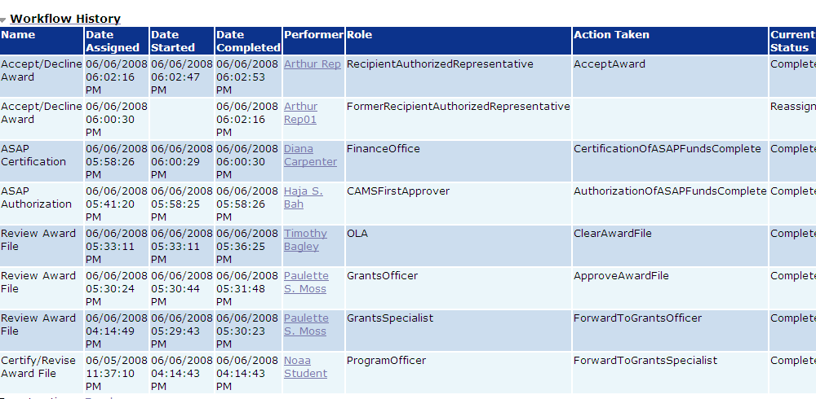
New “Date Assigned” Column on Workflow (Ticket 21928)
New column indicates when task was sent to user. Note the Reassign task on the second row. Even though it was reassigned without being started, the workflow now shows when it was received. RETURN to OVERVIEW

Slide 8
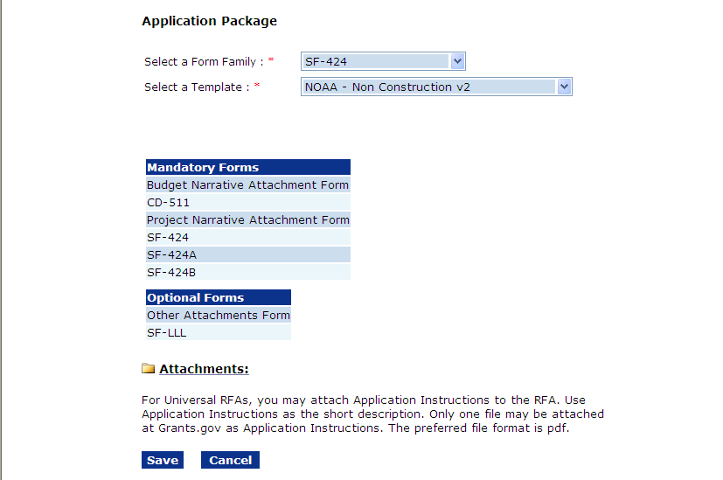
Cleaner Application Package screen (Tickets 23205 and 26413)
RETURN to OVERVIEW

Slide 9
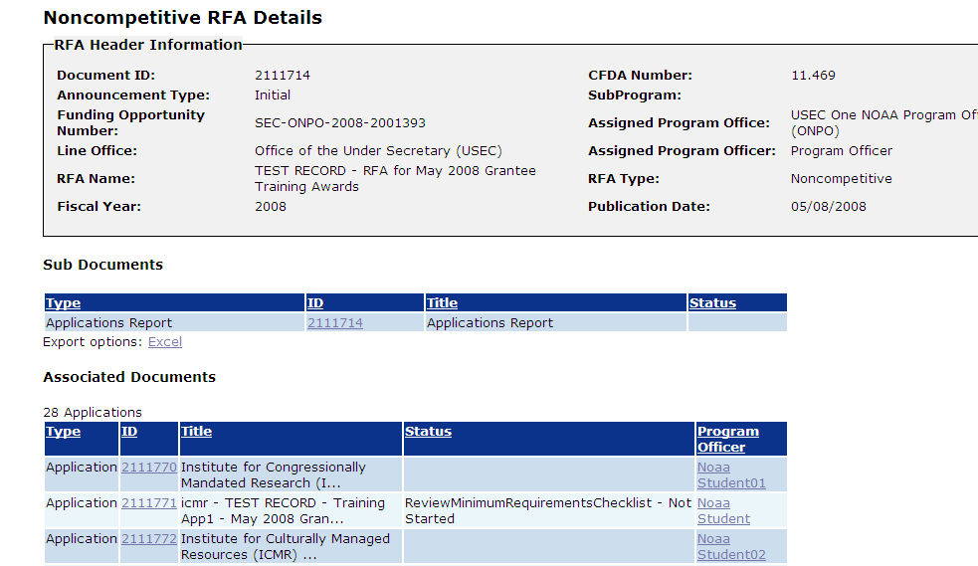
Count of Applications added back to RFA and Competition Launch Pages (Ticket 26430)
RETURN to OVERVIEW

Slide 10
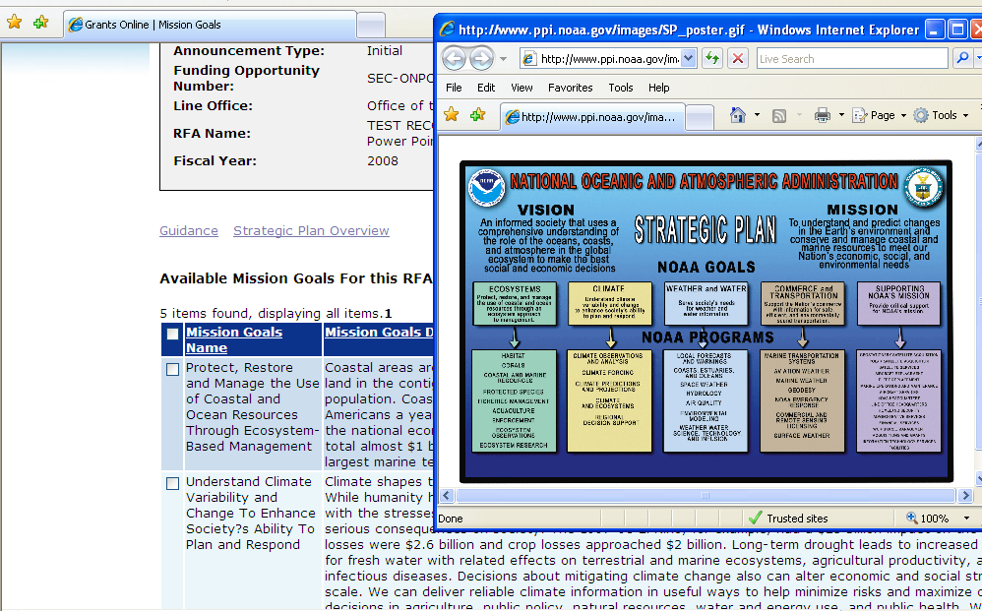
Guidance links on Mission Goals screen (Ticket 23205)
The “Guidance” link goes to http://www.ppi.noaa.gov/
The “Strategic Plan Overview” link goes to
http://www.ppi.noaa.gov/images/SP_poster.gif RETURN to OVERVIEW

Slide 11
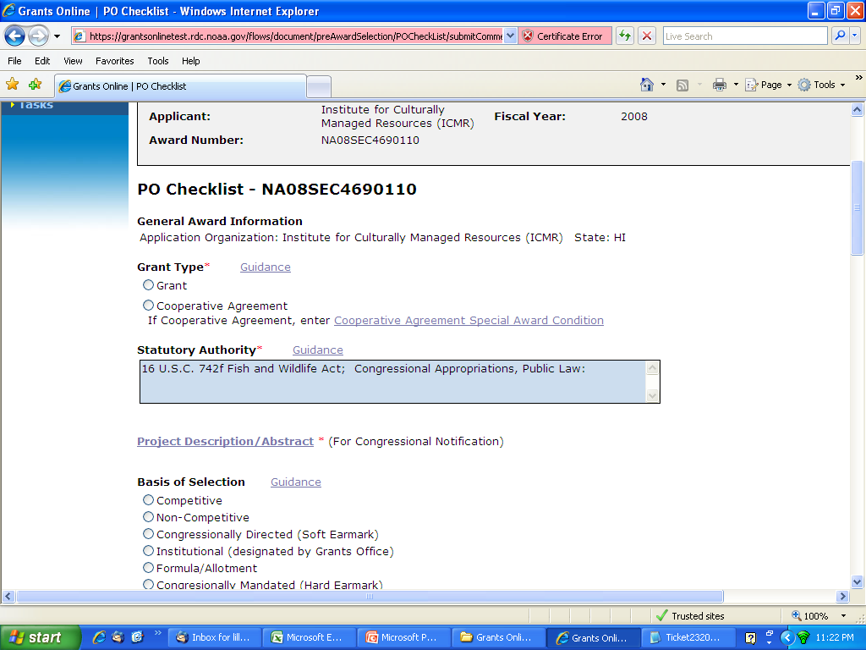
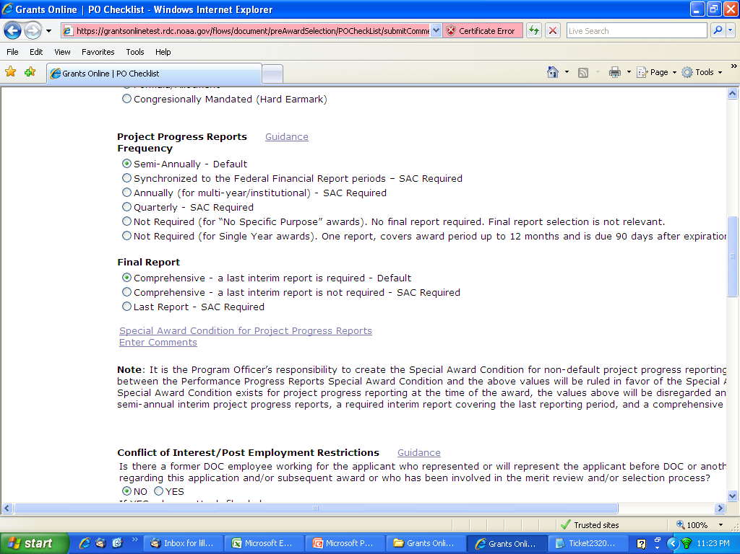
Cleaner PO Checklist screen (Tickets 23205 and 26413)
RETURN to OVERVIEW

Slide 12
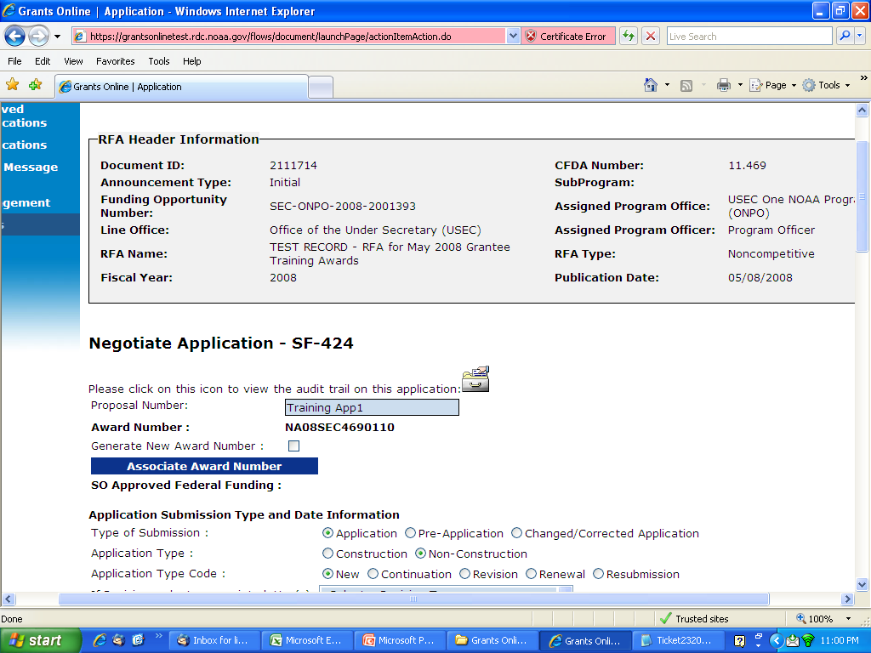
Award Number Regeneration during Conduct Negotiations (Ticket 22981)
This feature makes it EASY to change an award number when application is awarded in a different fiscal year from the RFA:
1. From “Certify/Revise Award File” task select the option to “Renegotiate”
2. Change the fiscal year on the first year of funding.
3. Click on the “Generate New Award Number” box and then save.
RETURN to OVERVIEW

Slide 13
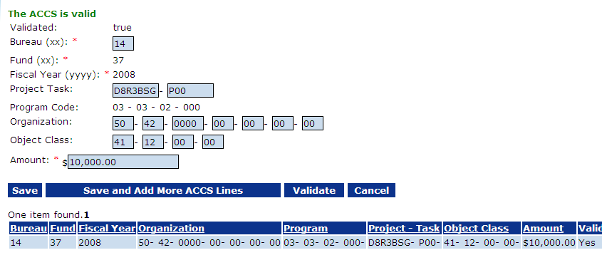
Color change on ACCS validation message (Ticket 26470)
RETURN to OVERVIEW

Slide 14
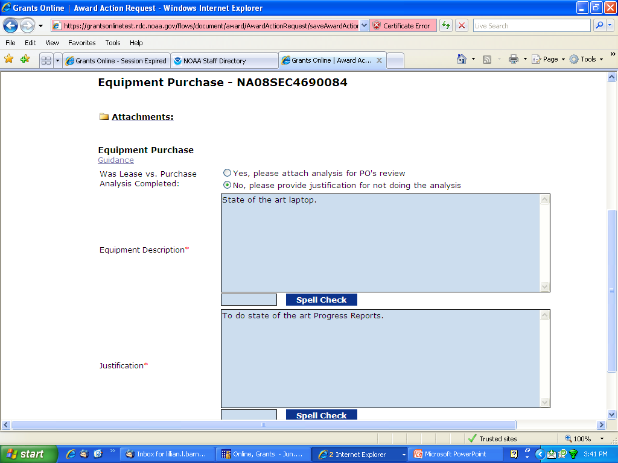
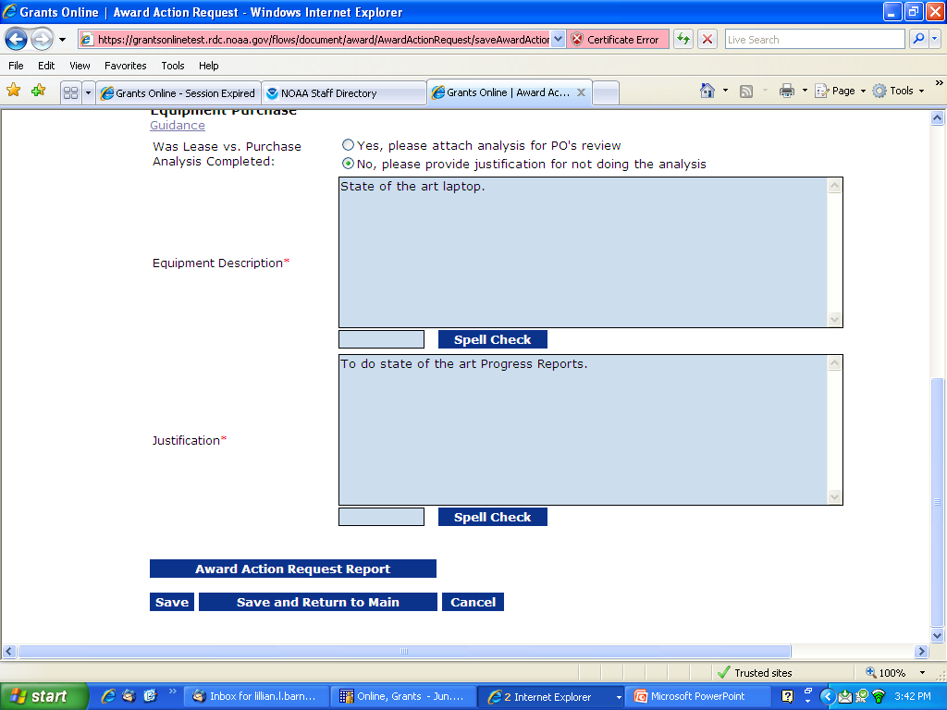
New Award Action Request Report (Ticket 24478)
RETURN to OVERVIEW

Slide 15
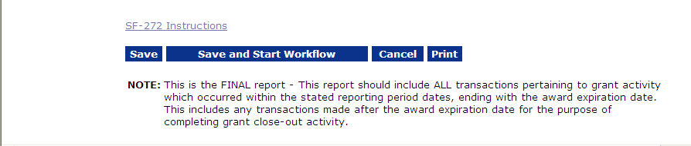
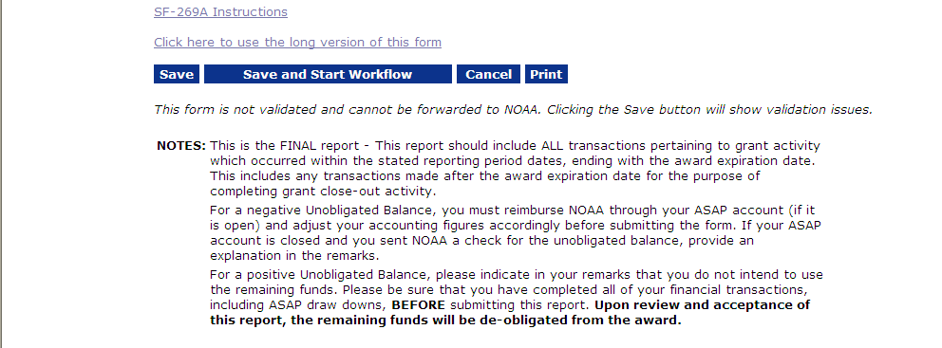
Enhanced guidance for FINAL SF-272 and SF-269 Reports (Ticket 25018)
Final SF-272
Final SF-269
RETURN to OVERVIEW

Slide 16
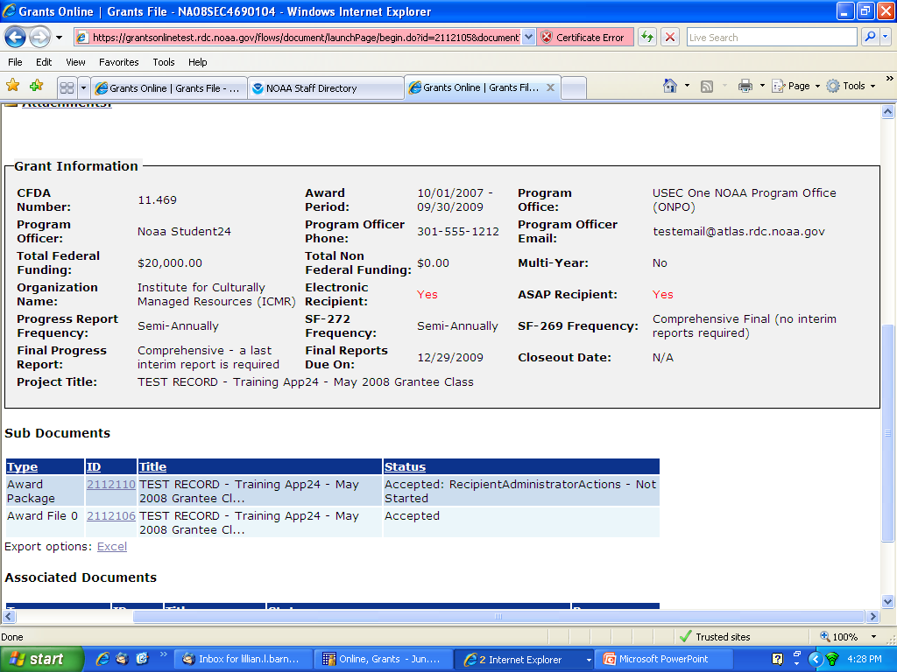
Cleaner Report Info on Grants File Header
(Tickets 22557,26155)
Information regarding Progress Report, SF-272, and SF-269 Frequency and Final Reports has been restated to reduce confusion.
RETURN to OVERVIEW

Slide 17
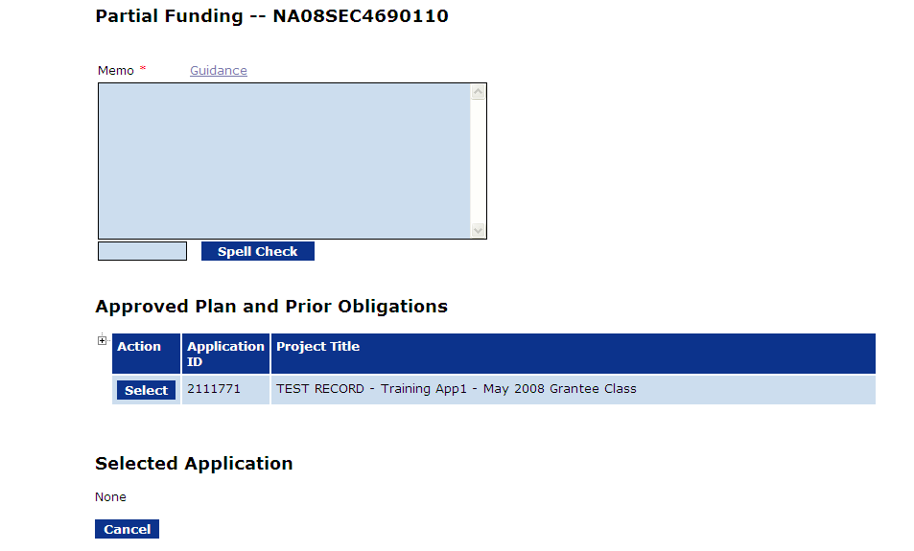
New Guidance link on Partial Funding details screen
(Ticket 26554)
This link provides examples of language provided by GMD for the Partial Funding memo. It also walks the user through the steps needed to change information previously entered on the Partial Funding document.
RETURN to OVERVIEW

Slide 18
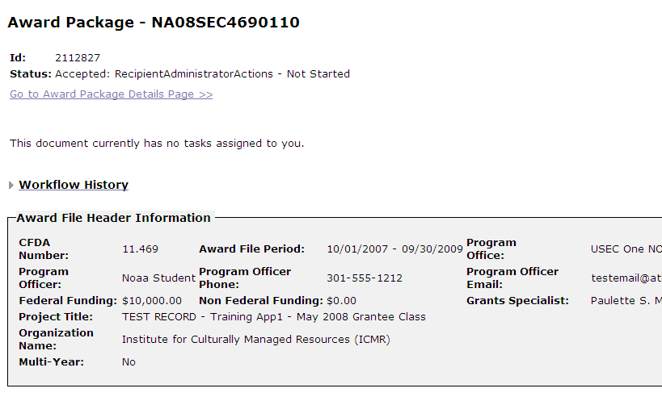
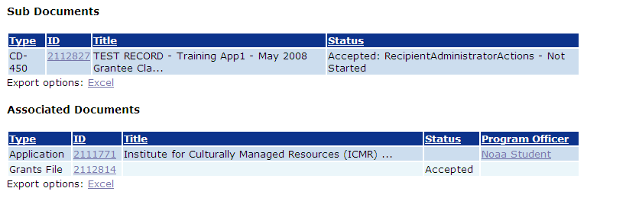
Former “Amendment 0” label on Award Package launch page changed to “CD-450” (Ticket 23205)
RETURN to OVERVIEW

Slide 19
Additional Resources
GrantsOnline.QandA@noaa.gov
GrantsOnline.HelpDesk@noaa.gov
  (301) 444-2112
  (877) 662-2478 (1-877-NOAAGRT)
Grants Online PMO Website at www.ofa.noaa.gov/~grantsonline to Access:
  Grants Online Training/Support Resources
  Frequently Asked Questions
  What’s New page
  RETURN TO OVERVIEW

