Slide 1
“Can You Hear Me Now?”
Linking STIs and HIV infection
David B. Johnson – Sr. Public Health Advisor
Dr. Roxanne Barrow – Medical Epidemiologist
Division of STD Prevention

Slide 2
From Coast to Coast
We got Issues

Slide 3

Gonorrhea — Rates by race/ethnicity and sex: United States, 2005

Slide 4
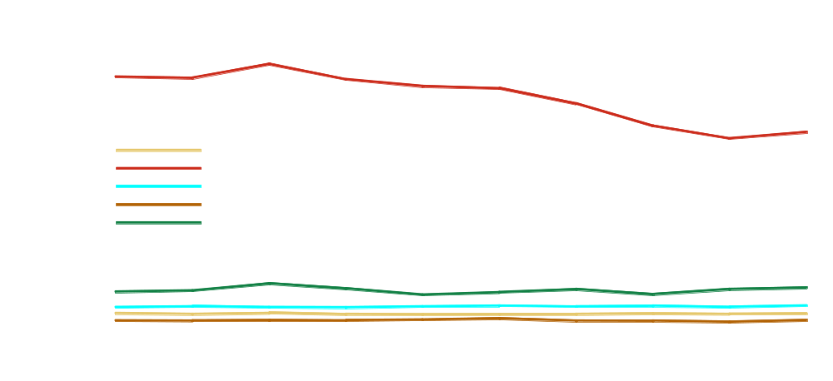
Gonorrhea — Rates among 15- to 19-year-old females by race/ethnicity:
United States, 1996–2005

Slide 5
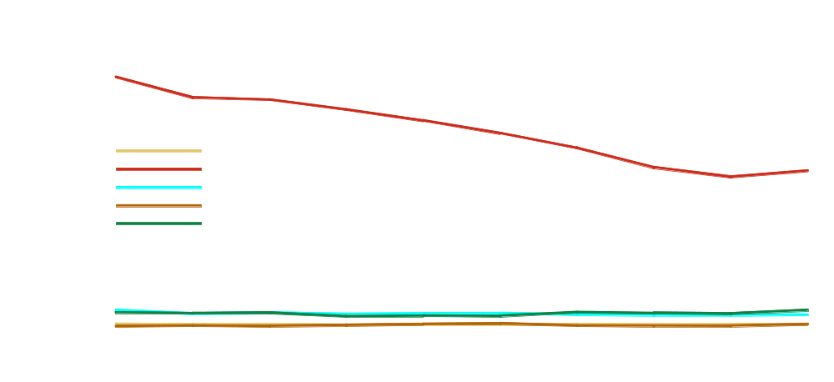
Gonorrhea — Rates among 15- to 19-year-old males by race/ethnicity:
United States, 1996–2005

Slide 6

Chlamydia — Rates by race/ethnicity and sex: United States, 2005

Slide 7

Primary and secondary syphilis — Rates by race/ethnicity and sex:
United States, 2005

Slide 8
What’s the link between STIs and HIV/AIDS?

Slide 9
The STD-HIV/AIDS Connection
Increased susceptibility
  Individuals who are infected with STDs are at least two to five times more likely than uninfected individuals to acquire HIV
  Genital ulcers (e.g., syphilis, herpes, or chancroid) result in breaks in the genital tract lining or skin which create a portal of entry for HIV
  Non-ulcerative STDs (e.g., chlamydia, gonorrhea, and trichomoniasis) increase the concentration of cells in genital secretions that can serve as targets for HIV (e.g., CD4+ cells)

Slide 10
The STD-HIV/AIDS Connection
Increased infectiousness
  HIV-infected individuals co-infected with another STD are more likely to transmit HIV through sexual contact than other HIV-infected persons (Wasserheit, 1992)
    HIV-infected individuals co-infected with other STDs are more likely to have HIV in their genital secretions
    Men infected with both gonorrhea and HIV are more than twice as likely to shed HIV in their genital secretions than are those who are infected only with HIV
    The median concentration of HIV in semen is as much as 10 times higher in men who are infected with both gonorrhea and HIV than in men infected only with HIV

Slide 11
What does any of this mean?
Clarity, Choices, and Networks

Slide 12
Clarity

Slide 13
Sexual behavior measured in terms of
    number of partners
    sexual practices
    condom use
    other individual level parameters
does not account for the observed racial disparities in STI

Slide 14
African American women have the highest rates of STI in most analyses – they do NOT have the highest levels of risk behavior.
Having a sexually transmitted infection does not mean the person is engaging in risky sexual behaviors.

Slide 15
Choices

Slide 16
Sexual Mixing Patterns
Assortative Mixing
  Partnerships between people who are at similar risk for infection
  Keeps infection within the risk subpopulation
  Most social and sexual networks are relatively assortative
Dissortative Mixing
  High and low risk people form partnerships
  Disseminates infection throughout the population

Slide 17
Mixing Among African Americans
Limited published data re: general black population
National Health and Social Life Survey
  More frequent contact between individuals with many partners (core) and those with few partners (dissortative)
  Sexual networks relatively segregated by race
      Laumann E, Youm Y. Sex Transm Dis 1999;26:250-261

Slide 18
Population Level Interventions

Slide 19
Population Level Intervention
Los Angeles County
Initiated a Women of Color Advisory Committee
Initiated a Media Campaign with Power 106 Targeting African Americans
Public Housing Project – Nickerson Gardens, Jordan Downs, Imperial Courts

Slide 20
Population Level Intervention
Maryland and Baltimore Health Department
Initiated a self-administered test for chlamydia using the Internet - www.iwantthekit.org
In 2004, tested 400 women and 41 tested positive for chlamydia
Continued use of the Internet site that has been expanded to include men

Slide 21
Population Level Intervention
US Public Health Region IV
Infertility initiative to screen women for chlamydia and gonorrhea
Annually screen African American women that attend historically Black colleges and universities within the Region

Slide 22
Networks

Slide 23
Consultation to Address STD Disparities in African American Communities
Meeting held June 5-6, 2007
Consultants included external and internal partners
Meeting activities
  Review the epidemiology of bacterial STDs
  Discuss the determinants
  Discuss the individual, social, and health impact of the disparities
  Develop an action plan for CDC and meeting consultants to address STD disparities among African Americans
  Identify opportunities for collaboration with other sexual health issues such as HIV, herpes, and hepatitis B

Slide 24
Consultation to Address STD Disparities in African American Communities
Initial activities
  Commitment of four workgroups consisting of CDC and external partners to continue collaborative post-meeting activities for at least the next year
  Development of preliminary goals and action items
    Conduct community outreach to improve screening especially for males
    Establish a community coalition to foster policy changes
    Promote advocacy for reimbursement of screening costs by healthcare providers

Slide 25
Consultation to Address STD Disparities in African American Communities
Lessons learned (Fenton Five)
  Expand the public health paradigm
  Partner with diverse groups and organization
  Define a new dialectic about sexuality and sexual health in African American communities
  Promote cultural competent interventions
  Move from general principles to specific actions

Slide 26
“The important stuff is always simple.”
“The simple things are always hard.”

