Slide 1

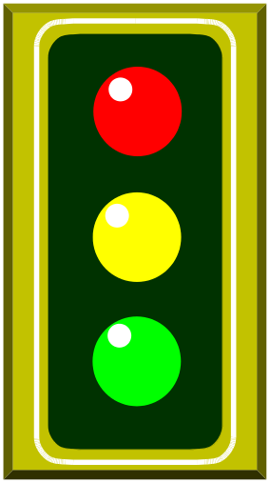


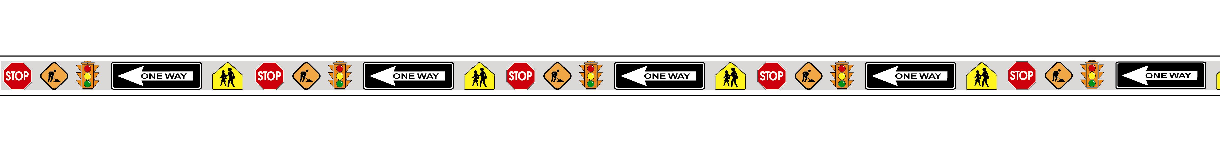
MUTCD Part 4: Traffic Signals
Notes:
We now move on to Part 4 of the new Manual. Traffic signals are addressed in Part 4.

Slide 2

Changes in General
Reorganized for clarity
Defined all terms in text: 71 definitions versus 4 previously
  deleted definitions no longer appearing in text
Changes to some existing criteria
New technology items added
Symbols required for all new pedestrian signals
Notes:
In general, the changes to part 4 were made to reorganize and revise the part for clarity. Seventy-one new definitions were added as a means of defining all terms in the text. We deleted definitions that no longer appear in the text. We made changes to some existing criteria as well as added new technology items in Chapters 4E (accessible pedestrian signals) and 4L (in-roadway lights). In addition, we now require symbols for all new pedestrian signals.

Slide 3
Important Notes
RED ARROWs are allowed in the 2000 manual
11 warrants consolidated into eight warrants
Notes:
RED ARROWS were allowed in the 1988 Manual and are retained in the 2000 Manual, even though the FHWA had proposed to delete RED ARROWS in a notice of proposed rule making. There was overwhelming support for keeping the RED ARROWS.
The number and complexity of Warrants was modified for the 2000 Manual by consolidating some of them together. Warrants 1, 2, & 8 were combined into Warrant 1 on eight hour vehicular volume

Slide 4
Important Notes (cont’d)
Traffic control signal needs studies: warrant 1, eight-hour vehicular volume
  elimination of the “56% rule”
  values for 80% and 70% are now listed separately table 4C-1
Notes:
In the 1988 edition, Warrant 10 addressed “Peak Hour Delay” and Warrant 11 addressed “Peak Hour Volumes.” In the 2000 edition these were consolidated into Warrant 3. The peak hour warrant is intended for use at locations where traffic conditions are such that for a minimum of 1 hour of an average day, the minor street traffic suffers undue delay when entering or crossing the major street.

Slide 5
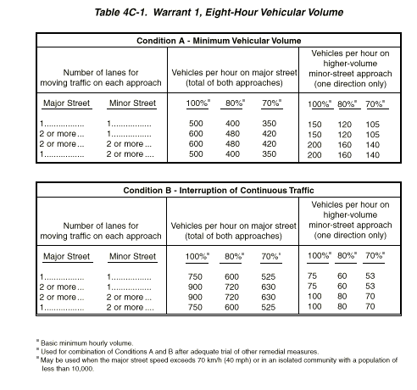
Notes:
The 56% assumption is eliminated because the values for 80% and 70% are listed separately.
This was done because 80% of the minimum vehicular volume and interruption of continuous traffic values was what was originally intended, but some practitioners were calculating 80% of the 70% value. Table 4C-1 shows how the new Warrant 1 is applied.

Slide 6
Change in Standard
Meaning of vehicular signal indications
  STANDARD: New language added to allow turns on CIRCULAR RED
  STANDARD: New language added to prohibit turns on RED ARROW, except when a sign is used to indicate turns are allowed on red after stopping
Notes:
In the 1988 Manual, Section 4B-5 of the 1988 MUTCD, did not allow turns on CIRCULAR RED nor RED ARROW. In the 2000 Manual, Standard language was added to Section 4D to allow turns on CIRCULAR RED from a one-way street into a one-way street.
Standard language is also added to prohibit turns on RED ARROWS except when a sign is used to indicate that turns are allowed on red after stopping.

Slide 7
New Standards
Application of steady signal indications for left turns
  STANDARD added allowing Dallas Left-Turn Phasing
    provides for a protected/permitted (five section) signal which displays a CIRCULAR GREEN for the left turn approach while displaying a CIRCULAR RED for the through movement approach
Notes:
New standard language has been added to allow a shared left-turn signal face for protected/permissive mode, which is also known as Dallas left-turn phasing. The shared left-turn signal face has 5 sections. During the protected left-turn movement, the signal face shall simultaneously display a left turn GREEN ARROW and a circular GREEN for the adjacent through lane. During the protected left-turn movement, the signal face for through traffic on the opposing approach shall simultaneously display CIRCULAR RED. During the permissive left-turn movement, all signal faces on the approach shall display CIRCULAR GREEN.

Slide 8
Temporary & Portable Traffic Control Signals
Temporary
Portable
Notes:
“Temporary” and “portable” traffic control signals have been redefined to have fewer restrictions on their use.
Temporary is defined as being installed for a limited time period
Portable is defined as a temporary signal designed to be transported and reused at different locations.

Slide 9
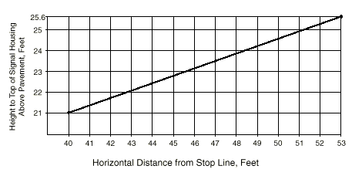
Maximum Mounting Height of Signal Faces
Notes:
A vertical viewing angle of as high as 23.8 degrees was implicitly allowed in the 1988 MUTCD. Ergonomic statistics demonstrated that, with these extreme vertical angle placements, tall motorists are unable to view the top of the signal face because they are blocked by the vehicle ceiling line. Therefore, the FHWA changed the maximum height of a signal head to fall in line with a 20 degree maximum vertical viewing angle.
This graph shows the different maximum mounting heights allowed depending on how far the signals are from the stop line.
The top of the signal housing shall not be more than 25.6 ft (7.8m) above the pavement.

Slide 10
Change in Standard
Notes:
Pedestrian signal indication requirements have been revised for recognition and adequate visibility. The reason for this is that research has found that the 6 in. pedestrian symbols, are adequate for distances of up to 100 ft. The subjects used in the research included 48 seniors aged 62 and older. The research included incandescent light emitting diode (LED) and fiber-optic pedestrian signals.

Slide 11

Accessible Pedestrian Signals and Detectors
New Accessible Pedestrian Signal Detector
Notes:
The vast majority of intersections will not require any accessible pedestrian signals. However, for those intersections that do present difficulties for pedestrians who have visual disabilities to cross safely and effectively, the intersection should first be reviewed for pedestrian safety in general (both visually able and visually disabled pedestrians) and then a further examination to assess whether accessible signals would provide information not readily apparent in the environment.
Consideration of these devices is important because many factors increase crossing difficulty. These include:
Increasingly quiet cars
Right turn on red, which masks the beginning of the through phase
Continuous right turn movements
Complex signal operations, traffic circles, and Wide streets.
Advice from organizations representing pedestrians who have disabilities should be given deference; and there should be widespread agreement that there is community demand for accessible pedestrian signals.

Slide 12
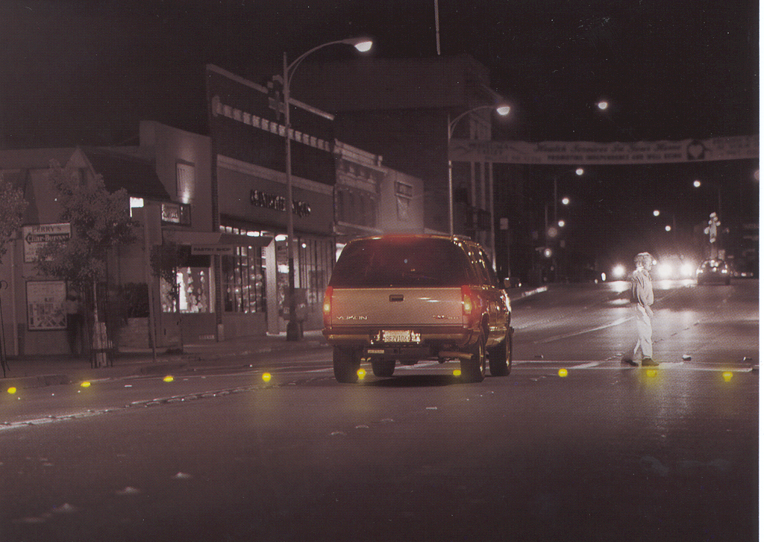
In-Roadway Warning Lights
Courtesy of S. Wainwright, Montgomery County
Notes:
This figure is an example of In-Roadway Lights. This new chapter has been added to the 2000 MUTCD to provide Standards, Guidance, Options, and Support for the design and operation of In-Roadway Lights installations.
Some of the STANDARDs are:
Installation shall occur only at uncontrolled, marked crosswalks with applicable warning signs
Parallel to the edge of the crosswalk
Operation shall be initiated based on pedestrian actuation
Operations shall cease at a predetermined time or with passive detection when the pedestrian clears the cross walk
The height of the lights shall not exceed 20 mm or ¾ inch.

