Slide 1
Structures and Standards for Our Bibliographic Future
Diane I. Hillmann
Research Librarian
Cornell University Library

Slide 2
Some General Questions
Are we now talking less about ‘standards compliance’ and more about ‘standards interoperability?’
Have we moved from thinking we’re operating within a ‘library standards’ environment to operating within a larger standards world?

Slide 3
The Past
Libraries have a long history of building and working within standards
Libraries also have a remarkable history of sharing data using consensus exchange standards and protocols
Our past success and our history has lately become a straitjacket--preventing us from responding to changes in our environment

Slide 4
Today, and Tomorrow ...
Two imperatives:
  1. Learn to operate in a broader web-based arena, using standards and protocols developed for sharing information on the Web, not just between libraries
  2. Expose to others the legacy data and vocabularies we’ve developed as a community, to assist us and others to manage and share information

Slide 5
An Important Start ...
RDA/DCMI Data Model Meeting, 30Apr.-1May2007--produced agreement to work together to:
  Develop an RDA Element Vocabulary
  Expose RDA Value Vocabularies
  Develop an RDA Application Profile, based on FRBR and FRAD

Slide 6
An RDA Element Vocabulary
Separates elements (attributes/properties) from the instructions for application
Provides definitions, relationships between elements and sub-elements that can be exposed to humans and machines
Will explicitly include FRBR and its entities as defined relationships

Slide 7
What Would an RDA-EV Include?
Element names, e.g.: Title proper
URIs--persistent and unambiguous references to the term and its structure
Definitions--ensuring semantic understanding
Relationships--providing a blueprint for processing and inference
History of term changes

Slide 8
Why is This Important?
Formal representation will break down the ‘silo’ around library data, making it understandable by others--whether human or machine
FRBR relationships can be incorporated explicitly, providing needed clarity in expressing and exploring bibliographic relationships
Within such a structure, extensibility becomes far easier

Slide 9
RDA Value Vocabularies
RDA (like AACR2 and MARC21) is loaded with controlled vocabularies
Controlled vocabularies need to be formally expressed to be effectively used, reused, and extended (as the major legacy vocabularies already are in some respects)
  Recent RDA/ONIX joint effort a step in the right direction
  An example: RDA Carrier Vocabulary

Slide 10
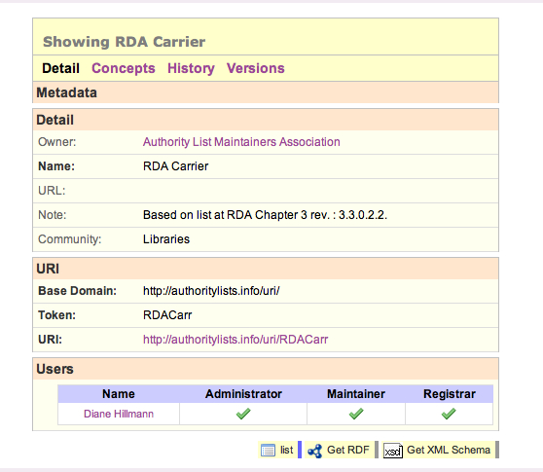
Value Vocabularies
Example registration, containing:
  Description of entire vocabulary as a collection of concepts
  URI for the vocabulary itself
  Links to Concepts, History, Versions
  Links to XML schema and RDF encoding

Slide 11
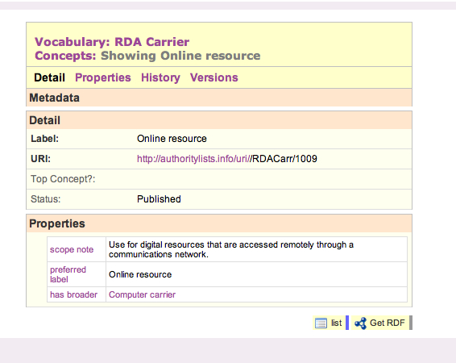
Human Readable Concepts
Uses traditional thesaural structure encoded in SKOS (Simple Knowledge Organisation System)
Each concept contains:
  URI representing the entire concept and its properties
  Familiar thesaural properties (BT, NT, RT, Scope note, etc.)

Slide 12
An RDA Application Profile
Provides documentation of community understanding and intent: What is being described? What are the key relationships?
Documents obligations and constraints for RDA instance metadata
Provides guidance for semantic crosswalks, specifications, tools/applications and encodings
Serves as primary documentation for decisions and criteria by which a specific set of metadata was created
Specifies appropriate controlled vocabularies and syntax encoding schemes

Slide 13
Why is This Important?
An Application Profile using the RDA Element Vocabulary provides a sound basic structure for re-thinking library applications
Specialized communities can express their needs using a related AP, reusing as much as they wish of the RDA Element Vocabulary
Particular community needs for extension can be accommodated within a common structure and understood and re-used by others

Slide 14
Effects on RDA?
Allows emerging structure to be more easily used to test data assumptions and instructional clarity
Allows specialized usage to evolve within an interoperable framework
Does not tie RDA to any specific encoding
Does not constrain the historic complexity of traditional library data

Slide 15
What’s in it for DCMI?
DC community work on Application Profiles frustrated by lack of formally declared properties suitable for reuse
RDA will provide the Semantic Web community with a plethora of stable, well-tested, and generally applicable element properties and value vocabularies
More general participation in development of DC Abstract Model-compliant Application Profiles

Slide 16
Moving Forward
Task Force being established under the aegis of DCMI (co-chaired by Gordon Dunsire and Diane Hillmann)
Funding being sought to support timely effort towards completion of goals
Important issues still on the table, but the participants are continuing to work towards resolution

Slide 17
Legacy Vocabularies
Legacy vocabularies (LCSH, Name Authorities, LC Classification, etc.) currently difficult to use outside MARC-based applications
  Lack URIs
  Not always well structured for web application (particularly true of LCSH)
  No formal representation available for tools or applications developed outside traditional libraries

Slide 18
Why Are They Still Unavailable?
Represent a library community resource, managed by LC but built with significant investment by other libraries
Current restrictions on re-use based on Congressional mandates for “cost-recovery” by LC
Calls for change at least since the Bicentennial Conference in 2000
Solving this problem must be a higher priority for LC on behalf of the library community

Slide 19
Can They be Repurposed?
These vocabularies should be “Webified” for easier use by all
  URIs essential for use within web-based applications
“Webification” particularly important for use in newly emerging catalogs and other discovery mechanisms
See article by Corey Harper and Barbara Tillett in upcoming CCQ: “Library of Congress controlled vocabularies and their application to the Semantic Web”

Slide 20
Thank you
Questions?
Diane I. Hillmann
Cornell University Library
dih1@cornell.edu

