Slide 1

Reroute Advisory Tool
RAT
This logo used by permission of the RAT Fan Club

Slide 2
Project Goals
The Reroute Advisory Team was formed with the goal of improving the clarity and usefulness of reroute advisories issued by the Air Traffic Control System Command Center.
Among the activities of this team was to investigate how a list of flights affected by a reroute could be appended to an advisory. This was identified as a high priority enhancement since it would go a long way toward removing ambiguity both for NAS users and FAA field personnel.

Slide 3
Project Goals
Provide a list of aircraft to be considered for reroutes, attached to an Advisory for ATCSCC reroutes. This allows system users and facilities common situational awareness for a reroute.
The flight list will be provided to system users and FAA facilities to accurately depict what flights are included in a reroute. This creates the opportunity for system users to participate in the pre-departure phase of the reroute process.
Develop the capability to parse flight specific, route specific information. This is a necessary first step towards the development of further automation tools.
Reduce the amount of advisories received by Users and FAA facilities by tailoring the addressing in Autosend. This will allow for advisories to be parsed to facilities only included in the reroute for the advisory issued. This will be developed in the Summer and implemented in Fall of 2003.

Slide 4
Team/Resources
Mitre
Volpe
Aviation Industry
ATCSCC
FAA Field Facilities
OSU

Slide 5
Technology
RAT WRITER
RAT READER
RAT LISTENER
RAT RESPONDER

Slide 6
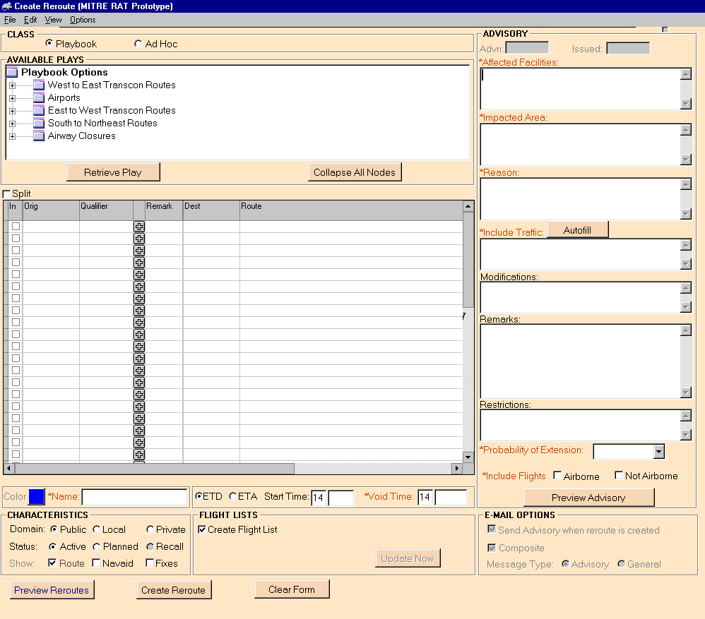
RAT WRITER

Slide 7
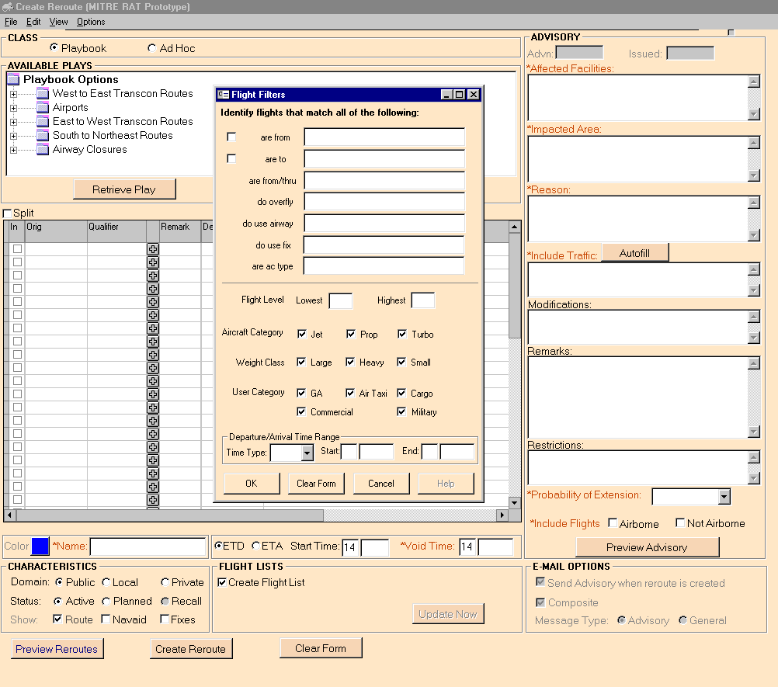
RAT WRITER

Slide 8
RAT WRITER
ATCSCC ADVISORY
ATCSCC ADVZY 501 DCC 10/21/2002 ORD FWA 1 REROUTE ADVISORY (MITRE RAT Prototype)
IMPACTED AREA: ORD FWA STAR THROUGH ZOB
REASON: HHH
INCLUDE TRAFFIC: REROUTE ABE MDT PHL ZNY CLE PIT DEPARTURES TO ORD
VALID TIMES: ETD START: 211730 END: 212030
FACILITIES INCLUDED: ZOB/ZAU/ZNY
PROBABILITY OF EXTENSION: LOW
REMARKS: TEST
INCLUDE NON-AIRBORNE FLIGHTS ONLY
ASSIGNED REROUTE:
ORIG DEST ASSIGNED ROUTE
==== ==== ==============
(ZNY) ABE MDT, ORD, PSB J60 DJB FNT PMM PMM4
(ZNY) PHL, ORD, DITCH J225 JFK LHY J36 FNT PMM4
(ZNY) ZNY -PHL -ABE -MDT, ORD, COATE J36 FNT PMM4
(ZOB) CLE, ORD, CRL FNT PMM PMM4
(ZOB) PIT, ORD, DJB FNT PMM PMM4
211730-212030

Slide 9
RAT WRITER
ETMS QUERY
FLIGHT LIST
ETMS query:
REQ D [ABE MDT PHL CLE PIT] [ORD] 10/21 1730 2030 EVERY 9999
SETLEN 299 LIST ACID DCENTR ACENTR ORIG DEST ETD ETA PGTD PGTA
SGTD SGTA E_TYPE ALT CLASS USER AC_CAT RTE SORT DCENTR ETD
REQ D [ZNY -PHL -ABE -MDT] [ORD] 10/21 1730 2030 EVERY 9999
SETLEN 299 LIST ACID DCENTR ACENTR ORIG DEST ETD ETA PGTD PGTA
SGTD SGTA E_TYPE ALT CLASS USER AC_CAT RTE SORT DCENTR ETD
FLIGHTCOUNT: 31 UPDATED: 211730

Slide 10
RAT WRITER
FLIGHT LIST
ARTCC ZOB
DCENTR ETD ORIG ACENTR ETA DEST PGTD ACID TYPE
ZOB P1741 CLE ZAU E1837 ORD 1725 UAL488 T/B735/F
REROUTE: CRL FNT PMM PMM4
ZOB P1858 CLE ZAU E2002 ORD 1840 EGF236 T/E135/F
REROUTE: CRL FNT PMM PMM4
ZOB P1951 CLE ZAU E2048 ORD 1935 UAL1773 T/B735/F
REROUTE: CRL FNT PMM PMM4
ZOB P1735 PIT ZAU E1844 ORD 1720 UAL741 T/B733/F
REROUTE: DJB FNT PMM PMM4
ZOB P1838 PIT ZAU E1953 ORD 1825 EGF165 T/E145/F
REROUTE: DJB FNT PMM PMM4
ZOB P1923 PIT ZAU E2032 ORD 1910 UAL571 T/B733/F
REROUTE: DJB FNT PMM PMM4
ZOB S1952 CLE ZAU E2051 ORD - BTA3261 E145
REROUTE: CRL FNT PMM PMM4
ZOB S2001 PIT ZAU E2114 ORD - USA1422 B735
REROUTE: DJB FNT PMM PMM4

Slide 11
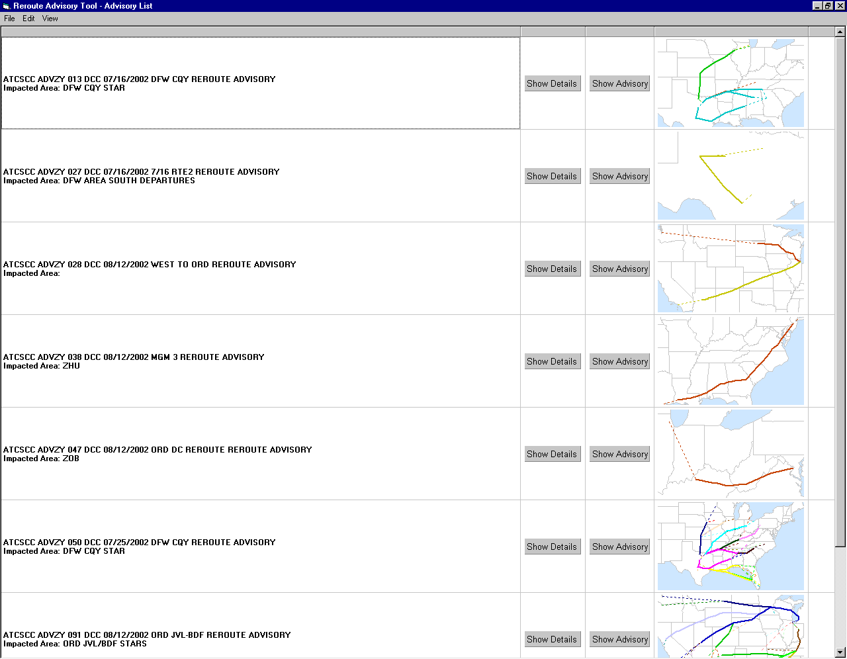
RAT READER

Slide 12
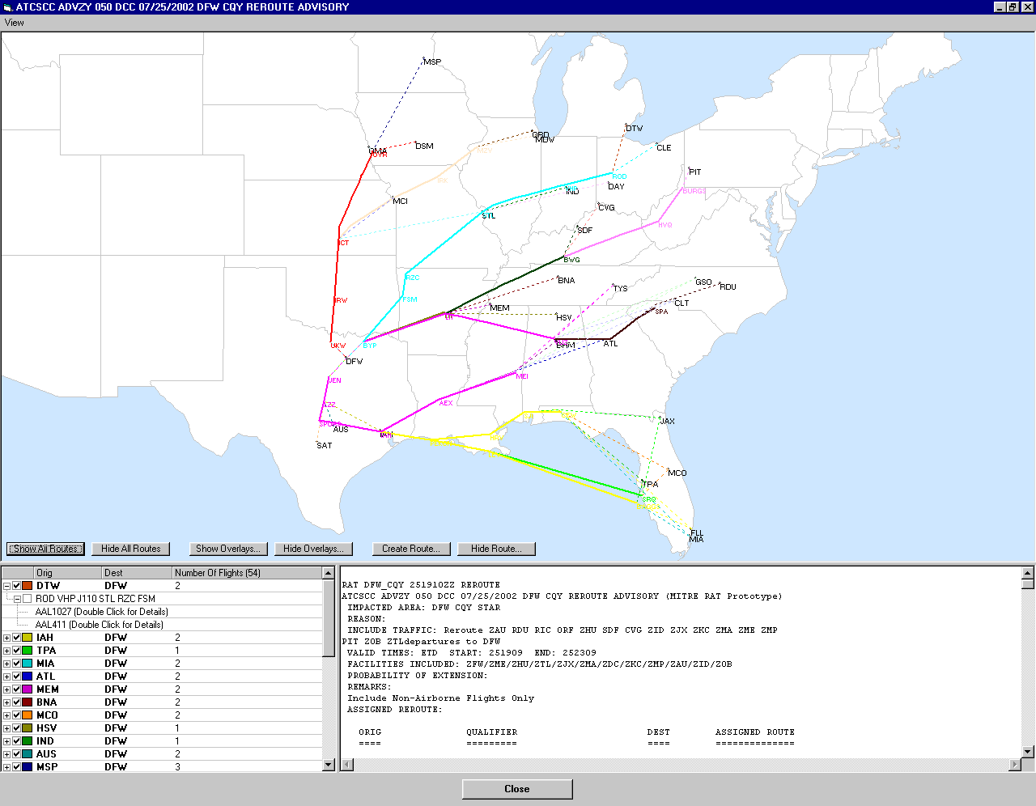
RAT READER

Slide 13
RAT RESPONDER
The RAT responder has not yet been developed.
The team is exploring possibilities for incorporating
technology to allow for industry response to reroutes.
This would be similar to substitutions that are currently
In use for Ground Delay Programs.

Slide 14
Procedures
FAA facilities are responsible to ensure flights are on the required reroute prior to leaving their area of responsibility.
System Users will be asked to explore the possibility of taking responsibility for rerouting their flights prior to departure. Currently, 45 minutes prior to aircraft push-back from the gate is being discussed as a cutoff point for them. After this point, the FAA would assume responsibility for the reroute.
This allows for system users to depart from the gate with full authorization for the flight to be able to accept the reroute. It would also allow for better ETMS data for the FAA facilities, letting them examine demand for routes and sector volumes in a more timely manner.

Slide 15
Schedule
Begin testing sample format messages with FAA field facilities.
in mid December, 2002.
Testing will be necessary 3 days per week. Monday, Wednesday and Friday. 0800-1600 EST will be identified testing periods.
This schedule will begin December, 2002 and be completed.
by February 30th, 2002.
Solicit feedback from FAA facilities for the following categories:
1. Accuracy of data received in the RAT flight list.
2. Format of the received advisory and RAT flight list.
3. Content of the advisory and RAT flight list.
4. Usefulness of the RAT flight list in your operations.
5. Collaboration and understanding of your needs and
limitations.

Slide 16
Schedule
Deploy the initial operational version of RAT in ETMS 7.6. This will occur in spring 2003.
Use RAT to send flight list advisories with Transcon Playbook reroutes. The initial implementation will be for Transcon reroutes that have at least 1 hour of lead time prior to commencement of the reroute. This allows for users to participate in the process of route planning.
Expand the use of RAT throughout the Summer to include all
Playbook reroutes.

