Slide 1

John E. Ogren
Deputy Regional Director
NOAA’s National Weather Service
Central Region Headquarters

Slide 2
Outline
Digital Services
Education opportunities
Challenges ahead

Slide 3
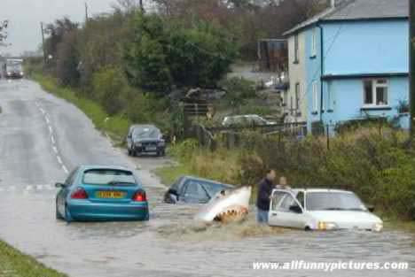

Message Clarity??
Or Be Eaten!!

Slide 4
Digital Services
National Digital Forecast Database (NDFD)
Storm Based Warnings
Experimental Daily Weather Stories

Slide 5
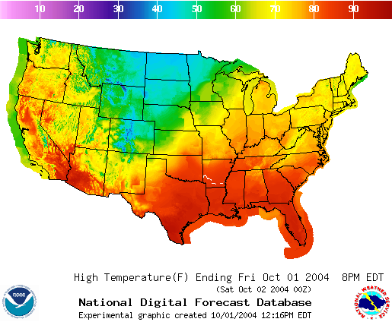
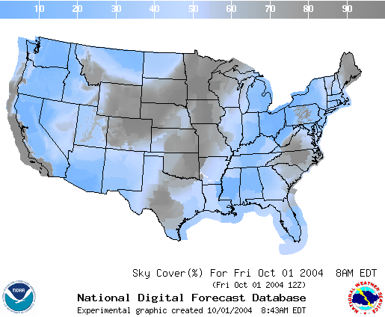
Digital Services
National Digital Forecast Database
  Hourly forecasts for 13 elements
  5 km resolution
  Available graphically on web or in GIS formats

Slide 6
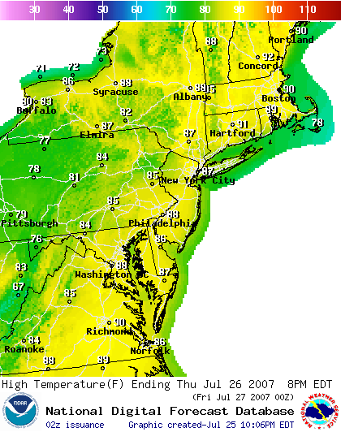
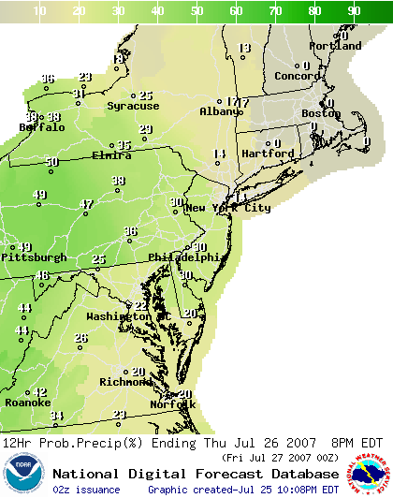
Today’s Forecast
Max Temperatures
Probability of Precipitation

Slide 7
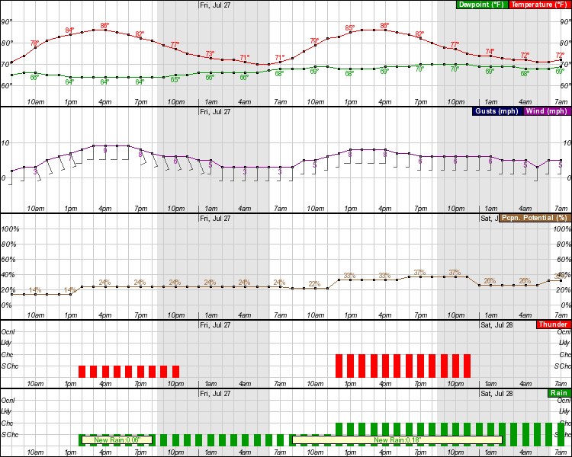
Hourly Forecast Graph

Slide 8
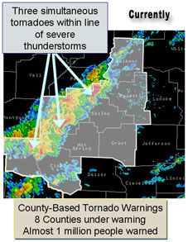
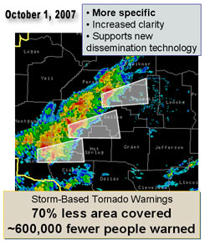
Why Storm Based Warnings??

Slide 9
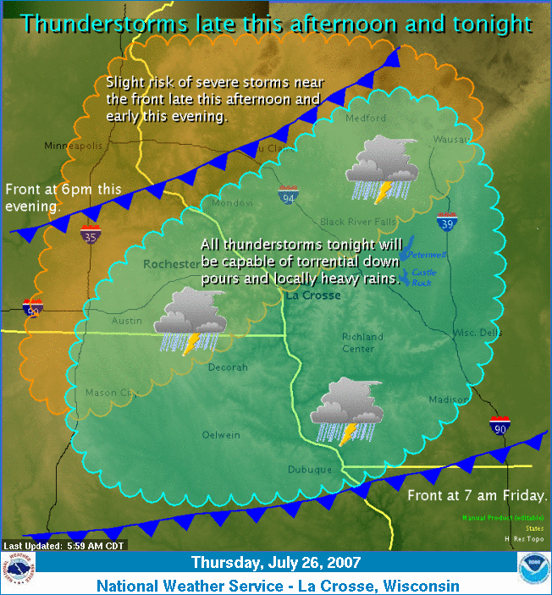
Daily Weather Story

Slide 10
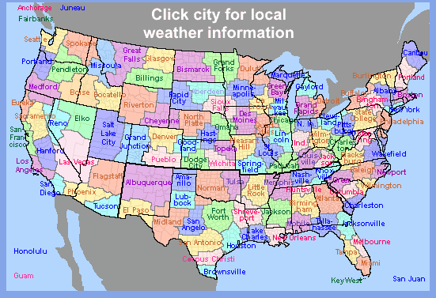
Education and Outreach
Warning Coordination Meteorologists
  Training
  Decision Support

Slide 11


Predicting the Unpredictable
Notes:
Title Slide. This slide could contain a collection of pictures of various weather types based on season or geography.

Slide 12

Topics
Weather
  Basics
  Global to Local Scale
  Types
Weather Data Interpretation
  Satellite
  Radar
  Surface Observations
  Internet Products
Weather Terms and Definitions

Slide 13
Challenges Ahead
Impact Forecasting
Understanding Probabilistic Forecasts
Integrating forecasts into decision support tools
Partnering with other agencies and the “Weather Enterprise”

Slide 14

  John.Ogren@noaa.gov

