Slide 1
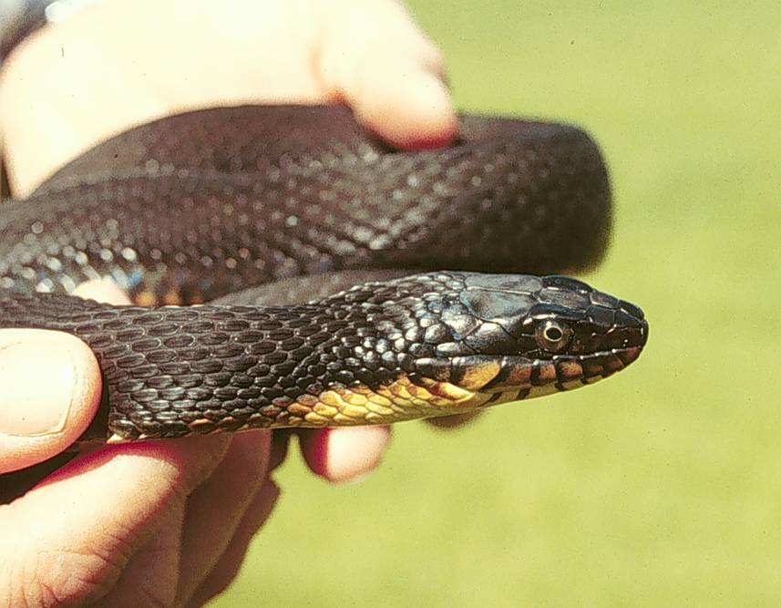
The St. Joseph River Watershed

Slide 2
What did we learn?
Smaller groups are more functional than larger groups
Starting from different places delays performance of group
Don’t sweat the details
Visuals bring clarity, enhance learning
Establish common language/definitions early and often
Bite off first chunk in your comfort zone and then move on to the rest of the pie
Try a prototype and then react

Slide 3
Stochastic Demographic Population Model

Slide 4
Population Model
Problem Statement: What population size is needed to obtain a probability of extinction of less than 10 percent within 100 years?
  Purpose: test our population objectives, i.e., will 1000 individuals provide a probability of extinction<10% for 100 years
Notes:
Recommendations highlight add’t purposes

Slide 5
Population Model
CWS Life cycle
Neonate
Juvenile
Adult

Slide 6
Population Model
Model Variables
P Proportion of adults breeding - sample from an equal distribution
R Proportion of reproductively mature females giving birth - sample from an equal distribution
F Number of young per female - sample from an equal distribution
A Adult survival rate - sample from an equal distribution
Sn Neonate survival rate age 0 - sample from an equal distribution
Sji Juvenile survival rate age 1 to 3 - sample from an equal distribution
Initial N
First age of breeding age = 3 yrs
Maximum age of breeding = 7 yrs.
Notes:
P based on all plain bellied watersnakes
R assuming all females that participate in breeding give birth
F copperbelly value
A Uncertainty large
Sn Based on all snakes

Slide 7
Population Model
Analytical Approach
Expert opinion to populate model
Used stable age-structure to set initial pop
Evaluated model behavior
Added catastrophic events

Slide 8
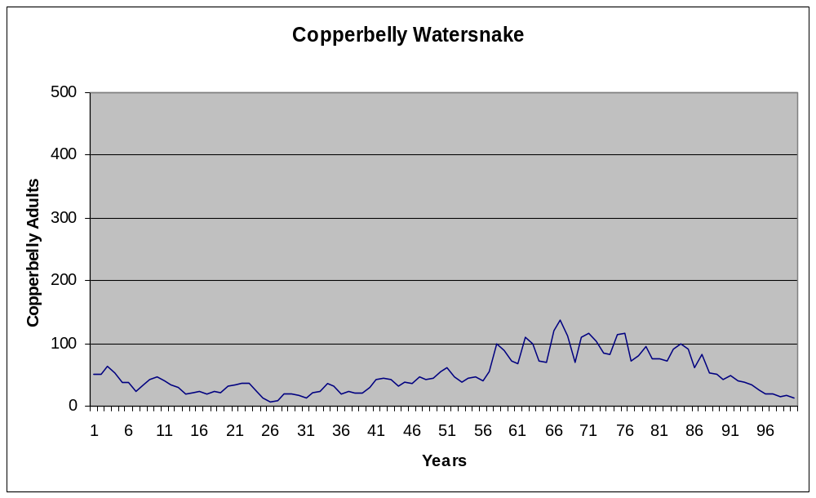
Population Model
CWS

Slide 9
Where are we going next?
Refine and improve stochastic demographic model
Examine population objective and assure ourselves that extinction risk is acceptable and revise as needed
Sensitivity analysis to identify management priority and research

Slide 10
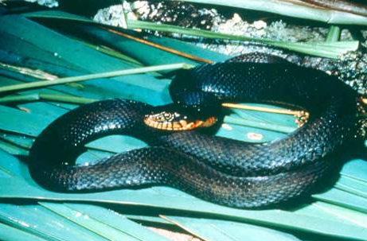
Problem
PFW program lacks a standard method for differentiating between CWS habitat restoration projects

Slide 11
Considerations
Combined the biological, economical, and practical (real-world) parameters.
Utilized the SMART (Simple Multi Attribute Ranking Technique) tool for establishment of a decision matrix.
Decision matrix included 6 attributes
  one directly tied to the biological model output,
  five represented the most important economical and practical parameters to PFW biologists.
Additional attributes may be added or substituted to our decision matrix.
Attributes were weighted based on factors that are most important in differentiating between potential CWS habitat restoration projects.

Slide 12
Private Lands Decision Tool
Attribute | units | goal | Multi Wet | Forest | Lg Wet | For Wet | Forest | Wetland | For. Wet | Wet Com
CWS score | 1-10 | max | 10 | 2 | 6 | 4 | 6 | 3 | 8 | 5
LAG TIME | 0-1 | min | 0 | 1 | 0 | 0 | 1 | 0 | 0 | 0
total cost/acre | $/ac | min | 1500 | 450 | 350 | 1000 | 600 | 500 | 750 | 1000
difficulty | 1-5 | min | 5 | 1 | 3 | 3 | 2 | 1 | 3 | 3
priority species | # | max | 1 | 1 | 1 | 2 | 2 | 0 | 2 | 2
cost share | % | max | 0 | 50 | 50 | 0 | 20 | 0 | 0 | 0
agreement duration | # | max | 10 | 15 | 15 | 15 | 15 | 10 | 30 | 15

Slide 13
Private Lands Decision Tool
Attribute | units | goal | Weight | Multi Wet | Forest | Lg Wet | For Wet | Forest | Wetland | For. Wet | Wet Com
CWS score | 1-10 | max | 65 | 65 | 0 | 32.5 | 16.25 | 32.5 | 8.125 | 48.75 | 24.375
LAG TIME | 0-1 | min | 10 | 10 | 0 | 10 | 10 | 0 | 10 | 10 | 10
total cost | $ | min | 5 | 0 | 4.565217 | 5 | 2.173913 | 3.913043 | 4.347826 | 3.26087 | 2.173913
difficulty | 1-5 | min | 5 | 0 | 5 | 2.5 | 2.5 | 3.75 | 5 | 2.5 | 2.5
priority species | # | max | 10 | 5 | 5 | 5 | 10 | 10 | 0 | 10 | 10
cost share | % | max | 5 | 0 | 5 | 5 | 0 | 2 | 0 | 0 | 0
agreement duration | # | max | 5 | 0 | 1.25 | 1.25 | 1.25 | 1.25 | 0 | 5 | 1.25
 |  | sum | 105 | 0.761905 | 0.19824 | 0.583333 | 0.401656 | 0.508696 | 0.261646 | 0.757246 | 0.479037

Slide 14
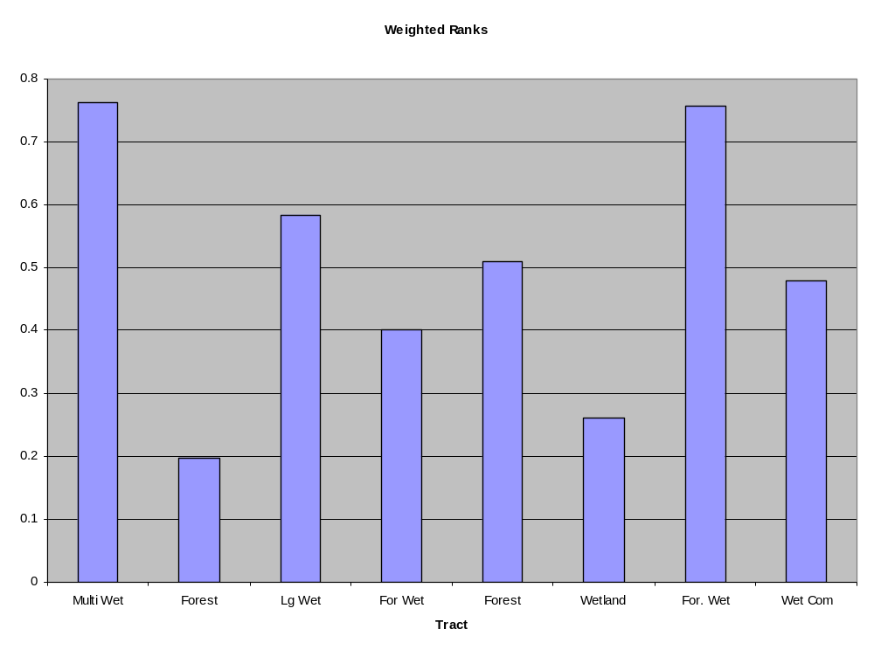
Decision Tool Output

Slide 15
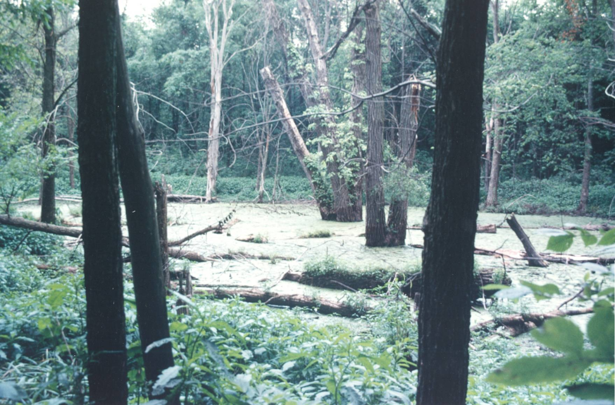
Conservation Delivery
Paradigm Shift
  Targeting Individual Parcels
  Landowner Protections
  Funding and Time Allocations

Slide 16
Where are we going next?
Private lands decision tool is ready to use once CWS score is developed
Explore funding distribution alternatives to support restoration work in CWS area
Design evaluation of decision tool
Share with and bring in other agencies

Slide 17
Priority Species
Population Objectives
Synthesis of science (models)
Build the scientific
foundation for
Management
Program
Accomplishments
Net progress toward
Population objectives
Biological
Planning
Assumption-based
Research
Outcome-based
Monitoring
Conservation
Design
Spatially-Explicit
Models
Habitat Objectives
Program Priority
Areas
Conservation
Delivery
Population
Impacts
Notes:
This is the basic SHC framework that the MBP, JVs and others promoting and striving to implement . It consists of 5 elements – activities will be going on each of the elements all the time so this is not a linear sequence of events.
Biological planning spins off priority species, population objectives and a synthesis of applied science summarized as models – these are valuable communication tools but they also inform the other SHC elements.
Conservation design is the process of applying models to spatial data – this is important because habiat conservation always has a geographic component – where is an important questions. Habitat objectives and programmatic priority areas are important products of this element.
*Conservation delivery is what this is all about – efficiently attaining a population response – although this is usually the role of the NWRS, PFW, and States.
Every management action is based on some degree of uncertainty about the outcome. Monitoring to assess outcomes compared to expectations and using research to test key assumptions are essential to making future decisions more reliable.
SHC is a way to bridge the chronic gap between research and monitoring and actual management outcomes. Each of these elements will be discussed in more detail throughout the workshop.

Slide 18
Recommendations / SHC
Regions need to increase capacity for modeling
Share capacity across FWS program boundaries
Need assistance from USGS
Accountability measures—outcome based rather than output
Bite off manageable sized pieces

Slide 19
Recommendations
Follow up to workshop to bring team back together
Determine how to support outside expertise
Break up workshop into smaller functional groups
Functional directory of expertise of people to pull in to solve problems

