Slide 1
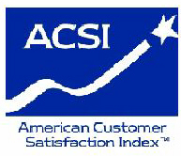

Trends In Customer Satisfaction with the U.S. Federal Government –
Findings of the ACSI
David VanAmburg and Forrest Morgeson
ACSI, National Quality Research Center
Ross School of Business, University of Michigan
Washington, D.C., December 15, 2006

Slide 2
Snapshot of ACSI
Established in 1994, the only standardized measure of customer satisfaction in the U.S. economy, covering 200 companies in 43 industries - roughly one-third of the total U.S. economy.
A quarterly measure of the national economy’s health; complementary to measures such as GDP, PCE, CPI, productivity and unemployment.
More than 100 segments of departments/agencies of the U.S. Federal Government measured on an annual basis.
Results from all surveys are published quarterly in various media and on the ACSI website at www.theacsi.org

Slide 3
ACSI National, Sector, and Industry Scores:
Q4 2005 – Q3 2006
ACSI
74.4
Utilities
72.4
Information
68.6
Accommodation &
Food Services
75.8
E-Business
76.5
Public
Administration/
Government
65.8
Finance &
Insurance
73.9
Transportation &
Warehousing
72.3
Health Care &
Social Assistance
74.1
Manufacturing/
Durable Goods
80.1
Manufacturing/
Nondurable Goods
82.3
Retail Trade
72.4
E-Commerce
79.6
72 Energy
Utilities
63 Newspapers
73 Motion Pictures
69 Broadcasting
TV News
74 Software
70 Fixed Line
Telephone
Service
66 Wireless
Telephone
Service
63 Cable &
Satellite TV
75 Hotels
77 Limited-
Service
Restaurants
73 News &
Information
76 Portals
79 Search
Engines
62.7 Local
Government
72.3 Federal
Government
75 Banks
75 Life Insurance
68 Health
Insurance
78 Property &
Casualty
Insurance
65 Airlines
71 U.S.
Postal
Service
83 Express
Delivery
74 Hospitals
77 Personal
Computers
80 Electronics
(TV/VCR/DVD)
81 Major
Appliances
81 Automobiles
& Light
Vehicles
70 Cellular Telephones
83 Food
Manufacturing
83 Pet Food
84 Soft Drinks
82 Breweries
78 Cigarettes
80 Apparel
76 Athletic Shoes
84 Personal Care
& Cleaning
Products
74 Supermarkets
69 Gasoline Stations
75 Department &
Discount Stores
74 Specialty Retail Stores
76 Health & Personal Care Stores
81 Retail
78 Auctions
76 Brokerage
77 Travel

Slide 4
Why Measure Satisfaction with Government?
    Raise citizen trust in government
    Hold agencies accountable for results
    Improve program operating performance
    Balanced measures for Senior Executives

Slide 5
Citizen-Centered Government – History
Government Performance & Results Act (GPRA) (1993)
Executive Order 12862, “Setting Customer Service Standards” (1993)
President’s Management Agenda, “Getting to Green” (2001)
E-Government Act (2002)
Has more than a decade of performance-based initiatives focusing, in part, on greater accountability of government to its customer base – U.S. citizens – made a difference?

Slide 6
ACSI METHODOLOGY

Slide 7
ACSI Methodology
Customer satisfaction (ACSI) is embedded in a system of cause and effect relationships
Measures are general enough to be comparable across agencies, companies
ACSI is measured using multiple indicators
Objective: Explain desired outcomes

Slide 8
The Basic ACSI Model for Government
Perceived
Quality
Customer
Complaints
Customer
Satisfaction
(ACSI)
Customer
Expectations
Citizen Trust

Slide 9
Enhanced ACSI Model for Government (Typical)
Ease/Accessibility
Timeliness
Process
Clarity
Usefulness
Information
Perceived
Quality
Customer
Complaints
Customer
Satisfaction
(ACSI)
Courtesy
Professionalism
Customer
Service
Customer
Expectations
Citizen Trust
Confidence
Recommend

Slide 10
What Agencies Receive
(Hypothetical Example)
78
72
Ease/Accessibility
Timeliness
Process
65
73
78
15%
Clarity
Usefulness
70
Information
Perceived
Quality
Customer
Complaints
75
72
Customer
Satisfaction
(ACSI)
80
80
Customer
Service
Courtesy
Professionalism
80
70
76
Customer
Expectations
Citizen Trust
77
Scores on 0-100 scale – How is the agency performing?
Confidence
Recommend
74

Slide 11
What Agencies Receive
(Hypothetical Example)
78
72
Ease/Accessibility
Timeliness
Process
65
2.1
73
78
15%
Clarity
Usefulness
70
Information
Perceived
Quality
Customer
Complaints
75
0.5
3.5
72
-2.1
1.3
Customer
Satisfaction
(ACSI)
80
0.4
0.6
80
Customer
Service
Courtesy
Professionalism
4.0
80
70
0.1
76
Customer
Expectations
Citizen Trust
77
Scores on 0-100 scale – How is the agency performing?
Impacts assume 5 point change – What are the best leverage points?
Confidence
Recommend
74

Slide 12
How Agencies Utilize ACSI Data
  Test results against current assumptions
  Reexamine improvement plans and strategy
  Report results to Congress, employees, and customers
  Design and conduct more detailed drill-down surveys on low-performing areas
  Identify strategic benchmarking partners; identify/adopt “best practices”

Slide 13
2006 DETAILED ACSI RESULTS
FOR THE
U.S. FEDERAL GOVERNMENT

Slide 14
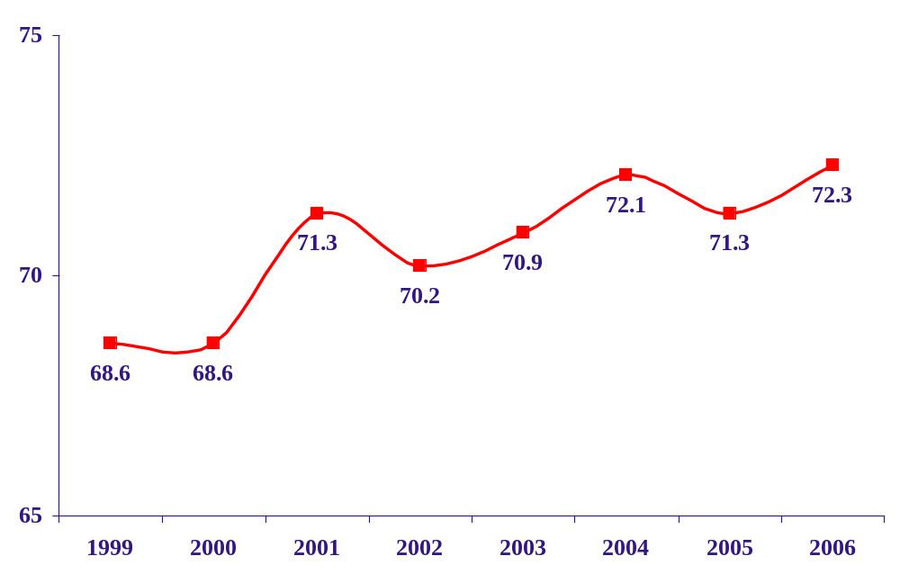
Government Satisfaction Reaches
All-Time ACSI High
Aggregate Customer Satisfaction with
Federal Government, 1999-2006*
*0-100 Scale

Slide 15
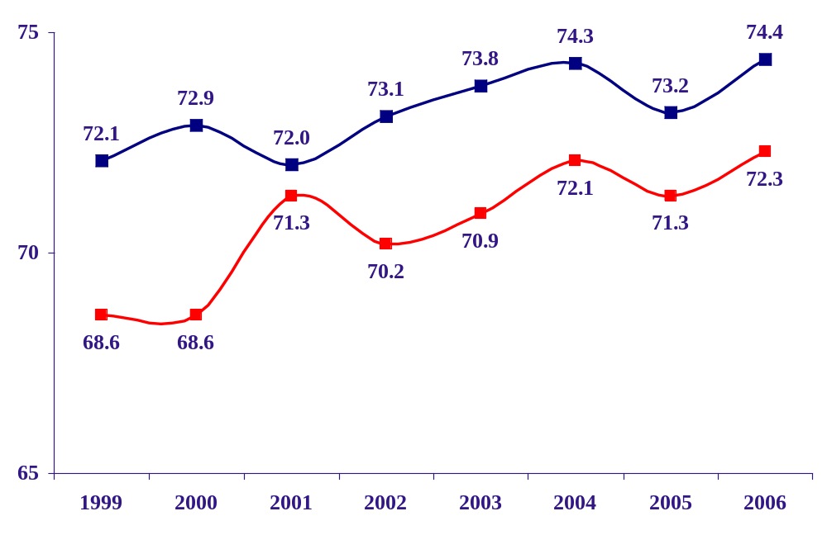
Government Still Lags Private Sector but Keeping Pace with Its Improvement
+3.2% from 1999
National ACSI
+5.4% from 1999
Federal Government

Slide 16
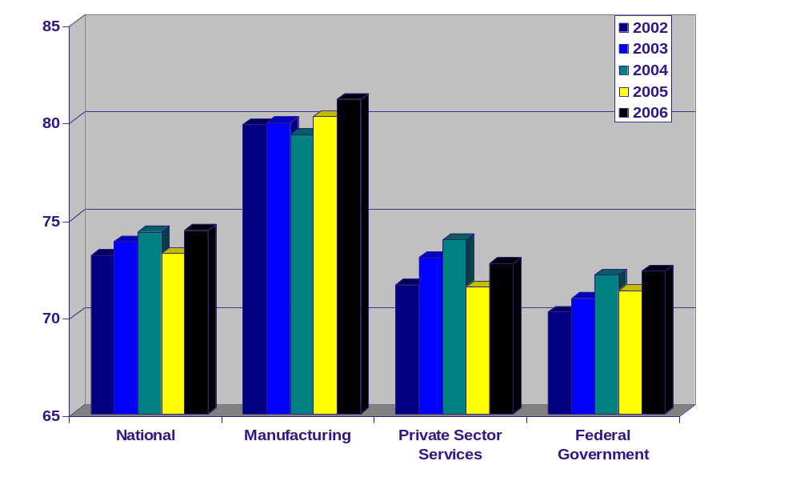
Government Compared with Private Sector –
Nearly Equal to Private Services
81.1
74.4
72.7
72.3

Slide 17
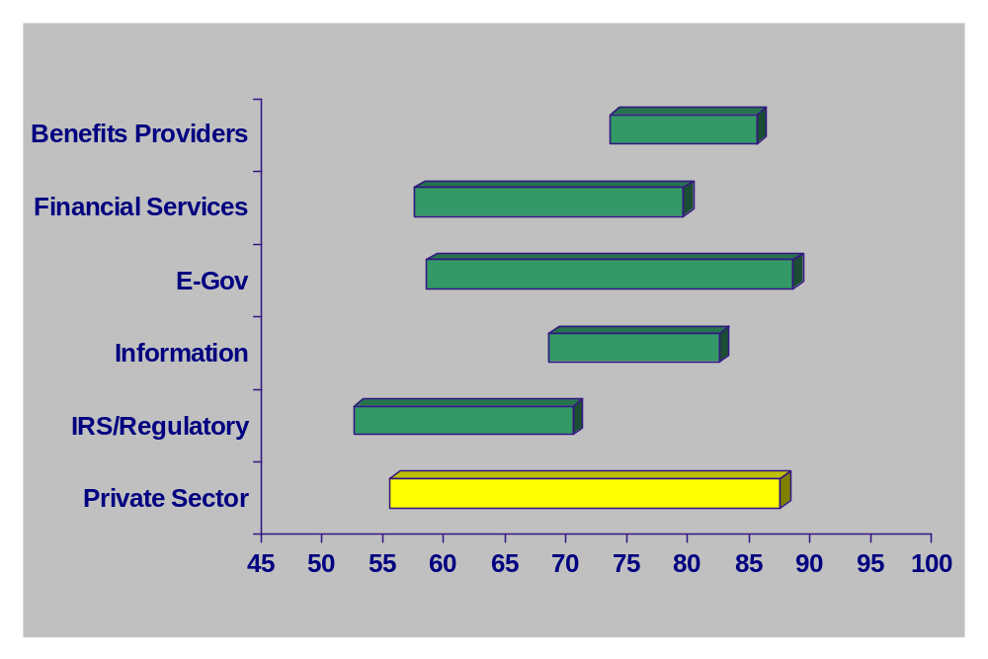
2006 Ranges of Scores for
Different Agency Types
73
85
57
75
58
88
68
82
52
70
55
87

Slide 18
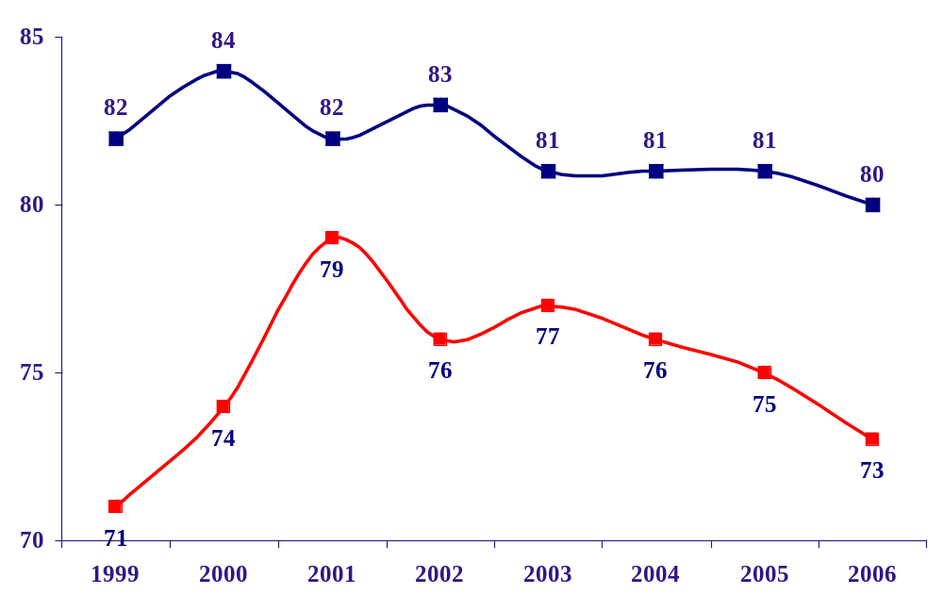
Social Security and Medicare – Trending Down
Social Security
Medicare

Slide 19
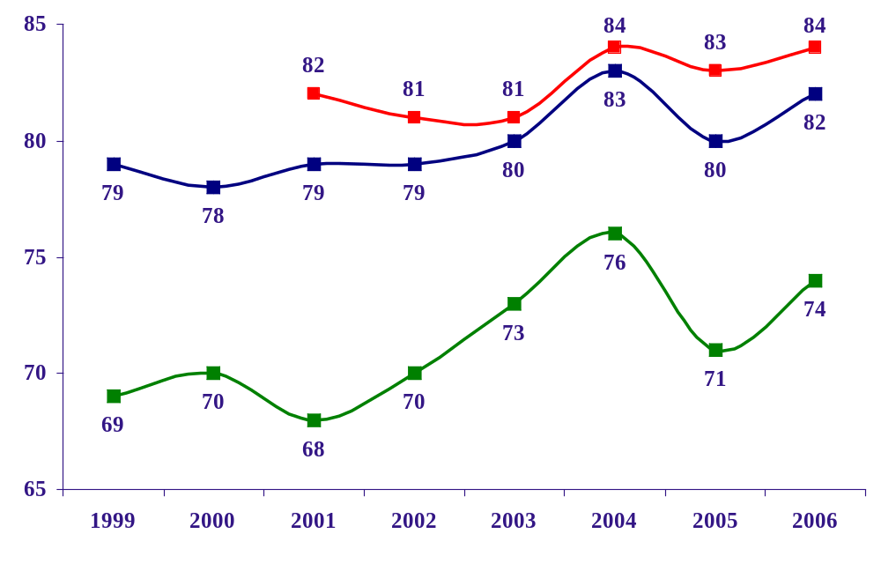
VA Hospital Experience Improving, Leads
Private Sector by Wide Margin
VHA Inpatient
VHA Outpatient
Hospital Industry

Slide 20
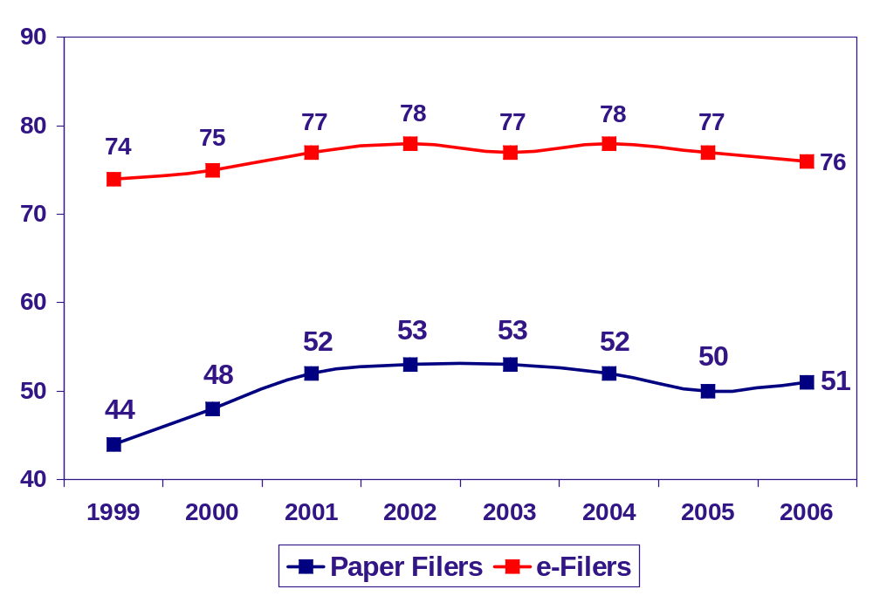
IRS Finding: e-Filers Vastly More Satisfied
fewer errors, quicker problem resolution
earlier refunds, easy status tracking
30 points
25 points

Slide 21
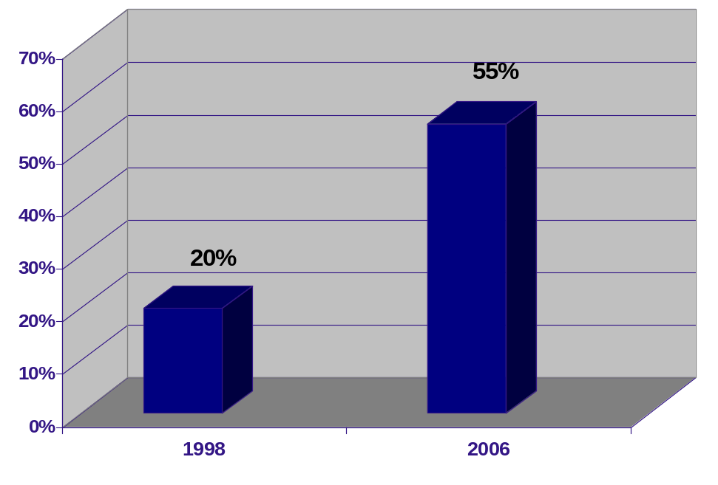
IRS: More e-Filers
Number of e-filers nearly triples in 8 years
“We realize we have more work to do, but the survey is just one more indication that the IRS reorganization and its emphasis on customer service are paying off. The satisfaction with IRS e-file won´t surprise any taxpayer who has used it. When they try it, they like it. It is fast, accurate and dependable.” - Charles O. Rossotti, IRS commissioner, December 17, 2001

Slide 22
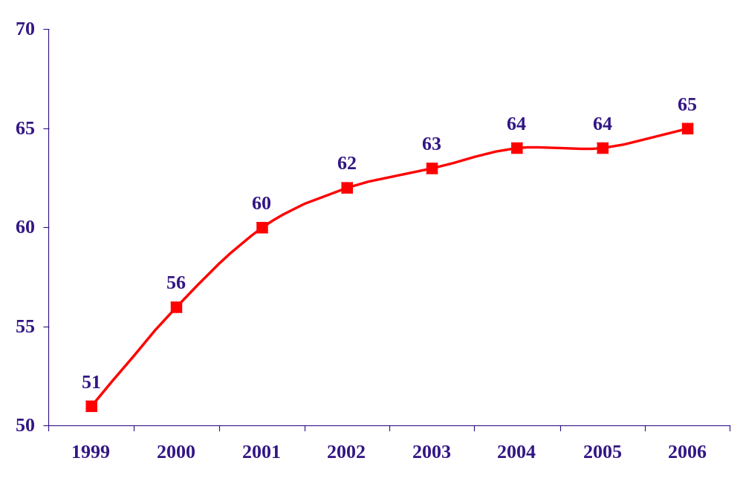
IRS: Improved Individual Tax Filing Experience
IRS hears the voice of the customer…
    Commitment to customer service
    Increased awareness and usage of e-filing
All Individual Tax Filers
Customer Satisfaction Up 14 Points

Slide 23
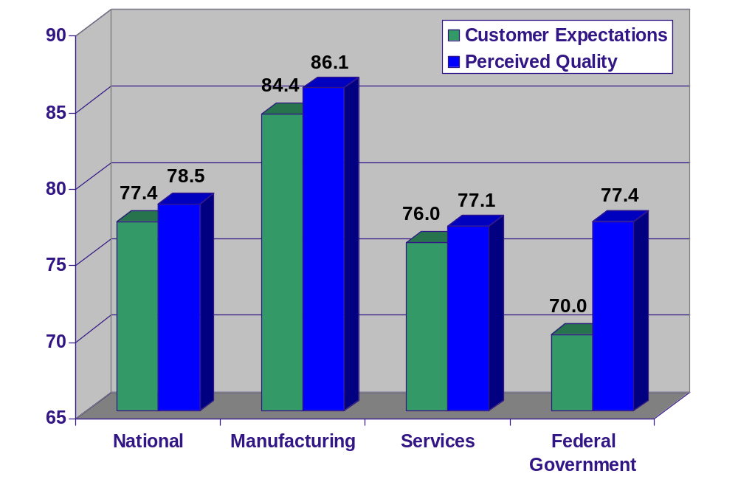
Customers Expect Less of Government
Than of Private Sector
2006 Comparison of Expectations and Quality

Slide 24
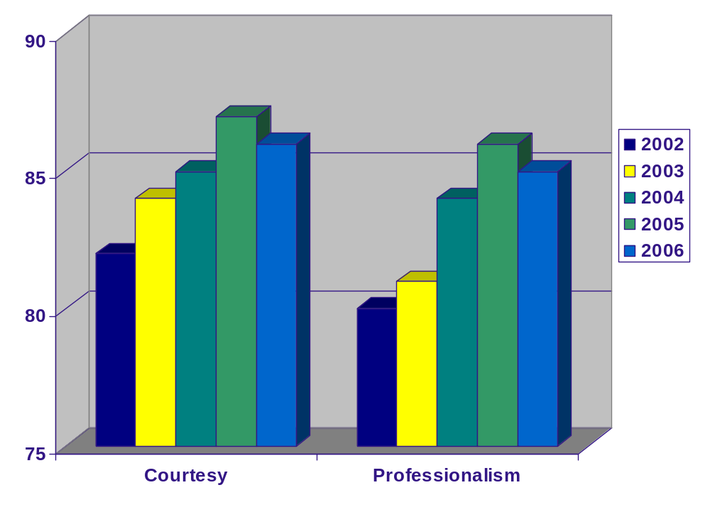
Customer Service Statistically Flat
86
85

Slide 25
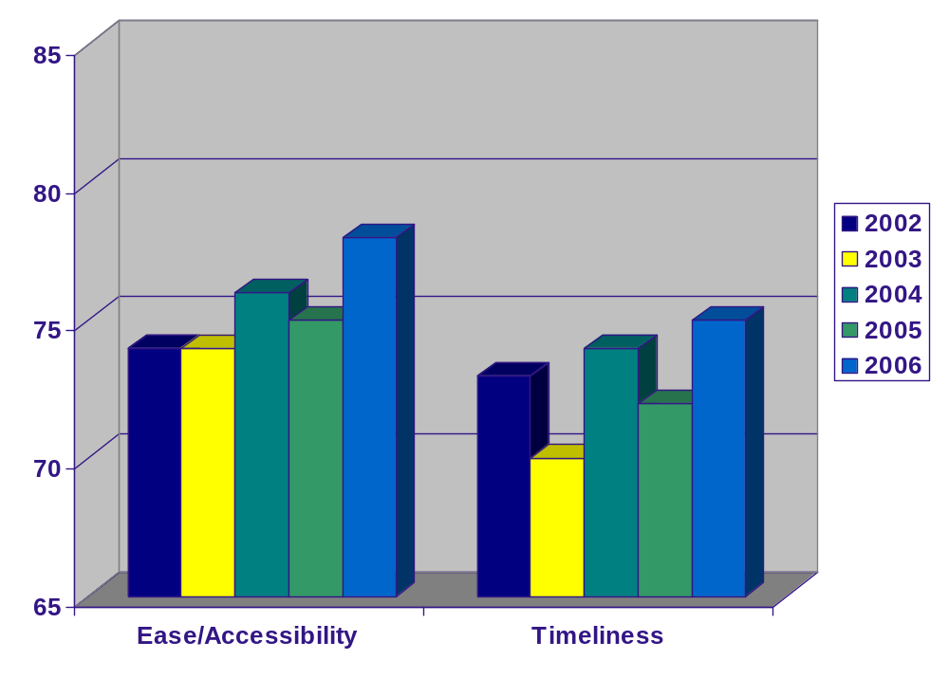
Government Efficiency Improves
Access to Services, Timeliness of Delivery Hit All-Time Highs
78
75

Slide 26
Next Steps: 2007 and Beyond
Re-measure 2006 participants
Expansion with new agencies/segments signing up for measurement in early 2007
Continue to grow e-Gov measurement
For more information see:
www.theacsi.org
www.fcg.gov

