Slide 1


Vendor Day
FAC-P/PM Updates
November 10, 2008

Slide 2
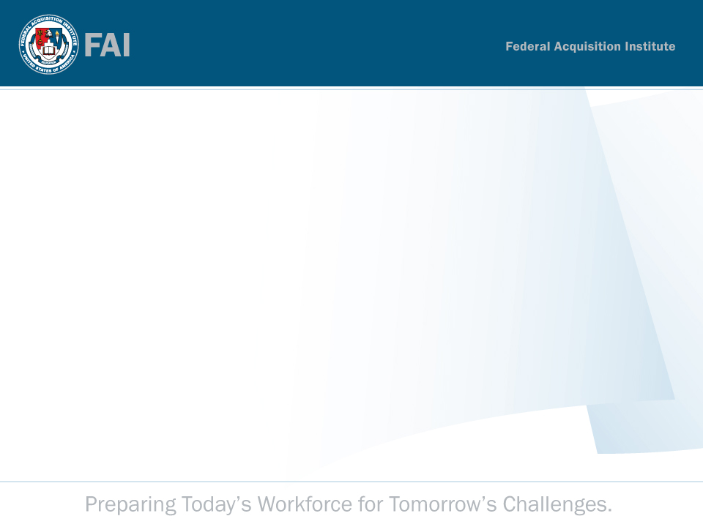
Agenda
Welcome
• Vendor Consortium
• Revised Vendor Submission Process
• Training Gaps
• Questions & Answers

Slide 3
Welcome
FAI Participants
Linda Ott
  Project Director, FAI Human Capital Management
Andrea Nagy
  Lead, FAI Certification Management
Michael Camburn
  Lead, Logistics and Communications

Slide 4
Agenda
• Welcome
Vendor Consortium
• Revised Vendor Submission Process
• Training Gaps
• Questions & Answers

Slide 5
Vendor Consortium: Available FAC-P/PM Training from Vendors
Description
Found on FAI.gov under FAC-P/PM Certification
(http://www.fai.gov/certification/management.asp)
  Established in mid August 2008
  Currently has 32 courses listed by three vendors
The Vendor Consortium includes a list of vendor course offerings that map to FAC-P/PM training course areas and competencies. It lists vendor's name, course description, method of training (online or classroom), and length of training as well as a point of contact to register. There is also a frequently asked question (FAQ) link and a search function that allows one to search by:
  Vendor
  Course title
  Certification level
  Coursework area
  Method of training
  Competencies (forthcoming)

Slide 6

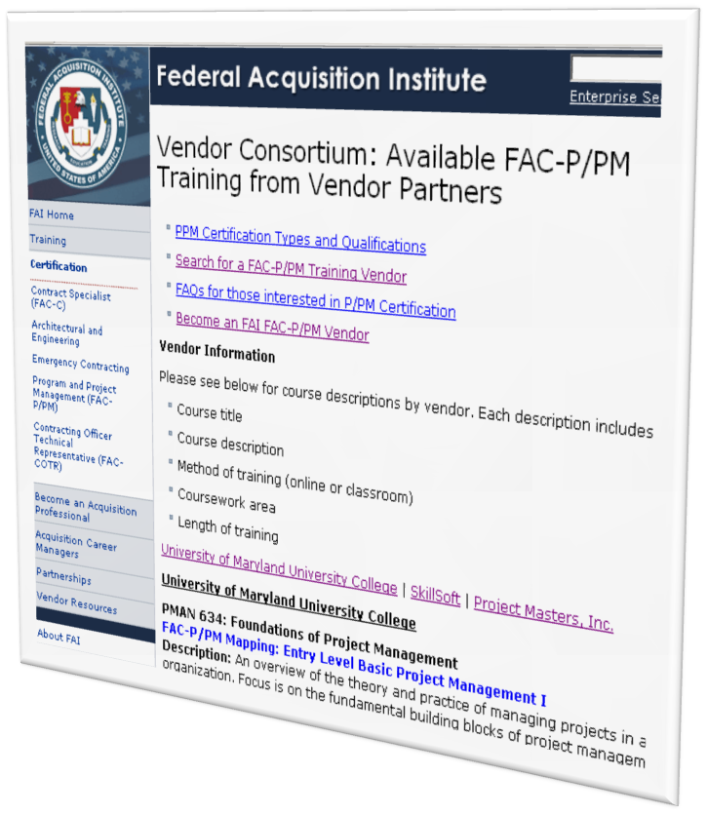
Vendor Consortium: Available FAC-P/PM Training from Vendors
Audience
This webpage was created to increase the visibility of available training from vendors
  Specifically, this public site is intended for those seeking training courses to fulfill their required training hours to be FAC-P/PM certified at the qualified level
Benefits to You
Serves as a communication channel to agencies and individuals seeking training that your training course has been reviewed by FAI and maps to FAI course areas/competency requirements
Enables agencies to identify potential opportunities to pool resources to procure training
Creates a one-stop shop for those who seek FAC-P/PM training to obtain FAC-P/PM certification and vendors who list their training on this site will be considered as a training source by those who visit the site

Slide 7
Agenda
• Welcome
Vendor Consortium
Revised Vendor Submission Process
• Training Gaps
• Questions & Answers

Slide 8

Revised Vendor Submission Process
Background
The revised vendor submission process was developed to streamline and simplify the existing vendor submission resources while adding increased clarity and rigor to the review process.
FAI consolidated and leveraged the content of seven existing documents that vendors are currently required to use to submit their training courses to FAI for review
  These documents
    FAC-P/PM Vendor Worksheet Instructions
    Vendor Worksheet By Courses
    Vendor Worksheet by Process
  will no longer be required to be completed for submission but may still be used for reference and background materials for the FAC-P/PM program
Need for Revision
To continuously improve the process, instructions and materials have been updated to increase overall clarity
  The revised submission materials and process are meant to be more clear, simple and efficient

Slide 9
Revised Vendor Submission Process
Overview of the Revised Process
The revised vendor submission process is competency-based, requiring that you as the vendor map your training objectives to the FAC-P/PM competencies and aligned skills
  The revised process focuses the vendors to develop a learning map, mapping the
  course’s learning objectives to competencies
    Competencies are the underpinning of the Human Capital
    Lifecycle and are also the basis for recruitment, award,
    performance management, succession planning, etc; making it
    important that competencies be likewise the basis for developing
    the Project/Program Managers of the acquisition workforce
The revised submission process is competency-based and replaces the previous submission process which was course work, process and competency based.

Slide 10
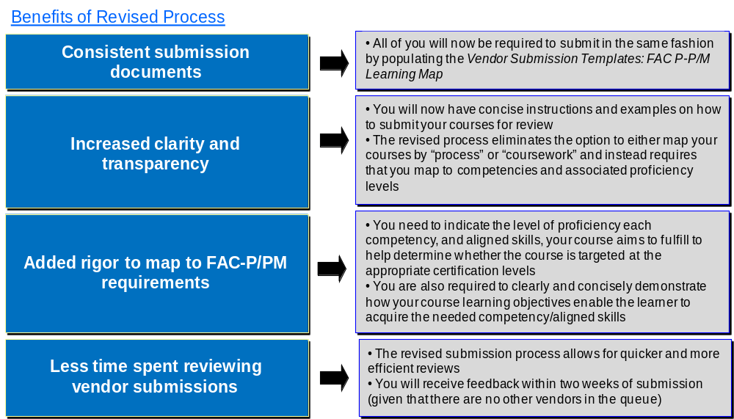
Revised Vendor Submission Process

Slide 11
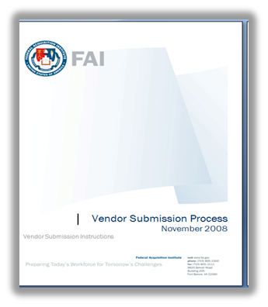
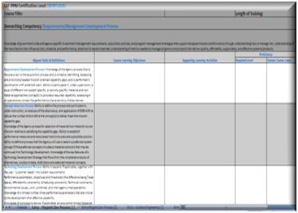
Revised Vendor Submission Process
Documents Needed
The revised process is simple and you will only need two documents
to understand and complete your submission
  These two documents are the Vendor Submission Instructions (Word
  document) and Vendor Submission Templates: FAC-P/PM Learning Map
  (Excel spreadsheet) and are together referred to as the “Vendor Submission
  Process”
    The Vendor Submission Templates: FAC-P/PM Learning Map is
    available as an Excel spreadsheet focused on Entry, Mid or Senior
    depending to which level you are mapping your training
    courses
    The Vendor Submission Templates: FAC-P/PM
    Learning Map should be used by vendors to compare
    existing training courses or certification programs to
    FAC-P/PM or to plan new training and certification
    programs to align with the FAC-P/PM

Slide 12
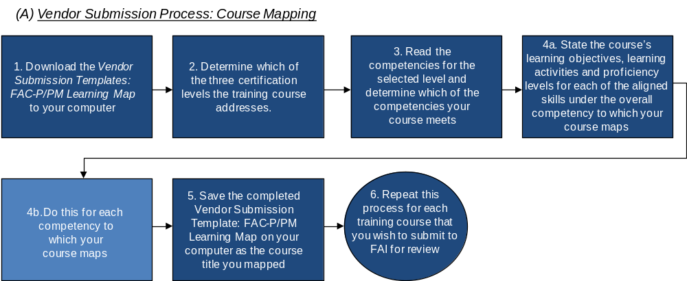
Revised Vendor Submission Process – Course Mapping
Course Mapping Step-by-Step
The course mapping portion of the revised vendor submission process consists of six key steps

Slide 13
Revised Vendor Submission Process – Course Mapping
Course Mapping Step 1
Download the MS Excel spreadsheet, Vendor Submission Templates: FAC-P/PM Learning Map to your computer
1. Download the Vendor Submission Templates: FAC-P/PM Learning Map to your computer
Course Mapping Step 2
Determine which of the FAC-P/PM levels (entry, mid or senior) your training course addresses
  A template exists for each FAC-P/PM competency for each certification level (entry, mid, and senior)
  Vendors must first determine which of the three levels their training course(s) address
2. Determine which of the three certification levels the training course addresses.

Slide 14
Revised Vendor Submission Process – Course Mapping
Course Mapping Step 3
Once the certification level is selected, you should consider which FAC-P/PM competencies your training course addresses
  There is no set rule as to the number of competencies a course may address
  The comprehensiveness of focus and subject of a course often dictates this number
  A competency should be mapped to a course only if it appears to be the explicit aim of the course to develop the competency
3. Read the competencies for the selected level and determine which of the competencies your course meets
Course Mapping Step 4
Demonstrate how your training courses meet certain FAC-P/PM competencies and aligned skills by stating the course’s learning objectives, supporting learning activities and proficiency levels for the applicable aligned skills and the overarching competency
  Note that ideally your course should map to the overarching competency defined on the top portion of the template and to the aligned skills under that competency
  Repeat this step for each competency to which your course maps
  If you do not have a program or course(s) that match certain competencies and aligned skills, you should leave those templates blank
4. State the course’s learning objectives, learning activities and proficiency levels for each of the aligned skills under the overall competency to which your course maps

Slide 15
Revised Vendor Submission Process – Course Mapping
Course Mapping Step 5
Submit a template for each competency at the identified certification level (entry, mid and senior) that your training course(s) address
Once you have mapped all your courses to competencies and aligned skills for the appropriate certification levels, save the completed Excel document on your computer
  Save the document with the name of the course title you just mapped
  You will have as many Vendor Submission Templates: FAC-P/PM Learning Maps as the number of courses you wish to submit
5. Save the completed Vendor Submission Template: FAC-P/PM Learning Map on your computer as the course title you mapped
Course Mapping Step 6
Repeat this process for all of the training courses that you wish to submit to FAI for review
6. Repeat this process for all the training courses that you wish to submit to FAI for review

Slide 16
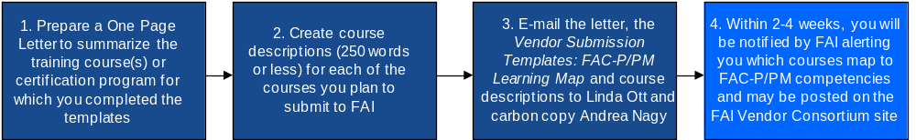
Revised Vendor Submission Process – Preparation and Submission of Documents
Preparation and Submission of Documents Step-by-Step
The preparation and submission of documents portion of the revised vendor submission process consists of four simple steps

Slide 17
Revised Vendor Submission Process – Preparation and Submission of Documents
Document Step 1
Once you complete the appropriate templates, based upon the certification level the course meets and the competencies and aligned skills the course maps to, you need to prepare a one page letter to FAI
  The letter should summarize the training course(s) or certification program for which the vendor has completed templates, specifying the course level (entry, mid, senior) the vendor is asking FAI to review for alignment with FAC-P/PM
1. Prepare a One Page Letter to summarize the training course(s) or certification program for which you completed the templates
Document Step 2
Create course descriptions for each course you have mapped and plan to submit to FAI for review
  Each course descriptions should not exceed 250 words
2. Create course descriptions for each of the courses you plan to submit to FAI

Slide 18
Revised Vendor Submission Process – Preparation and Submission of Documents
Document Step 3
Then, electronically submit the letter, the completed Vendor Submission Templates: FAC-P/PM Learning Map and course descriptions for each course to Linda.Ott@fai.gov with a carbon copy to Andrea.Nagy@Bearingpoint.com
3. E-mail the letter, the Vendor Submission Templates: FAC-P/PM Learning Map and course descriptions to Linda Ott and carbon copy Andrea Nagy
Document Step 4
FAI reviews and evaluates each course submitted to determine FAC-P/PM competency alignment
  Those courses that FAI has identified as mapping to FAC-P/PM competencies may be posted (with the vendor’s permission) to the “Vendor Consortium: Available FAC-P/PM Training from Vendors” area of the FAI website
  FAI will notify and provide feedback to vendors who have submitted their course for review within 2-4 weeks stating which courses map to FAC-P/PM competencies in addition to giving an overview of the high-level gaps
4. Within 2-4 weeks, you will be notified by FAI alerting you which courses map to FAC-P/PM competencies and may be posted on the FAI Vendor Consortium site

Slide 19
FAC-PPM Training Gaps
• Welcome
• Vendor Consortium
• Revised Vendor Submission Process
Training Gaps
• Questions & Answers

Slide 20
Training Gaps
Vendor Submission Analysis
To date, five vendors have submitted training courses to FAI to review and analyze to determine whether the training mapped to FAC-P/PM requirements
  These vendors offer courses that map to FAC-P/PM at all three levels but there are still many competencies that are not addressed by vendor courses
  Below is a summary of the competency gaps
Entry Level Mid Level
Overarching Competencies
1. Contracting
2. Business, Cost Estimating & Financial Management
Overarching Competencies
1. Requirements/Management Development Process
2. Systems Engineering
3. Test & Evaluation (T&E)
4. Life Cycle Logistics
5. Contracting
6. Leadership/Professional

Slide 21
Training Gaps
Vendor Submission Analysis (cont’d)
Senior Level
Overarching Competencies
1. Test & Evaluation (T&E)
2. Life Cycle Logistics
3. Contracting
4. Business, Cost Estimating & Financial Management
5. Leadership/Professional
Note
Even though available courses fulfill some competencies, you are encouraged to submit courses for all competencies for which you have already developed courses or for which you would like to create courses

Slide 22
Training Gaps
All Available Training Analysis
FAC-P/PM training is currently available from three sources (Vendors, Agencies, and DAU)
  To meet certain competencies, those seeking a FAC-P/PM certification may need to take as many as 500 hours of training to fulfill the competency requirements as one training course that may last 3 hours may only fulfill an aligned skill (there are more than 30 aligned skills at the entry level)
Below is a listing of critical and important gaps at all three certification levels
  Critical gaps means that there are no training course that map to the competency (red font)
  Important gaps means that there is only one training course that maps to the competency (blue font)
Entry Level
Overarching Competencies
1. System Engineering
Notes:
No courses in red font, entry level. Mid level red font courses are System Engineering and Test and Evaluation and for senior level, the red font course is Test and Evaluation

Slide 23
Training Gaps
All Available Training Analysis (cont’d)
Mid Level Senior Level
Overarching Competencies
1. Requirements/Management Development Process
2. Systems Engineering
3. Test & Evaluation (T&E)
4. Life Cycle Logistics
5. Contracting
6. Business, Cost Estimating & Financial Management
6. Leadership/Professional
Overarching Competencies
1. Requirements/Management Development Process
2. Systems Engineering
3. Test & Evaluation (T&E)
4. Life Cycle Logistics
5. Contracting
6. Business, Cost Estimating & Financial Management
6. Leadership/Professional

Slide 24
Agenda
Welcome
• Vendor Consortium
• Revised Vendor Submission Process
• Training Gaps
Questions & Answers

Slide 25

Questions and Answers
For questions about the Federal Acquisition Institute, please contact Linda Ott at linda.ott@fai.gov. For questions about the vendor submission process, please contact Andrea Nagy at andrea.nagy@bearingpoint.com.
For additional information, you may also visit the FAI website at http://www.fai.gov/index.asp and for vendor specific information go to the vendor resources page at http://www.fai.gov/vendor/index.asp.

