Slide 1


Slide 2
Multiple Primary and Histology Rules 101
Format of MP/H Materials

Slide 3
By the end of this presentation:
Basic understanding of MP/H rules
Pick a usage style
Understand the MP/H rules and how they work
Importance of reading
How the equivalent terms work

Slide 4
What we will cover:
General Information
Format of new rules
When and how to use the rules
What to expect from the General Rules

Slide 5


Important!
The 2007 multiple primary rules replace all previous multiple primary rules.
Notes:
First – a very important note: DO NOT USE THESE RULES TO DETERMINE CASE REPORTABILITY.
The 2007 multiple primary rules replace call previous multiple primary rules. Even the ones like “so-n-so told me in 1988 that this is how you code these cases”

Slide 6
When?
The rules are effective for cases diagnosed January 1, 2007 and after.
Do not use these rules to abstract cases diagnosed prior to January 1, 2007.
Notes:
The rules are effective for cases diagnosed January 1, 2007 and after. Do not use these rules to abstract cases diagnosed prior to January 1, 2007

Slide 7

Question ???
“How do I code a non-analytic case that comes to our hospital after 1/1/07 with residual/metastatic cancer diagnosed in 2005?”

Slide 8

Answer:
Use the previous rules.
Notes:
The rules are effective for cases diagnosed 1/1/07 and after, not accessioned. You are not dealing with a new data item just new RULES – that is the way you assign the codes.

Slide 9
Style
The histology/multiple primary coding rules are available in three formats: flowchart text matrix
The rules are identical, only the formats differ.
Notes:
As we discussed this morning, people adapt to different styles of the same materials. When we reviewed the Map Quest – some of you liked to use the step by step map, some like just the written materials, and others just looked at the map. The Multiple Primary and Histology Committee have worked at developing the new rules in three different formats. They are available in text, flowchart or the matrix format. The rules are identical – just the presentation or format are different.

Slide 10
Using the Rules
Notes and examples are included with some of the rules to highlight key points or to add clarity to the rules.
  They are not exclusive.
  They do not replace the rules.
Notes:
Notes or examples may often use a specific case to illustrate the point; it does NOT mean that the rule pertains only to cases similar to the example.
Do not attempt to code cases by using an example and deciding that your case and the case in the example are very similar, so you will code your case in the same way. Use the rules to make coding decisions, not the examples

Slide 11
How to Use the Rules
Read the General Instructions
    General Terms/Definitions
    Used for all cases EXCEPT:
    Hematopoietic Primaries
    Benign or borderline CNS
    DO NOT use for casefinding
Notes:
Please turn to your handout labeled _______________; see at the top are what is considered equivalent or equal terms: Multicentric, multifocal or Tumor, mass, lesion, neoplasm. This gives you an idea what terms you might encounter

Slide 12
How to Use the Rules
2. Read the site-specific equivalent or equal terms
“Multicentric” = “Multifocal”
or
“Tumor” = “Mass” = “Lesion”
= “Neoplasm”

Slide 13
How to Use the Rules
3. Used for: coding histology
except for hematopoietic primaries
(Do Not use for casefinding)
4. Use multiple primary rules before
coding histology
5. Code histology for each primary
Notes:
3. Use these rules to make a decision on coding the histology for all reportable solid malignant tumors and do not use the rules when doing casefinding.
4. You must use the multiple primary rules to determine whether the patient has a single or multiple primaries BEFORE you even try to code the histology.
5. You will then code the histology for each primary site in a separate abstract

Slide 14
How to Use the Rules
Use site-specific rules for:
  Brain, malignant
  Breast
  Colon
  Head & Neck
  Kidney
  Lung
  Malignant Melanoma of Skin
  Renal Pelvis, ureter, bladder and other urinary

Slide 15
How to Use the Rules
Use “Other Sites” rules
8. Determine single vs. multiple tumors
  - Don’t count metastatic tumors
  - Multicentric/multifocal = Unknown if single or multiple tumors
  - Don’t count the foci
  - Only count tumors used to prepare abstract
Notes:
You will use the rules for “Other Sites” for all solid tumors that occur in primary sites that are not included in the site-specific rules.
Then you will determine whether the patient has a single tumor or multiple tumors that will be abstracted as a single primary.
Don’t count the separate tumors that are described as metastatic (ex: Pt has breast cancer with metastatic carcinoma in liver)
When a tumor is described as multicentric or multifocal, use the unknown if single or multiple tumors module
When there is a tumor or tumors with separate foci of tumor, do not count the foci
Only count tumors that will be used to prepare that abstract. For example, when there are two tumors that will be abstracted as multiple primaries, you would use the Single Tumor modules to determine the histology code for each of the abstracts vs. if you have multiple tumors considered to be one primary (ex: bladder)

Slide 16

How to Use the Rules
Each Section = Complete Set of Rules
*Stay within module
10. Use the first rule that applies and
Notes:
9. Each Section (there’s a section on Single Tumors, and one on Multiple Tumors Abstracted as a Single Primary) is an independent complete set of rules. For example – it pt. has multiple tumors that will be abstracted as a single primary, start with the first rule under the heading “Multiple Tumors Abstracted as a Single Primary”. DO NOT use any of the rules under the header SINGLE TUMOR

Slide 17
Pathology Reports
Code from the pathology report
  1. from the most representative specimen examined
  2. from the final diagnosis

Slide 18
Pathology Reports
Note 1: A revised/amended diagnosis replaces the original final diagnosis. Code the histology from the revised/amended diagnosis.
Note 2: The new rules limit the information to the final diagnosis. The old rules allowed coding from information in the microscopic description.

Slide 19
Pathology Reports
If there is NO pathology report:
1. Cytology report
2. Documentation in the medical record that references pathology or cytology

Slide 20
Using the Rules
The Multiple Primary Rules
3 independent modules
    1. Unknown if Single or Multiple Tumors
    2. Single tumor
    3. Multiple tumors
Rules in appropriate module
Notes:
Within the MP rules, there are three (3) independent modules.
First – is a module that applies to when it’s unknown if there is a single or multiple tumors
Second module is for when there is only one (1) single tumor
and the Third module is for when there are multiple tumors.
You must start with rules in the appropriate module and do not use rules from any other module

Slide 21
Using the Rules
The Histology Coding Rules
2 independent modules
  1. Single Tumor (one primary site)
  2. Multiple Tumors abstracted as a single primary site
Rules are hierarchical within each module

Slide 22
General Terms and Definitions
Bilateral
Clinical Diagnosis
Contiguous tumor
Contralateral
Different histology
Different (multiple) primaries
Focal
Foci
Focus
Ipsilateral
Most representative specimen
Multiple primaries
Overlapping tumor
Paired organ/site
Single histology
Single (one) primary
Unilateral
Notes:
Some of the terms you might encounter might be . . . . . . . . . . (name a few)

Slide 23
General Terms and Definitions (continued)
Recurrence
  The reappearance of disease that was thought to be cured or inactive (in remission).
  2. A new occurrence of cancer arising from cells that have nothing to do with first cancer. A new occurrence of cancer
Notes:
When dealing with a “recurrence” this term has two (2) meanings:
It could be the reappearance of disease that was thought to be cured or inactive (in remission). Recurrent cancer starts from cancer cells that were not removed or destroyed by the original therapy.
A new occurance of cancer arise from cells that have nothing to do with the earlier (first cancer). A new or another occurrence, incidence, episode, or report of the same disease (cancer) is a general sense – a new occurrence of cancer

Slide 24
General Terms and Definitions (continued)
Recurrence continued
Do not use a physician’s statement
Use the multiple primary rules as written
  unless a pathologist compares the present tumor to the “original” tumor and states that this tumor is a recurrence of the previous primary.
Notes:
Do not use a physician’s statement to decide whether the patient has a recurrence of a previous cancer or a new primary. Use the multiple primary rules as written unless a pathologist compares the present tumor to the “original” tumor and states that this tumor is a recurrence of the previous primary. The statement that the present tumor/mass is a recurrence of the previous primary may be anywhere on the pathology report.

Slide 25
Ambiguous Terms
Apparent(ly)
Appears
Comparable with
Compatible with
Consistent with
Favor(s)
Most likely
Presumed
Probable
Suspect(ed)
Suspicious (for)
Typical (of)

Slide 26
No “Negative” Lists
If it isn’t listed, don’t code it.
  No “Do not use ambiguous terms” list
  No “Terms that do not represent the majority of the tumor” list

Slide 27
Using the Rules
Notes and examples are included with some of the rules:
  1. Highlight key points
  2. Add Clarity
  They are NOT exclusive
  They DO NOT replace the rules

Slide 28
Learning Styles
Visual
Auditory
Read/Write
Kinesthetic
Text
Flowchart
Matrix
Use what works for you!

Slide 29
Example of Text Format
Multiple Primary Rules
M2 A single tumor is always a single primary
Note: The tumor may overlap onto or extend
into adjacent/contiguous site or subsite.
Histology Rules
H4 Code the invasive histologic type when a single tumor has invasive and in situ components.
Notes:
Here is an example of MP/H rules in text format

Slide 30
Example of Matrix Format
Multiple Primary Rules
Rule | Site | Notes/Examples | Primary
M2 | Single Tumor | The tumor may overlap onto or extend into adjacent/contiguous site or subsite. | Single
Histology Rules
Rule | Behavior | Notes/Examples | Code
H4 | Invasive and in situ |  | The invasive histologic type
Notes:
Here are the same rules as they appear in the matrices
(abbreviated for slide)

Slide 31
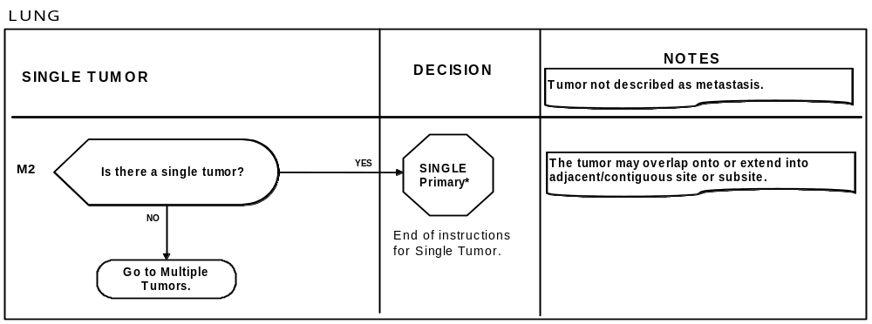
Example of Flowchart Format
Multiple Primary Rules
Notes:
And the third format here shows the rules as a flow chart

Slide 32
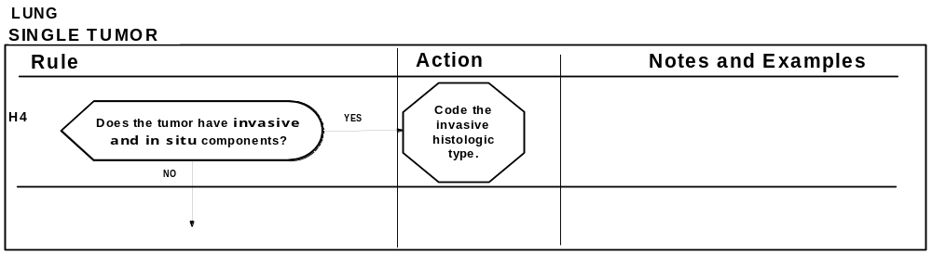
Example of Flowchart Format
Histology Coding Rules

Slide 33
Warning!
Do not use all three
format of rules at the same time

Slide 34
Using the Rules
First the Multiple Primary Rules
3 independent modules:
Unknown if Single or Multiple
Tumors
Single Tumor
Multiple Tumors
Use rules in appropriate module

Slide 35
Using the Rules
Second are the Histology Coding Rules
Two independent modules:
Single Tumor (one primary site)
Multiple Tumors abstracted as
a single primary site
Rules are hierarchical within each
module.

Slide 36
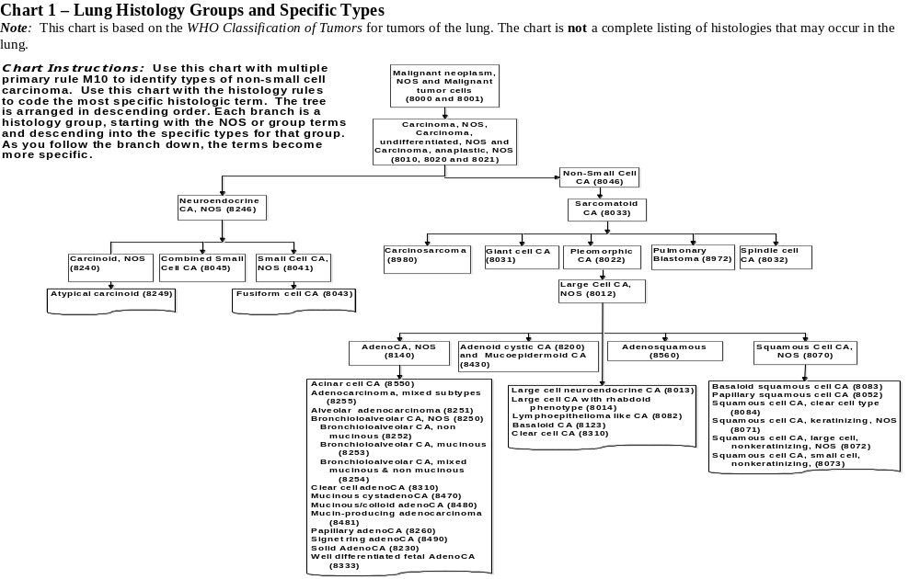

Slide 37
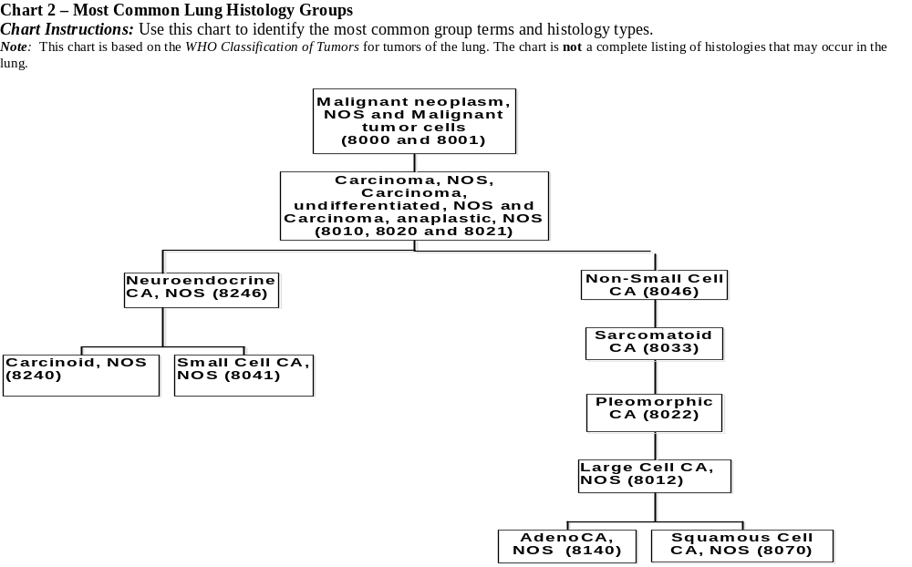
Notes:
Condensed version of Chart 1.

Slide 38
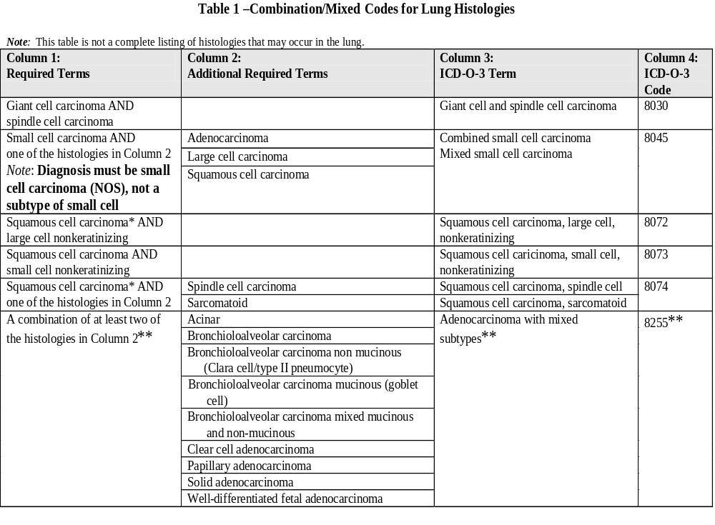
Notes:
Demonstrate how to use the table by reading the instructions on the left and explaining how you would combine the histologies. Do at least two examples.

Slide 39
Other Miscellaneous
Other Sites
  Similar to site-specific rules
  Some site-specific rules included
    Prostate
    Ovary
    Retinoblastoma
    Kaposi sarcoma
    Thyroid
  Address remaining combination and mixed histology issues

Slide 40
Lung
Multiple Primary Rules
Unknown Number of Tumors Module

Slide 41
Unknown Number Of Tumors
Note: Tumors not described as metastasis
Rule M1 When it is not possible to determine if there is a single tumor or multiple tumors, opt for a single tumor and abstract as a single primary.*
Note 1: Use this rule only after all information
sources have been exhausted

Slide 42

This is the end of instructions for Unknown Number of Tumors
Notes:
Note that this statement appears at the end of the section concerning M1 – and what does it tell you???? That you STOP, you don’t go looking for another rule; if it meets the criteria, then you have found your answer.

Slide 43
Single Tumor Module

Slide 44
Single Tumor
Note: Tumor not described as metastasis
Rule M2 A single tumor is always a single primary. *
Note: The tumor may overlap onto or extend
into adjacent/contiguous site or subsite.
*Prepare one abstract.
This is the end of instructions for Single Tumor.
Notes:
A single non-metastatic tumor is always a single primary; Now here is a NOTE:
The tumor may overlap onto or extend into adjacent/contiguous site or subsite.
And see the notation: This is the end of instructions for single tumor. If this fits the case, then you stop here

Slide 45
This is the end of instructions for Single Tumors
Notes:
Note that this statement appears at the end of the section concerning M1 – and what does it tell you???? That you STOP, you don’t go looking for another rule; if it meets the criteria, then you have found your answer.

Slide 46
Multiple Tumors Module

Slide 47
Multiple Tumors
Multiple tumors may be a single or multiple primaries
Note: Tumors not described as metastases
Rule M3 Tumors in sites with ICD-O-3 topography codes that are different at second (Cxxx) and/or third character (Cxxx) are multiple primaries. **
Note: This is a change in rules; tumors in the trachea (C33) and in the lung (C34) were a single primary in the previous rules.

Slide 48
Multiple Tumors
Multiple tumors may be a single or multiple primaries
Note: Tumors not described as metastases
Rule M4 At least one tumor that is non-small cell carcinoma (8046) and another tumor that is small cell carcinoma (8041-8045) are multiple primaries.**

Slide 49
Multiple Tumors
Multiple tumors may be a single or multiple primaries
Note: Tumors not described as metastases
Rule M5 A tumor that is adenocarcinoma with mixed subtypes (8255) and another that is bronchioloalveolar (8250-8254) are multiple primaries. **

Slide 50
Multiple Tumors
Multiple tumors may be a single or multiple primaries
Note: Tumors not described as metastases
Rule M6 A single tumor in each lung is multiple primaries. **
Note: When there is a single tumor in each lung, abstract as multiple primaries unless stated or proven to be metastatic.

Slide 51
Multiple Tumors
Multiple tumors may be a single or multiple primaries
Note: Tumors not described as metastases
Rule M7 Multiple tumors in both lungs with ICD-O-3 histology codes that are different at the first (xxxx), second (xxxx) or third (xxxx) number are multiple primaries. **

Slide 52
Multiple Tumors
Multiple tumors may be a single or multiple primaries
Note: Tumors not described as metastases
Rule M8 Tumors diagnosed more than three (3) years apart are multiple primaries.**

Slide 53
Multiple Tumors
Multiple tumors may be a single or multiple primaries
Note: Tumors not described as metastases
Rule M9 An invasive tumor following an in situ tumor more than 60 days after diagnosis is a multiple primary.**
Note 1: The purpose of this rule is to ensure that the case is counted as an incident (invasive) when incidence data are analyzed.
Note 2: Abstract as multiple primaries even if the medical record/physician states that it is recurrence or progression of disease.
Notes:
In the rare instance where the patient has not been treated and is still having diagnostic tests greater than 60 days after the in situ malignancy is diagnosed, do not count the invasive as a multiple primary. In other words, when the invasive component is found during the work-up phase, it is not coded as a multiple primary.

Slide 54
Multiple Tumors
Multiple tumors may be a single or multiple primaries
Note: Tumors not described as metastases
Rule M10 Tumors with non-small cell carcinoma, NOS (8046) and a more specific non-small cell carcinoma type (Chart 1) are a single primary.*

Slide 55
Multiple Tumors
Multiple tumors may be a single or multiple primaries
Note: Tumors not described as metastases
Rule M11 Tumors with ICD-O-3 histology codes that are different at the first (xxxx), second (xxxx) or third (xxxx) number are multiple primaries**
Note: Adenocarcinoma in one tumor and squamous cell carcinoma in another tumor are multiple primaries.

Slide 56
Multiple Tumors
Multiple tumors may be a single or multiple primaries
Note: Tumors not described as metastases
Rule M12 Tumors that do not meet any of the above criteria are a single primary.*
Note 1: When an invasive tumor follows an in situ tumor within 60 days, abstract as a single primary.
Note 2: All cases covered by this rule are the same histology.

Slide 57
Multiple Tumors
Multiple tumors may be a single or multiple primaries
Note: Tumors not described as metastases
Footnotes:
* Prepare one abstract. Use the histology coding rules to assign the appropriate histology code.
**Prepare two or more abstracts. Use the histology coding rules to assign the appropriate histology code to each abstract.

Slide 58
This is the end of instructions for Multiple Tumors

Slide 59
Lung Histology
Rules
Excludes lymphoma and leukemia M9590-9989 and Kaposi Sarcoma M9140

Slide 60
Lung Histology
Rules
Single Tumor Module
Notes:
Ok – we’ve just covered how to determine the number of primaries; now let’s talk about the rules for coding the histology of these primaries.

Slide 61
Single Tumor
Rule H1 Code histology documented by physician when there is no pathology/cytology specimen or pathology/cytology report is not available.

Slide 62
Single Tumor
Rule H1 continued
Note 1: Priority of documents
Documentation referring to pathologic/cytologic findings
Physician’s reference to type of cancer in medical record
CT, PET, or MRI scans
Chest x-rays

Slide 63
Single Tumor
Rule H1 continued
Note 2: Code the specific histology when documented
Note 3: Code histology to 8000 or 8010 as stated by the physician when nothing more specific is documented

Slide 64
Single Tumor
Rule H2 Code histology from a metastatic site when there is no pathology/cytology specimen from primary site.
Note: Code behavior /3

Slide 65
Single Tumor
Rule H3 Code histology when only one histologic type is identified.
Note: Do not code terms that do not appear in the histology description.
Ex 1: Do not code squamous cell carcinoma non-keratinizing unless the words “non-keratinizing” actually appear in the diagnosis.
Ex 2: Do not code bronchioalveolar non-mucinous unless the words “non-mucinous” actually appear in the diagnosis.

Slide 66
Single Tumor
Rule H4 Code invasive histologic type when a single tumor has invasive and in situ components

Slide 67
Single Tumor
Rule H5 Code most specific term using Chart 1 when multiple histologies within same branch.
Examples of histologies within the same branch are:
Cancer/malignant neoplasm, NOS (8000) and a more specific histology or
Carcinoma, NOS (8010) and a more specific carcinoma or
Adenocarcinoma, NOS (8140) and a more specific adenocarcinoma or
Sarcoma, NOS (8800) and a more specific sarcoma

Slide 68
Single Tumor
Rule H5 continued
Note: The specific histology may be identified as type, subtype, predominantly, with features of, major, or with ____differentiation
Ex 1: Adenocarcinoma, predominantly mucinous. Code 8480 (mucinous adenocarcinoma).
Ex 2: Non-small cell carcinoma, papillary squamous cell. Code 8052 (papillary squamous cell carcinoma).

Slide 69
Chart 1

Slide 70
Single Tumor
Rule H6 Code appropriate combination/mixed code (Table 1) when there are multiple specific histologies or when there is a non-specific with multiple specific histologies

Slide 71
Single Tumor
Rule H6 continued
Note: The specific histologies may be identified as type, subtype, predominantly, with features of, major, or with ____differentiation.
Ex 1 (multiple specific histologies): Solid and papillary adenocarcinoma. Code 8255 (adenocarcinoma with mixed subtypes).
Ex 2 (multiple specific histologies): Combined small cell and squamous cell carcinoma. Code 8045 (combined small cell carcinoma).
Ex 3 (non-specific with multiple specific histologies): Adenocarcinoma with papillary and clear cell features. Code 8255 (adenocarcinoma with mixed subtypes).

Slide 72
Notes:
Demonstrate how to use the table by reading the instructions on the left and explaining how you would combine the histologies. Do at least two examples.

Slide 73
Single Tumor
Rule H7 Code the histology with the numerically higher ICDO-3 code.

Slide 74
This is the end of instructions for Single Tumor
Notes:
Note that this statement appears at the end of the section concerning M1 – and what does it tell you???? That you STOP, you don’t go looking for another rule; if it meets the criteria, then you have found your answer.

Slide 75
Lung Histology
Rules
Multiple Tumor Module

Slide 76
Multiple Tumors Abstracted as a Single Primary
Rule H8 Code histology documented by physician when there is no pathology/cytology specimen/report available

Slide 77
Multiple Tumors Abstracted as a Single Primary
Rule H8 continued
Note 1: Priority of documents
Documentation that refers to pathologic/cytologic findings
Physician’s reference to type of cancer in medical record
CT, PET, or MRI scans
Chest x-rays

Slide 78
Multiple Tumors Abstracted as a Single Primary
Rule H8 continued
Note 2: Code the specific histology when documented
Note 3: Code histology to 8000 or 8010 as stated by the physician when nothing more specific is documented

Slide 79
Multiple Tumors Abstracted as a Single Primary
Rule H9 Code the histology from a metastatic site when there is no pathology/cytology specimen from primary site
Note: Code behavior /3

Slide 80
Multiple Tumors Abstracted as a Single Primary
Rule H10 Code the histology when only one histologic type is identified.
Note: Do not code terms that do not appear in the histology description.
Ex 1: Do not code squamous cell carcinoma non-keratinizing unless the words “non-keratinizing” actually appear in the diagnosis.
Ex 2: Do not code bronchioalveolar non-mucinous unless the words “non-mucinous” actually appear in the diagnosis.

Slide 81
Multiple Tumors Abstracted as a Single Primary
Rule H11 Code the histology of the most invasive tumor.
Note 1: This rule should only be used when the first three numbers of histology are identical (This is a single primary).
Note 2: See Lung Equivalent Terms, Definitions, Charts, Tables, Illustrations for definition of most invasive.

Slide 82
This is the end of instructions for Multiple Tumors
Notes:
Note that this statement appears at the end of the section concerning M1 – and what does it tell you???? That you STOP, you don’t go looking for another rule; if it meets the criteria, then you have found your answer.

Slide 84
Chart 2: Most Common Lung Histology Groups
Chart Instructions: Use this chart to identify the most common group terms and histology types.
Note: This chart is based on the WHO Classification of Tumors for tumors of the lung. The chart is not a complete
listing of histologies that may occur in
the lung.

Slide 85
Table 1: Combination/Mixed Codes for Lung Histologies
Table Instructions: Use this table to select combination/mixed histology codes. Compare the terms in the diagnosis to the terms in columns 1 and 2. If the terms match, abstract the case using the ICD-O-3 histology code in column 4. Use the combination/mixed codes listed in this table only when the histologies in the tumor match the histologies listed below.

Slide 86
Table 1 continued
Use the combination/mixed codes for a single tumor when all histologies are present in a single tumor.
Note: This table is not a complete listing of histologies that may occur in the lung

Slide 88
Multiple Primaries and Histology Coding Rules–Lung Cases
Case 1
Lung bx: Poorly differentiated non-small cell lung carcinoma (mixed large cell undifferentiated and adenocarcinoma).
(Single primary)
Histology code:
Histology rule:
8140
H7

Slide 89
Multiple Primaries and Histology Coding Rules–Lung Cases
Case 2
Lung with moderately differentiated adenocarcinoma, mucin secreting cells, mixed acinar, papillary, and bronchioalveolar features.
(Single primary)
Histology code:
Histology rule:
8255
H6
Notes:
“mucin-secreting” cells and “mucin-producing” cells are not synonymous with mucinous.

Slide 90
Multiple Primaries and Histology Coding Rules–Lung Cases
Case 3
Poorly differentiated carcinoma, non-small cell type.
(Single primary)
Histology code:
Histology rule:
8046
H5

Slide 91
Multiple Primaries and Histology Coding Rules–Lung Cases
Case 4
Lung, right upper lobectomy: 2 nodules of carcinoma with mucin production (c/w pulmonary primary), one nodule has bronchoalveolar features, the other shows focal squamous differentiation.
(2 primaries) #1 #2
Histology code:
Histology rule:
8250
8070
H5
H5

Slide 92











MP/H Task Force

