Slide 1
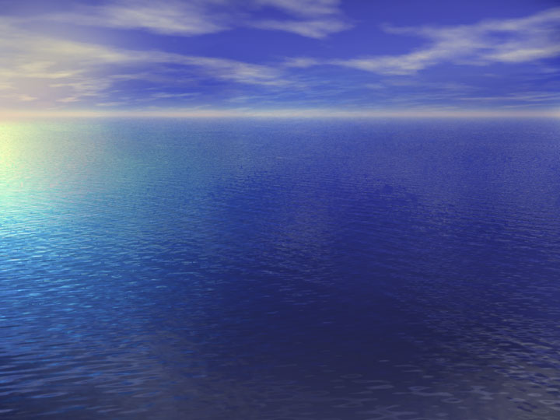
The Importance of Coastal Waters - Recent Reports
National Coastal Condition Report
Heinz Center’s State of the Nation’s Ecosystems
Europe's water: An indicator-based assessment
The Report of the Pew Oceans Commission
U.S. Commission on Ocean Policy
Notes:
http://www.oceancommission.gov/welcome.html

Slide 2
National Coastal Condition Report
Data collected largely from estuaries
Seven Indicators:
  water clarity,
  dissolved oxygen,
  coastal wetland loss
  Eutrophic condition
  sediment contamination
  benthic condition
  Fish tissue contamination

Slide 3
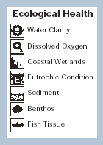
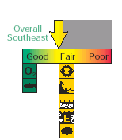
National Coastal Condition Report

Slide 4
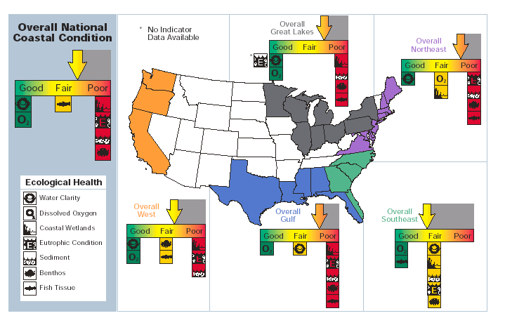

Slide 5
National Coastal Condition Report
Update has been drafted
  Extends coverage to West Coast
  Updates the indicator of eutrophication

Slide 6
Heinz Center
Report on the Nation’s Ecosystems
Farmlands
Forests
Grasslands and Shrublands
Urban and Suburban Areas
Fresh Waters
Coasts and Oceans,
  Recommended 16 Indicators:
    System Dimensions
    Chemical and Physical Dimensions
    Human Uses

Slide 7
Heinz Center
Report on the Nation’s Ecosystems
System Dimensions
  Coastal Living Habitats
  Shoreline Types

Slide 8
Heinz Center
Report on the Nation’s Ecosystems
Chemical and Physical Conditions
  Areas with Depleted Oxygen:
  Contamination in Bottom Sediments
  Coastal Erosion
  Sea Surface Temperature

Slide 9
Heinz Center
Report on the Nation’s Ecosystems
Biological Components
  At-Risk Marine Species
  Non-native Species
  Unusual Marine Mortalities
  Frequency/ Extent of Harmful Algal Blooms
  Condition of Bottom-Dwelling Animals
  Chlorophyll Concentrations

Slide 10
Heinz Center
Report on the Nation’s Ecosystems
Human Uses
  Commercial Fish and Shellfish Landings
  Status of Commercially Important Fish Stocks
  Selected Contaminants in Fish and Shellfish
  Recreational Water Quality

Slide 11
Heinz Center
Report on the Nation’s Ecosystems
  Core National Indicators
    Extent of Major Ecosystem Types
    Fragmentation and Landscape Patterns
    Movement of Nitrogen
    Chemical Contamination
    Natural Ecosystem Services

Slide 12
Europe's water:
An indicator-based assessment
6 of 57 Indicators cover coastal waters
  Nutrients in coastal and marine waters
  Loads of nutrients discharged to sea
  Atmospheric deposition of nitrogen to marine and coastal waters
  Chlorophyll in coastal and marine waters
  Harmful phytoplankton in coastal waters
  Oxygen in bottom layers of marine waters

Slide 13
Pew Oceans Commission
A Report to the Nation - Recommendations for a New Ocean Policy, May 2003
  Links development and growth along the coasts to the declining health of ocean habitats and resources

Slide 14
Pew Oceans Commission
: State of America’s Oceans
  Coastal watersheds are now home to more than half of the U.S. population, but are only 13% of the land. Another 25 million people will live along the coast by 2015, further straining our wetlands, mangrove forests, estuaries, coral reefs, and other coastal habitats.

Slide 15
Pew Oceans Commission
Recommendations:
Revise, strengthen, and redirect pollution laws to focus on nonpoint source pollution on a watershed basis.
Address unabated point sources of pollution.
Create a flexible framework to address emerging and nontraditional sources of pollution.
Strengthen control over toxic pollution.

Slide 16
U.S. Coastal Commission
The Commission and its report were established by Congress to deal with:
  stewardship of fisheries and marine life;
  responsible use of offshore oil, gas and non-living resources;
  coastal storms and other natural hazards;
  ocean and coastal pollution;
  marine transportation;
  the role of oceans in climate change;
  oceanographic science and technologies; and
  international leadership and cooperation in marine affairs.

