Slide 1
3dDeconvolve
Advanced Features
Just in case you weren’t
confused enough already

Slide 2
Other Features of 3dDeconvolve - 1
-input1D = used to process a single time series, rather than a dataset full of time series
  e.g., test out a stimulus timing sequence on sample data
  -nodata option can be used to check for collinearity
-censor = used to turn off processing for some time points
  for time points that are “bad” (e.g., too much movement; scanner hiccup)
  -CENSORTR 2:37 = newer way to specify omissions (e.g., run #2, index #37)
-sresp = output standard deviation of HRF (β ) estimates
  can then plot error bands around HRF in AFNI graph viewer
-errts = output residuals (difference between fitted model and data)
  for statistical analysis of time series noise
-TR_times dt = calculate -iresp and -sresp HRF results with time step dt (instead of input dataset TR)
  Can be used to make HRF graphs look better
-jobs N = run with independent threads — N of them
  extra speed, if you have a dual-CPU system (or more)!

Slide 3
Other Features - 2
http://afni.nimh.nih.gov/pub/dist/doc/misc/Decon/DeconSummer2004.html
http://afni.nimh.nih.gov/pub/dist/doc/misc/Decon/DeconSpring2007.html
Equation solver: Program computes condition number for X matrix (measures of how sensitive regression results are to changes in X)
  If the condition number is “bad” (too big), then the program will not actually proceed to compute the results
  You can use the -GOFORIT option on the command line to force the program to run despite X matrix warnings
    But you should strive to understand why you are getting these warnings!!
Other matrix checks:
  Duplicate stimulus filenames, duplicate regression matrix columns, all zero matrix columns
Check the screen output for WARNINGs and ERRORs
  Such messages also saved into file 3dDeconvolve.err

Slide 4
Other Features - 3
All-zero regressors are allowed (via -allzero_OK or -GOFORIT)
  Will get zero weight in the solution
  Example: task where subject makes a choice for each stimulus (e.g., male or female face?)
    You want to analyze correct and incorrect trials as separate cases
    What if some subject makes no mistakes? Hmmm…
      Can keep the all-zero regressor (e.g., all -stim_times = *)
      Input files and output datasets for error-making and perfect-performing subjects will be organized the same way
3dDeconvolve_f program can be used to compute linear regression results in single precision (7 decimal places) rather than double precision (16 places)
  For better speed, but with lower numerical accuracy
  Best to do at least one run both ways to check if results differ significantly (Equation solver should be safe, but …)

Slide 5
Other Features - 4
Default output format is 16-bit short integers, with a scaling factor for each sub-brick to convert it to floating point values
  -float option can be used to get 32-bit floating point format output — more precision, and more disk space
3dDeconvolve recommends a -polort value, and prints that out as well as the value you chose (or defaulted to)
  -polort A can be used to let the program set the detrending (AKA “high pass filtering”, since detrending removes low frequency content from data) level automatically
-stim_file is used to input a column directly into X matrix
  Motion parameters (as in previous examples)
  If you create a stimulus+response model outside 3dDeconvolve (e.g., using program waver)

Slide 6
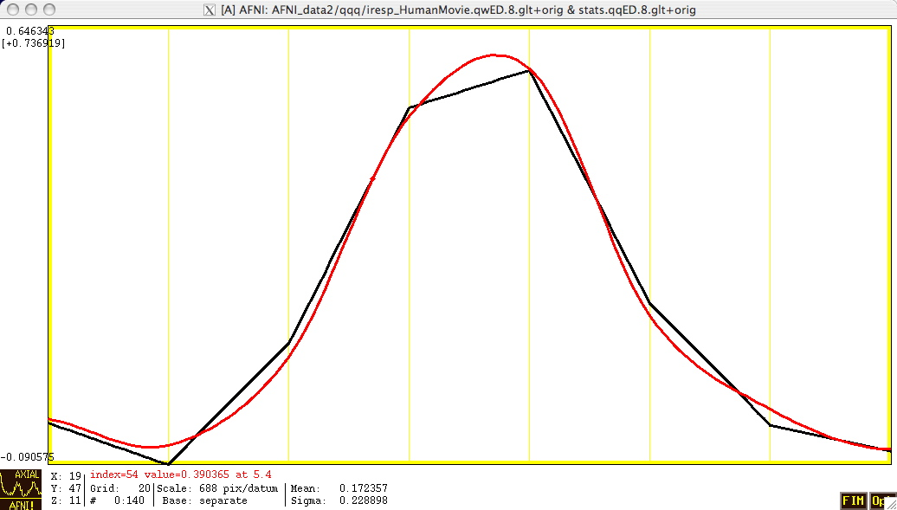
Other Features - 5
-stim_times has some other basis function options for the HRF model besides BLOCK and TENT
  CSPLIN = cubic spline instead of TENT = linear spline
    Same parameters: (start,stop,number of regressors)
    Can be used as a “drop in” replacement for TENT
Red = CSPLIN
Black = TENT
Differences are not significant
(But looks nicer)
-iresp plotted using -TR_times 0.1

Slide 7
Other Features - 6
-fitts option is used to create a synthetic dataset
  each voxel time series is full (signal+baseline) model as fitted to the data time series in the corresponding voxel location
3dSynthesize program can be used to create synthetic datasets from subsets of the full model
  Uses -x1D and -cbucket outputs from 3dDeconvolve
    -cbucket stores β coefficients for each X matrix column into dataset
    -x1D stores the matrix columns (and -stim_labels)
  Potential uses:
    Baseline only dataset
      3dSynthesize -cbucket fred+orig -matrix fred.x1D -select baseline -prefix fred_base
      Could subtract this dataset from original data (via 3dcalc) to get signal+noise dataset that has no baseline component left
    Just one stimulus class model (+ baseline) dataset
      3dSynthesize -cbucket fred+orig -matrix fred.x1D -select baseline Faces -prefix fred_Faces

Slide 8
Other Recent Small Changes
Defaults are changed:
  -nobout & -full_first & -bucket & -x1D are always implied
  Names of statistics sub-bricks are slightly altered (to be more consistent)
Checks if -stim_times inputs are out of range (AKA: the PSFB syndrome)
  Prints WARNING message, but continues analysis
When using -nodata with -stim_times, it is important to give the number of time points and the TR, as in -nodata 250 2.3
  With -input1D, use -TR_1D 2.3 to specify TR

Slide 9
IM Regression - 1
IM = Individual Modulation
  Compute separate amplitude of response for each stimulus
    Instead of computing average amplitude of responses to multiple stimuli in the same class
  Response amplitudes (βs) for each individual block/event will be highly noisy
    Can’t use individual activation map for much
    Must pool the computed βs in some further statistical analysis (e.g., a t-test via 3dttest?)
  Usage: -stim_times_IM k tname model
    Like -stim_times, but creates a separate regression matrix column for each time given

Slide 10
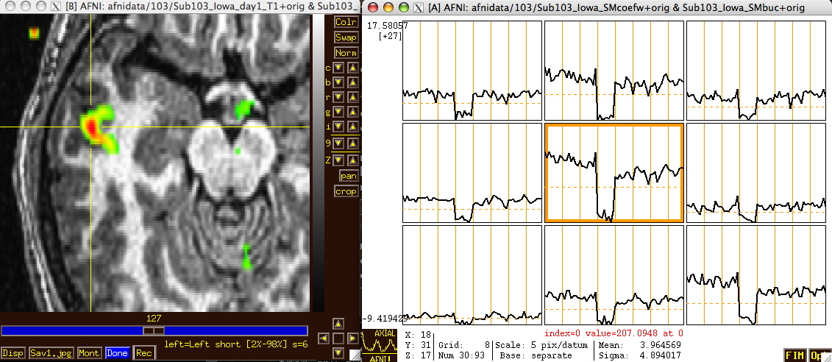
IM Regression - 2
Only application of IM thus far has been in checking some data we received from another institution
Experiment: 64 blocks of sensorimotor task (8 runs each with 8 blocks)
Plot of 64 BLOCK βs from -cbucket output
N.B.: sign reversal in run #4 = stimulus timing error!

Slide 11
IM Regression - 3
IM works naturally with blocks, which only have 1 amplitude parameter per stimulus
With event-related experiment and deconvolution, have multiple amplitude parameters per stimulus
  Difficulty: each event in same class won’t get the same shaped HRF this way
  Desideratum: allow response shape to vary (that’s deconvolution), but only allow amplitude to vary between responses in the same stimulus class
  Problem: get unknowns that multiply each other (shape parameters × amplitude parameters) — and we step outside the realm of linear analysis
  Possible solution: Total Least Squares mathematical methodology — am investigating now

Slide 12
AM Regression - 1
AM = Amplitude Modulated (or Modulation)
  Have some extra data measured about each response to a stimulus, and maybe the BOLD response amplitude is modulated by this
  Reaction time; Galvanic skin response; Pain level perception; Emotional valence (happy or sad or angry face?)
Want to see if some brain activations vary proportionally to this ABI (Auxiliary Behaviorial Information)
Discrete levels (2 or maybe 3) of ABI:
  Separate the stimuli into sub-classes that are determined by the ABI (“on” and “off”, maybe?)
  Use a GLT to test if there is a difference between the FMRI responses in the sub-classes
  3dDeconvolve ... \
  -stim_times 1 regressor_on.1D 'BLOCK(2,1)' -stim_label 1 'On' \
  -stim_times 2 regressor_off.1D 'BLOCK(2,1)' -stim_label 2 'Off' \
  -gltsym 'SYM: +On | +Off' -glt_label 1 'On+Off' \
  -gltsym 'SYM: +On -Off' -glt_label 2 'On-Off' ...
  “On+Off” tests for any activation in either the “on” or “off” conditions
  “On-Off” tests for differences in activation between “on” and “off” conditions
  Can use 3dcalc to threshold on both statistics at once to find a conjunction

Slide 13
AM Regression - 2
Continuous (or several finely graded) ABI levels
  Want to find active voxels whose activation level also depends on ABI
  3dDeconvolve is a linear program, so must make the assumption that the change in FMRI signal as ABI changes is linearly proportional to the changes in the ABI values
Need to make 2 separate regressors
  One to find the mean FMRI response (the usual -stim_times analysis)
  One to find the variations in the FMRI response as the ABI data varies
The second regressor should have the form
  Where a_{k} = value of k ^{th} ABI value, and a is the average ABI value
Response (β ) for first regressor is standard activation map
Statistics and β for second regressor make activation map of places whose BOLD response changes with changes in ABI
  Using 2 regressors allows separation of voxels that are active but are not detectably modulated by the ABI from voxels that are ABI-sensitive

Slide 14
AM Regression - 3
New feature of 3dDeconvolve: -stim_times_AM2
Use is very similar to standard -stim_times
  -stim_times_AM2 1 times_ABI.1D 'BLOCK(2,1)'
  The times_ABI.1D file has time entries that are “married” to ABI values:
  Such files can be created from 2 standard ASCII .1D files using the new 1dMarry program
    The -divorce option can be used to split them up
3dDeconvolve automatically creates the two regressors (unmodulated and amplitude modulated)
  Use -fout option to get statistics for activation of the pair of regressors (i.e., testing null hypothesis that both β weights are zero: that there is no ABI-independent or ABI-proportional signal change)
  Use -tout option to test each β weight separately
  Can 1dplot X matrix columns to see each regressor
10*5 23*4 27*2 39*5
17*2 32*5
*
16*2 24*3 37*5 41*4

Slide 15
AM Regression - 4
The AM feature is new, and so needs some practical user experiences before it can be considered “standard practice”
  In particular: don’t know how much data or how many events are needed to get good ABI-dependent statistics
If you want, -stim_times_AM1 is also available
  It only builds the regressor proportional to ABI data directly, with no mean removed:
  Can’t imagine what value this option has, but you never know … (if you can think of a good use, let me know)
Future directions:
  Allow more than one amplitude to be married to each stimulus time (insert obligatory polygamy/polyandry joke here)
    How many ABI types at once is too many? I don’t know.
  How to deal with unknown nonlinearities in the BOLD response to ABI values? I don’t know. (Regress each event separately, then compute MI?)
  Deconvolution with amplitude modulation? Requires more thought.

Slide 16
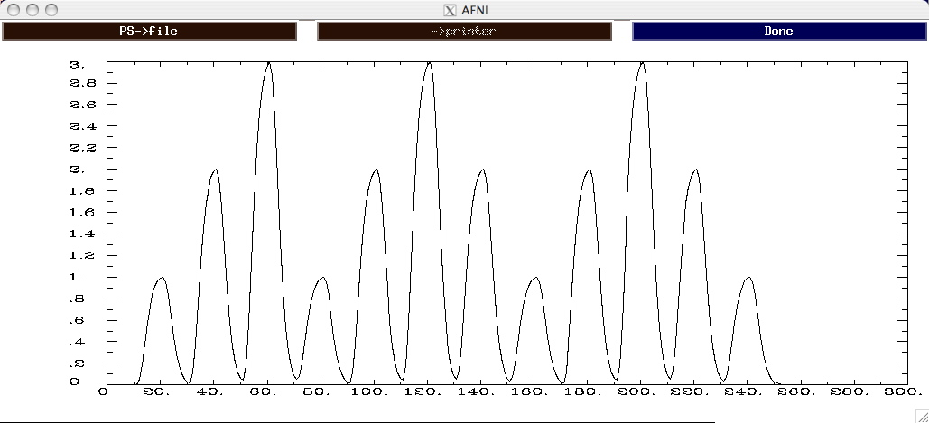
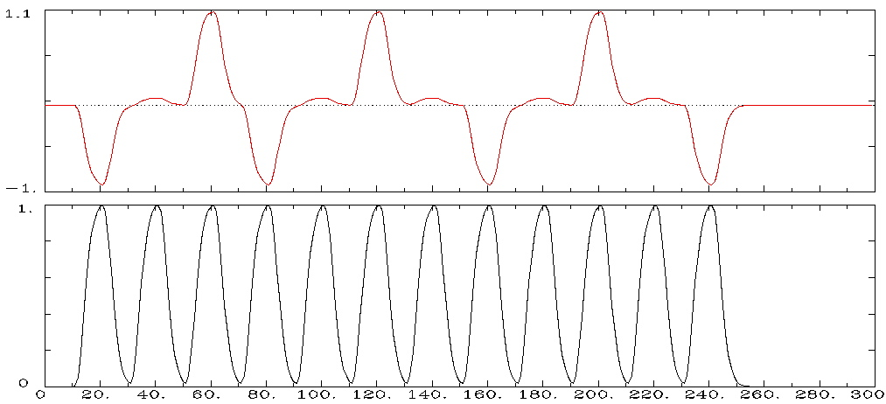
AM Regression - 5
Timing: AM.1D = 10*1 30*2 50*3 70*1 90*2 110*3 130*2 150*1 170*2 190*3 210*2 230*1
3dDeconvolve -nodata 300 1.0 -num_stimts 1 \
-stim_times_AM1 1 AM.1D 'BLOCK(10,1)' -x1D AM1.x1D
1dplot AM1.x1D'[2]'
3dDeconvolve -nodata 300 1.0 \
  -num_stimts 1 \
  -stim_times_AM2 1 \
  AM.1D 'BLOCK(10,1)' \
  -x1D AM2.x1D
1dplot -sepscl \
  AM2.x1D'[2,3]'
AM1 model of signal (modulation = ABI)
AM2 model of signal:
is 2D sub-space spanned by these 2 time series

Slide 17
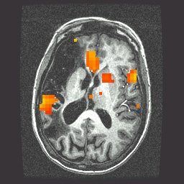
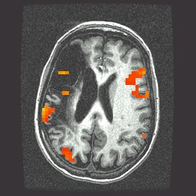
AM Regression - 6
  First actual user: Whitney Postman (formerly NIDCD; PI=Al Braun)
  Picture naming task in aphasic stroke patient
  ABI data = number of alternative names for each image (e.g., “balcony” & “porch” & “veranda”, vs. “strawberry”), from 1 to 18
    8 imaging runs, 144 stimulus events
  2 slices showing activation map for BOLD responses proportional to ABI (β_{AM2})
    What does this mean? Don’t ask me!

Slide 18
AM Regression - 7
  Alternative: use IM to get individual βs for each block/event and then do external regression statistics on those values
  Could do nonlinear fitting via 3dNLfim, or inter-class contrasts via 3dttest, 3dLME, 3dANOVA, etc.
  What is better: AM or IM+ ?
    We don’t know – experience with these options is limited thus far – you can always try both!
    If AM doesn’t fit your models/ideas, then IM is clearly the way to go
    Probably need to consult with SSCC to get some hints/advice

Slide 19
Other Advanced Topics in Regression
Can have activations with multiple phases that are not always in the same time relationship to each other; e.g.:
    subject gets cue #1
    variable waiting time (“hold”)
    subject gets cue #2, emits response
      which depends on both cue #1 and #2
  Cannot treat this as one event with one HRF, since the different waiting times will result in different overlaps in separate responses from cue #1 and cue #2
  Solution is multiple HRFs: separate HRF (fixed shape or deconvolution) for cue #1 times and for cue #2 times
    Must have significant variability in inter-cue waiting times, or will get a nearly-collinear model
      impossible to tell tail end of HRF #1 from the start of HRF #2, if always locked together in same temporal relationship
    How much variability is “significant”? Good question.
}
timing of events
is known

Slide 20
Even More Complicated Case
Solving a visually presented puzzle:
    subject sees puzzle
    subject cogitates a while
    subject responds with solution
The problem is that we expect some voxels to be significant in phase (b) as well as phases (a) and/or (c)
Variable length of phase (b) means that shape for its response varies between trials
  Which is contrary to the whole idea of averaging trials together to get decent statistics (which is basically what linear regression for the β weights does, in an elaborate sort of way)
Could assume response amplitude in phase (b) is constant across trials, and response duration varies directly with time between phases (a) and (c)
  Need three HRFs
  Can’t generate (b) HRF in 3dDeconvolve
}
timing of events
is measured

Slide 21
Noise Issues
“Noise” in FMRI is caused by several factors, not completely characterized
  MR thermal noise (well understood, unremovable)
  Cardiac and respiratory cycles (partly understood)
    In principle, could measure these sources of noise separately and then try to regress them out
      RETROICOR program underway (Rasmus Birn of FIM / NIMH)
  Scanner fluctuations (e.g., thermal drift of hardware)
  Small subject head movements (10-100 m)
  Very low frequency fluctuations (periods longer than 100 s)
Data analysis should try to remove what can be removed and allow for the statistical effects of what can’t be removed
  “Serial correlation” in the noise time series affects the t- and F-statistics calculated by 3dDeconvolve
  At present, nothing is done to correct for this effect (by us)

Slide 22
Nonlinear Regression
Linear models aren’t the only possibility
  e.g., could try to fit HRF of the form
  Unknowns b and c appear nonlinearly in this formula
Program 3dNLfim can do nonlinear regression (including nonlinear deconvolution)
  User must provide a C function that computes the model time series, given a set of parameters (e.g., a, b, c)
    We could help you develop this C model function
    Several sample model functions in the AFNI source code distribution
  Program then drives this C function repeatedly, searching for the set of parameters that best fit each voxel
  Has been used to fit pharmacological wash-in/wash-out models (difference of two exponentials) to FMRI data acquired during pharmacological challenges
    e.g., injection of nicotine, cocaine, ethanol, etc.
    these are difficult experiments to do and to analyze

Slide 23
Spatial Models of Activation
Smooth data in space before analysis
Average data across anatomically-selected regions of interest ROI (before or after analysis)
  Labor intensive (i.e., hire more students)
Reject isolated small clusters of above-threshold voxels after analysis

Slide 24
Spatial Smoothing of Data
Reduces number of comparisons
Reduces noise (by averaging)
Reduces spatial resolution
  Blur it enough: Can make FMRI results look like low resolution PET data
Smart smoothing: average only over nearby brain or gray matter voxels
  Uses resolution of FMRI cleverly
    New AFNI program: 3dBlurToFWHM
  Or: average over selected ROIs
  Or: cortical surface based smoothing

Slide 25
Spatial Clustering
Analyze data, create statistical map (e.g., t statistic in each voxel)
Threshold map at a low t value, in each voxel separately
  Will have many false positives
Threshold map by rejecting clusters of voxels below a given size
Can control false-positive rate by adjusting t threshold and cluster-size thresholds together

Slide 26
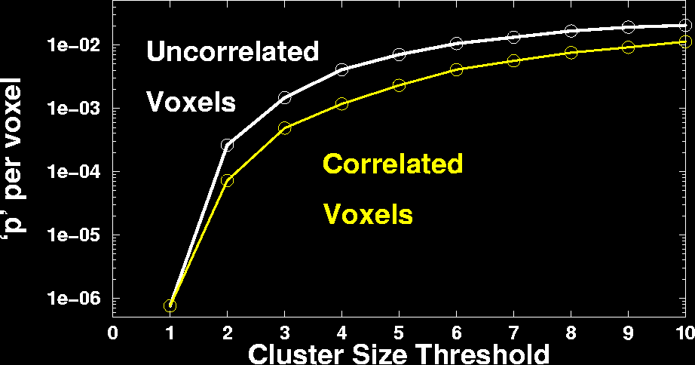
Cluster-Based Detection

Slide 27
What the World Needs Now
Unified HRF/Deconvolution ⊕ Blob analysis
  Time⊕Space patterns computed all at once, instead of arbitrary spatial smoothing
    Increase statistical power by bringing data from multiple voxels together cleverly
  Instead of time analysis followed by spatial analysis (described earlier)
  Instead of component-style analyses (e.g., ICA) that do not use stimulus timing
Difficulty: models for spatial blobs
  Little information à priori ⇒ must be adaptive

Slide 28
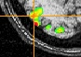
3dBlurToFWHM
New program to smooth FMRI time series datasets to a specified smoothness (as estimated by FWHM of noise spatial correlation function)
  Don’t just add smoothness (à la 3dmerge) but control it (locally and globally)
  Goal: use datasets from diverse scanners
Why blur FMRI time series?
  Averaging neighbors will reduce noise
  Activations are (usually) blob-ish (several voxels across)
  Diminishes the multiple comparisons problem
3dBlurToFWHM blurs only inside a mask
  To avoid mixing air (noise-only) and brain voxels
  Partial Differential Equation (PDE) based blurring method
    2D (intra-slice) or 3D blurring

Slide 29
In the Pondering Stages
“Area under curve” addition to -gltsym to allow testing of pieces of HRF models from -stim_times
Slice- and/or voxel-dependent regressors
  For physiological noise cancellation, etc.
  To save memory? (Could process each slice separately)
    One slice-at-a-time regression can be done in a Unix script, using 3dZcutup and 3dZcat programs
Extend AM regression to allow for more than 1 piece of auxiliary information at each stimulus time
Interactive tool to examine -x1D matrix for problems
  and 3dDeconvolve testing of GLT submatrices

