Slide 1
NOAA CoastWatch
OceanWatch
(My Twenty Years in the Valley of Death)
Kent H. Hughes
CoastWatch Program Manager
Satellite Oceanography Division
Center for Satellite Applications and Research
Camp Springs, MD
http://coastwatch.noaa.gov

Slide 2
NOAA CoastWatch
The Challenge
Deliver operational near real-time high resolution satellite data and products for the
U. S. coastal ocean to:
federal, state, and local governments
marine scientists
coastal resource managers
educators
public

Slide 3
NOAA CoastWatch
Key Events
North Carolina Harmful Algal Bloom 1987:
  Trigger event
Coastal Ocean Program 1990:
  Regular funding established (research oversight)
NOAA CoastWatch operational 1991:
  Complete national coverage established (Hawai’i)
CoastWatch in NESDIS base budget 1994/1995:
  Program becomes fully operational
Freedom of Information Act 1997:
  Full and open access
Management:
  NODC (‘87-‘92), OSDPD (‘92-‘00), ORA (‘00–present)
OceanWatch: Commerce budget guidance (FY 2003):
  Develop with existing resources ($680K)

Slide 4
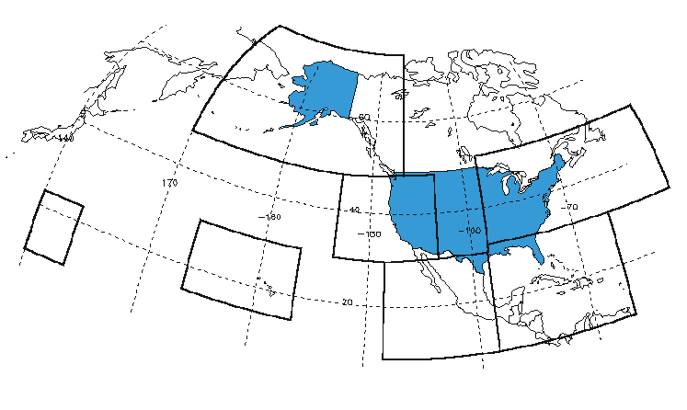
NOAA CoastWatch
CoastWatch Geographic Coverage (2001-2002)

Slide 5
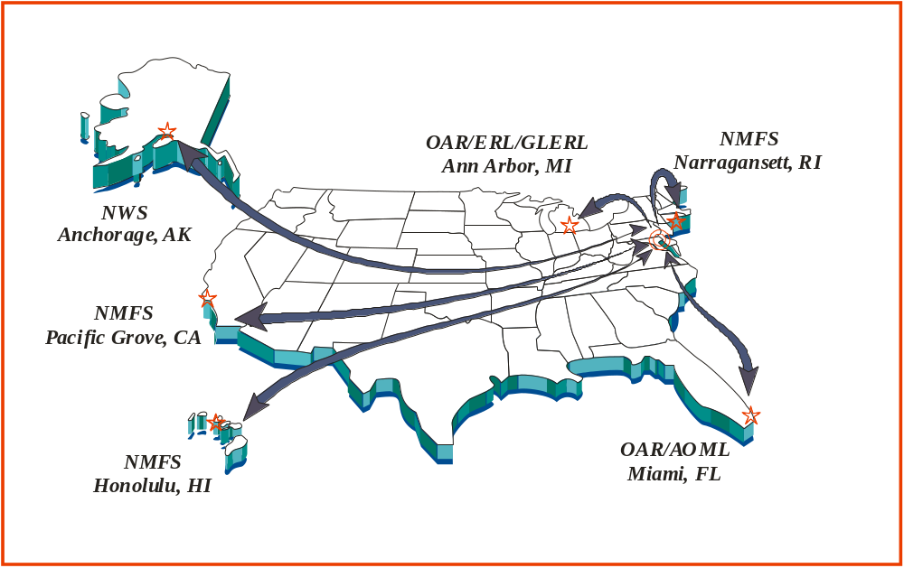
National and Regional Centers

Slide 6
NOAA CoastWatch
Program Baselines
$1.4M and 1 FTE (ORA)
  Associated manpower: 20 FTEs
14,000 registered users (as of April 2003)
  Recreational users largest segment
Three product types produced
  SST, ocean color, ocean surface winds
555K Observational generated annually (Central only)
Five active distributed regional nodes – NOAA laboratories and offices (three Line Offices)
Six environmental satellite systems: US, non-US, and commercial – 9 TB communicated via Internet
Notes:
CEMSCS POES SST
TERASCAN SST (90 products per day [11 regions * 8 passes + overlap] )
GOES SST ( 8 products/day + 1 composite/day = 9 products x 7 Regions = 63 images per day [x 3 formats = 189] )
WINDS (48 qscat_products/day + 16 ssmi_products/day = 64 products per day)
MODIS (19 chlor_A/day + 19 chlor_B/day = 38 products per day [+ 14 composites/day = 52 products per day])

Slide 7
NOAA CoastWatch
Annual Registrations by Category

Slide 8
NOAA CoastWatch
User Distribution by Regional Node
Southeast
14%
Northeast
19%
Hawaii
West Coast
3%
36%
Gulf of Mexico
18%
Alaska
Great Lakes
2%
3%
Caribbean
5%

Slide 9

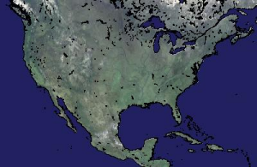

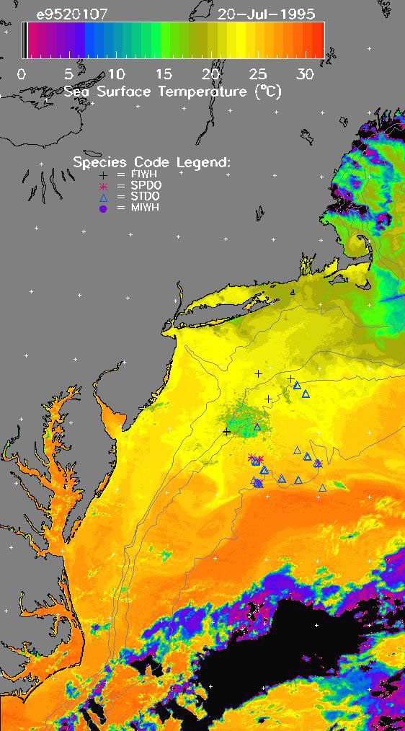
Regional Products
Marine Mammal Distribution
+ Fin Whale
☞ Spotted Dolphin
Δ Striped Dolphin
 Mink Whale
Notes:
Check Dolphin names
NORTHEAST
Marine Mammal and Swordfish Turtle Bycatch for support of NMFS
GOMx / SOUTHEAST
Marine mammal research and cruise data analysis in support of NOS
(Hypoxia something?)
WEST COAST
El nino product.
HAWAII
OCEANWATCH APPLICATION OF CW DATA:
Aug 2000: Purpose of closures – reduce incidental by catch of sea turtles.
Area A closed year round (in red because overlaps interim closure area).
Judge drew closure area on a map that went up to Alaska.
Area B closed (w/ exceptions)-- Loggerhead is the driver for the closures.
Closed with exceptions, 500(?) sets per year, 100% observer coverage of the fleet.
Effect was shutdown of Swordfishery.
Area C limited closure – guided by leatherback turtle takes – this region is the usual Tuna fishery.
One problem is lack of information on Leatherbacks – not much known –
tagging program now in effect and CW data is being used to describe their habitat –
POSSIBLE APPROACH TO DEFINE TIME AND AREA CLOSURES:
Identify habitats using satellite sensors, e.g.
Areas of convergence - Wind Stress Curl (QuikSCAT and ADEOS-II)
Swordfish habitat - 18 C Isotherm (GOES and AVHRR)
Marine turtle habitat - 0.2 Chlorophyll (MODIS AM/PM)
Model anticipated longline fishery interactions
Adjust fishery closures accordingly
Because of Leatherback (lack of knowledge) it remains a possible
approach – although it works for Loggerheads.
OCEAN FEATURES ARE IMPORTANT IN PELAGIC ECOSYSTEMS AND EFH:
Vertical Thermal Topography – temperatures throughout the water column
– Topex can assist, along with SST and XBT/TAO data.
Wave heights – fishability/catchability – primary concern with Lobster trapping.
Wind stress curl (shape of the wind field) proportional to Ekman Upwelling.
SPATIAL and TEMPORAL DYNAMICS of SUBTROPICAL CONVERGENCE:
Negative value of wind stress curl – purple – areas of convergence.
18 Degrees isotherm is where swordfish gather.
.2 Chl location of loggerheads.
When chlorophyll dips below 18C, turtle catches may increase (hypothesis).
Wind is the driver.
MEAN Winter Convergence – NW Hawaiian chain acts as a comb

Slide 10
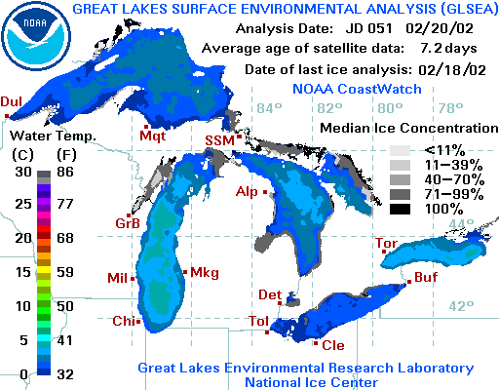
NOAA CoastWatch
SST and Ice Extent
Notes:
NORTHEAST
Marine Mammal and Swordfish Turtle Bycatch for support of NMFS
GOMx / SOUTHEAST
Marine mammal research and cruise data analysis in support of NOS
(Hypoxia something?)
WEST COAST
El nino product.
HAWAII
OCEANWATCH APPLICATION OF CW DATA:
Aug 2000: Purpose of closures – reduce incidental by catch of sea turtles.
Area A closed year round (in red because overlaps interim closure area).
Judge drew closure area on a map that went up to Alaska.
Area B closed (w/ exceptions)-- Loggerhead is the driver for the closures.
Closed with exceptions, 500(?) sets per year, 100% observer coverage of the fleet.
Effect was shutdown of Swordfishery.
Area C limited closure – guided by leatherback turtle takes – this region is the usual Tuna fishery.
One problem is lack of information on Leatherbacks – not much known –
tagging program now in effect and CW data is being used to describe their habitat –
POSSIBLE APPROACH TO DEFINE TIME AND AREA CLOSURES:
Identify habitats using satellite sensors, e.g.
Areas of convergence - Wind Stress Curl (QuikSCAT and ADEOS-II)
Swordfish habitat - 18 C Isotherm (GOES and AVHRR)
Marine turtle habitat - 0.2 Chlorophyll (MODIS AM/PM)
Model anticipated longline fishery interactions
Adjust fishery closures accordingly
Because of Leatherback (lack of knowledge) it remains a possible
approach – although it works for Loggerheads.
OCEAN FEATURES ARE IMPORTANT IN PELAGIC ECOSYSTEMS AND EFH:
Vertical Thermal Topography – temperatures throughout the water column
– Topex can assist, along with SST and XBT/TAO data.
Wave heights – fishability/catchability – primary concern with Lobster trapping.
Wind stress curl (shape of the wind field) proportional to Ekman Upwelling.
SPATIAL and TEMPORAL DYNAMICS of SUBTROPICAL CONVERGENCE:
Negative value of wind stress curl – purple – areas of convergence.
18 Degrees isotherm is where swordfish gather.
.2 Chl location of loggerheads.
When chlorophyll dips below 18C, turtle catches may increase (hypothesis).
Wind is the driver.
MEAN Winter Convergence – NW Hawaiian chain acts as a comb

Slide 11
NOAA CoastWatch
Products Used by Regional Nodes
 | Local AVHRR Acquisition | Polar SST | GOES SST | Ocean Color | Surface Winds | Altimetry | SAR
Hawai’i | HRPT | X | X | X | X | X
Northeast |  | X | X |  | X
Caribbean | HRPT | X |  | X | X | X
Great Lakes |  | X | X |  |  |  | X
Gulf of Mexico |  | X |  | X
Alaska | HRPT | X |  |  |  |  | X
West Coast | HRPT | X | X | X | X | X
Notes:
Move alaska up one

Slide 12
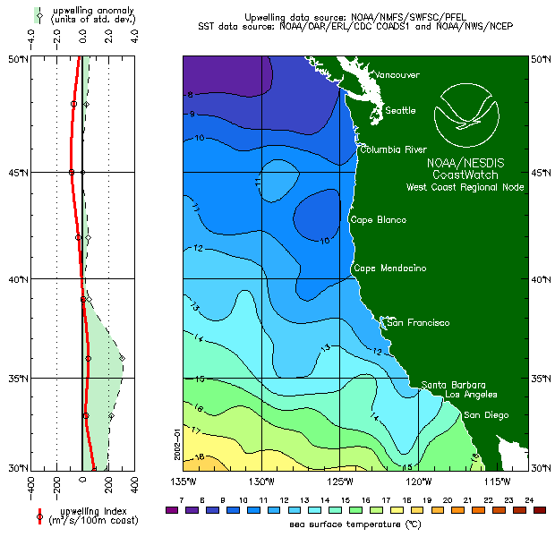
NOAA CoastWatch
El Nino Watch
Notes:
NORTHEAST
Marine Mammal and Swordfish Turtle Bycatch for support of NMFS
GOMx / SOUTHEAST
Marine mammal research and cruise data analysis in support of NOS
(Hypoxia something?)
WEST COAST
El nino product.
HAWAII
OCEANWATCH APPLICATION OF CW DATA:
Aug 2000: Purpose of closures – reduce incidental by catch of sea turtles.
Area A closed year round (in red because overlaps interim closure area).
Judge drew closure area on a map that went up to Alaska.
Area B closed (w/ exceptions)-- Loggerhead is the driver for the closures.
Closed with exceptions, 500(?) sets per year, 100% observer coverage of the fleet.
Effect was shutdown of Swordfishery.
Area C limited closure – guided by leatherback turtle takes – this region is the usual Tuna fishery.
One problem is lack of information on Leatherbacks – not much known –
tagging program now in effect and CW data is being used to describe their habitat –
POSSIBLE APPROACH TO DEFINE TIME AND AREA CLOSURES:
Identify habitats using satellite sensors, e.g.
Areas of convergence - Wind Stress Curl (QuikSCAT and ADEOS-II)
Swordfish habitat - 18 C Isotherm (GOES and AVHRR)
Marine turtle habitat - 0.2 Chlorophyll (MODIS AM/PM)
Model anticipated longline fishery interactions
Adjust fishery closures accordingly
Because of Leatherback (lack of knowledge) it remains a possible
approach – although it works for Loggerheads.
OCEAN FEATURES ARE IMPORTANT IN PELAGIC ECOSYSTEMS AND EFH:
Vertical Thermal Topography – temperatures throughout the water column
– Topex can assist, along with SST and XBT/TAO data.
Wave heights – fishability/catchability – primary concern with Lobster trapping.
Wind stress curl (shape of the wind field) proportional to Ekman Upwelling.
SPATIAL and TEMPORAL DYNAMICS of SUBTROPICAL CONVERGENCE:
Negative value of wind stress curl – purple – areas of convergence.
18 Degrees isotherm is where swordfish gather.
.2 Chl location of loggerheads.
When chlorophyll dips below 18C, turtle catches may increase (hypothesis).
Wind is the driver.
MEAN Winter Convergence – NW Hawaiian chain acts as a comb

Slide 13
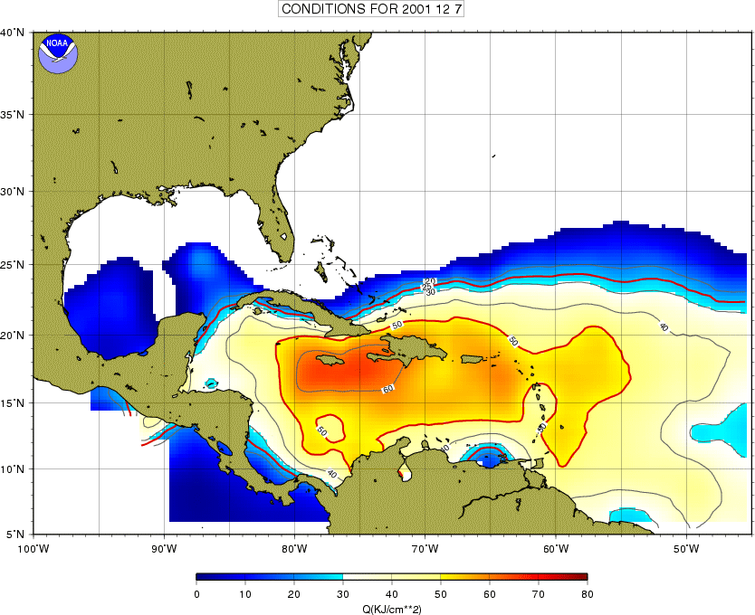
NOAA CoastWatch
Caribbean Heat Content Prototype (AOML)
Hurricane Heat Potential
Notes:
Caribbean/AOML – Hurricane Heat Potential
NCCOS/CSC/CW – HAB Bulletin
PLACEHOLDER for NWS
PLACEHOLDER for SAR ICE

Slide 14

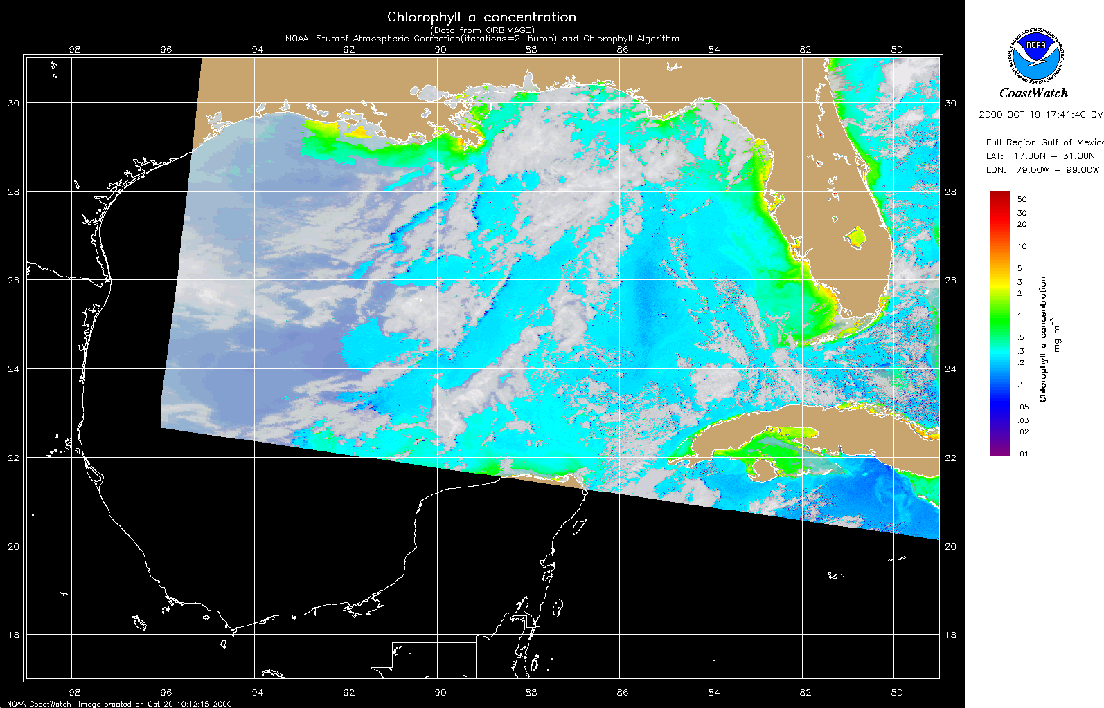
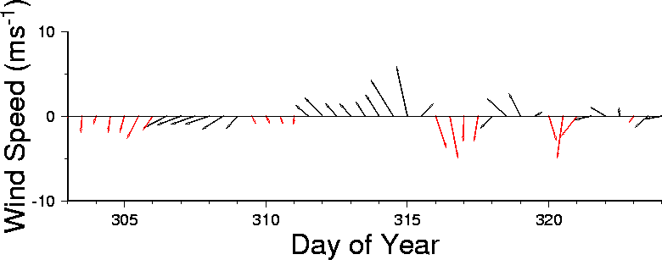
NOAA CoastWatch
Gulf of Mexico Harmful Algal Bloom Analysis
Experimental Gulf of Mexico HAB Bulletin 11
20 October 2000
NOAA/NCCOS
CSC
NESDIS CoastWatch and NDBC
Last bulletin: 18 October 2000
ANALYSIS
SW Florida:
After persisting and increasing by 2-3 fold over the past week, the bloom off Sanibel/Ft. Myers decreased substantially between Oct 17 and Oct 19. On Oct 11, maximum chlorophyll was 3-6 ug/l; on Oct 17, 10-20 ug/l; on Oct 19, only 1-2 ug/l. A narrow band of higher chlorophyll, extends from 26d 08'N to 26d 20'N along 82d 01 W. Pockets of chlorophyll of 1-2 ug/l also persist well offshore, along 26N from 82W to 82d20'W.
Normal behavior of decreasing chlorophyll offshore was observed.
NW Florida:
Background chlorophyll (< 0.5 ug/l) from Panama City west and offshore. Clouds just east of Panama City. (As of Oct 17, up to 1 ug/l in that area, where bloom was reported.) Any bloom is tightly constrained to the coast.
Texas:
On Oct 18, clouds from 27dN to Galveston. South of 27dN to Brownsville, chlorophyll low at ~1 ug/L (background) along the coast.
--rick
Winds at Venice, FL
Please not the following restrictions on all SeaWiFS imagery derived from CoastWatch:
1. These data are restricted to civil marine applications only; i.e. federal, state, and local government distribution is permitted.
2. Distribution for military, international, or commercial purposes is NOT permitted.
Wind speed and direction are averaged over 12 hours from measurements made on NOAA buoys. Length of line indicates speed; angle indicates direction. Red vectors indicate that wind direction favors upwelling near the coast.
Notes:
Caribbean/AOML – Hurricane Heat Potential
NCCOS/CSC/CW – HAB Bulletin
PLACEHOLDER for NWS
PLACEHOLDER for SAR ICE

Slide 15
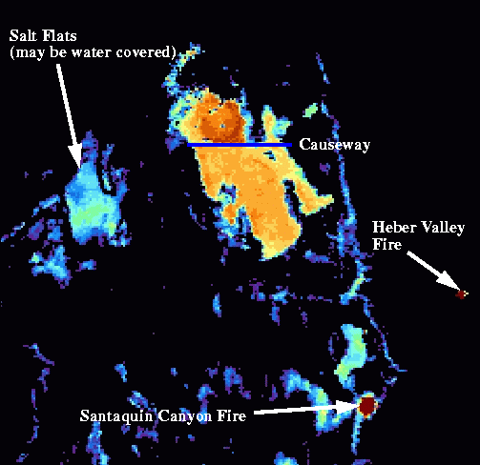
NOAA CoastWatch
Great Salt Lake SST Product
GSL ingredient in lake-effect snow in Salt Lake City-hard to initialize in models
CoastWatch SST product to be used in mesoscale model for Winter 2002 Olympic Support
Produced using new TeraScan system (IPD).
Notes:
The Problem:
From Prof. Jim Steenburgh, University of Utah:
For the past several years, we've been running a mesoscale model over the Intermountain West. The modeling system will be upgraded to 4-km grid spacing this summer and will be used by the forecast team for the 2002 Winter Olympics in Salt Lake City. One of our biggest modeling challenges has been properly initializing
the temperature of the Great Salt Lake (GSL). We expect this challenge to grow as we continue to increase model resolution. The GSL produces substantial lake-effect snowstorms several times a year. Such storms have produced more than 3 feet of snow in the Salt Lake City metropolitan area. Because the GSL is very shallow (average depth of only 4.8 m), it warms very rapidly. Lake-effect storms have been observed from September - May. Most of the lake is very remote and obtaining reliable in situ lake-temperature observations has been extremely difficult. We have installed real-time lake-temperature sensors at two locations, and will be installing a moored buoy this summer. If problems crop up with this equipment, which is not uncommon, it can take weeks to arrange for a visit and repair. At times, we cannot access the sensors since they are located on small islands in sensitive bird-nesting areas. What we would like to do is to utilize remotely sensed lake-temperature observations, along with available in situ observations, to initialize lake temperature in our model forecasts. If your group could provide them, we would download the most recent gridded lake-temperature analyses available and incorporate them into our real-time modeling system. We would likely do some validation work and run some model tests to see how to best incorporate the data. NCEP also has a need for improved lake-temperature observations from the
GSL since they will be running the Eta model at 8 km resolution this fall. This modeling system will also be used for Olympic weather prediction.
Finally, we are also interested in building an archive that will allow us to learn more about the temperature structure and cycle of the GSL. Such an archive would be useful for both meteorological, environmental, and biological studies of the GSL.
About the Image
Again from Prof. Steenburgh: “I had an opportunity to download and use your software {CDAT} to examine the most recent GSL data file obtained with clear skies. Very nice! Your software is quite easy to use. I've appended an image, which was taken around 1000 UTC 19 Aug (3 am LST), since it contains some interesting features. Note that the scale is set so that everything < 20 C is black. First, note the contrast in lake temperature between the north and south arm of the lake. An earthen causeway (blue line) prevents mixing between the two arms. The AVHRR-derived SST's in the south arm were within 1 C of what our in situ sampler had at this time. Also of interest are two fires near the southern and eastern sides of the image. The Santaquin fire started Saturday night and burned 10,000 acres in 24 h (if the news reports I heard are correct). Finally, the relatively high "SST's" over the Salt Flats are interesting. This is a very unique ecosystem. Sometimes the salt flats are covered by water that is only a couple of inches deep. However, even if they are dry, they have a different thermal inertia than the surrounding desert and are typically much warmer at night and in the early morning. This is probably why there are higher brightness temperatures in this region.”
Imagery produced using TeraScan system purchased through IPD (John Sapper). GSL product produced by Peter Hollemans, SES Inc.

Slide 16
OceanWatch
First steps
FY 2003 request ($680K increase within Sustained Healthy Coasts) for:
  science support
  three regional demonstrations, and
  systems development / expanded operations.
Department of Commerce FY 2003 directed – “No increase is provided for the OceanWatch program. The small amount needed for this activity should be provided for out of existing base funds.”

Slide 17
OceanWatch
Next steps
Attempted several small steps forward to define and execute OceanWatch:
  Restrict to two limited demonstrations (Pacific Grove and Hawai’i)
  Solicit collaboration with multiple national and international partners (new data sources, techniques development, broadened applications, etc.)
  Investments in a native NOAA capability for broadened NOAA role in operational ocean remote sensing

Slide 18
OceanWatch
The latest steps
April 2006: NOAA Transition Board directs development of plans for dozens of research to operations projects (FY 2010)
Ocean Remote Sensing / OceanWatch briefed to uppers levels as CEO contribution
NOAA groups being established and plans being developed for summer submission
OceanWatch will rely on groups in NOAA to:
  Coordinate access to best available ocean remote sensing science (SST, Ocean Color, Surface Winds, and Altimetry)
  Rely on “other” r2o groups for science development and investment
  Organize sustainable operational and research facilities supporting above, and
  Organize and execute sustainable national and international operational ocean remote sensing demonstrations

Slide 19
NOAA CoastWatch
OceanWatch
Kent H. Hughes
CoastWatch Program Manager
Satellite Oceanography Division
Center for Satellite Applications and Research
Camp Springs, MD

