Slide 1

The SEAL Project
20 February 2003
P. Calafiura (mostly copied from P. Mato)
Shared Environment
for Applications at LHC

Slide 2
What is Seal
SEAL stands for Core Libraries and Services Project (don’t ask)
It is a CERN LCG Application Area Project
SEAL goal is to
  provide a common LHC software infrastructure, basic framework(s), libraries and tools
  address the selection, integration, development and support of foundation and utility class libraries
Developers: Pere Mato, Stefan Roiser; Jacek Generowicz; Lassi Tuura; Lorenzo Moneta; Massimo Marino; Alain Bazan; Thierry Bouedo; Christian Arnault; RD Schaffer; Zhen Xie; Radovan Chytracek
http://seal.web.cern.ch/seal/

Slide 3
Release Roadmap
Release | Date | Status | Description (goals)
V 0.1 | 14/02/03 | internal | Establish dependency between POOL and SEAL Dictionary generation from header files
V 0.2 | 31/03/03 | public | Essential functionality sufficient for the other existing LCG projects (POOL) Foundation library, system abstraction, etc. Plugin management
V 0.3 | 16/05/03 | internal
V 1.0 | 30/06/03 | public | Essential functionality sufficient to be adopted by experiments Collection of basic framework services Scripting support
public = complete, documentation, etc.

Slide 4
Work Packages
Foundation and Utility Libraries
Math Libraries
Component Model and Plug-in Manager
LCG Object Dictionary
Basic Framework Services
  Logging (Message Reporting)
  Exception Handling
  Event (Incident) Management (post V1)
  Object Whiteboard (post V1)
Scripting Services
Grid Services
Education and Documentation

Slide 5
Foundation and Utility Libraries
Goal
  Develop SEAL utility and system library complementary to Boost and STL from existing code in classLib, Gaudi, HepUtilities, etc.
Achieved so far
  Boost installation
  Inventory of existing utility classes
  classlib in SEAL repository
  Few classes required by POOL moved from POOL to SEAL
Packages
  Foundation/SealKernel (available in pre-release V 0.1)

Slide 6
Math Libraries
New SEAL work package
  The Math Libraries project (F. James et al.) is becoming a work package of the SEAL project
  Started to define the work plan
Goals
  Provide to experiments with math and statistics libraries to be used in analysis, reconstruction, simulation.
Current activities
  Evaluation of GSL (India). Finished by 15 April 2003
  Implementation of Minuit in C++, …
  CLHEP participation and support
  GSL support

Slide 7
Component Model and Plugin Manager
Goals
  Define component and interface model following the blueprint report guidance. Develop plug-in Manager for lookup, loading plugins.
Current activities
  Design phase. Definition of concepts.
  Ideas from Iguana and Gaudi.
Deliverables
  Prototype should be ready by first public release (end March)

Slide 8
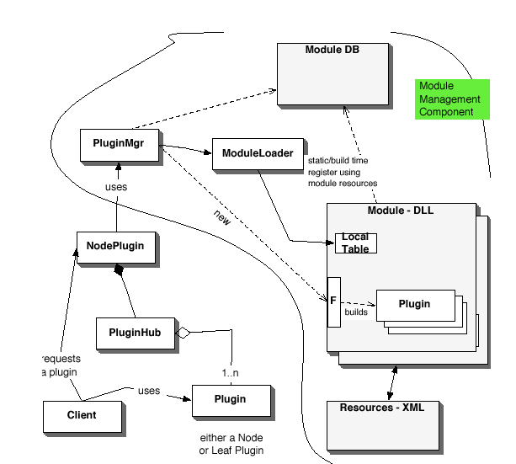
Plugin Management (current ideas)
PluginMgr
Library lookup, caching, loading, unloading
Loaded Objects
Management
Module
Framework services will be modeled as plugin and plugin hubs
Construction of “modules” containing plugins.
Abstract factories.

Slide 9
LCG Object Dictionary
Areas of work
  Reflection Packages (Reflection, ReflectionBuilder)
  Dictionary generation from header files using gcc_xml technology (DictionaryGenerator)
  Python-binding to Reflection
  Gateway CINT -> LCG Dictionary
  Generation of .h-files and dictionary from some higher-level-language (e.g. XML)
Concentrating in Reflection packages and dictionary generation from header files
  Main goal: Full support of C++, without any class instrumentation
  Parsing XML file from gccxml and producing “usable” dictionaries
Packages available in pre-release V 0.1
  Reflection, ReflectionBuilder, DictionaryGenerator, DictionaryExample

Slide 10
Dictionary Generation
lcgdict
.h
gccxml
.xml
par
ser
filter
+
exten
gendict
_dict.cpp
.so
make
.h
.h
.h
Dictionary Clients
>lcgdict LorentzVector.h –I{...}\CLHEP\1.8.0.0\include
Parsing file with GCC_XML OK
Generating LCG Dictionary
Generating class HepLorentzVector
Generating class Tcomponent

Slide 11
Filtering and Extending
For any simple header file, gccxml generates the information for hundreds of classes
Started filtering with a naïve and simple algorithm
  The dictionary is generated for al classes defined in the input file and templated classes using these classes.
  Explicit template instantiations will be required
Extensions to classes are also required by some clients (e.g. POOL)
  Default constructors, special methods to handle collections, class ID, etc.
  Handing based on conventions and strategies for the time being
  Later these extensions could be provided by the client itself applying the same conventions and strategies

Slide 12
Dictionary ToDo
The Dictionary supports already quite a lot of C++
  No problem with things like vector<pair<list<A>,pair<B,C> > >
Things to be improved in the dictionary or in the generation
  Handling function types
  Handling typedef
  Proper handling of attributes (public, private, const, etc.)
Integration in the build system (SCRAM)
  Minimal integration done for V 0.1 pre-release
Not unsolvable known problems
  The “guinea-events” from ATLAS and CMS will be used as examples

Slide 13
Scripting Services
Goals
  Define guidelines for developing Python bindings
  Python bindings for standard services and utility libraries developed in SEAL
  Upgrade Python bindings for ROOT (PyROOT)
Current activities
  Evaluate existing options: SWIG, Boost.Python, SIP,..., raw Python API
  Started with PyROOT (C++) and PyGSL (C) as examples in the evaluation process. They are candidates to become “real” products.

Slide 14
Pre-release V 0.1
Platform and Externals
  Linux gcc-3.2
  Current external packages: Python 2.2.2, gccxml 0.4.0
  Soon: boost 1.29, GSL 1.3
The repository will be tagged Friday 14th
  Ready to be used by POOL in V0.4

Slide 15
Pre-Release V 0.1
The goals of this first pre-release V 0.1 are:
  Exercise the dependency and integration between POOL and SEAL
  LCG Dictionary generation (at prototype level) to produce “usable” persistency applications
  Good test for the development process and infrastructure for SEAL
Do not expect much more in this release
Looking forward to have more functionality by end of March (V 0.2)

Slide 16
My Impressions
CERN-centric project
Small strong group working well
Outside groups roles unclear
  Active costumers (testing, kibitzing)
  Run some side-show (e.g. Java interfacing)
LBL may be the exception thanks to Massimo (and David) involvement

