Slide 1
Dependent Regular Worksheet A
EFC:

Slide 2
Objectives
Calculate the EFC using Worksheet A
Identify allowances against student’s and parent’s income
Evaluate impact of assets for both parents and students
Evaluate inclusion of untaxed income from FAFSA worksheets A, B, and C

Slide 3
Formula Review
Regular
Simplified
Automatic zero

Slide 4
Scenario 1
Dependent student
FL residents
Age of older parent 52
Parent’s AGI $78,000
  Filed 1040
Student’s income $2,240
Household size 5
Number in college 2
Investments of $28,000
Ownership of a small business with 105 full-time employees worth $122,000

Slide 5
Formula Determination
Live Meeting Poll
Which formula should be applied using the information provided?
Regular
Simplified
Automatic Zero
Changes directly made to this slide will not be displayed in Live Meeting. Edit this slide by selecting Properties in the Live Meeting Presentation menu.

Slide 6
Scenario 1 – Poll Answer
Formula to use – Regular
Why
  Parents filed 1040
  Parents’ income over $49,999

Slide 7
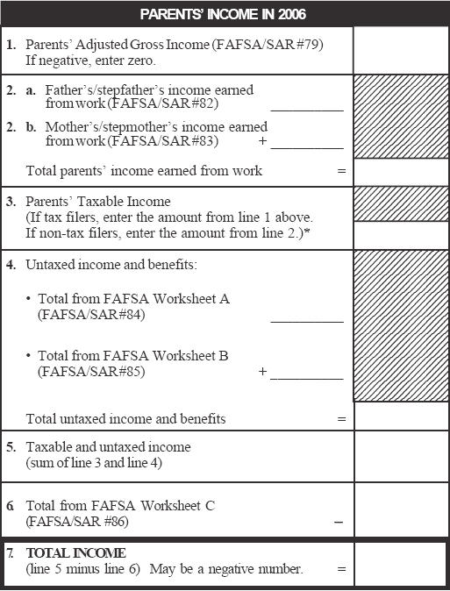
Dependent Regular - Income
^{78,000}
^{34,000}
^{44,000}
^{78,000}
^{78,000}

Slide 8
Untaxed Income and Benefits
^{78,000}
^{34,000}
^{44,000}
^{78,000}
^{78,000}
⁰
^{1,600}
^{1,600}

Slide 9
Taxable and Untaxed Income
^{78,000}
^{34,000}
^{44,000}
^{78,000}
^{78,000}
⁰
^{1,600}
^{1,600}
^{79,600}

Slide 10
FAFSA Worksheet C / Total Income
^{78,000}
^{34,000}
^{44,000}
^{78,000}
^{78,000}
⁰
^{1,600}
^{1,600}
^{79,600}
⁵²
^{79,548}

Slide 11
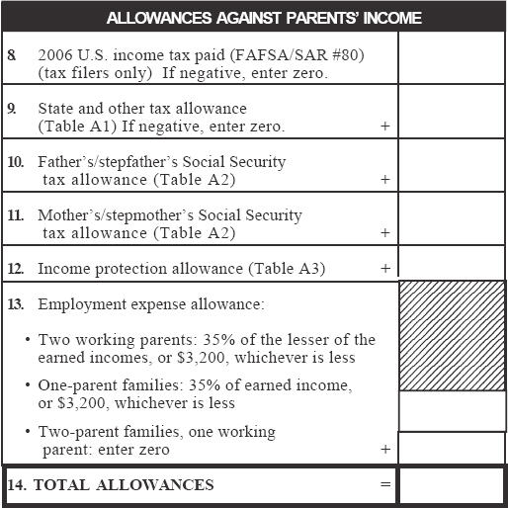
State and Other Tax Allowances
^{3,650}
^{FL Tax Rate: 1%}
^{.01 X 79,548 = 795}
⁷⁹⁵

Slide 12
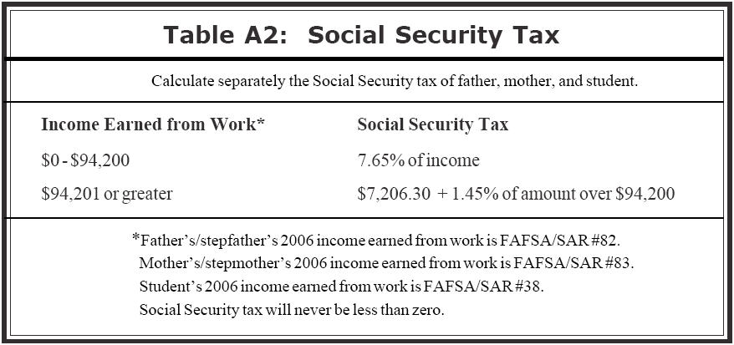
Social Security Tax Allowance
^{3,650}
⁷⁹⁵
^{.0765 X 34,000 = 2,601}
^{2,601}
^{.0765 X 44,000 = 3,366}
^{3,366}

Slide 13
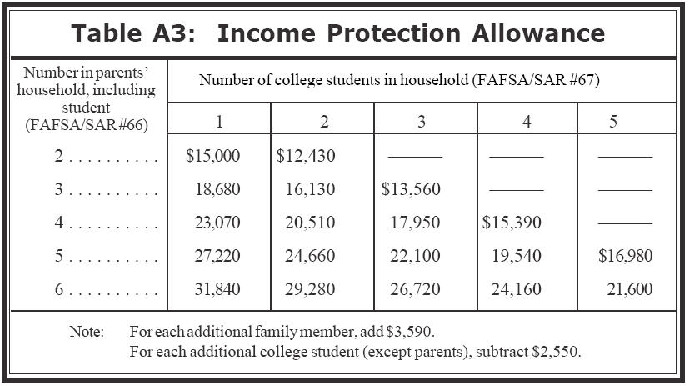
Income Protection Allowance
^{3,650}
⁷⁹⁵
^{2,601}
^{3,366}
^{24,660}

Slide 14
Employment Expense Allowance
^{3,650}
⁷⁹⁵
^{2,601}
^{3,366}
^{24,660}
^{.35 X 34,000 = 11,900}
^{11,900}
^{3,200}

Slide 15
Total Allowances
^{3,650}
⁷⁹⁵
^{2,601}
^{3,366}
^{24,660}
^{11,900}
^{3,200}
^{38,272}

Slide 16
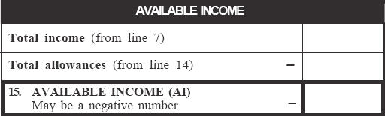
Available Income
^{79,548}
^{38,272}
^{41,276}

Slide 17
Income Calculation
If total income increases by $20,000, will the Available Income also increase by $20,000?

Slide 18
Income Calculation Answer
If total income increases by $20,000, will the Available Income also increase by $20,000?
  Not if the increase is due to earned income.
  The increase in available income would be proportional based on the state and Social Security allowance calculations.

Slide 19
State and Other Tax Allowance
Would the EFC be higher or lower if the state of residence were New Jersey instead of Florida?

Slide 20
State and Other Tax Allowance Answer
Would the EFC be higher or lower if the state of residence were New Jersey instead of Florida?
  The EFC would be lower.
  Florida’s allowance offset is 1% and New Jersey’s is 7% for income over $15,000.
^{FL Tax Rate: 1%}
^{.01 X 79,548 = 795}
^{NJ Tax Rate: 7%}
^{.07 X 79,548 = 5,568}

Slide 21
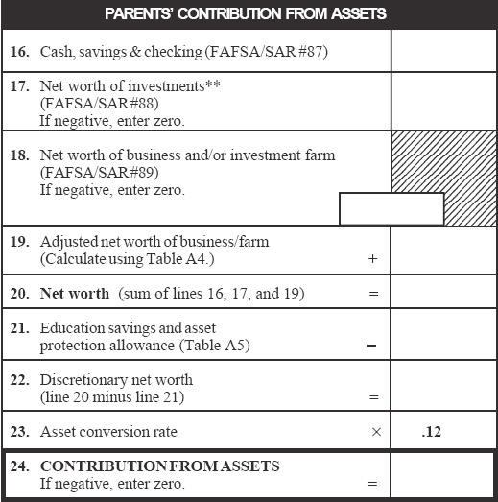
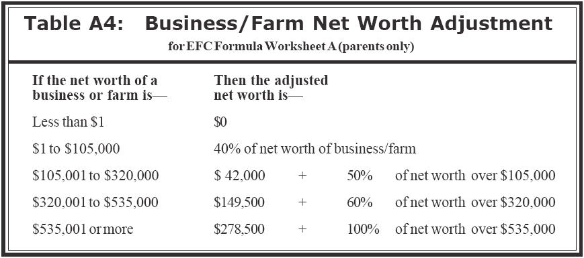
Parents’ Contribution from Assets
^{3,200}
^{28,000}
^{122,000 – 105,000 = 17,000}
^{.50 X 17,000 = 8,500}
^{42,000 + 8,500 = 50,500}
^{122,000}
^{50,500}
^{81,700}

Slide 22
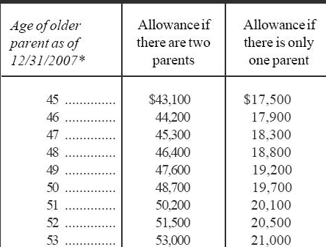
Parents’ Contribution from Assets
^{3,200}
^{28,000}
^{122,000}
^{50,500}
^{81,700}
^{51,500}

Slide 23
Parents’ Contribution from Assets
^{3,200}
^{28,000}
^{122,000}
^{50,500}
^{81,700}
^{51,500}
^{30,200}
^{3,624}

Slide 24
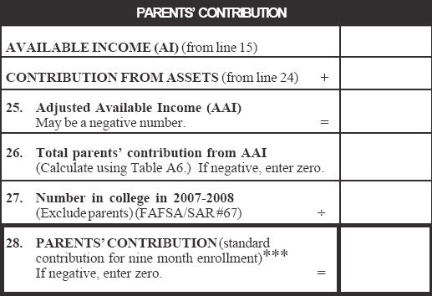
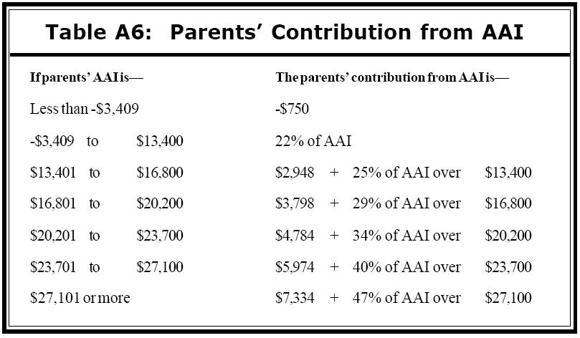
Parents’ Contribution
^{41,276}
^{3,624}
^{44,900 – 27,100 = 17,800}
^{.47 X 17, 800 = 8,366}
^{7,334 + 8,366 = 15,700}
^{44,900}
^{15,700}
²
⁷⁸⁷⁴

Slide 25
Parents’ Contribution
^{41,276}
^{3,624}
^{44,900}
^{15,700}
²
^{7,850}

Slide 26
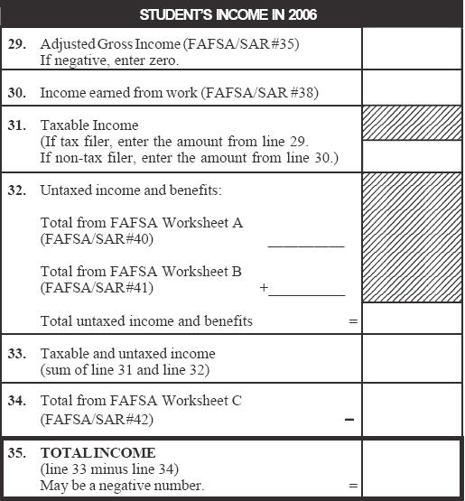
Student’s Income
^{2,240}
^{2,240}
⁰
^{2,240}
⁰
^{2,240}

Slide 27
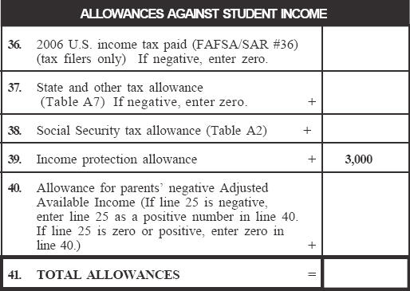
Allowances Against Student Income
⁰
⁰
^{.0765 X 2,240 = 171}
¹⁷¹
⁰
^{3,171}

Slide 28
Allowances Against Student Income
⁰
⁰
¹⁷¹
⁰
^{3,171}

Slide 29
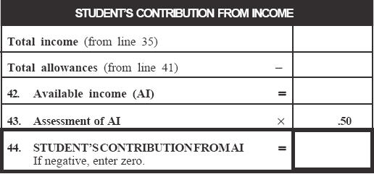
Student’s Contribution from Income
^{2,240}
^{3,171}
⁻⁹³¹
⁰

Slide 30
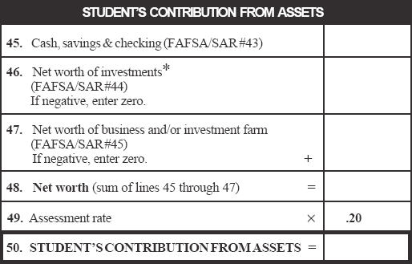
Student’s Contribution from Assets
⁰
^{12,800}
^{12,800}
^{2,560}

Slide 31
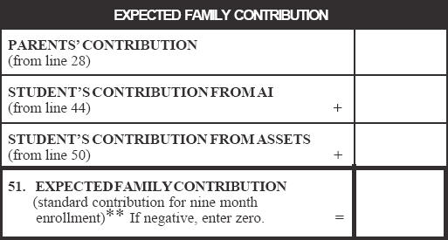
Expected Family Contribution
^{7,850}
⁰
^{2,560}
^{10,410}

Slide 32
Asset Conversion Rate
Live Meeting Poll
An asset of $10,000 would likely result in a higher EFC for a dependent student
if reported as a parent's asset
if reported as a student's asset
Changes directly made to this slide will not be displayed in Live Meeting. Edit this slide by selecting Properties in the Live Meeting Presentation menu.

Slide 33
Effect of Change in Student Assets
⁰
⁰
^{12,800}
⁰
^{12,800}
⁰
^{2,560}
⁰
^{7,850}
^{8,235}
⁰
⁰
^{2,560}
⁰
^{10,410}
^{8,235}

Slide 34
Scenario 2 – Activity
Complete the Regular Worksheet A activity located on PW page 2-3

Slide 35
Scenario 2 – Activity Debrief
Dependent student
OH residents
Age of older parent 52
Parent’s AGI $100,800
  Filed 1040
Student’s income $3,290
Household size 5
Number in college 2

Slide 36
Total Income
^{100,800}
^{62,000}
^{50,000}
^{112,000}
^{100,800}
⁰
^{100,800}
⁰
^{100,800}

Slide 37
Total Allowances
^{6,200}
^{OH Tax Rate: 5%}
^{.05 X 100,800 = 5,040}
^{5,040}
^{.0765 X 62,000 = 4,743}
^{4,743}
^{3,825}
^{.0765 X 50,000 = 3,825}
^{24,660}
^{.35 X 50,000 = 17,500}
^{17,500}
^{3,200}
^{47,668}

Slide 38
Available Income
^{100,800}
^{47,668}
^{53,132}

Slide 39
Parents’ Contribution from Assets
^{3,200}
⁰
⁰
^{3,200}
^{51,500}
^{-48,300}
⁰

Slide 40
Parents’ Contribution
^{53,132}
⁰
^{53,132}
^{53,132 – 27,100 = 26,032}
^{0.47 X 26,032 = 12,235}
^{7,334 + 12,235 = 19,569}
^{19,569}
²
^{9,785}

Slide 41
Student’s Income
^{3,290}
^{3,290}
^{3,290}
⁰
^{3,290}
^{1,050}
^{2,240}

Slide 42
Allowances Against Student Income
^{OH Tax Rate: 4%}
^{.04 X 2,240 = 90}
³²⁸
⁹⁰
²⁵²
^{.0765 X 3,290 = 252}
⁰
^{3,670}

Slide 43
Student’s Contribution from Income
^{2,240}
^{3,670}
^{-1,430}
⁰

Slide 44
Student’s Contribution from Assets
⁵⁰
^{3,075}
^{3,125}
⁶²⁵

Slide 45
Expected Family Contribution
^{9,785}
⁰
⁶²⁵
^{10,410}

Slide 46
Compare EFC Between Scenarios
Scenario 1
Lower income
High parental assets
Higher student assets
^{7,850}
⁰
^{2,560}
^{10,410}
Scenario 2
Higher income
Low parental assets
Lower student assets
^{9,785}
⁰
⁶²⁵
^{10,410}

