Slide 1
The FairTax
HR 25/S 25
Presentation of Americans For Fair Taxation
on the
FairTax Comprehensive Tax Reform Proposal
to
The President's Advisory Panel on Federal Tax Reform
May 11, 2005
by
Tom Wright
Executive Director
Americans For Fair Taxation

Slide 2
FairTax.org strongly advocates enactment of the FairTax Plan.
Replaces federal income, estate, and payroll taxes
Provides a simple, transparent, progressive national retail sales tax system administered through existing state sales tax operations
Generates sufficient revenue to replace, dollar for dollar, all federal income, estate and payroll taxes
“Prebates” every family, ensuring no American pays any federal tax up to (and beyond) the poverty level

Slide 3
FairTax.org strongly advocates enactment of the FairTax Plan.
Taxes all new goods and services once, with no exceptions, at $0.23 out of every dollar spent – a revenue neutral rate
Eliminates repeated embedded taxes at research, production, distribution, and retail levels
Prohibits federal dual taxation systems by repealing the 16th Amendment
Uses a thorough research basis to provide this
non-partisan, apolitical replacement

Slide 4
Panel criteria
1. Tax base | New goods & services
a. Revenue neutral | Yes
2. Exemptions | None
3. Tax rate | $0.23 out of every dollar
b. Progressive | Yes, via a prebate
4. Distribution | Retail spending above poverty level
5. Charitable giving | Giving untaxed dollars

Slide 5
Panel criteria
6. Home ownership | Purchase with untaxed dollars
7. Education | Investment, therefore not taxed
8. Collection | Existing state systems
9. Fairness | Polling respondents say yes; millions of non-filers captured
10. Business | Favors savings/growth/investment
11. Simplicity | Simple/understandable/predictable
12. Growth | Significant GDP & job growth; improves balance of trade
13. Compliance | Better compliance at lower cost

Slide 6
The FairTax makes the U.S. a competitive juggernaut.
No alternative combines all of the following:
Eliminates all federal tax costs from the supply chain of American products or services
Taxes imports sold at retail in the same manner it taxes domestic goods sold at retail
Brings the most fertile investment tax environment to our shores: Zero percent
Is a magnet for capital and corporate profits currently hesitant or trapped offshore
Encourages savings, investment & growth

Slide 7
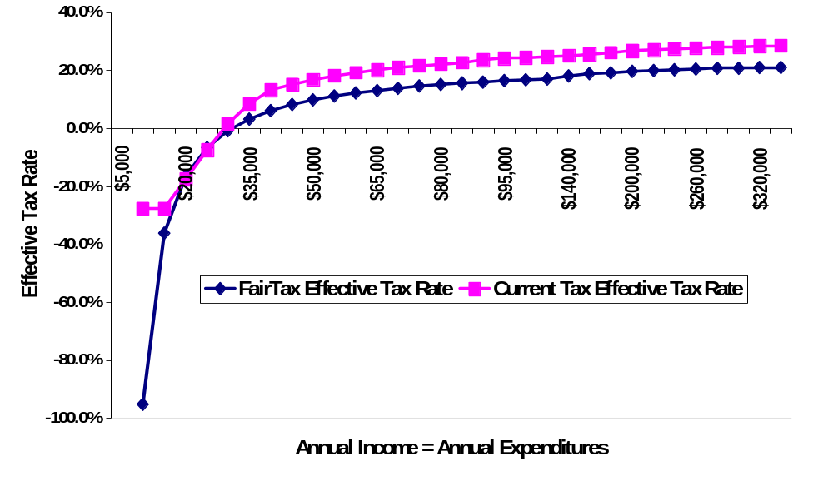
The FairTax is progressive.
The FairTax taxes consumption – the best measure of one’s ability to pay.
Prebate eliminates all federal taxes up to (and above) the poverty level.
The FairTax ends all tax costs in the supply chain.
The FairTax completely untaxes the poor, removing the tax on upward mobility.
Gross pay = net pay.
Negative tax rates are better than –90 percent.

Slide 8
The FairTax is progressive.
The working poor enjoy EITC-like benefits,
but no filing, no preparation costs & no audits.
Private sector compliance costs are eliminated.
Effective rates are lower on fixed incomes.
Effective rates are lower for middle class.
Wealthy consumers pay the highest taxes.
Accumulated wealth is taxed successfully.
No tax on wages.

Slide 9
The FairTax benefits home ownership.
Taxes new homes; used home prices already reflect the taxes paid.
Makes the entire house payment with untaxed dollars, not just the interest component.
Makes all homeowners eligible; no itemization.
Allows faster accumulation of down payments with no tax on savings and investment.
Reduces interest rates by about
250 basis points (tax wedge on interest).

Slide 10
The FairTax benefits charitable giving.
Giving correlates best with the economy and personal income growth.
The FairTax boosts the economy.
Giving has remained at 2% of GDP while top marginal tax rates have fluctuated
between 70 and 28 percent.
Giving made with untaxed dollars.
Today about 1 in 3 givers itemize.
No prohibition of political speech by non-profits removes threat to non-profit status.

Slide 11
Collection of the FairTax:
Impact on retailers
Collect such taxes now in 46 jurisdictions.
Enjoy an overnight termination of income/
payroll related costs; compliance costs drop.
Domestic suppliers experience similar reductions.
Gives American consumers full paychecks, free from federal withholding, immediately.
Strong economic growth and high employment lead to higher investment and higher consumption.
Receive ¼ of one percent (25 bps)
for collection.

Slide 12
States benefit from the FairTax.
Enjoy the huge benefits of higher nationwide economic growth estimated at about 10%.
Get a national template addressing the goals of the Streamlined Sales Tax Project.
Should they conform to the FairTax base:
  Significantly reduce current sales tax rates, and more
  Enjoy higher compliance at lower costs
  End revenue growth that lags their economies due to taxing only products
  Access to prebate system
Receive 25 bps.

Slide 13
Appendix
Comparison of proposals
FairTax: Chambliss/Linder
Flat tax (hybrid VAT): Specter/Burgess
Consumed income tax: English
BEST tax: DeMint
VAT/BTT No sponsor currently

Slide 14
Appendix
Social Security
FairTax.org is not engaged in the Social Security reform debate in any way, but our proposal has always addressed its funding.
Social Security/Medicare are funded via a dedicated income stream from FairTax collections.
Ends the regressive, narrow payroll tax.
Uses a broad, progressive sales tax.

Slide 15
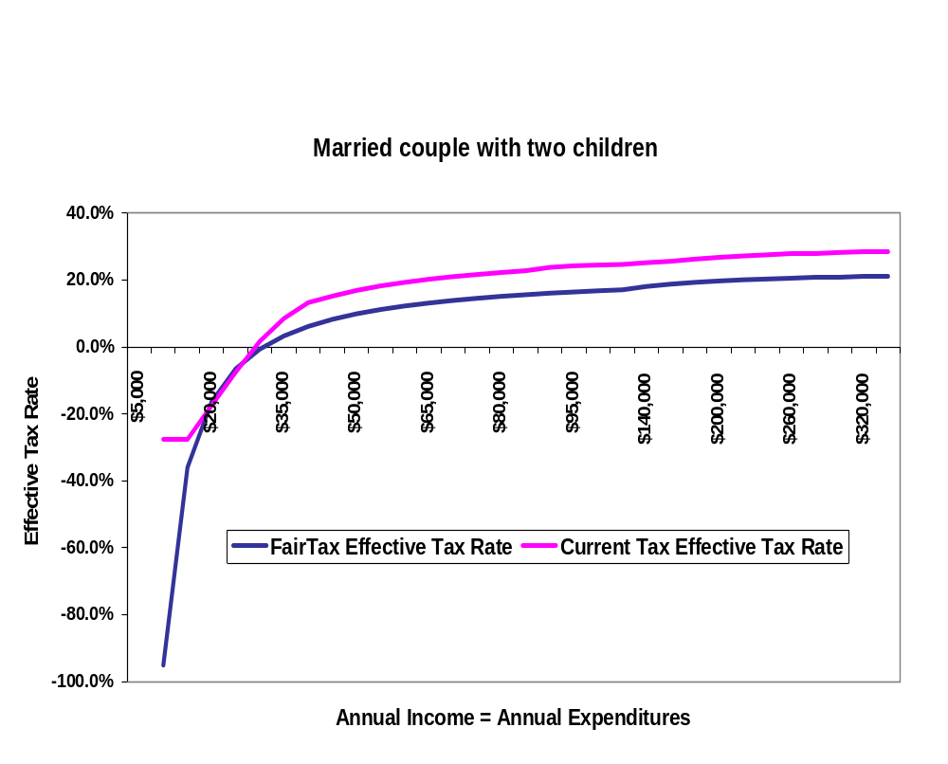
Appendix
The FairTax is progressive.

Slide 16
Appendix
Compliance under current law
The system’s complexity breeds public cynicism.
Complexity favors professional lobbyists over constituents.
Compliance costs the private sector a conservative $250 billion/year or about three percent of GDP.

Slide 17
Appendix
Compliance under the FairTax
Reduces tax filers by more than 80 percent.
Concentrates more than 80% of tax collections to less than 15% of retailers.
Reduces tax form/filing complexity to an irreducible minimum – state sales tax returns.
Encourages compliance via transparency and simplicity.
Lowest marginal tax rate means less incentive to cheat.
It takes two to cheat.

Slide 18
Appendix
Border adjustability
Better than all plans that do not end payroll taxes
Eliminates all federal tax costs from American exports of products or services
Complies with all existing trade treaties
Taxes all imports sold at retail in the same manner it taxes American-produced goods sold at retail
Brings the most fertile investment tax environment to our shores (zero rate)

Slide 19
Appendix
Transition
Less pronounced and more easily handled than under flat, business transfer or value-added tax regimes
Transition strategy: Fairness and minimization of market disruption; additional research initiated
Inventory held on effective date provided a credit equal to the FairTax rate when sold at retail
Pushes forward the effective date in order to allow time for the various sectors of the economy to adjust

Slide 20
Appendix
Earned Income Tax Credit
Preserves the spirit of the EITC
Encourages work by simply taking no federal taxes of any kind out of any paycheck, period
Eliminates record keeping, preparer expense and abuse, and targeted audits
Delivers a negative effective tax rate below the poverty level
Requires a simple, once-a-year registration for the FairTax prebate

Slide 21
Appendix
Seniors
A broad, progressive sales tax ensures Social Security/
Medicare funding.
Prebate zeros federal taxes up to poverty-level spending (and beyond).
Cost of living adjustment protects against retail price fluctuations.
Effective rates are lower for fixed-income Americans.
Tax-deferred funds not taxed on withdrawal, but only when spent at retail on new goods or services.
Estate tax complexities end though
accumulated wealth is taxed successfully.

Slide 22
Appendix
The FairTax meets all of
President Bush’s criteria.
Simplicity, reduce cost and administrative burden of compliance
Appropriate progressivity and fairness
Home ownership
Charitable giving
Pro-growth and job creation
Encourage work effort, savings & investment
Strengthen the competitiveness of the U.S.
in the global marketplace
Revenue neutrality

Slide 23
Appendix
The FairTax meets all of the Democratic leadership’s criteria.
Fairness (progressive, no tax increase on middle-income families/repeals the alternative-minimum tax)
Simplification (far less complex, lower compliance costs, no more “taxpayer’s nightmare”)
Fiscal responsibility (revenue neutral/does
not add to deficit)

Slide 24
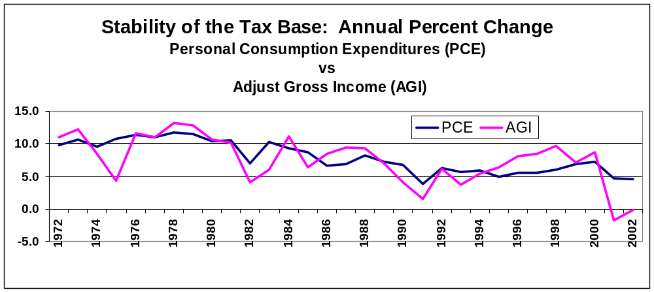
Appendix
Relative stability of taxable bases,
1972 to 2002
Source: Ross Korves, chief economist (retired), American Farm Bureau Federation

Slide 25
Appendix
Americans For Fair Taxation (FairTax.org)
Non-partisan/non-profit
Local volunteer leadership in all 50 states and the majority of congressional districts
Almost 600,000 members
With endorsing, allied, and like-minded organizations, a total grassroots reach above seven million
www.fairtax.org
1-800-FAIRTAX

Slide 26
Selected References
Tax base and rate calculation
Jorgenson, Dale, The Economic Impact of the National Retail Sales Tax, Final Report to Americans For Fair Taxation, May 18, 1997.
Kotlikoff, Laurence, Replacing the U.S. Federal Tax System with a Retail Sales Tax – Macroeconomic and Distributional Impacts, Final Report to Americans For Fair Taxation, December, 1996.

Slide 27
References (continued)
Charitable contributions
Giving USA, 1996, p. 56.
Economic Report of the President, February 1996, pp. 284, 308.
Reynolds, Alan, “Death, Taxes and the Independent Sector: Reflections on the Past and Future Growth of Private Charities and Foundations,” The Philanthropy Roundtable, 1997, pp. 27-28.
Clotfelter, Charles T., “The Economics of Giving,” Duke University, July 2002.

Slide 28
References (continued)
State sales taxes
Mazerov, Michael, “Expanding Sales Taxation of Services: Options and Issues,” Center on Budget and Policy Priorities, June, 2003.
Economic growth & savings
Auerbach, Alan, “Tax Reform, Capital Allocation, Efficiency, and Growth,” in Economic Effects of Fundamental Tax Reform, ed. Henry Aaron and William Gale (Washington: Brookings Institution Press, 1996), p. 58.
Golob, John E., “How Would Tax Reform Affect Financial Markets?” Economic Review, Federal Reserve Bank of Kansas City, Fourth Quarter, 1995.

Slide 29
References (continued)
Robbins, Gary and Aldona, "Eating Out Our Substance: How Taxation Affects Savings," Institute for Policy Innovation, Policy Report No. 131, September, 1995.
Compliance
Edwards, Chris, “Simplifying Federal Taxes: The Advantages of Consumption-Based Taxation,” Policy Analysis No. 416, Cato Institute, October 17, 2001.
Edwards, Chris, “Options for Tax Reform,” Policy Analysis No. 536, Cato Institute, February 24, 2005.
Dronenburg, Ernest J. “SAFCT: State Administered Federal Consumption Tax: The Case for State Administration of a Federal Consumption Tax,” paper presented at NYU Annual State and Local Taxation Conference, New York, Nov. 30, 1995

