Slide 1
Independent Regular Worksheets B and C
EFC

Slide 2
Objectives
Calculate the EFC using Worksheets B and C
Identify allowances against a student’s and spouse’s income
Evaluate impact of assets
Evaluate inclusion of untaxed income from FAFSA worksheets A, B, and C

Slide 3
Scenario 1
Independent student without dependents
TN resident
Student’s AGI $16,500
Owns a small business with 112 full-time equivalent employees and a net worth of 27,000
Student’s age 29
Required to file 1040
Household size 1
Number in college 1

Slide 4
Formula Determination
Live Meeting Poll
Which formula should be applied using the information provided?
Regular
Simplified
Automatic Zero
Changes directly made to this slide will not be displayed in Live Meeting. Edit this slide by selecting Properties in the Live Meeting Presentation menu.

Slide 5
Scenario 1 Poll Answer
Formula to use – Regular
Why
  Student filed 1040

Slide 6
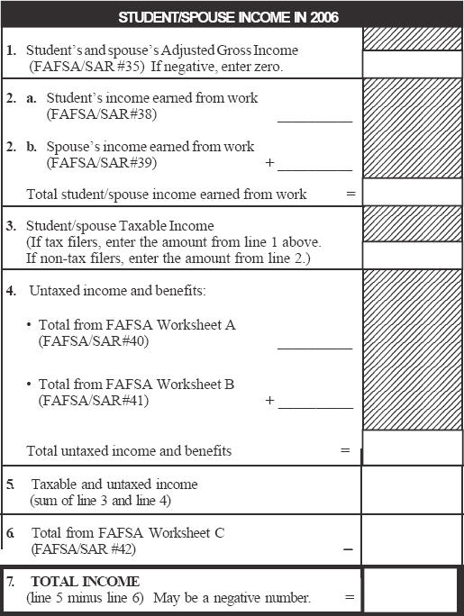
Student’s Income
^{16,500}
^{16,500}
^{16,500}
^{16,500}
⁰
^{16,500}
⁰
^{16,500}

Slide 7
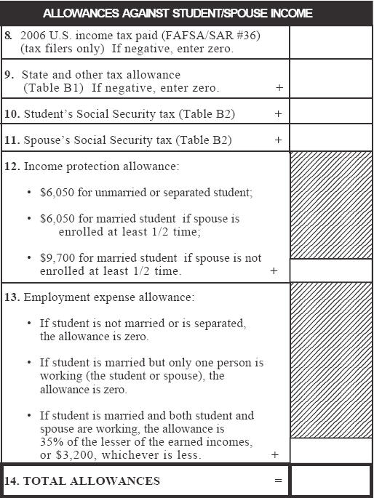
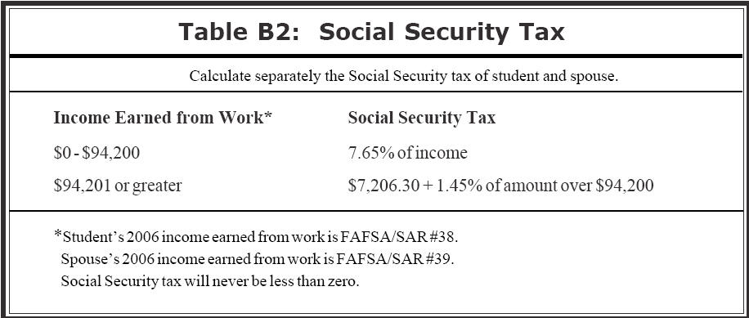
Tax Allowances
^{2,094}
^{TN Tax Rate: 0%}
⁰
^{1,262}
^{.0765 X 16,500 = 1,262}
^{2,094}

Slide 8
Allowances Against Student Income
^{2,094}
⁰
^{1,262}
^{6,050}
⁰
^{9,406}

Slide 9
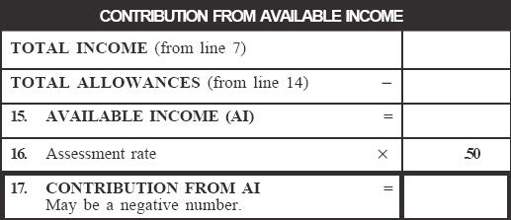
Contribution from Available Income
^{16,500}
^{9,406}
^{7,094}
^{3,547}

Slide 10
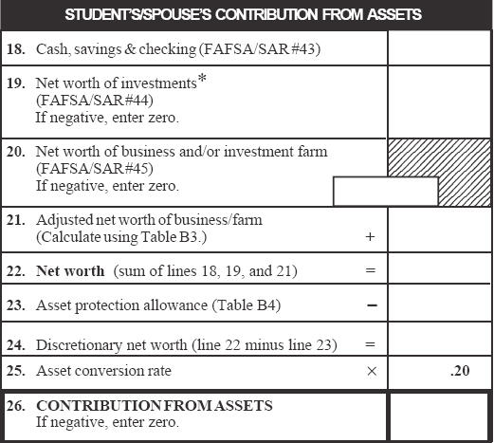
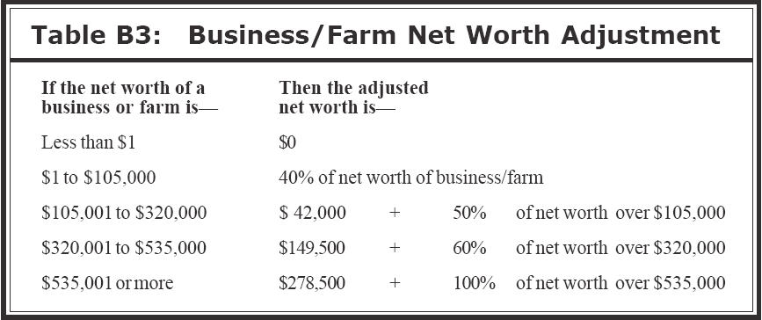
Contribution from Assets
^{1,300}
⁰
^{27,000}
^{.40 X 27,000 = 10,800}
^{10,800}
^{12,100}

Slide 11
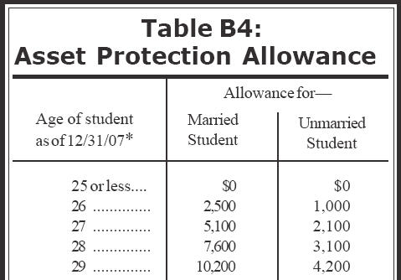
Contribution from Assets
^{27,000}
^{12,100}
^{4,200}
^{7,900}

Slide 12
Contribution from Assets
^{1,300}
⁰
^{27,000}
^{10,800}
^{12,100}
^{4,200}
^{7,900}
^{1,580}

Slide 13
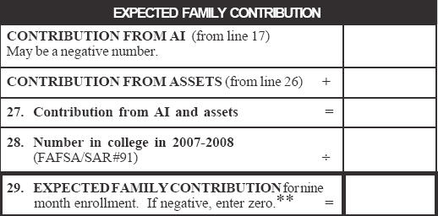
Expected Family Contribution
^{3,547}
^{1,580}
^{5,127}
¹
^{5,127}

Slide 14
Scenario 2 - Activity
Complete the Regular Worksheet C activity located on PW page 4-3

Slide 15
Scenario 2 – Activity Debrief
Independent student
  Married with dependent
VA residents
Student/spouse AGI $36,200
  Filed 1040
Student’s age 29
Household size 3
Number in college 1

Slide 16
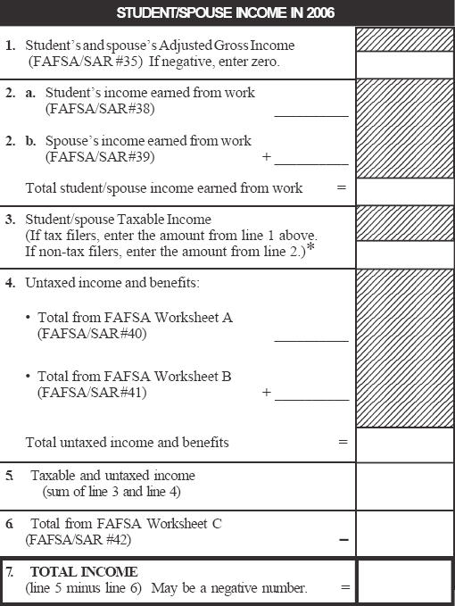
Total Income
^{36,200}
^{8,800}
^{27,000}
^{35,800}
^{36,200}
^{1,240}
^{1,240}
^{37,440}
⁰
^{37,440}

Slide 17
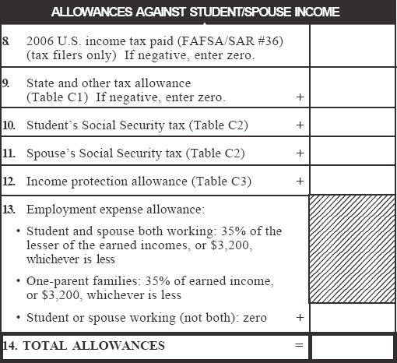
Allowances Against Income
^{4,859}
^{VA Tax Rate: 4%}
^{.04 X 37,440 = 1,498}
^{1,498}
^{.0765 X 8,800 = 673}
⁶⁷³
^{2,065}
^{.0765 X 27,000 = 2,065}
^{19,070}
^{.35 X 8,800 = 3,080}
^{3,080}
^{31,245}

Slide 18
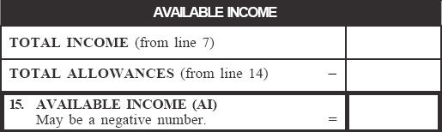
Available Income
^{37,440}
^{31,245}
^{6,195}

Slide 19
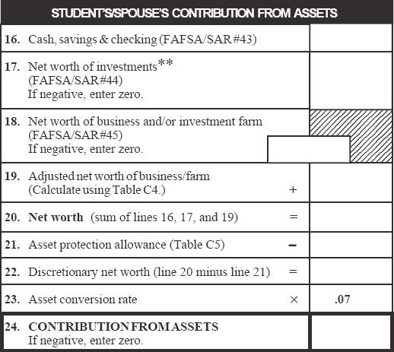
Contribution from Assets
^{1,300}
⁰
^{27,000}
^{.40 X 27,000 = 10,800}
^{10,800}
^{12,100}
^{10,200}
^{1,900}
¹³³

Slide 20
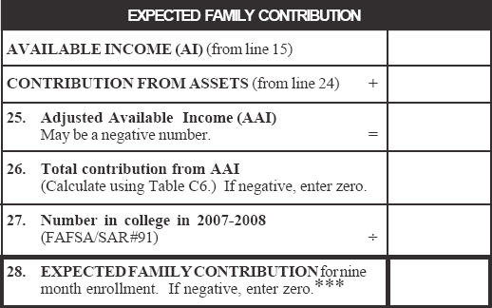
Expected Family Contribution
^{6,195}
¹³³
^{6,328}
^{1,392}
¹
^{1,392}

Slide 21
Asset Conversion Rate
Live Meeting Poll
An asset of $10,000 would likely result in a higher EFC for an
independent student without dependents other than a spouse
independent student with dependents other than a spouse
Changes directly made to this slide will not be displayed in Live Meeting. Edit this slide by selecting Properties in the Live Meeting Presentation menu.

Slide 22
Asset Conversion Rate Poll Answer
Independent without dependents since the asset conversion rate is higher at 20% vs. 7%

Slide 23
Compare Asset Contribution
Scenario 1
Scenario 2
^{1,300}
^{1,300}
⁰
⁰
^{27,000}
^{27,000}
^{10,800}
^{10,800}
^{12,100}
^{12,100}
^{4,200}
^{10,200}
^{1,900}
^{7,900}
¹³³
^{1,580}

Slide 24
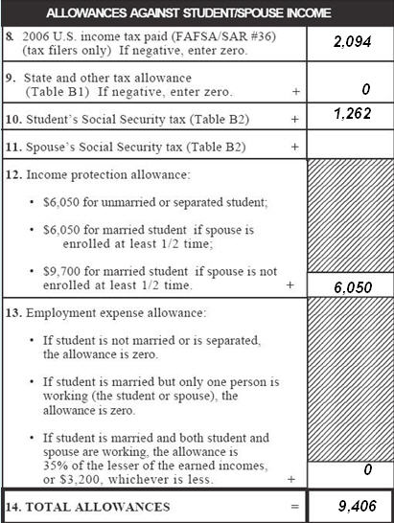
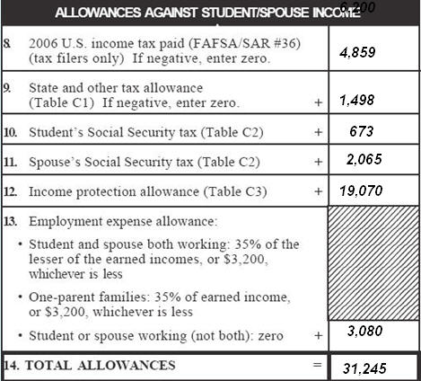
Compare Income Protection Allowance
Scenario 1
Independent Without Dependents
Scenario 2
Independent With Dependents

Slide 25
Closing
Questions or comments

