Slide 1

DOE Hydrogen Program
and the
Role of Systems Analysis
Fred Joseck
Technology Analyst
DOE Hydrogen Program
April 12, 2005

Slide 2
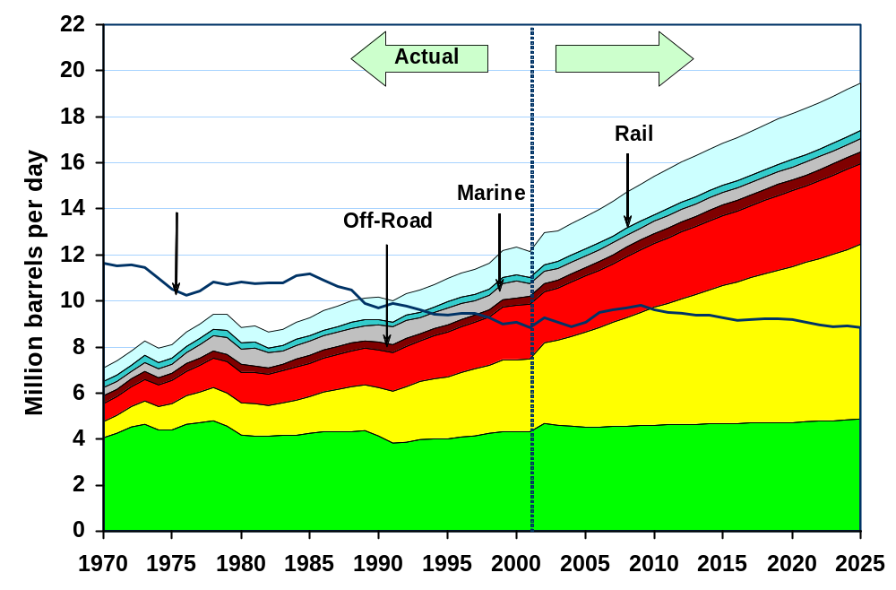
Transportation Petroleum Use by Mode (1970-2025)
2003 Total = 13.42 mbpd
Note: Domestic production includes crude oil, natural gas plant liquids, refinery gain, and other inputs. This is consistent with EIA, MER, Table 3.2. Previous versions of this chart included crude oil and natural gas plant liquids only.
Source: Transportation Energy Data Book: Edition 24, ORNL-6973, and EIA Annual Energy Outlook 2005, Preliminary release, December 2004.

Slide 3

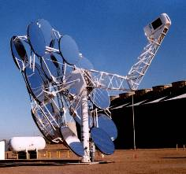


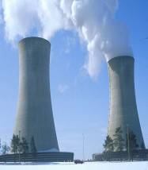

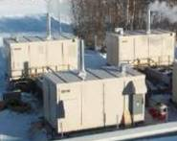
Why Hydrogen?
Energy Security
  Produced from diverse domestic resources
Environment
  Mobile criteria pollutants eliminated
  Stationary emissions easier to control
  Greenhouse gas emissions reduced
Economic Competitiveness
  Abundant, reliable, and affordable energy is an essential component in a healthy, global economy
Biomass
Transportation
HIGH EFFICIENCY & RELIABILITY
Hydro
Wind
Solar
Geothermal
Nuclear
Distributed
Generation
Oil
Coal
With Carbon Sequestration
Natural Gas*
ZERO/NEAR ZERO
EMISSIONS
It’s abundant, clean, efficient, and can be derived from diverse domestic resources
U.S. Energy Policy for hydrogen is focused on research
* H₂ from NG during transition phase only

Slide 4
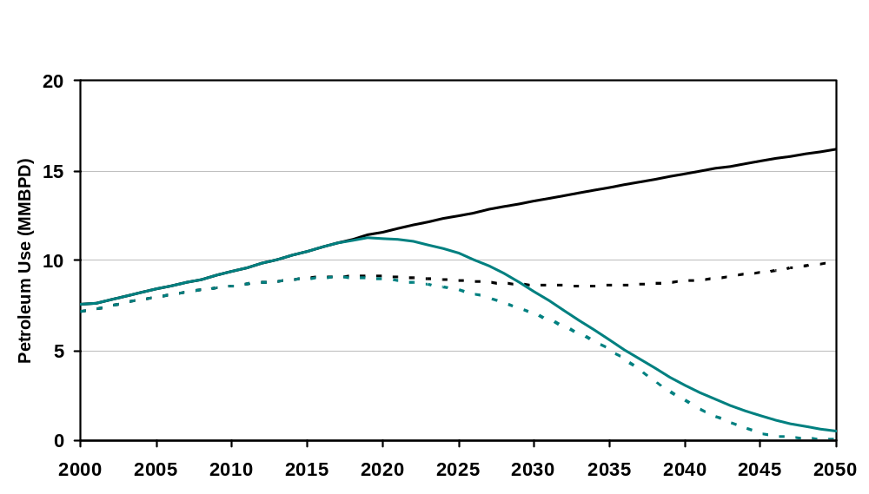

Hybrids are a Bridge
Hybrid vehicles are a bridge technology that can reduce pollution and our dependence on foreign oil until long-term technologies like hydrogen fuel cells are market-ready.
Potential scenarios – not predictions
Hybrid/Hydrogen FCV Strategy
Near-term focus on hybrids
  Transition Phase to Hydrogen; decentralized H2 production from distributed natural gas
  Long-term hydrogen fuel production from diverse domestic carbon free sources such as renewables, nuclear and coal with sequestration.
  *Only carbon emissions come from energy used in hydrogen production & delivery process

Slide 5


Hydrogen Infrastructure and Fuel Cell Technologies put on an Accelerated Schedule
  President Bush commits a total $1.7 billion over first 5 years:
    $1.2 billion for hydrogen and fuel cells RD&D ($720 million in new money)
    $0.5 billion for hybrid and vehicle technologies RD&D
  Accelerated, parallel track enables industry commercialization decision by 2015.
Fuel Cell Vehicles in the Showroom
and Hydrogen at Fueling Stations
by 2020

Slide 6

Integrated Plan Developed to Overcome Challenges
Describes technology development to support commercialization decision by industry in 2015
Covers basic research through technology validation
  Office of Science
  Office of Fossil Energy
  Office of Nuclear Energy, Science and Technology
  Office of Energy Efficiency and Renewable Energy
Identifies performance-based milestones for stakeholders to track progress

Slide 7
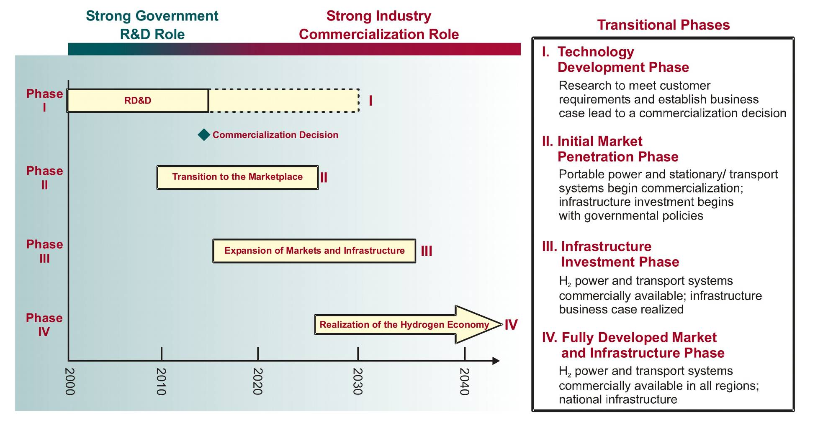
Timeline for a Hydrogen Economy
Positive commercialization decision in 2015 leads to beginning of mass-produced hydrogen fuel cell cars by 2020

Slide 8
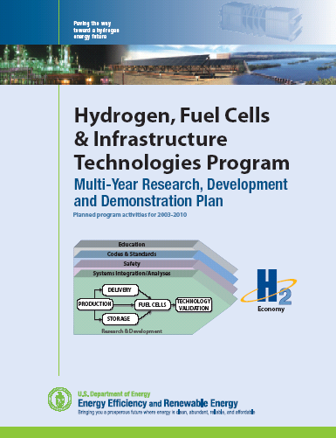
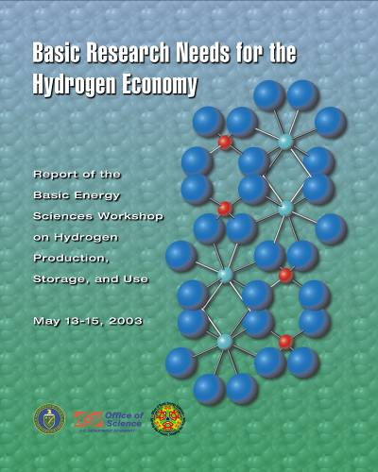
Barriers to a Hydrogen Economy
Critical Path Technology Barriers:
Hydrogen Storage (>300 mile range)
Hydrogen Production Cost ($1.50-2.00 per gge)
Fuel Cell Cost (< $50 per kW)
Economic/Institutional Barriers:
Codes and Standards (Safety, and Global Competitiveness)
Hydrogen Delivery (Investment for new Distribution Infrastructure)
Transition from a Hydrocarbon-Based Economy to a Hydrogen-Based Economy
Education
http://www.eere.energy.gov/hydrogenanfuelcells/mypp/
http://www.er.doe.gov/production/bes/hydrogen.pdf

Slide 9

The National Energy Plan (NEP)
NEP Recommended:
Increasing international cooperation on finding alternatives to oil, especially for the transportation sector
Promotion of market-based solutions to environmental concerns
Support of exports of U.S. clean energy technologies and encourage overseas development activities,
To explore collaborative international basic research and development in energy alternatives and energy-efficient technologies,
Exploration of innovative programs to support the global adoption of these technologies.

Slide 10









FreedomCAR and Fuel Partnership
Established
New Energy Company/DOE
Technical Teams
Production
Delivery
Fuel Pathway Integration
New Joint Auto/Energy/DOE
Technical Teams
Codes and Standards
Storage

Slide 11
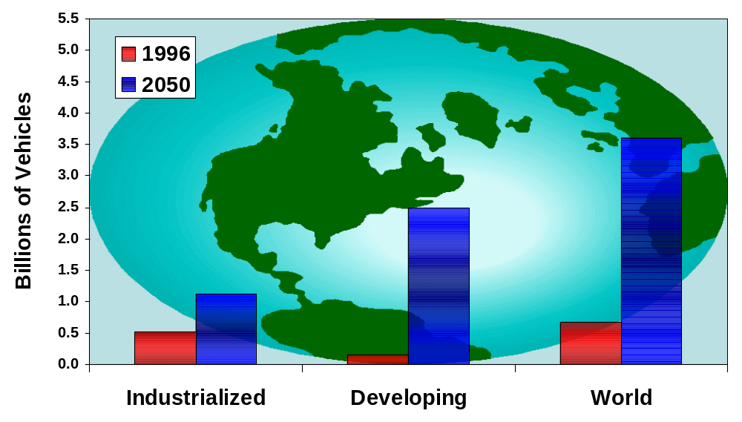
. . . the Number of Vehicles in the World Is Growing
Global Perspective
Source: EE Analytic Team
Many countries have concerns about energy and environmental security related to transportation/mobility
Notes:
The number of worldwide automobile and truck registrations is expected to grow tremendously in future years*. Here’s the situation in industrialized countries – a doubling between now and 2050.* Developing nations like China and India are expected to experience an explosion in the number of vehicles. *Over the next 50 years, the number of vehicles worldwide would grow from 670 million to over 3.5 billion.

Slide 12
















International Partnership for the Hydrogen Economy
Russian
Federation
Iceland
USA
Canada
Japan
IPHE Partners’ Economy:
Over $35 Trillion in GDP, 85% of world GDP
Nearly 3.5 billion people
Over 75% of electricity used worldwide
> 2/3 of CO₂ emissions & energy consumption
United
Kingdom
South
Korea
France
IPHE Vision:
“… consumers will have the practical option of purchasing a competitively priced hydrogen power vehicle, and be able to refuel it near their homes and places of work, by 2020.”
- Secretary Abraham, April 2003
China
Germany
India
Italy
Brazil
European
Commission
Australia
Norway

Slide 13

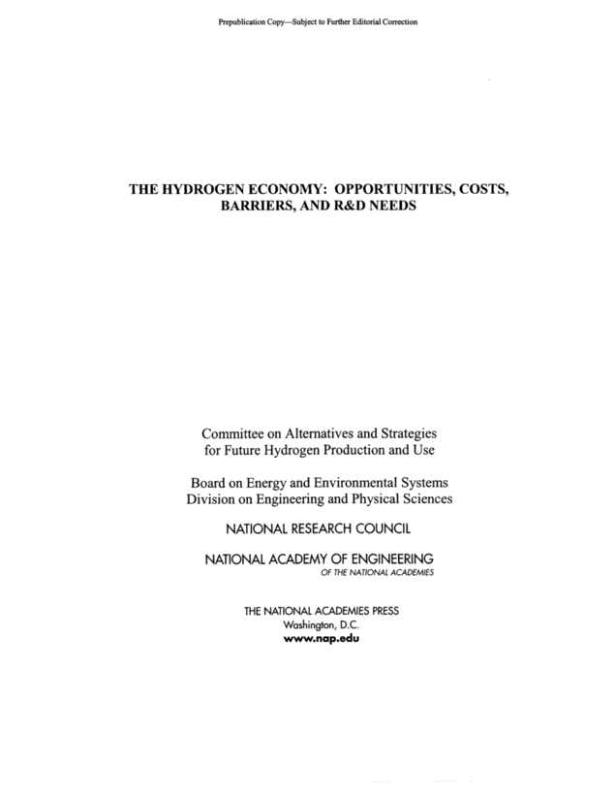
DOE Requested the National Academies to Evaluate its Hydrogen Planning
“A transition to hydrogen as a major fuel in the next 50 years could fundamentally transform the U.S. energy system, creating opportunities to increase energy security through the use of a variety of domestic energy sources for hydrogen production while reducing environmental impacts …”
“This committee believes that investigating and conducting RD&D activities to determine whether a hydrogen economy might be realized are important to the nation.”

Slide 14
DOE is Evolving its H₂ Program to Respond to NRC Recommendations
Focus on the “transition” to a hydrogen economy, critical issues needed for 2015 decision
  Exploratory research on hydrogen storage and fuel cell cost & durability
  “Laser-like” focus on distributed hydrogen infrastructure. Lower capital costs & increase efficiency of natural gas reformers and electrolyzers
Let the long-term hydrogen economy “evolve”
  Fundamental and exploratory research on coal/carbon capture sequestration, photoelectrochemical, photobiological, thermochemical, etc.
The National Academies’ conclusions support the President’s vision.
DOE concurs fully with 35 of 43 recommendations.
Currently evaluating other 8 for implementation.

Slide 15
Path Forward to Implement the
NRC Recommendations
Use hydrogen storage model to shift emphasis in fuel cells to exploratory research for cost & durability
Increase investments in natural gas reforming and electrolyzers (treat these as critical path)
Employ systems analysis to map out options and a transition plan consistent with developing infrastructure
Strengthen infrastructure program (storage, purity, pipeline materials, compressors, leak detection, permitting, and codes/standards)
Increase underlying safety research and analysis
Establish fundamental science efforts in longer term hydrogen production concepts, storage, fuel cells, etc.
Integrate with carbon capture/sequestration and across all department programs

Slide 16
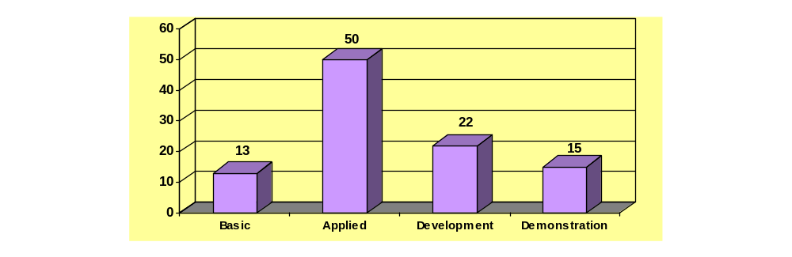
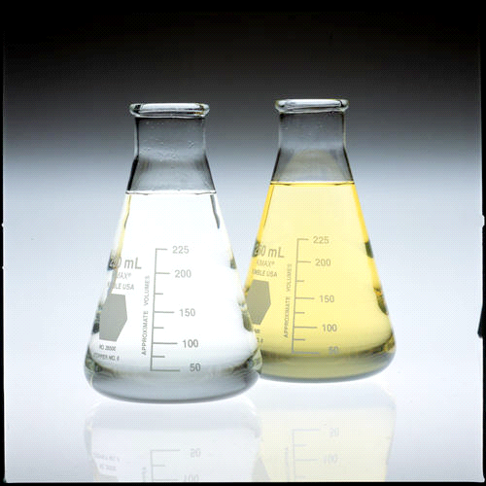

Balanced Program Being Implemented
FY 2006 Total Budget Request by Category ($259.5M)
% of Budget
Technology Validation through “Learning Demonstrations”
Research & Development

Slide 17
Systems Analysis
Introduction
Systems Analysis
  Coordinated, comprehensive analytical and modeling function for the DOE Hydrogen Program.
  Integrated process linking modeling tools and resources.
  Foundation for decision making from a consistent set of inputs.
The Hydrogen Economy: Opportunities, Costs, Barriers, and R&D Needs
“The effective management of the
hydrogen program…far
more challenging than any activity
previously undertaken…”
“…establish a systems analysis function…”
NRC, February 4, 2004
Finding 9-2
Recommendation 9-3
  The importance and need of a robust Systems Analysis capability, supporting the DOE Hydrogen Program, was identified in the National Research Council and National Academy of Engineering report (The Hydrogen Economy: Opportunities, Costs, Barriers, and R&D Needs, February 2004).

Slide 18
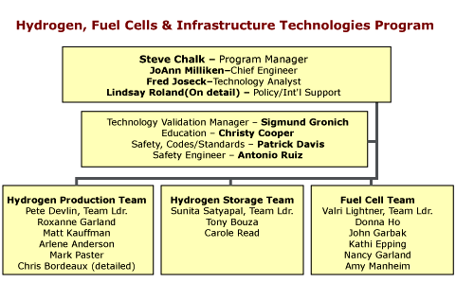
Organization
Systems
Integrator -
Dale
Gardner
(NREL)

Slide 19

Systems Analysis
Purpose
  Identify the impacts of various hydrogen technology pathways.
  Identify the key costs, associated cost elements and the cost drivers.
  Evaluate the research and development status and priorities.
    Evaluate the significance of R&D results.
    Assess and make recommendations concerning the progress of R&D efforts.
SYSTEMS ANALYSIS
DELIVERY
TECH.
VALIDATION
Economy
PROD.
FUEL CELL
STORAGE
RESEARCH & DEVELOPMENT

Slide 20
Key Barriers and
Systems Analysis
Key Barriers to be addressed through Systems Analysis
  Infrastructure requirements and development
  Transition
    Understanding the transition from a hydrocarbon based economy to a hydrogen based economy.
    Vehicle penetration
  Means
  Modeling
  Analysis
  Analysis community
SYSTEMS ANALYSIS
DELIVERY
TECH.
VALIDATION
Economy
PROD.
FUEL CELL
STORAGE
RESEARCH & DEVELOPMENT

Slide 21
Systems Analysis
Systems Analysis Projects in 2005
Project
Organization
Project Type/Description
Macro-System Model
NREL
Model development for overarching modeling of infrastructure, transition and production.
Transitional Analysis
DTI
Transition Analysis with available resources and infrastructure.
Transitional Analysis
EEA
Transitional analysis with Markal model with focus on competition between H2 production with respect to demand.
Transitional Analysis
RCF
New model for transition analysis will be built with an AGENT based modeling philosophy.
Emissions Analysis
ANL
Analyze the WTW emissions for various production, delivery and transition scenarios.
Fuels Choice
TIAX
Risk based analysis for fuels choice options.
Infrastructure Anal.
NREL
Analysis of infrastructure with the Geographic Information System.
HyDS
NREL
Model development for the optimization of hydrogen production, delivery and infrastructure using the WINDS framework.

Slide 22
Summary
Cost Reduction is a Primary R&D Driver
Hydrogen Production and Delivery
  Cost of hydrogen must be competitive with gasoline, without adverse environmental impacts
    $1.50/gge-$2.00/gge untaxed
Hydrogen Storage
  Capacity must enable >300-mile range, and meet packaging, performance, and cost requirements
    $2/kWh (~ $300 for 5-kg H₂ storage system)
Fuel Cells
  System cost must be competitive with ICE and meet performance and durability requirements
    $30/kW (~ $2400 for an automotive fuel cell system)
High-volume manufacturing processes are critical to meeting
cost targets.
Systems Analysis will be focusing on infrastructure and transition
analysis.
A lot of work ahead…

Slide 23
Backup

Slide 24
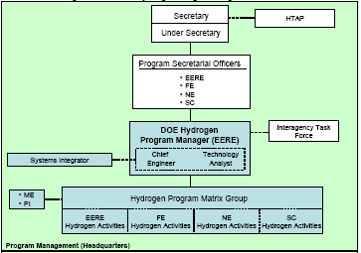
Organization
HFCIT

Slide 25
Hydrogen Modeling Methodology Overview
Systems Analysis
Outputs/
Results
Market & Benefits Analysis (PBA)
(NEMS and MARKAL Models)
Balanced R&D portfolio
Information for making federal investment decisions
Implications of policy decisions
Identification of interagency coordination.
Macro System Model
Standard Set of Base Models
Data Book
Transition & Vehicle
Penetration Models
Vehicle Model PSAT
Hydrogen Posture Plan

Slide 26
PEM Fuel Cell Cost
7X gap between today’s high volume cost & our target
Cost of a fuel cell prototype remains high (~$3,000/kW), but the high volume¹ production cost of today’s technology has been reduced to $225/kW
Through 1990, PEM cost was dominated by platinum loading (~20g/kW)
3000
Cost goal of $30/kW approximates the cost of conventional engine technology
Today’s high volume estimate is $225/kW and is attributed to platinum and membrane cost
Cost in $/kW
50kW system
Cost improved through
Platinum reduction to
0.8 g/kW
Further platinum reduction to
goal of 0.2g/kW, and
reduced membrane cost
200
30
1990
1995
2000
2005
2010
2015
Year
High volume production defined as 500,000 units per year
Cost estimated by Tiax with enhanced hydrogen storage.

Slide 27
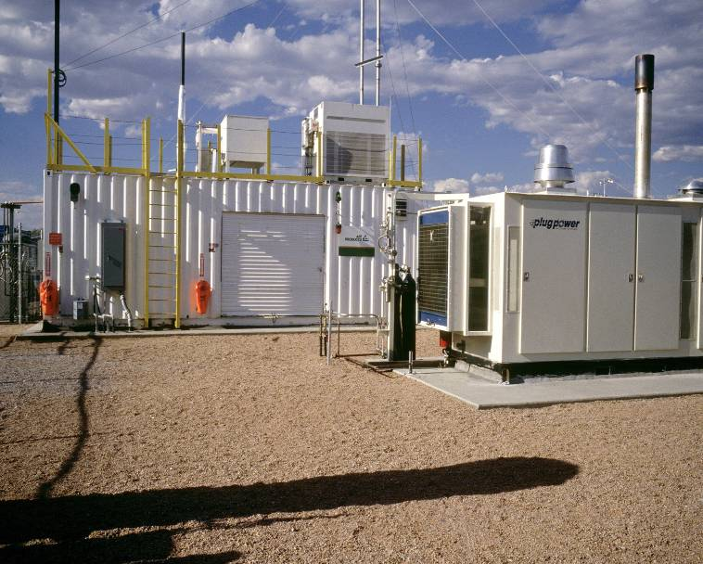

Distributed Hydrogen Production From Natural Gas On Target
APCI validated $3.60/gge hydrogen – delivered, untaxed, co-producing electricity at 8¢ per kWh.
$3.00/gge target in 2005 within reach
Reformer research
  Optimized desulfurization, reformer, and shift catalysts
  Improved heat recovery system
PSA research
  99.999% pure H₂
  3x cost reduction compared to commercial units
  Decreased size
  82% efficiency (64% in 2003)
Las Vegas station
In 2025, assuming FCVs represent 12% of LDV inventory, EIA estimates only 2.8% increase in natural gas demand compared to reference case
PSA Unit
Notes:
Reducing refueling station capital costs and improving system efficiencies are technical barriers being overcome with the APCI “Turnkey Refueling Station” partnership. At the start of this partnership, the efficiency of commercial H2 PSA units was approximately 64% when delivering 99.999% purity H2 from a steam-methane-reformer syngas stream delivered at 120 psig. As a reminder, H2 PSA efficiency is defined as: (moles of H2 in product H2 stream) / (moles of H2 in syngas stream fed to PSA unit).
Significant progress has been achieved as a result of APCI investigating new adsorbents, developed a new PSA mechanical system, and built and operated 2 prototype H2 PSA units in the field. These field PSA units (located in Butler, PA) are operating at just over 80% efficiency, which meets or exceeds the PSA target for 2005 ! More specifically, novel structured adsorbents and advanced beaded adsorbents show significant improvement in bed size and hydrogen recovery. PSA cycle development work concluded and was used to fully utilize the advanced adsorbents capabilities.
Regarding capital cost, the DOE has communicated H2 PSA goals of reducing the cost from $0.17/kg H2 to $0.11/kg H2, or a 35% reduction in cost. To date, APCI’s new H2 PSA unit is about 1/3 to 1/4 the cost (65 to 75% reduction in cost) of the H2 PSA systems available when we started the program, again meeting the DOE targeted improvement.
In FY 04, APCI continues working towards integrating a new second generation reformer (based on the Las Vegas Harvest reforming technology) with the other system subcomponents. Dispenser development was just completed.

Slide 28
Analysis Roles & Responsibilities
TECHNOLOGY ANALYST
Accountable for analysis activities
Provide inputs/priorities to the Analysis Agenda
Advises PM on policy issues
Assure communication of a consistent data and info
Provide analysis that is inherent Govt responsibility
Provide analysis in response to short-term and urgent requests (quick-response tasks)
Primary direction/guidance interface with TDMs/subprograms and Tech Teams
Provide analysis coordination within DOE (EERE programs, Offices, PBA, EIA)
Interpret analysis scenarios provided by SI

Slide 29
Analysis Roles & Responsibilities
NREL SYSTEMS INTEGRATION
Develop Analysis Agenda (including technical and time pathways)
Develop, maintain, resolve consistent data sets/info and standard analysis assumptions and guidelines
Provide independent analysis (policy-related issues, Go/No-Go recommendations, H2 in the context of larger energy markets, etc.)
Ensure tools/models are developed, maintained, available, validated
Provide independent review of analysis results
User and/or requestor of info generated by TA (especially from other parts of DOE)
Define analysis scenarios

