Slide 1

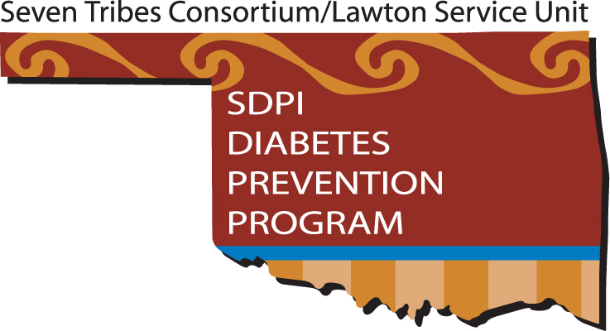
Lawton Diabetes Prevention Program
Lawton Indian Health Service
1515 Lawrie Tatum Road
Lawton, OK 73501
580-354-5640
May 20, 2008

Slide 2
About Lawton Service Unit
Services 10 counties in SW Oklahoma where 25,000+ members of the Apache, Caddo, Comanche, Delaware, Ft. Sill Apache, Kiowa, and Wichita are concentrated
Lawton Service Unit includes the Lawton Indian Hospital, the Anadarko Indian Health Center, and the Carnegie Health Station
LIH located in Lawton, the third largest city in Oklahoma, has a staff of 31 providers (23 physicians)

Slide 3
History
2004 – LSU DPP Competitive Grant Awarded (input DM program, CHRs, REACH 2010, OU)
October 2005 – program planning began after many challenges
May 2006 – actual program implementation began

Slide 4
Diabetes Prevention Program Staff
Sandra Miller, RN, BSN, CDE – Program Dir/Coord/Nurse Ed
Myrna Quinones, RD/LD, CDE – Dietitian
Sunshine Fixico – Lifestyle Coach
Gwendolyn Scott – Lifestyle Coach
Daisy Mammedaty – Lifestyle Coach
Verna Longhair – Data Entry
Cheryl Nevaquaya – Secretary
Dr. Evaristo Quinones, MD – Family Practice
Dr. Marc Clanton – Behavioral Health
Notes:
Possible staff picture?

Slide 5
Partnership
The Lawton Indian Hospital DPP partnered with the seven tribes and REACH 2010 forming the Lawton Service Unit/7Tribes Consortium.
Funds were budgeted for the 7 tribes to recruit/screen/promote in their respective communities.
The Lawton Indian Hospital DPP staff conducts the Intensive Classes, assists with the community activities, provides less intensive activities, and collaborates with the community workers.

Slide 6
GOAL
Every tribal member will know that Pre-Diabetes exists and will have an opportunity to receive information about testing and prevention.

Slide 7
Promotion/Recruitment/Screening
Partnership efforts results as of 9/07:
133 events/activities reached a total of 357,412 community members
660 persons were screened
54 recruited

Slide 8
Intensive Activities
Classes held at LIH, AIHC, and 1 tribal complex
As of 5/2008:
85 completed intensive classes (68 LIH and 17 AIHC)
13 currently in class
30 dropped

Slide 9
Retention and Aftercore
Lifestyle Coaches
are in direct contact with participants,
attend the classes with the participants,
coordinate information about community events as well as DPP activities,
Participate in weekly department meetings

Slide 10
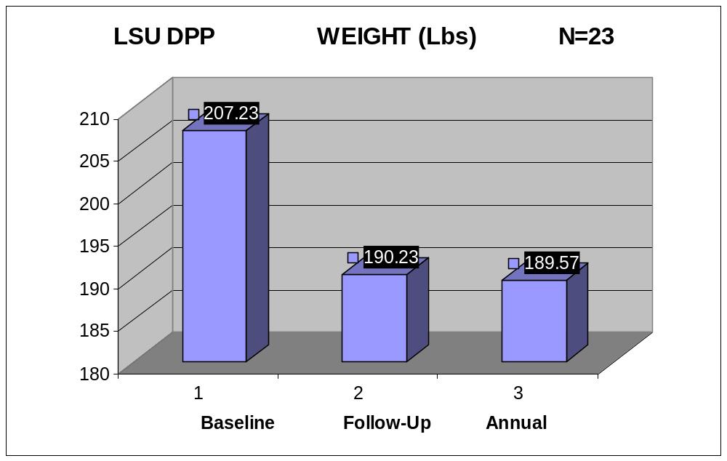

Slide 11
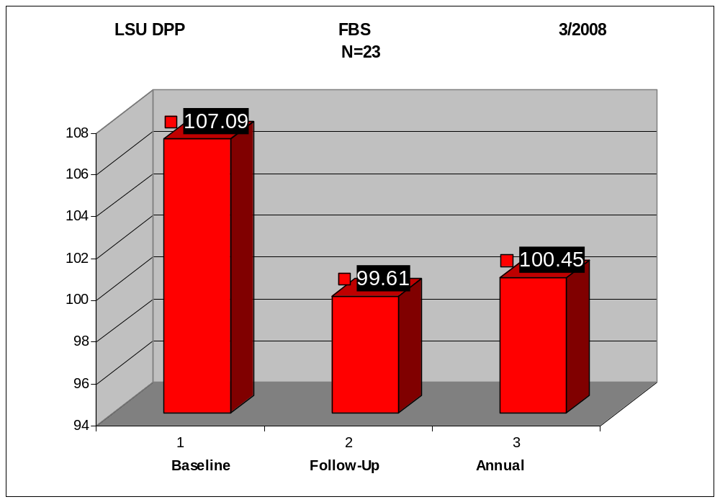

Slide 12
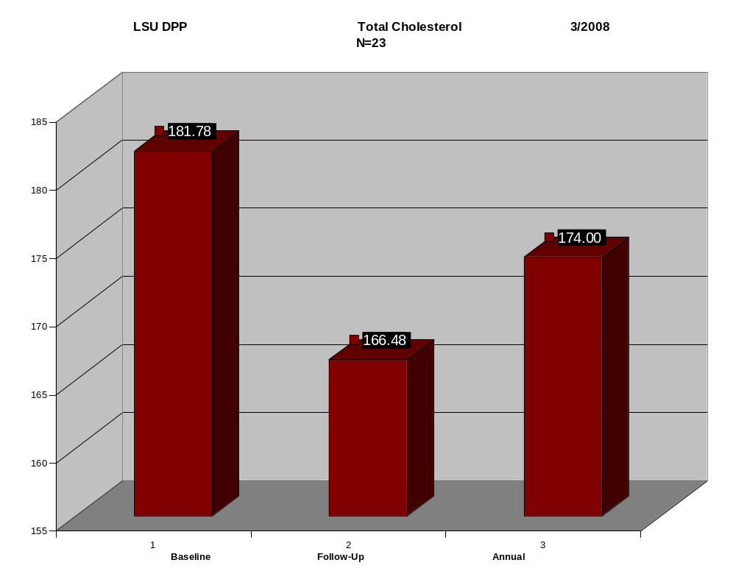

Slide 13
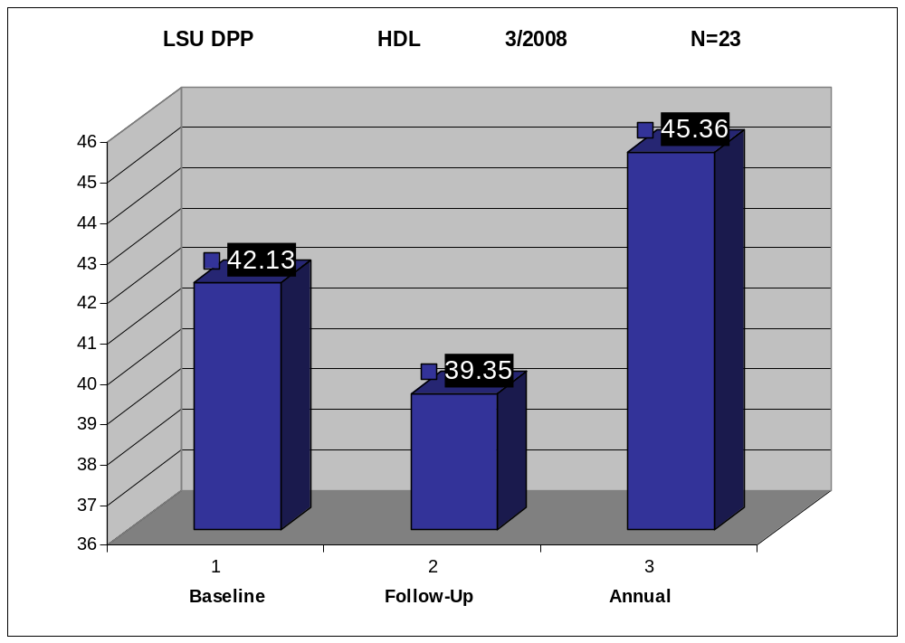

Slide 14
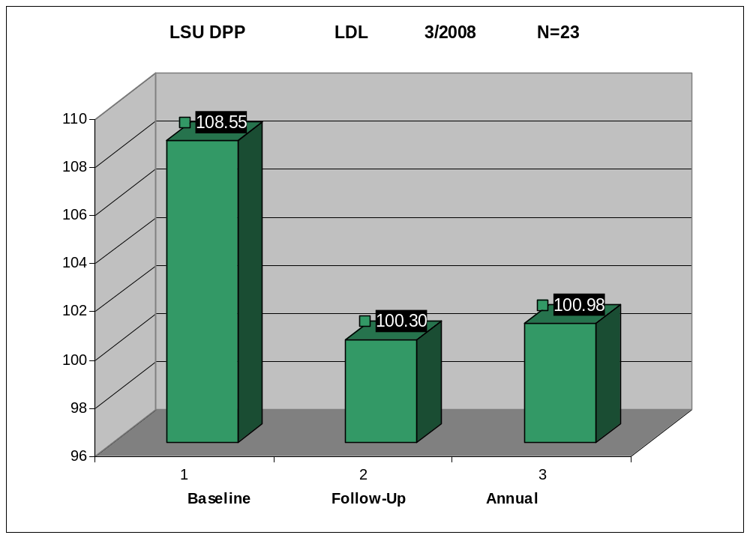

Slide 15
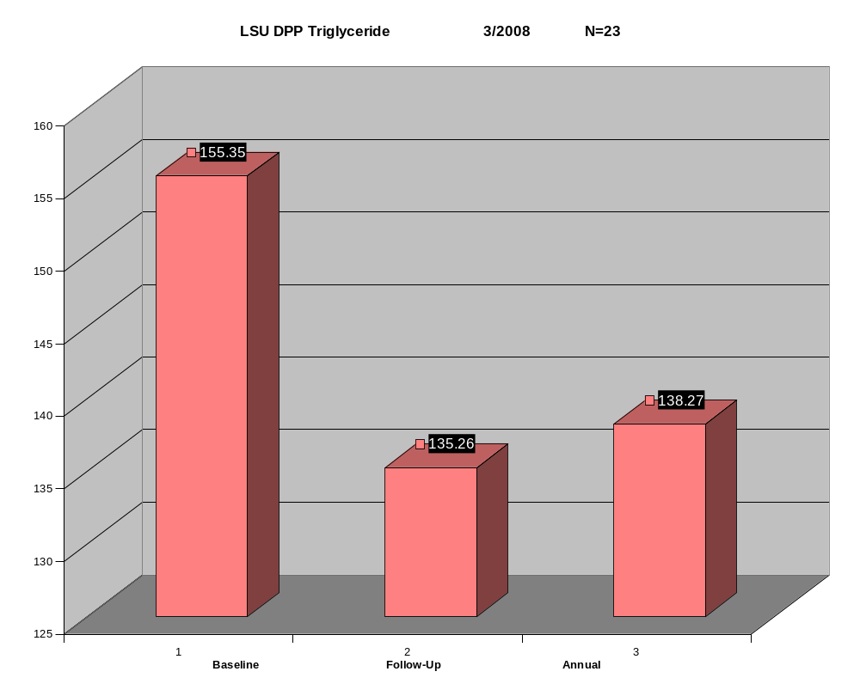

Slide 16
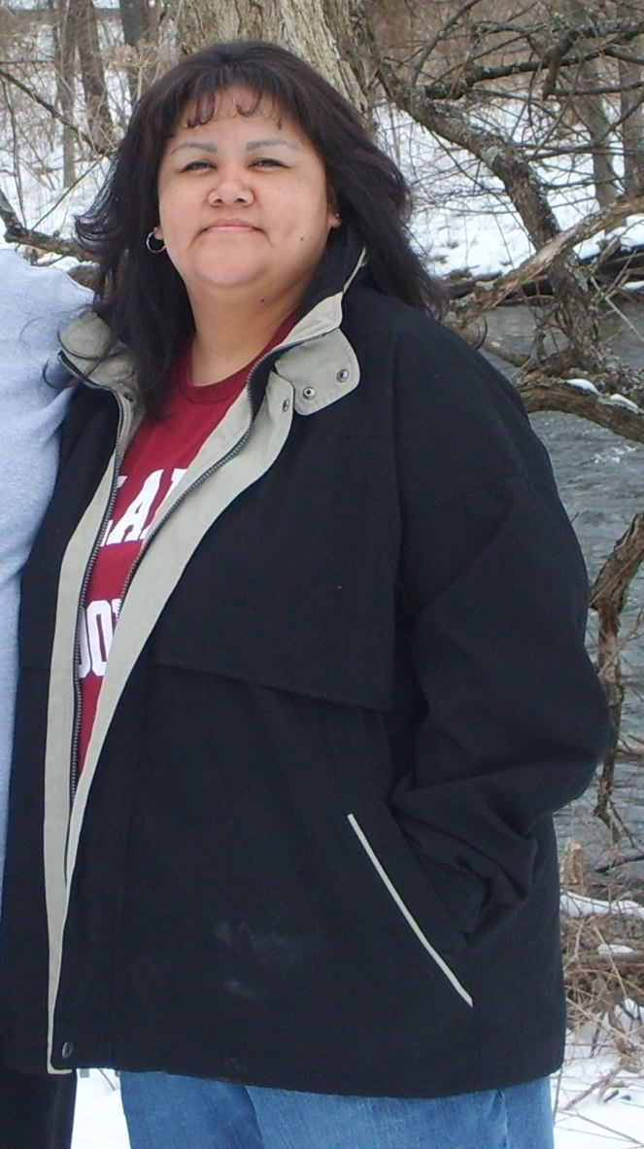
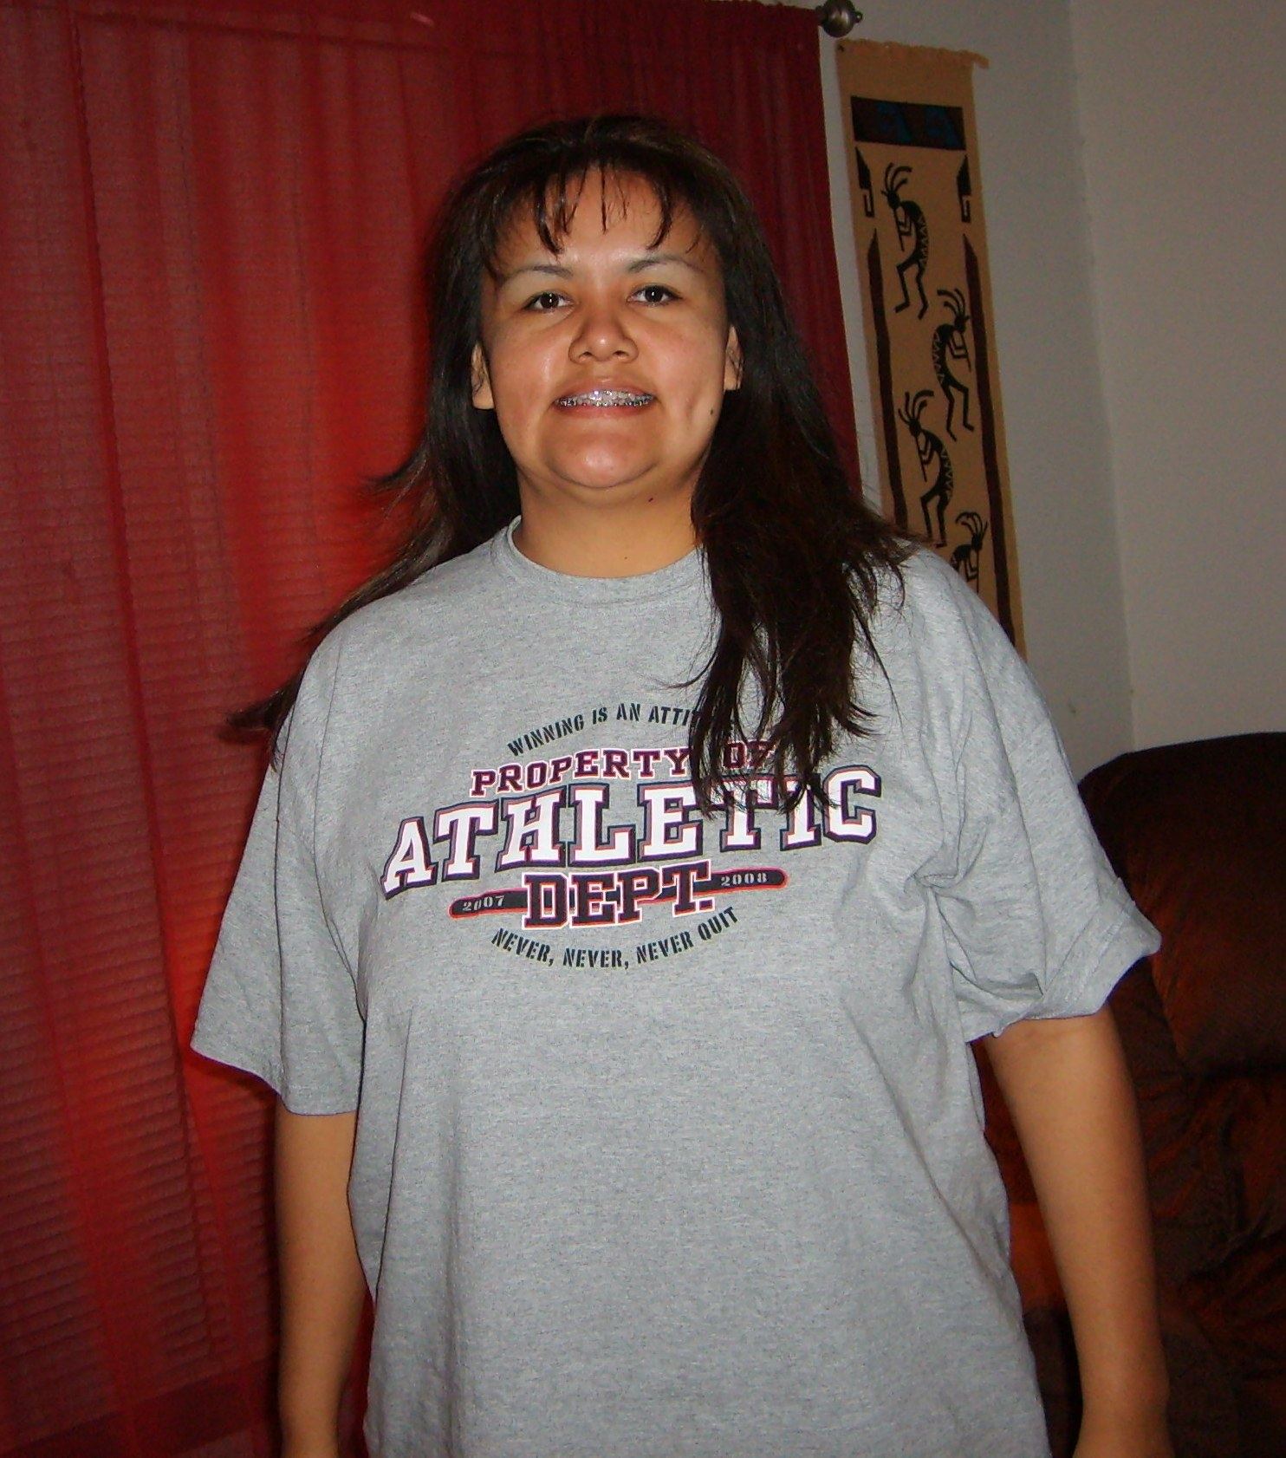
“I consider myself a successful participant because of what I’ve accomplished since the
start of the program. I’ve accomplished a healthier me…I will never go back to that overweight person.” JP
2007
2008

Slide 17
Our Best Foot Forward
Our (proudest) accomplishment is the success of our participants. Pride comes from knowing those who go through our program will benefit from what they learn in class and from our staffs’ commitment to those participant’s goals.
Our program success comes only from a partnership with the community, with health professionals, with our education program staff and with the participants.
Wellness- a state of balance of the mind, body, soul and spirit.

