Slide 1


Analysis of digital ECG data -- Public presentations
What can you do with the digitized ECG waveform that you cannot do with a paper ECG record?
Continuous 12-lead ECG recording
Daniel B. Goodman, MD
Director Medical Affairs and Scientific Innovation
Covance Central Diagnostics, Covance, Inc.
Reno, NV USA

Slide 2
The Problem
Are we at the limit of the information value of the QT interval for repolarization analysis?
Better measurements of single ECGs only address methodological variation
High biologic variation of QT and QTc is inescapable
Need to achieve high statistical power with reasonable number of subjects
  to advance or reject compounds early
  to collect and analyze data in cost-effective manner

Slide 3
Proposed Solution
  Collect data continuously to ensure detection of peak effects
  Ensure availability at times of critical drug activity: C_{max}, E_{max}
  Collect continuously to fully characterize dose-response relationship: max tol dose
  Collect large number of data points to improve power by averaging

Slide 4
Why this talk?
  “What can you do with the digitized ECG waveform that you cannot do with a paper ECG record?”
  Paper ECGs can never meet this challenge
  Continuous ECGs can never be analyzed or reviewed in a paper environment
  The FDA mandate for digital data must support this breakthrough technology

Slide 5
Wide normal range of the QT
Population reference range
  14,379 children and adults from NHANES Study
  Males: mean QT std dev 40.1 msec (10.8%)
  Females: mean QT std dev 39.0 msec (10.4%)
    Rautaharju P, et al, Computers and Biomedical Research 1993: 26; 188-204
Only partially addressed by rate correction

Slide 6
Significant Intra-subject Variability
Conventional 24-hour Holter data
  21 healthy subjects
  mean intra-individual range QTc 95 msec
  std dev 20 msec
    Molnar J, et al, J Am Coll Cardiol 1996: 27; 76-83
12-lead ECG data
  1300+ healthy Scottish adults
  QTc std dev 23.4 msec (5.5 %)
    MacFarlane in Comprehensive Electrocardiology, MacFarlane, P and Veitch Lawrie, TD, Pergamon Press London, 1989, 1442

Slide 7
QTc Variability in Pharma R&D
Does pharma R&D do any better?
Actual experience
    Covance Central Diagnostics, unpublished data
  Single-site phase I study
  Single Cardiologist reader
  50 volunteers on non-treatment days
  2233 ECGs
    mean number of ECGs per subject 45
    min 17, max 54

Slide 8
Mean intra-subject QTc std dev
On all days
  14.8 msec (3.6%)
    95% range 8.6-21.7
On any day (at least 7 ECGs)
  13.3 msec (3.3%)
    95% range 5.5-24.6
By time of day (+/- 15 min) for subject
  13.2 msec (3.2%)
    95% range 4.6-25.2

Slide 9
12-lead ECG: Current State of Affairs
At HR of 72 bpm, one hour 4320 beats
Standard 12-lead ECG, 10 sec = 12 beats
  typically monitored hourly in Phase I
  total data is a single QTc value
  derived from 1-3 beats
Equivalent to sample rate of 0.7%
Inadequate in face of unknown kinetics
Inadequate in face of QT variability

Slide 10
Regulatory Encouragement
Raymond Lipicky, MD
  DIA Meeting May 7, 2001
“When is the best time to measure the ECG? CONTINUOUSLY”
“When to measure in relationship to dosing?
    At the exact time the QTc prolongation or torsades occurs
Who knows when that will be? That’s the reason for continuously.”

Slide 11
The Technology Exists Today
Two major US manufacturers with global distribution
Continuous 12-lead ECG monitoring
  distinct 12-lead ECG every 10 seconds or 8 beats
In one hour 360 - 540 values
Well-established analysis algorithms
Each QTc value derived from all beats
Sampling rate 100%

Slide 12
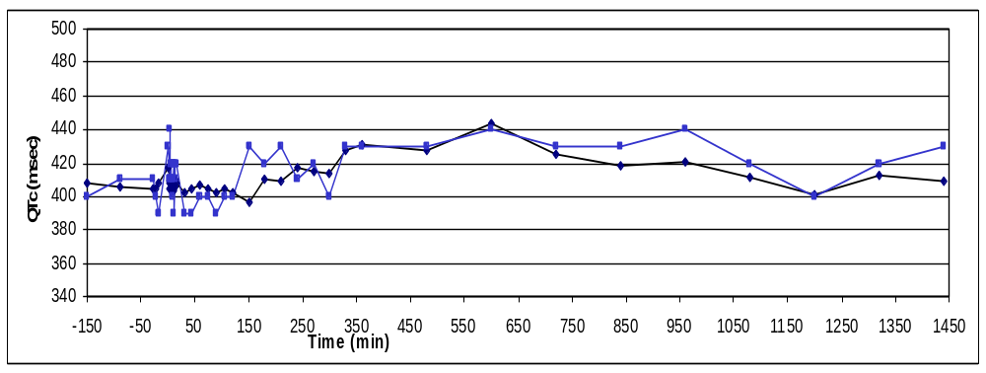
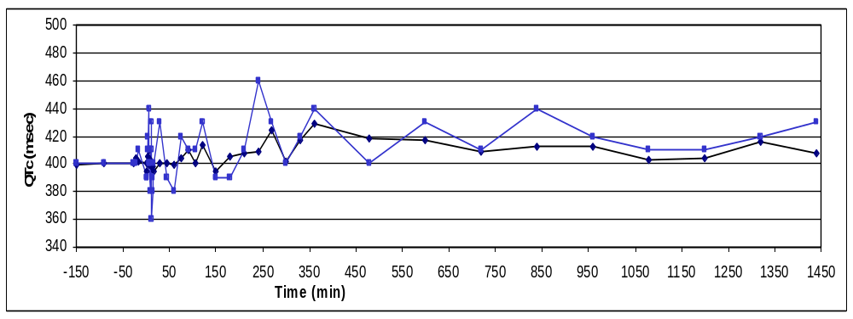
Continuous (averaged) vs Single ECG
Day 1
Day 4

Slide 13
Advantages
Reliable detection of effects over entire range of recording
Data available for retrospective scrutiny
  Cmax or QTcmax
Permits subject-by-subject custom correction of QT for Heart Rate
Familiar dataset at any time point
  Typical 12-lead ECG from digital data archive
  No need to extrapolate from 2- 3- channel data

Slide 14
Disadvantages
Non-standard electrode location
  BUT: does not affect QT or Heart Rate determination
Requires automated review
  BUT: well-established and approved algorithms
  can benchmark by human readings as desired
  permits technical review to reject artifact
  large number of data points average out errors

Slide 15
Phase I study - Actual experience
Averaged Continuous vs Single ECG
  Total Treated Subjects 48
  Total Treatment Sessions 185
  Total Continuous ECGs 373,937
    2,162 average values
  Total Conventional ECGs 1,108
QTc Continuous Single
Inter-Subj Std Dev
msec 17.1 23.4
Percent 4.0 5.8
Intra-Subj Std Dev
msec 9.2 14.8
Percent 2.1 3.7

Slide 16
Std Dev of Delta QTc’s
Treatment QTc- Baseline QTc
Averaged Continuous vs Single ECG
(msec) Continuous Single
Mean Delta 2.79 7.2
Min 8.0 17.6
Max 20.4 28.9
Std Dev 13.0 20.2

Slide 17
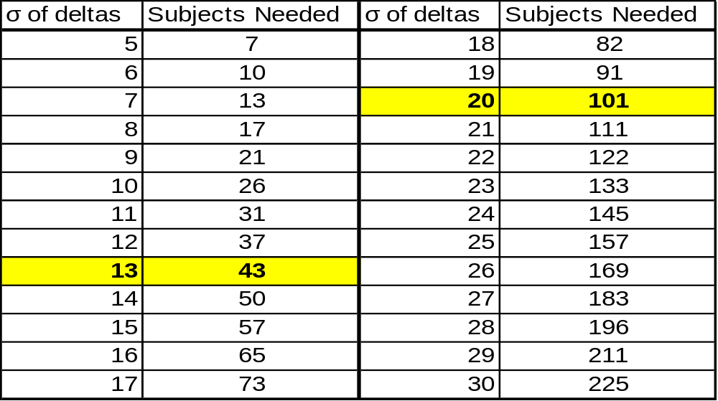
Power Calculation: comparison
Subjects needed for a power of 85% in a two-way test
to detect a δ of 6 msec at an α of 0.05
Power (expressed as number of subjects) is proportional to square of std dev of the deltas

Slide 18
Covance Continuous Repolarization Analysis - CCRA
  Continuous 12-lead ECG recording
  Collect data continuously to ensure detection of peak effects
  Ensure availability at times of critical drug activity: C_{max}, E_{max}
  Collect continuously to fully characterize dose-response relationship: max tol dose
  Collect large number of data points to improve power by averaging

Slide 19
Further Possibilities
Potential for additional measures using digital signal processing
  Time to 50%, 75%, 90%, 97% of total QRS-TU voltage
  Micro-volt T wave alternans
  QT/RR slope comparison
  Selective Beat Averaging
  T and U wave morphology characterization
  QTc distribution % outliers

