Slide 1

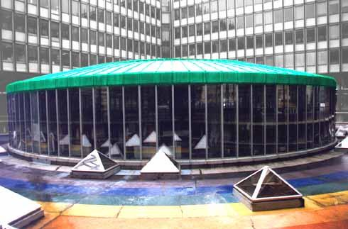
DØ collaboration
Workshop
T42 algorithm : noise suppresion
Towards a better Data Quality
www-d0.fnal.gov/~vlimant/noise-suppdescr/Description.html
Principle
Effects on calorimeter objects
Conclusions
BUSATO Emmanuel LPNHE 18 june 2003
VLIMANT Jean-Roch

Slide 2
T42
Inspired from an algorithm used in H1
I-Principle
Principle
  Keep high signal cells (above 4 sigma) : noise less than 4 cells/event
  Keep their neighbours above 2 sigma : very likely to be signal rather than noisy cells
  →Thresholds 2σ is 2.5σ at the moment due to current offline zero-suppression
  Reject negative energy cells : such signal cell less than 4 cells/event, very likely to be noise
Equivalent neighbours as with NADA
Complexity is linear with respect to the cell number (quick algorithm)
Killing/Shadow mode available (modify/leave untouched the CalDataChunk)
Dedicated Chunk with noisy cells : Calt42Chunk
Full description is available in DØNote 4124, 4146

Slide 3
T42 How to
T42 is set shadow mode in d0reco since p14 (included) : Calt42Chunk at DST level
  You are invited to have to look at it
Processing
  At DST level : combine the chunks with Calt42Combine hook
  At TMB level : set killing mode in Calt42Reco hook
Post-reconstruction of physical objects chunks is necessary : EMparticleChunk, JetChunk,…
Clear exercised instructions are at
www-d0.fnal.gov/~vlimant/noise-suppdescr/Description.html
www-d0.fnal.gov/~busato/HowTo/D0_code/reconstruction_at_TMB_level.html

Slide 4
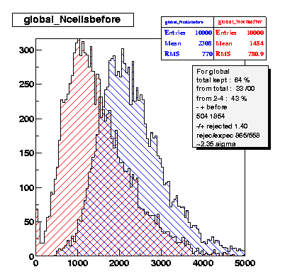
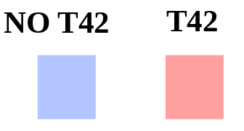
Population report unstreamed data

Slide 5
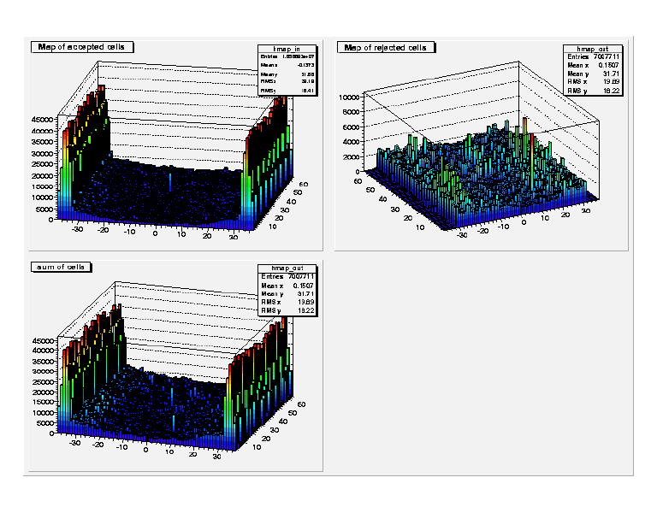
Smoothing effect
After
Rejected
Before
Peaks and strange features are removed

Slide 6
Rejection status
Number of cells with negative energy and positive energy are balanced : evidence of actual noise rejection
40% cells rejected
1 event = 3.3% of available cells in the calorimeter
Rejection a bit too high in the region close to the beam due to base line subtraction in underlying event cells

Slide 7
Samples
II- Effects on objects
Data sets
  EM studies
    DIEM15 stream of Wzskim, p13.05 p13.06
    Jpsi skim by Jan Stark,
  Jet studies
    Alljets stream from Top group, p13.06
  MET studies
    recoT file dated March, p13.06
MC sets
  Jet studies
    QCD Pt20 from CTF, p13.08

Slide 8
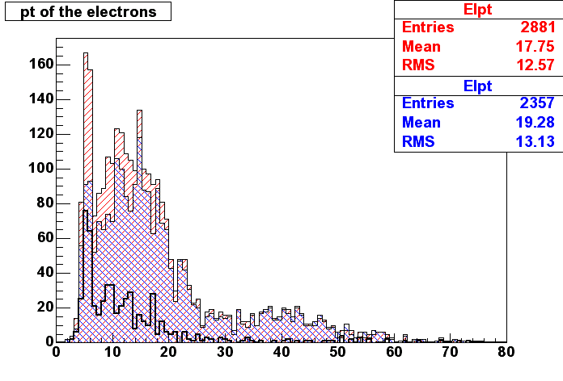
Effect on Electrons from calorimeter cluster
Difference
30% more EMid objects
18% more EMid+track match objects(electrons)
Mostly at low energy

Slide 9
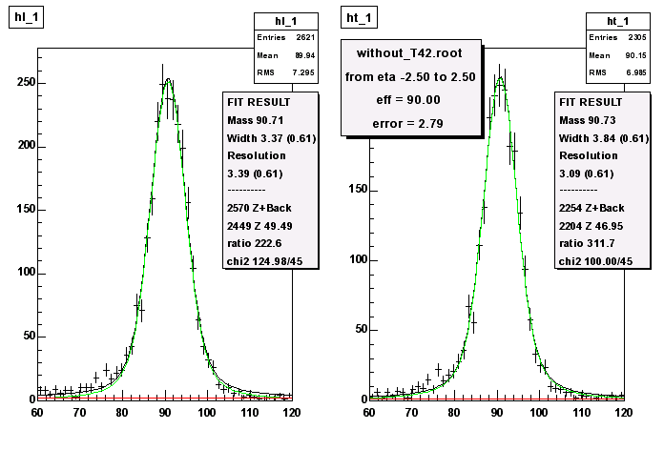
EMid efficiency
Method : use diem events, Probe is a track matched cluster and Tag is a tight electron back to back with the Probe
no T42

Slide 10
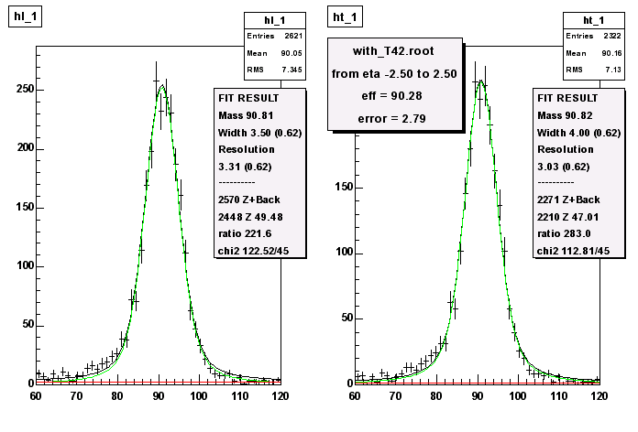
Effect on Electrons
T42

Slide 11
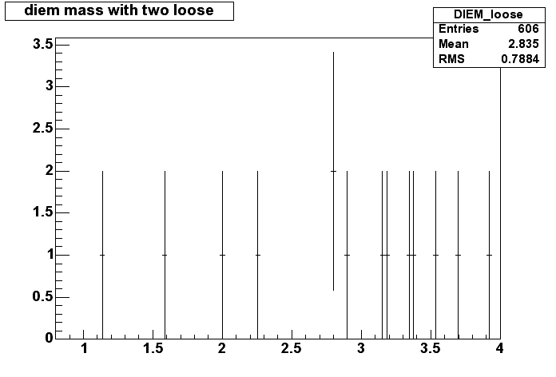
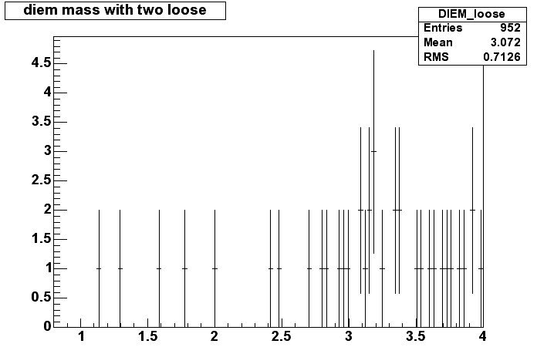
J/Ψ mass with cluster electrons
no T42
4→8 tights events in the mass window 2.5-3.5
T42

Slide 12
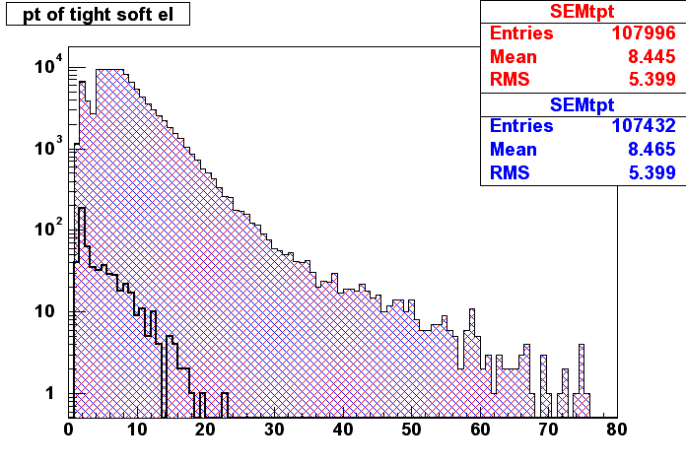
Effect on Electrons from Road Method
Difference
Tiny gain ( 8.10⁻²%) at low energy ( improvement limited by the number of isolated tracks )

Slide 13
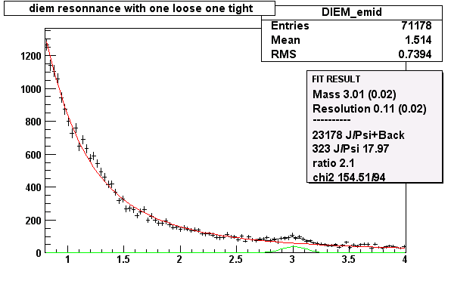

Effect on Soft Electrons
no T42
T42

Slide 14
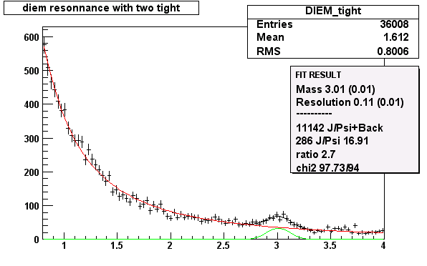

Effect on Soft Electrons
no T42
T42

Slide 15
Summary on EM objects
From calorimeter cells clustering
Slightly better efficiency in central region
Fake rate not estimated yet
Better mass
Better mass resolution
Less noise
ε_{EMiD} was 90.0±2.8 % is 90.3±2.7 %
From Road method
Slightly more J/Psi
Better Soft Electron Tag efficiency
ε_{TighSoftEl} was 88±7 % is 92±7 %

Slide 16
Effect on calorimeter jets

Slide 17
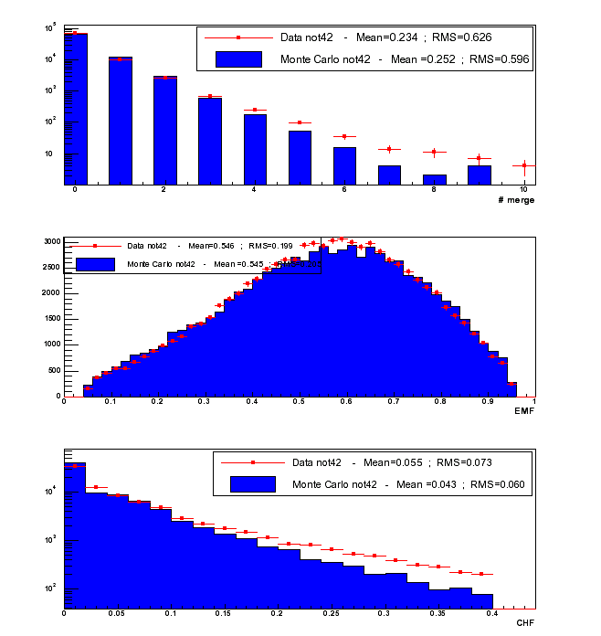
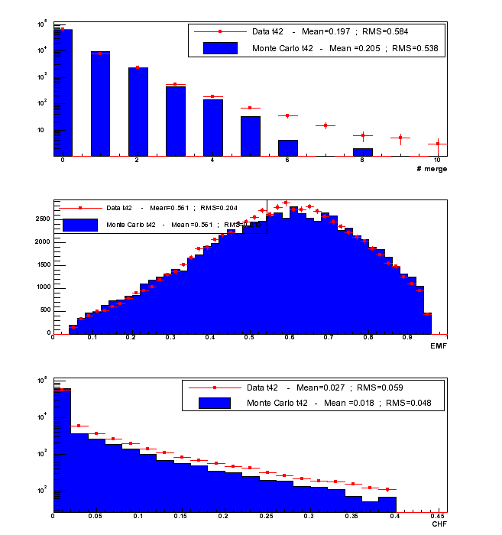
Data/MC comparison for jets
(-1<η<1)
# merge no T42
# merge T42
emf no T42
emf T42
CHF no T42
CHF T42

Slide 18
Quality cut efficiencies
Method : use photon+jet events, apply back to back requirement to maximize real jets over fakes ⇒ apply quality cuts on these jets
Data sample :
→ stripped thumbnails of jet-photon events from JES :
• reco version : p13.06.01
• triggers : all single electromagnetic triggers in CMT-9.50
• At least one EM object with |id|=10,11 and pT > 4.0 GeV
Additional cuts :
→ Photon candidate selection :
• Hmx8<20
• Isolation<0.15
• EM fraction>0.9
• in fiducial
• no track match
→ Δϕ (jet-photon)>3.0

Slide 19
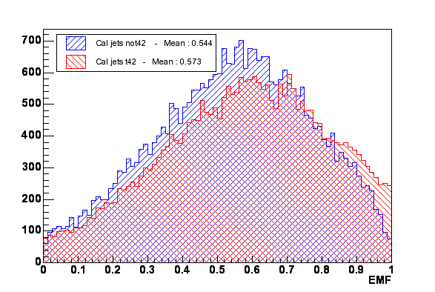
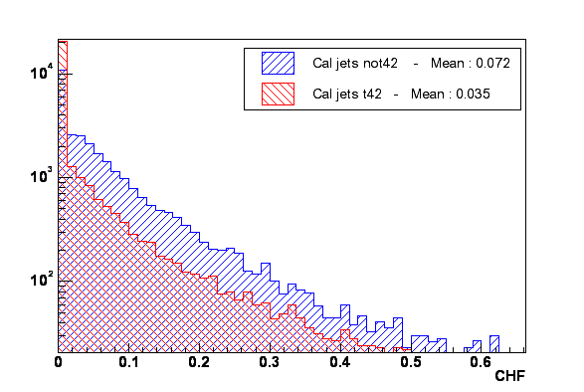
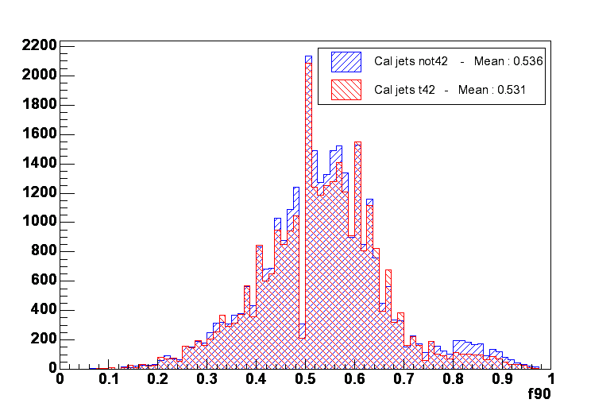
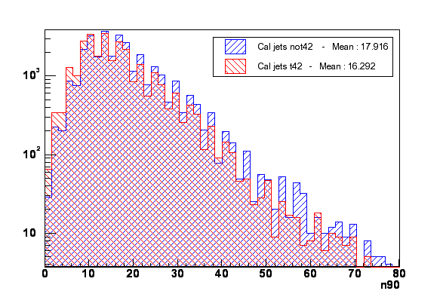
Jets properties
emf
CHF
f90
n90

Slide 20
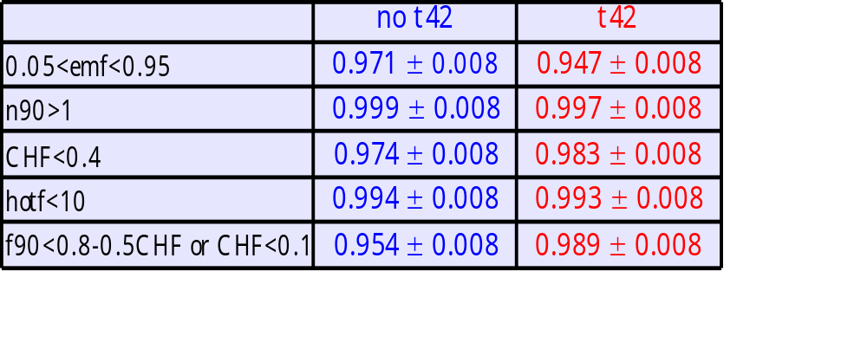
Quality cut efficiencies
Total 0.914 ± 0.008 0.929 ± 0.008
(Statistical error only)

Slide 21
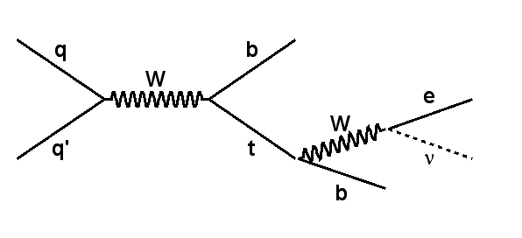
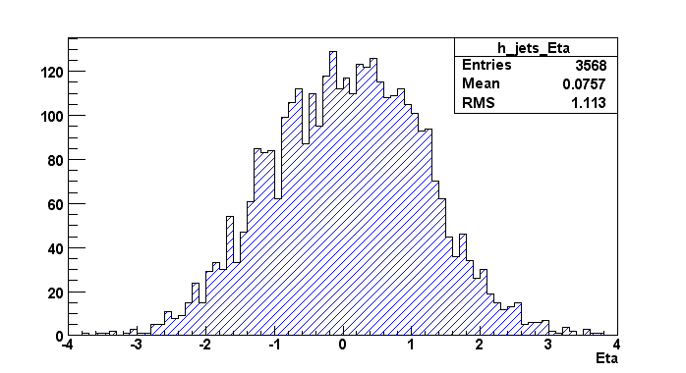
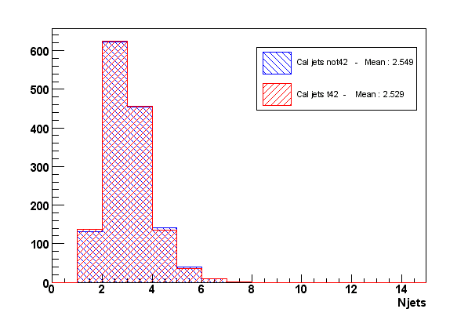
Does T42 cuts real energy ?
→ Single top events – s channel production mode :
• no calorimeter noise
• no minimum bias
Without t42 : Number of jets = 3568
With t42 : Number of jets = 3540
⇒ Reduction is ≈ 0.8%
→ In top group’s alljets skim : 0.9% of jets with pT > 25 GeV are not found
with T42. Two physical reasons explain this difference :
• threshold effect : “very” noisy jets or low pT good jets surrounded
by “very” hot cells and towers are suppressed
• split/merge effect
(cf http://www-d0.fnal.gov/~d0upgrad/d0_private/software/jetid/meetings2003/Apr24/busato.ppt)

Slide 22
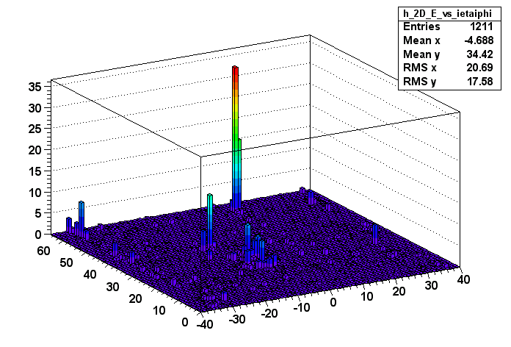
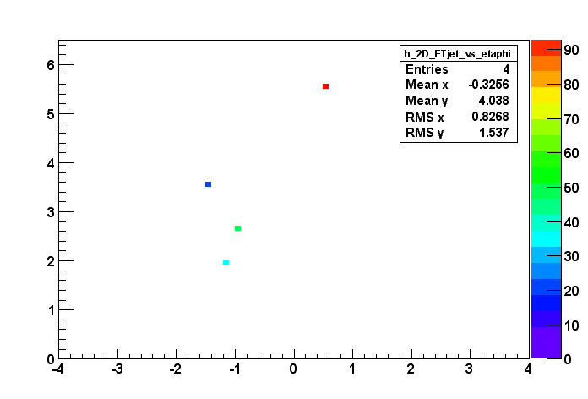


A particular event
Without t42
JETS
PT=42 GeV
merge=1
split=1
PT=31 GeV
merge=0
split=1
With t42
JETS
PT=64 GeV
merge=2
split=0

Slide 23
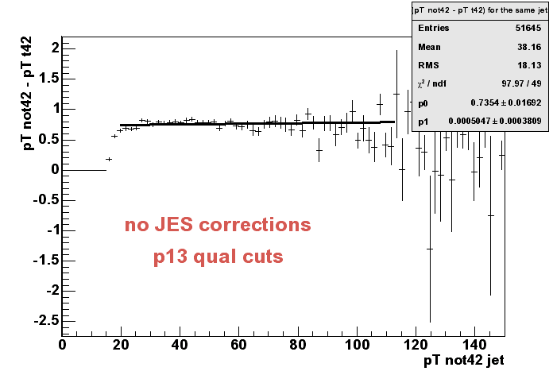
What else
• Current threshold in jet algorithms is set to pT>8Gev.
Jets reconstructed after t42 have lower energy, thus this cut may also be
reconsidered.
• Of course, new JES corrections need to be applied to « t42 jets ».
≈ 735 MeV
difference for
the same jet

Slide 24
Summary on jets
Quality cuts may be reconsidered : particularly on emf and f90
Maybe apply different pT threshold at reco level
In MC without noise very few real jets are lost with T42.
Almost all high pT good jets remain after T42.
ε_{jetID} was 91.4 ± 0.8% is 92.9 ± 0.8 %

Slide 25
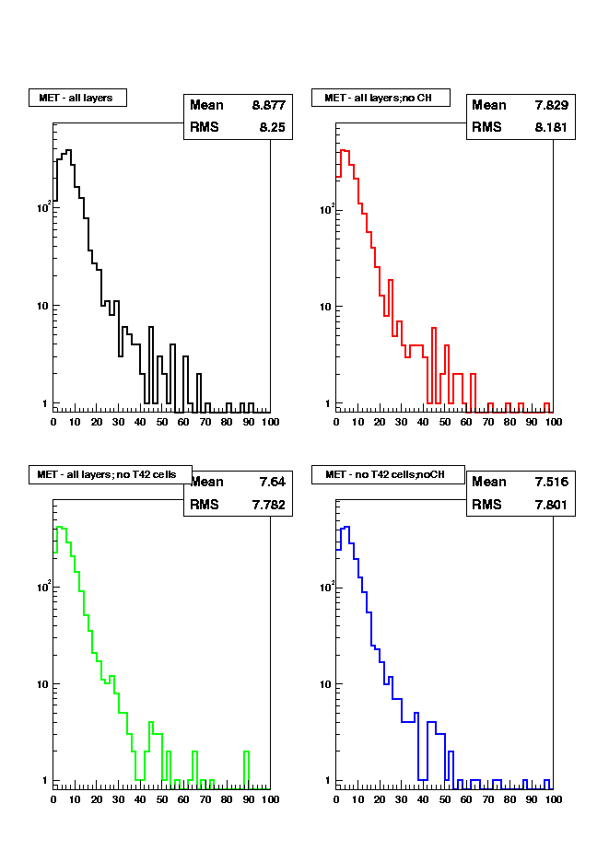
Effect on mEt

Slide 26
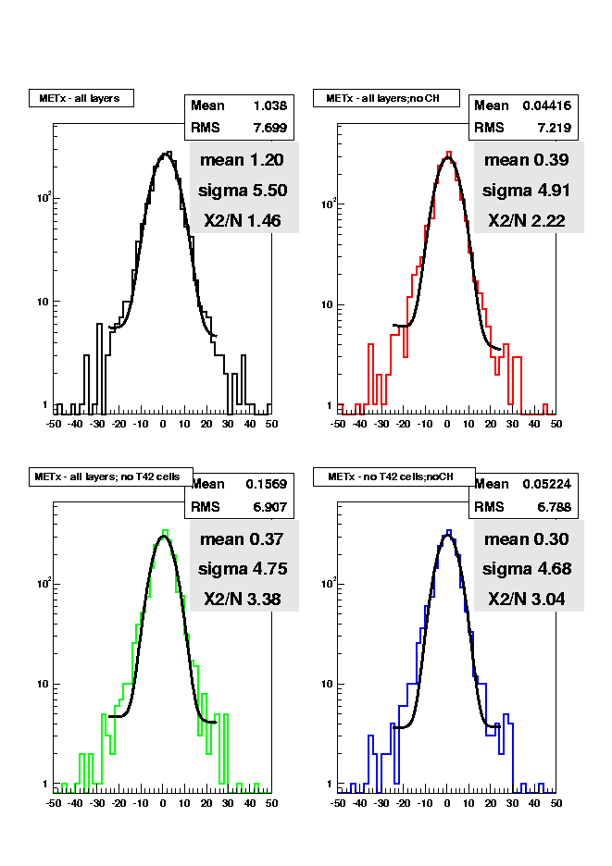
Effect on mEtx

Slide 27
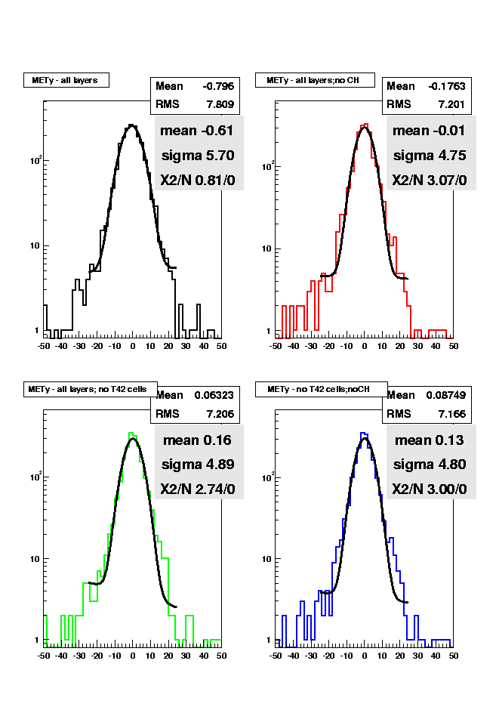
Effect on mEty

Slide 28
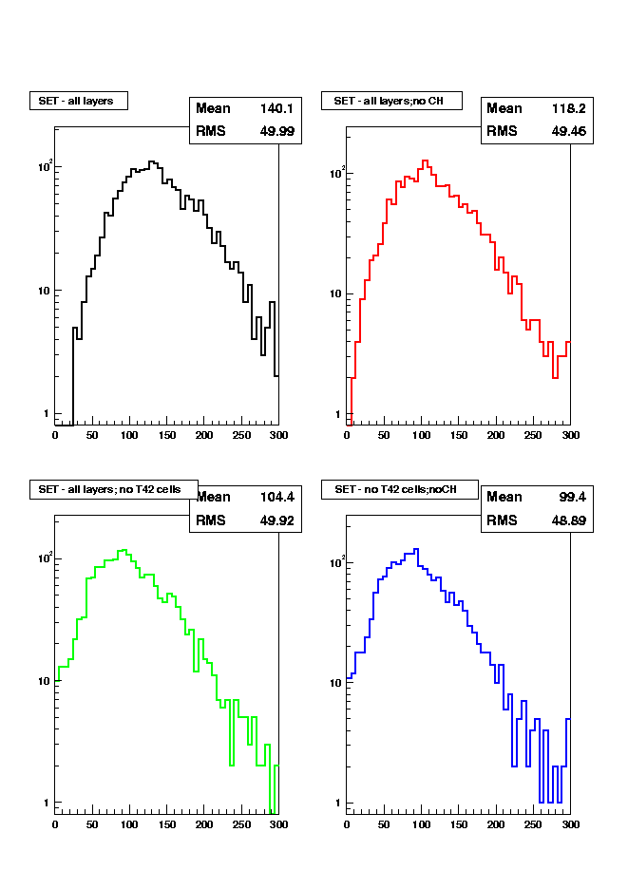
Effect on sEt

Slide 29
Effect on missing energy
Less missing energy
Better resolution
“Hot” region cleaned
Event without any cells now
σ_{x} σ_{y} decreases by 30%
<SEt> decreases by 30%
<mEt> decreases by 13%

Slide 30
Summary
T42 algorithm removes 40% of cells and 30% of energy
  without modifying relevant physics
  smoothes the occupancy distributions
  Still beam pipe BLS over-occupancy
Calt42Chunk in ThumbnailChunk to be implemented
Calorimeter based objects within |η|=2.5 identification is improved even though studied on biased (skimmed) samples
Fake rate and efficiencies to be re-calculated on unskimmed data
Quality cuts and energy scales should be reconsidered with T42
T42 in killing mode would improve the data quality for analysis…

