Slide 1
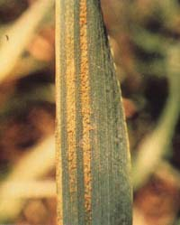
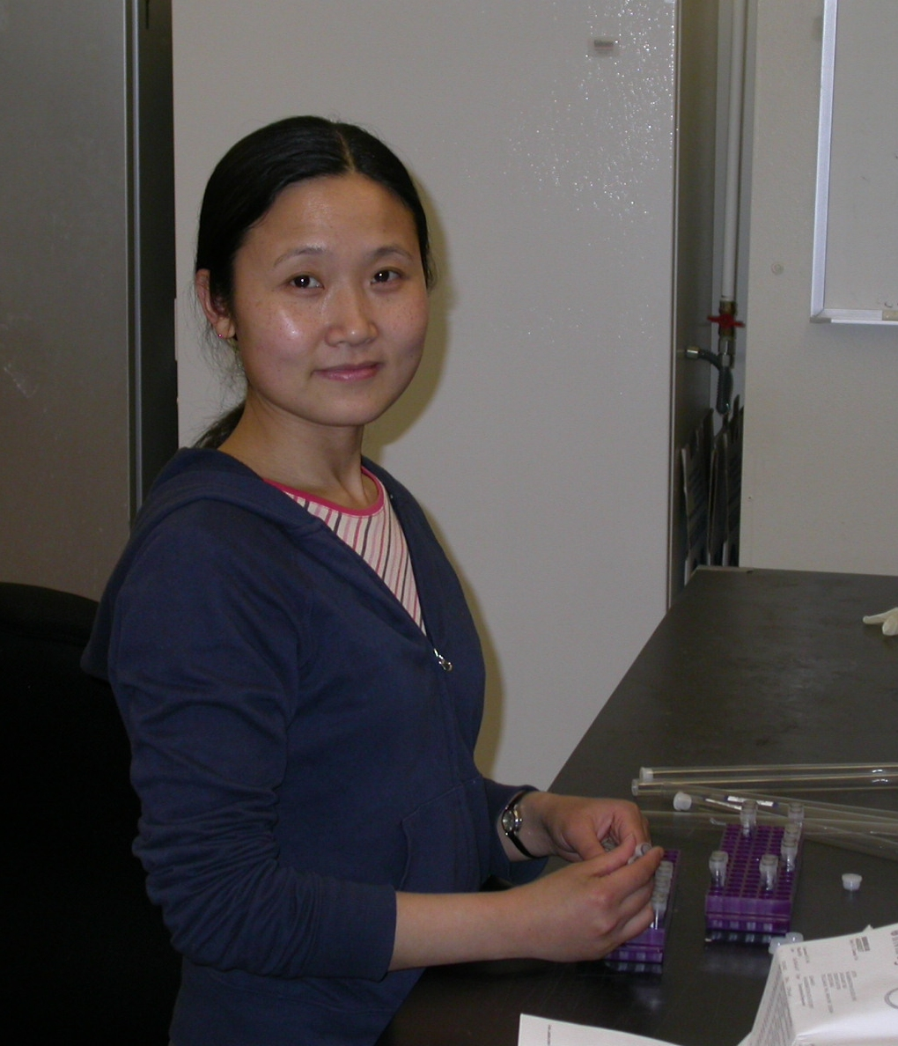
Stripe rust Haustorial cDNAs
Chuntao Yin, Xianming Chen, Scot Hulbert
Puccinia striiformis
Chuntao Yin

Slide 2
General Approach:
Isolate haustoria (pure as possible)
Make cDNA library
Sequence sample of library
Sequence more or make new preparation
Assemble unigenes/predict secreted proteins
Make expression constructs for in planta examination
of HR or ???

Slide 3
One plate (384 clones) sequenced from first library
Fungal ribosomal associated 25
No homology (fungal?) 19
Unknown fungal 11
U3 small nucleolar ribonucleoprotein 1
Nucleoside diphosphate kinase 1
Translation initiation factor eIF-1A subunit 1
Ubiquinone/menaquinone biosynthesis 1
Ubiquitin conjugating enzyme 1
Proteins with possible signal peptides 2
Unknown fungal with predicted signal anchors 2
Arabinose efflux permease (signal anchor) 1
65

Slide 4
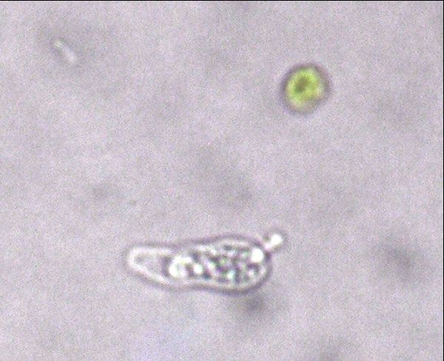
P. striiformis haustoria

Slide 5
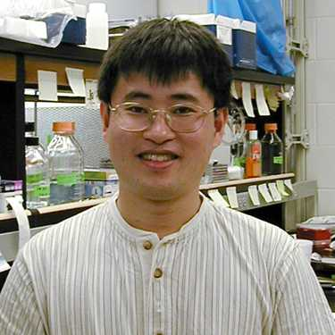
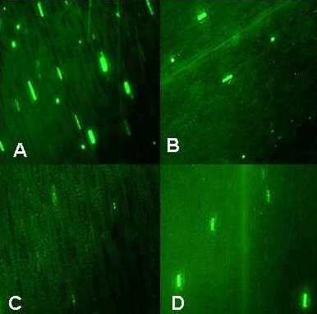
Biolistic transient assay for HR-inducing genes
Maize line
B73 (Rxo1) Mo17 (rxo1)
Plasmids
GFP only
GFP and
AvrRxo1
Bingyu Zhao

Slide 6
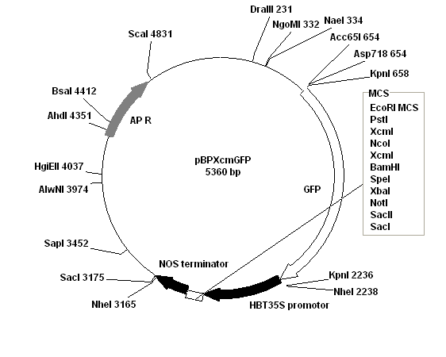
Transient expression vector for HR assays

Slide 7
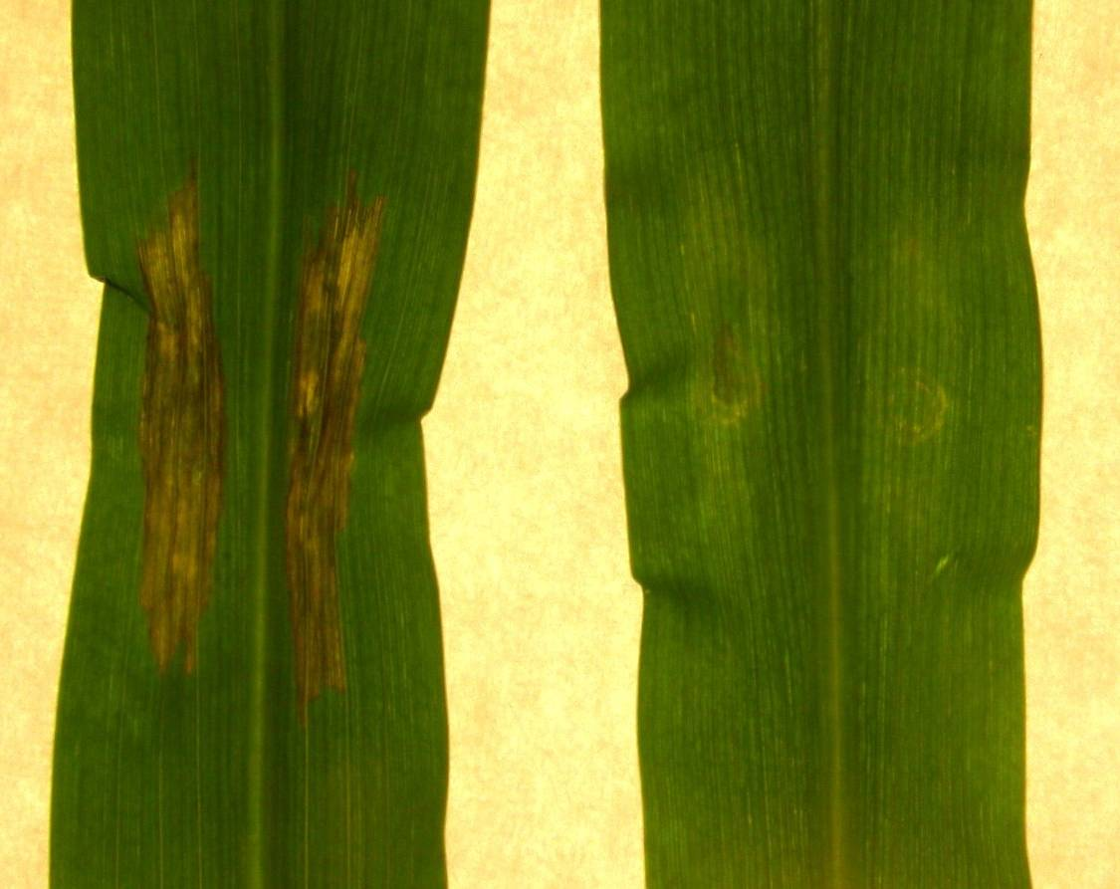
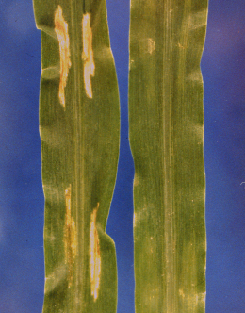
Delivery of effectors by host and nonhost bacteria
Rxo1 rxo1
Rxo1 rxo1
Burkholdaria andropogonis
(maize pathogen)
Xanthomonas oryzae pv. oryzicola
(non pathogen)

Slide 8
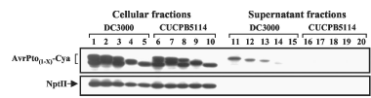

Delivery of rust effectors as bacterial effector fusions?
avr Pto fusions with Cya protein delivered into media by P. syringae DC3000:
Schechter et al. (2004) J. Bact
164 aa
135 aa
100 aa
Need to test DC3000 or DC3000 mutants for HR in cereals
Need to make and test constructs
Alan Collmer, Cornell

