Slide 1
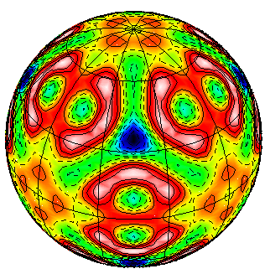
Basic Research Needs to Assure a Secure Energy Future
Status of Workshop
July 23, 2002
Iran L. Thomas
Division of Materials Sciences
and Engineering

Slide 2
BESAC’s Charge
The second activity might build on some of the ideas discussed above to answer the question: What are the 21st century fundamental scientific challenges that BES must consider in addressing the DOE missions in energy efficiency, renewable energy resources, improved use of fossil fuels, safe and publicly acceptable nuclear energy, future energy sources, science-based stockpile stewardship, and reduced environmental impacts of energy production and use? Over the years, the BES research portfolio has evolved to address these issues and more. There have been many successes. The National Energy Policy noted that the U.S. economy grew by 126% since 1973, but energy use increased by only 30 %. Approximately one-half to two-thirds of the savings resulted from technological improvements in products and services that allow consumers to enjoy more energy services without commensurate increases in energy demand. At the heart of these improvements is fundamental research. During this 30-year period, the basic research supported by the BES program has touched virtually every aspect of energy resources, production, conversion, efficiency, and waste mitigation. The basic knowledge derived from fundamental research has resulted in a vast array of advances, including high-energy and high-power lithium and lithium ion batteries and thin-film rechargeable microbatteries; thermoacoustic refrigeration devices that cool without moving partsand without the use of freons; compound semiconductors, leading to the world's highest efficiency photovoltaic solar cells; strong, ductile alloys for use in high-temperature applications; new steels, improved aluminum alloys, and high-performance magnet materials; polymer materials for rechargeable batteries, car bumpers, food wrappings, flat-panel displays, wear-resistant plastic parts, and polymer-coated particles in lubricating oils; new commercial processes for ethanol production,pulp and paper manufacturing, and in planta production of oils; and new catalysts for the production of polymers and for a host of other products and energy-efficient processes; and a host of new instruments, such as superconducting quantum interference devices (SQUIDs) that can sense minute magnetic fields for use in applications ranging from resource exploration to monitoring the human brain and heart. These advances came by exploiting the results of basic research that sought answers to fundamental questions. The challenge is to continue the tradition of discovery. To that end, I would like BESAC to oversee a small number of workshops (perhaps 2 or 3) that articulate 21st century discovery potential in DOE mission areas. Defining the role and challenges of basic research is particularly timely given the recent release of the President’s National Energy Policy.

Slide 3
Workshop will provide BESAC information and data needed to advise the Office of Science.
The primary customer is BES.
Advice will be used to develop research portfolio.

Slide 4
hyWhy is advice needed now?
When DOE was formed and until recently the major issues were increasing and ensuring the supply of oil and gas, finding ways to use coal cleanly and with less affects on the environment, and increasing efficiency primarily to reduce imports.
Climate change predictions have a profound affect.
85% of our energy comes from fossil fuels. If we can’t continue to depend on them, we have to find other ways to provide energy.

Slide 5
What is the focus of the workshop?
The focus should be on the technical issues, such as
the fact that currently there is no viable alternative
for gasoline.
Social issues should only be considered to the extent
that science may affect those issues, such as safer
nuclear reactors.
The basic research community has focused on many
of the known problems in energy technologies for
many years – the workshop should not rehash these
areas.
The workshop should focus on new revolutionary
basic research opportunities.

Slide 6
Chair: John Stringer
John Stringer has been a member of staff at EPRI (formerly the Electric Power Research Institute) since 1977, and acted as a consultant for projects sponsored by EPRI in the UK since 1974. For most of this period he directed the Materials Support Program. Since 1984, he has also been closely involved in the more basic research activities across the Institute as a whole through what began as the Exploratory Research program and is now the Strategic Science and Technology program. For all of his time at EPRI, he has also been a Consulting Professor in the Department of Materials Science and Engineering at Stanford University. John’s degrees are all from the University of Liverpool (U.K.): B. Eng., Ph.D., and D. Eng. Prior to joining EPRI he was Professor of Materials Science at the University of Liverpool. He is a Fellow of ASM International, of TMS, of NACE International, of AAAS, of the Institute of Energy (U.K., of the Royal Society of Arts (U.K.), and an Honorary Fellow of the Institute of Corrosion (U.K.). He is a member of AIME and of MRS. He has authored or co-authored some 325 papers in the scientific and technical literature, and has written and edited several books.

Slide 7
Vice Chair: Linda Horton
Linda Horton is the Project Director for the Center for Nanophase Materials Sciences (CNMS) Construction Project and the Director of ORNL’s Basic Energy Sciences Materials and Engineering Physics Program. She is responsible for basic science research that includes theoretical studies, materials characterization, radiation effects, intermetallics, advanced ceramics, process science, and engineering research. Her personal research has emphasized applications of electron microscopy to materials science problems and has included investigations of the effects of irradiation on the structure and properties of materials and studies of diamond thin films. She has authored over 45 publications and has
co-edited a book on diamond thin films. Her research has received award recognition from DOE, ASM International (including Fellow), and the Association for Women in Science. She has served as a Trustee of ASM International and as a Director in the Microscopy Society of America. Currently, she is Councilor of the Materials Research Society and serves on the Governance Committee. Dr. Horton served on the DOE Basic Energy Sciences Advisory Committee, including 2 years as vice-chairman. She has been a member of a number of DOE, NSF, and NRC committees and panels. Her past BESAC service includes participation in Panel on Synchrotron Sources and Science and the Panel on the Value of Basic Research.

Slide 8
Who, When and Where?
Who: Representatives from national laboratories, universities, industry, DOE staff, etc. BESAC members are invited and will get a letter soon,
but let Sharon Long know any time if you want to come.
When: October 22-25, 2002
Where: Gaithersburg Marriott Washington Center
Expected Attendance: About 150

Slide 9
Subpanels
A number of small topical panels will be used to make a preliminary assessment of the basic research opportunities in eight areas listed below. The topical panels will consist of 4-6 members and include representatives from BES, relevant DOE technologies office(s), the academic national laboratory community, and relevant industrial selector(s).
  Fossil (FE)
  Nuclear Fission (NE)
  Solar and other Renewable Energy (EERE)
  Nuclear Fusion (Fusion Energy Sciences)
  Hydrogen (EERE)
  Distributed Generation: transmission, storage, fuel cells, etc. (EERE, FE)
  Transportation (EERE)
  Industrial/Residential/Commercial (EERE)
  POTENTIAL CHAIRS HAVE NOT BEEN CONTACTED YET

Slide 10
Resource Document
A resource document is being prepared that will give
facts and figures describing the world energy situation.
Drafting committee: Stan Hadley, Roger Stoller, Tom
Rosseel, Claudet McKaney (ORNL).
Primary source of information is the Energy
Information Agency.
Units will be consistent throughout to make
comparison easy.

Slide 11
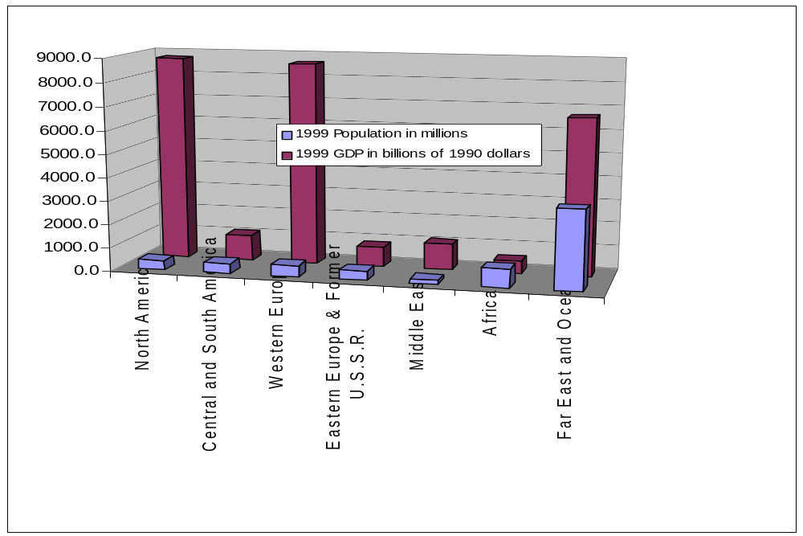
Population and Gross Domestic Product of World’s
Regions (IEA 1999 Annual Report)

Slide 12
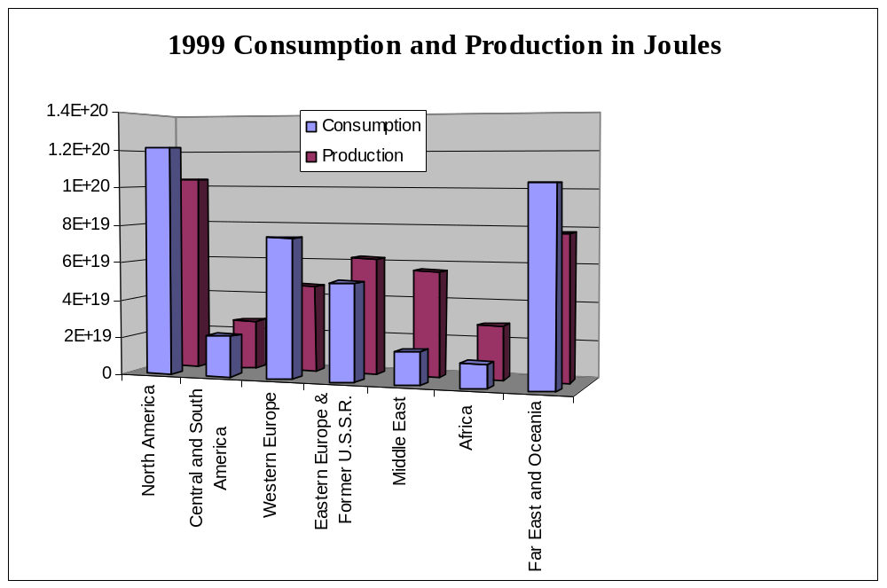
Energy Consumption and Production
of World's Regions (IEA 1999 Annual Report)

Slide 13
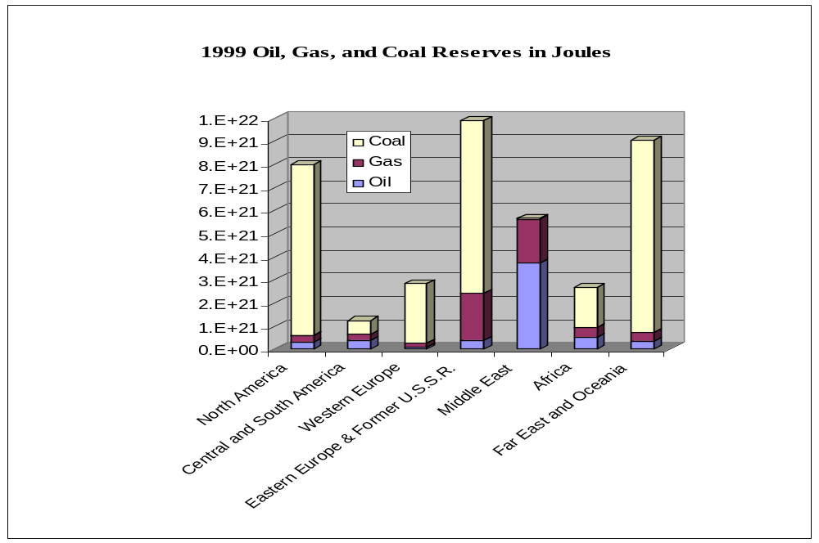
Energy Reserves in World's Regions (IEA 1999 Annual Report)

Slide 14
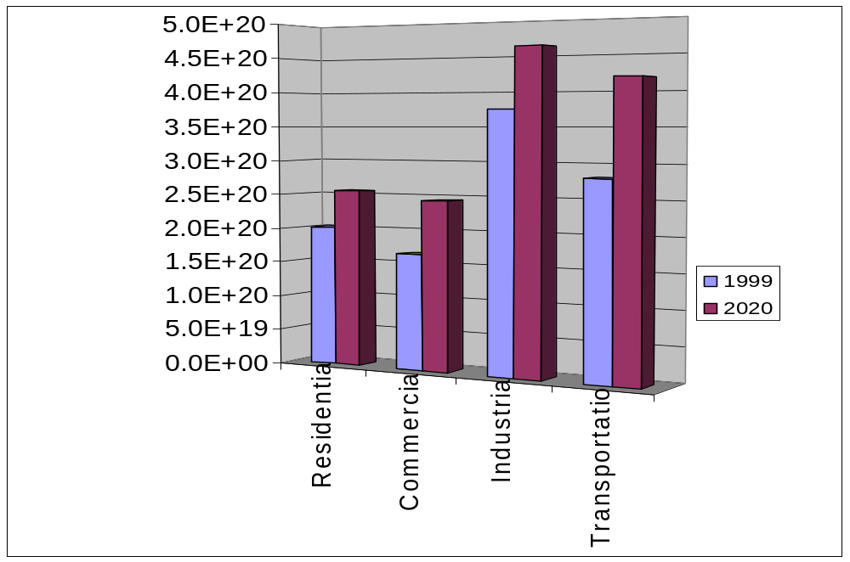
Energy Consumption by sector in Joules.
Annual Energy Outlook with Projections to 2020,
Energy Information Agency December 2001

