Slide 1


Noise Studies in the Calorimeter
Robert Zitoun
Stony Brook
Collaboration Meeting
October 10, 2003

Slide 2
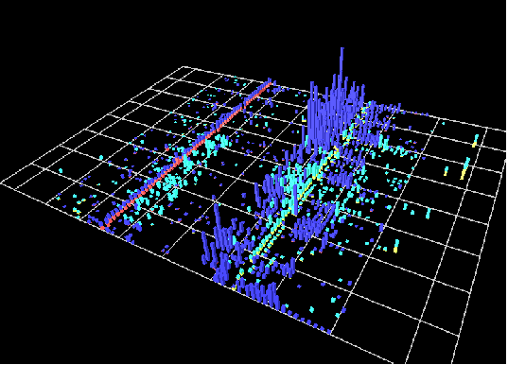
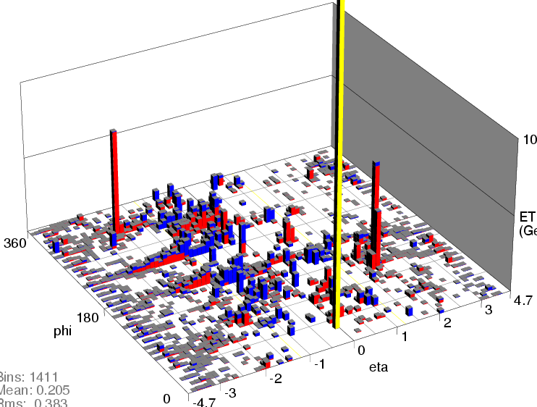
Evidence for Bad Data (1)
Ring of fire
ADC noise

Slide 3
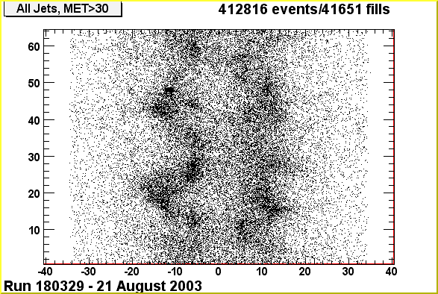
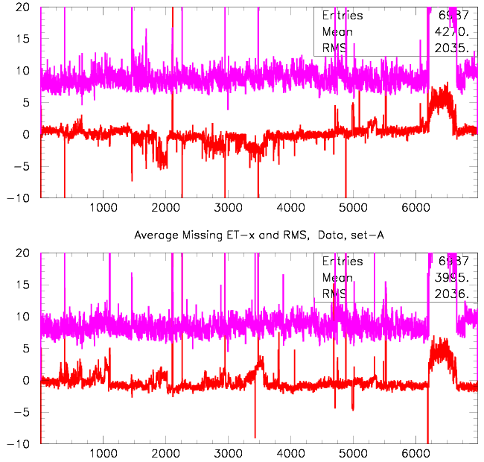
Evidence for Bad Data (2)
Yuri’s jets
MET x-y

Slide 4
Noise Study
Mike Arov, Dan Edmunds, Leslie Groer, Marvin Johnson, Dean Schamberger, RZ
+ colleagues from SMT, CFT, MUON, FPD
+ many techs
Occasional noises: ring of fire
Permanent noises

Slide 5
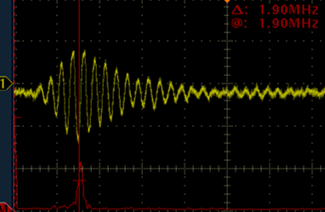
Ring of Fire
Outermost EM rings in EC fired
+ accompanied by HAD noise in ICR
Already seen in run 1:
  temperature monitoring system
  special ring shaped HV distribution
Occurs when the welder in DAB3
is triggered
In the 2 MHz region
Sudden burst of CAL triggers
welder noise at CAL

Slide 6
Ring of Fire (2)
Welder noise enters the cryostat on temperature monitoring cables
Disappears when cables are disconnected (safe!)
Remaining questions:
  how is this noise getting to these cables?
  does noise get also through purity monitoring cables?
  other unidentified sources?

Slide 7
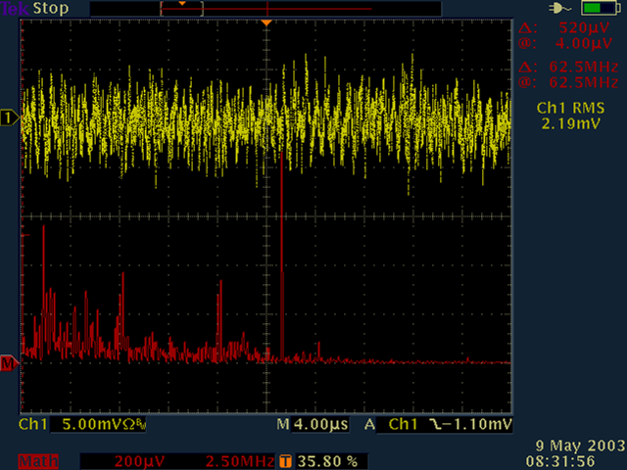
Hunting for Permanent Noises
Lines identified with a spectrum analyzer in May
  14.3 MHz (=RF/4)
  10 MHz
Find source(s)
Find path(s)
Fix
Note: those noises may not be harmful but other occasional bad noise may follow the same path
RF/4
10MHz

Slide 8
RF/4 Noise
Injected charge depends on the bunch number
Out of phase after a full turn
Produce coherent effect over the detector
  how large?
? Linked with observed coherent noise
(Bawo Daibo + Leslie Groer)
RF/4
•
•
•
•
•
|......|......|......|......|......|......|......|......|......|......|......|......|
RF = 53.10 MHz
1 tick = 132ns = RF/7
1 bunch = 3 ticks
RF/4 not multiple
of
1 turn = RF/7×153

Slide 9
RF/4 Noise (2)
Clearly correlated with MUON chambers
  on/off
  dropped when opening the central toroid
  clear radiation from the chambers (Stefan Grünendahl)
“Unstable”
  disappears (sometimes) if chambers are in synch
  smaller or larger with smaller number of chambers
MUON experts think it goes through power lines, then to ground
CAL experts think of capacitive coupling
  MUON chambers right above CAL preamp boxes
Difficult to shield
Studies would need to close/open central Iron at will

Slide 10
10 MHz Noise
Appeared when SMT sequencers started
Little contribution from CFT
No 10 MHz in the boards, but linked with DØ clock
Due to the superbunch structure (53 ticks, 12 bunches)
Fourier transform of bunch signal produces 2 strong lines @
  70 f_{tick} = 10.020 MHz & 71 f_{tick} = 10.162 MHz
  agrees perfectly with high-res spectrum analyzer measurement
.....................................................
bunch + signal
signal without bunch

Slide 11
10 MHz Noise (2)
How is it getting to CAL?
  Mostly in EC
  When ECN moved out, decreased in ECN but also partly in ECS
  When ECS moved out, decreased but not clear what happened
  Radio tuned on 10.16 MHz (“WSMT”) showed emission from
  cables bringing clock from sequencers to the interface boards
  front bottom of interface board crates
  a few SMT differential coaxials

Slide 12
10 MHz Noise (3)
Favorite hypothesis: noise comes in the cal by the ground
10 MHz is part of a synchronous noise
bunch signal should just move pedestal
  no large effect expected (except 1st bunches?)
  if noise path found, unidentified noises may disappear

Slide 13
Next Week Plans
Take benefit of Monday power outage to find the welder noise path
  disconnect D0 detector (including MCH) from safety ground (including SCL cables, FPD, phone lines, ... all line violating single point safety ground)
  look for unknown contact visually (visible light)
  set a 100 amp. current generator between cal and ground and look for IR light (touch for heat)
  hazardous, but already (successfully) done in Run I
  slow increase, voltage < 0.5V
Continue studies to understand how important are RF/4 and 10 MHz noises

Slide 14
Hunt for Other Bad Behavior
Not only noise
  Also hot cells, electronic failure, ...
2 (successful) examples

Slide 15
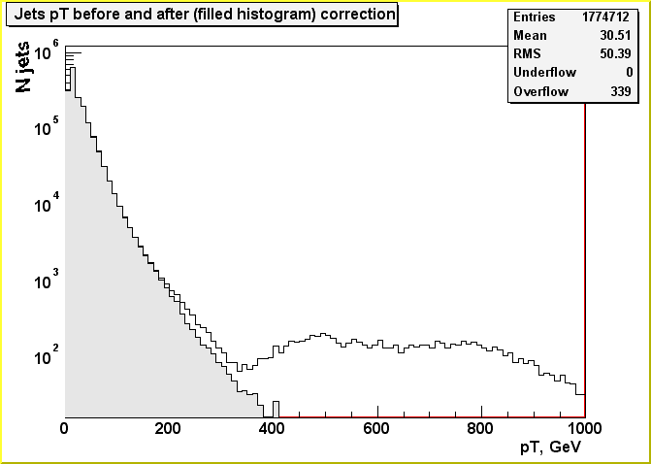
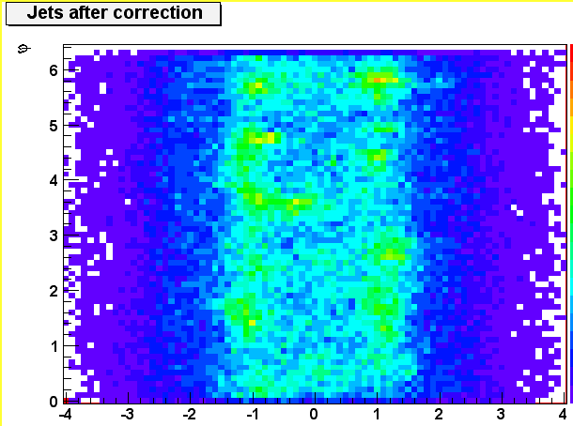
Jet Distribution in MHT30 Triggers
Slava Shary (Orsay)
  made list of hot cells found in zero bias events
  cells dropped from reco
after
before
  Turns a bad run into a good one!
  Is it the whole story?
after

Slide 16
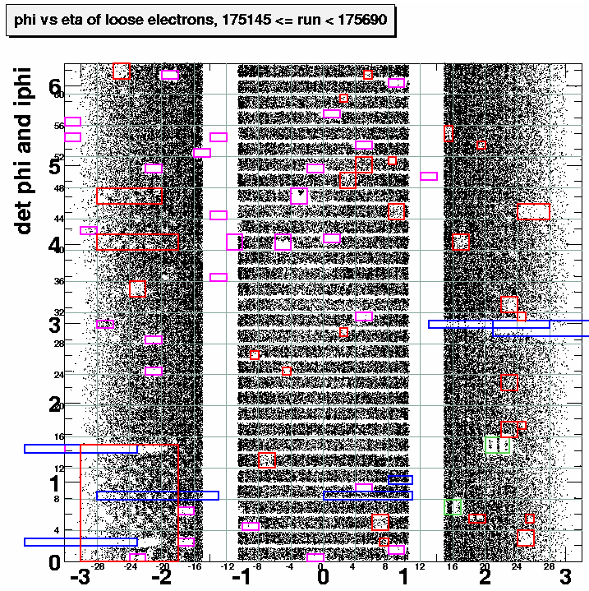
Readout Problems
Crate 8 (energy sharing) problem
Tower 2 (tower not read, another one read twice)
Both found from electronics studies
Plot by J. Gardner
  Shows tower 2 + crate 8
  Pointed to swapped cables
  Shows other problems
  How long to understand/fix them?

Slide 17
Conclusion
Noise
  Progress in its understanding, but still much to understand
  Difficult to know how much fixes will improve the data
Hot cells
  Much to be gained in correcting the data
Issues not yet addressed (when?)
  Yuri’s jets
  ADC noise
Real need of manpower

