Slide 1
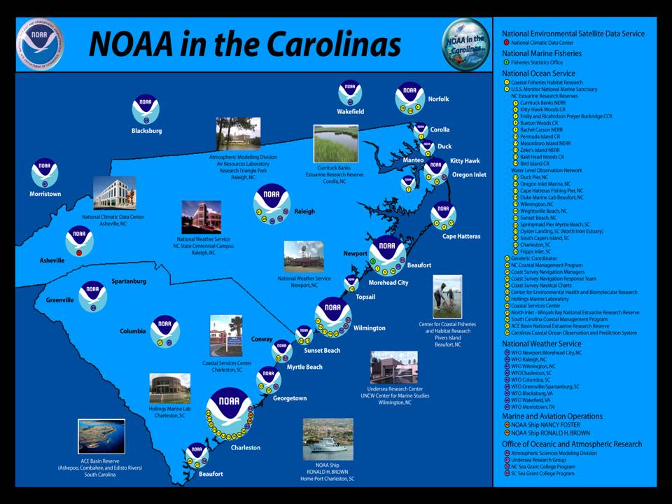
Notes:
Introduction; May 2004 workshop and continued efforts of steering committee

Slide 2
Steering Committee:
NC:
Andy Shepard, NOAA Undersea Research Center- UNCW; Katie Mosher, Jack Thigpen, NC Sea Grant; Tom Kriehn, Daren Figurskey, NOAA Weather Service; Rachel Lopiccolo, NOAA Fisheries; Mike Lopazanski, NC Dept. Natural Resources
SC:
Jeff Payne, Coastal Service center; Bob Bacon, SC Sea Grant
NOAA Advisor:
Dean Gulezian, NWS

Slide 3

Mission
In spirit of NOAA’s matrix management approach and “One NOAA” vision
Explore and develop more efficient and effective NOAA services and products.
“Collaboration and partnerships are no longer lofty goals. They are an economic reality to save time and money -- and avoid duplication of efforts.”- R. Hodson
Notes:
“Collaboration and partnerships are no longer lofty goals. They are an economic reality to save time and money -- and avoid duplication of efforts.”- R. Hodson
Respond to Admiral’s vision of “One NOAA”

Slide 4
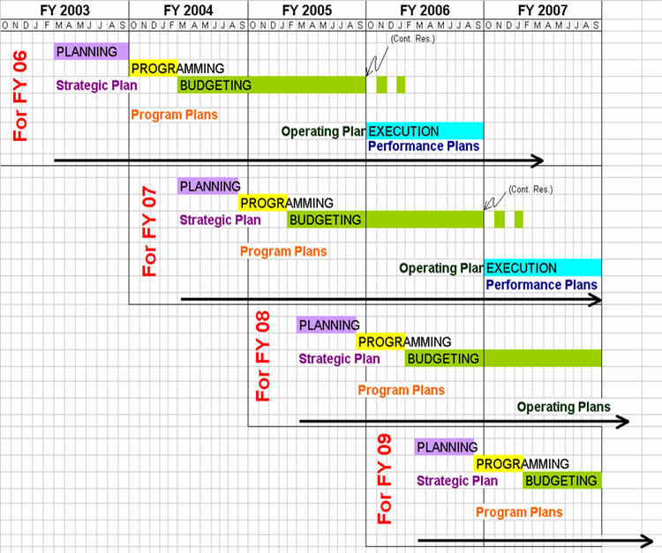
PPBES Process
NOAA in the Carolinas seeks to integrate regional partners into the NOAA planning process.
Notes:
Be knowledgeable about the process
Be engaged and/or represented in the process
Determine where and how you fit in program structure
Direct your thinking toward:
Contributions to goals, outcomes, results, annual priorities (AGM)
Valid requirements – fundable and support mandates and objectives
Customers – who are they and why do they care
Contributions to cross-cutting efforts – broad homes
Partnerships – leverage talent, resources, commitment, persuasion
Research to Operations; Research to Information – mission relevance
Cost/Schedule/Performance – VADM mantra

Slide 5
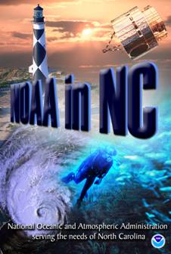
2004 NOAA in NC Workshop
Participants (26)– cross-L.O. including:
  NOAA Undersea Research Center at UNCW; NC Sea Grant; NOAA Coastal Services Center; NWS (RAH, ILM, MHX, AKQ, RNK, GSP, MRX); NCCOS (NESDIS, NOS) Beaufort; NCDC Asheville; NC Division of Coastal Management – Raleigh; NC National Estuarine Research Reserves
Goals:
Improve NOAA products and services to the public
Generate new resources via leveraging and ideas
Improve outreach, communications, and partnerships between NOAA elements
Agenda
Plenary—J. Payne, CSC-- NOAA Planning Process
Example partnership activity reports
Breakout group discussions
Outcomes:
New potential partnerships
Inventory of partnership projects
Outreach (e.g., report and Web site-- http://www.erh.noaa.gov/mhx/NOAACarolinas/NOAACarolinas.html#
NOAA Goal Team presentation– “expand to Carolinas!”

Slide 6
Power of One:
Examples of Partnership Projects
Weather
Service
Ocean
Service
Satellite &
Information
Service
Fisheries
Service
Regional
OOS
Ocean &
Atmospheric
Research
academia

Slide 7
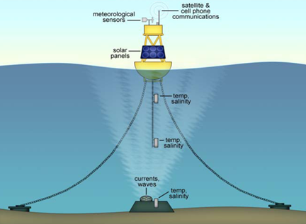
Existing Partnerships: Weather, Ocean Observing and Prediction System for NC
Objective: to improve integration of atmospheric and ocean observing programs
Partners: SEACOOS, NDBC, NWS, NC Sea Grant
NOAA Relevancy: Outreach and education/Weather and Water Goals
Products/Outcomes: QA/QCed real-time met/ocean data and products
Outreach: Live data updates available to public via SEACOOS (www.seacoos.org), Newport/Morehead City NWS (www.erh.noaa.gov/er/mhx/), and NDBC’s dial-a-buoy line.

Slide 8
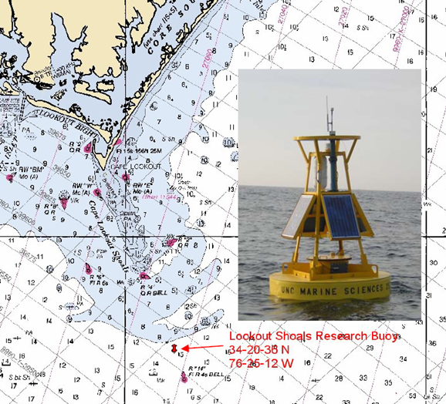
Lookout Shoals Buoy Variables
Iridium satellite/cell phone comms
Meteorological sensors (wind speed & direction, air temperature & humidity, long/ short wave solar radiation, barometric pressure and precipitation)
Water temperature & salinity (near surface, mid-depth and near seafloor)
Current speed & direction throughout water column
Wave height, period and direction
Argos, satellite-based tracking system
Batteries and solar charging system
[Red = enhancements to existing system]

Slide 9
Power of One. . .
Weather
Service
Ocean
Service
Satellite &
Information
Service
Fisheries
Service
State/local
Ocean &
Atmospheric
Research
academia

Slide 10
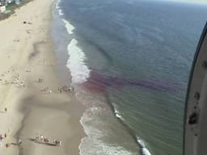

Existing Partnerships: NOAA-USLA Rip Current Safety Campaign
Objective: Promote public safety through awareness of rip currents
Partners: since 1970s--NC Sea Grant, NWS (ILM,MHX,AKQ), NOS CSC HQ, US Lifesaving Association, NC Beach Communities
NOAA Relevancy: Outreach and education/Weather and Water Goals
Products/Outcomes: model integrating shore-face geology with weather/wave/tide conditions to predict likelihood of rip currents at various locations
Outreach: National Task Force, “Break the Grip of Rip” campaign (http://www.ripcurrents.noaa.gov)
United States Lifesaving Association

Slide 11
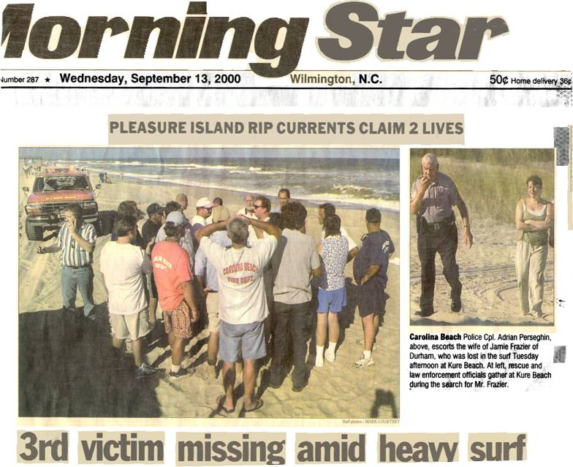
Grip of the Rip
80% of all rescues result of rip currents:
2003 – 17,716 rip current rescues
2002 – 20,890 rip current rescues
2001 – 25,565 rip current rescues
Estimated fatalities per year in U.S.:
206 - Heat
127 - Flooding
100 - Rip Currents
73 - Lightning
68 - Tornado
16 - Hurricane

Slide 12
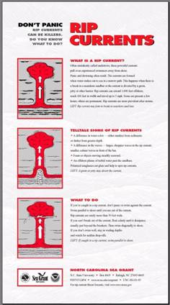
Grip of the Rip
Sea Grant & NWS work with beach communities, e.g., New Hanover County RCAST (Rip Current Safety Awareness Team) and Outer Banks officials
RCAST Project offers links to other safety issues, e.g., UV/skin cancer, lightning
Sea Grant’s Coastwatch, Spring 2005-- Wilmington NWS prototype waterspout forecast

Slide 13
Priority Projects: Ranking Criteria
  Feasibility: Cost (1= >$10k, 2 = < $10k, 3 = no new $) and Timing [1= longer multi-year effort; 2= short term (<1 year); 3= already done]
  Scope: 1 = 2 or fewer partners, 2 = 3, 3 = >3 partners
  Relevance: 1 = relevant to one NOAA goal, 2= 2 NOAA goals, 3 = 3 goals or more
  Weight: Measure of national importance/impact based on most current NOAA goals.
  Highest ranks = priority research and outreach efforts

Slide 14
Project Prioritization
Title | Cost | Timing | Scope | Relev. | Weight | Score
Research Projects:
Beach Safety and Human Health– rip currents, hazardous marine life, UV, health, safety, water quality | 1 | 3 | 3 | 2 | 3 | 12
Integration of maps with NOAA data and services | 1 | 2 | 3 | 3 | 3 | 12
Coastal Ocean Observations Inventory, Needs Assessment, and Outreach | 1 | 2 | 3 | 3 | 3 | 12
Community-based Monitoring of Invasive Species | 1 | 1 | 3 | 2 | 3 | 10
NERRs and Beaufort NOAA Fisheries Lab | 1 | 3 | 3 | 2 | 1 | 10
Climate and Fisheries Production | 1 | 1 | 3 | 2 | 2 | 9
NC Water Hazmat Response | 1 | 1 | 3 | 2 | 2 | 9
Atmospheric Deposition and Weather | 1 | 1 | 3 | 1 | 2 | 8

Slide 15
Project Prioritization
Title | Cost | Timing | Relev. | Weight | Score
OUTREACH EFFORTS:
Meetings:
Ad hoc briefings | 2 | 2 | 3 | 3 | 13
Annual gathering | 1 | 2 | 3 | 3 | 12
Partner meetings | 2 | 1 | 2 | 2 | 10
External meetings | 2 | 1 | 2 | 1 | 9
Mass Media:
Web site | 2 | 1 | 3 | 3 | 12
Contacts List | 3 | 1 | 3 | 2 | 12
TV/radio | 1 | 2 | 1 | 3 | 10
News letter | 2 | 2 | 2 | 1 | 10
Materials:
Brochure/poster | 2 | 3 | 3 | 3 | 14
Powerpoint ppt | 3 | 3 | 3 | 2 | 14
News column | 2 | 1 | 3 | 1 | 11
DVD | 2 | 1 | 3 | 1 | 10
Exhibit | 1 | 1 | 3 | 2 | 10

Slide 16
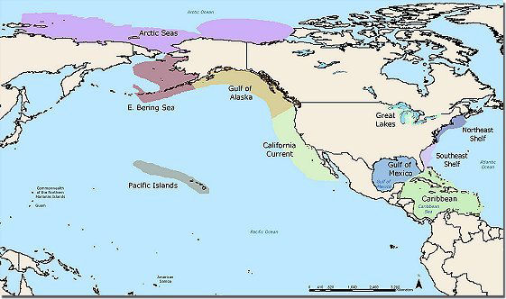
NOAA Goal Team Recommendations
February 2005
Continue outreach efforts
Expand– serve as model for regionalization?
Input to NOAA Program Planning, Budgeting and Execution System (PPBES) process
http://ecosystems.noaa.gov/

Slide 17
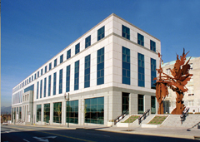
2005 Annual Meeting
One NOAA in the Carolinas and Regionalization– What? Why? How?
NC/SC Partnerships
Breakout Process– new One NOAA initiatives
Expected Outcomes
NOAA National Climatic Data Center, Asheville, NC, host to 2005 NOAA in the Carolinas meeting
Meeting Web site @:
http://www.erh.noaa.gov/mhx/NOAACarolinas/s081905.html

