Slide 1
Overview of DOE/ORNL
Heat Pump Design Model and Use of Web Version
C. Keith Rice
Oak Ridge National Lab
January 2001

Slide 2

Outline - First Part
HPDM History
General Capabilities
HX Assumptions
Solution Approach
Application Modeling
  Design Analysis
  Off-Design Simulation
Flow Control Types

Slide 3
Outline - Second Part
Web Version
  Sample Run
  Input Screens
  Design Case
  Off-Design Setup
  Parametrics
  Plans
Mark VI Version
  Plans

Slide 4
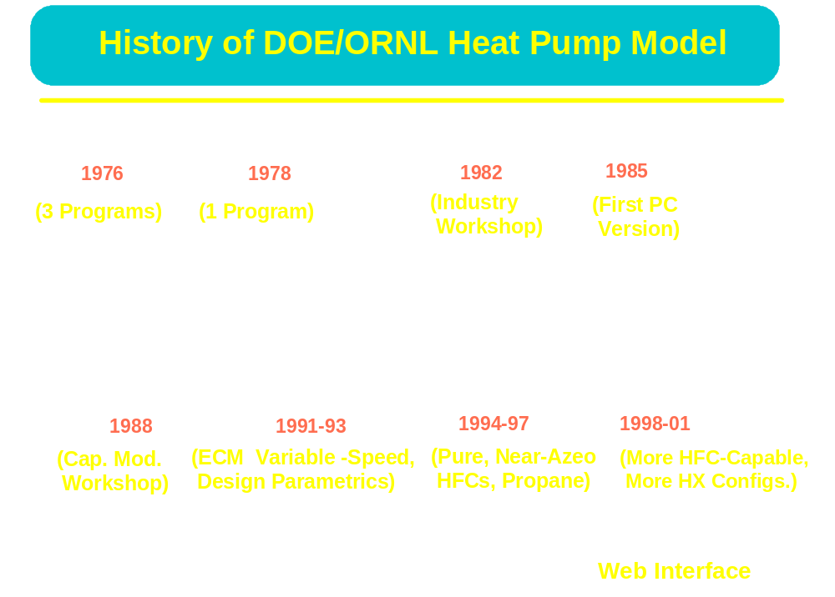

Slide 5
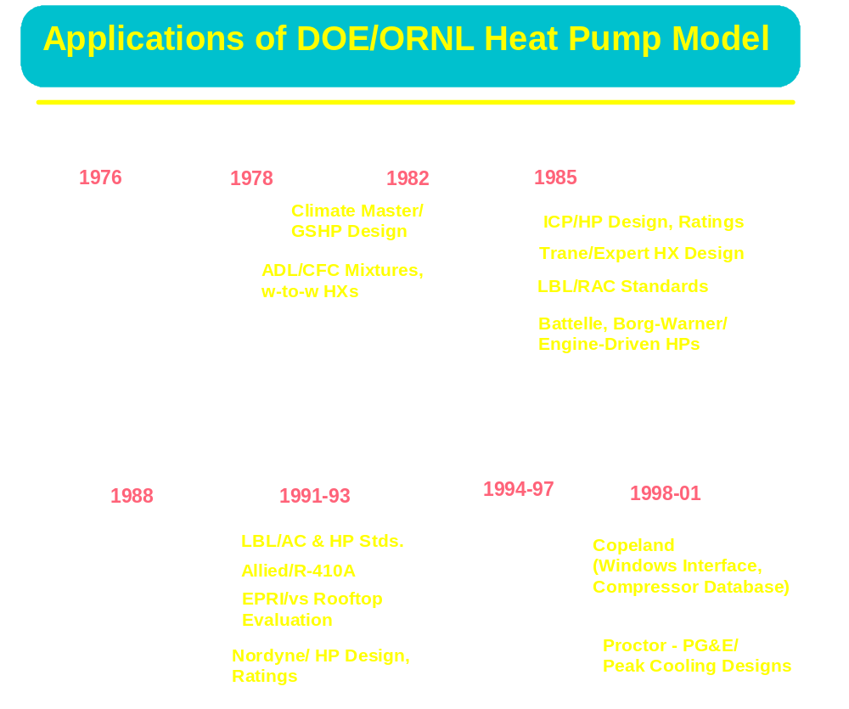

Slide 6
General Capabilities
Air-to-Air Heat Pumps
  Steady-State Cooling and Heating
  Hardware-Based Representations
    Fin-and-Tube HXs
    Compressor Performance Maps
    Single- or Variable-Speed Compr/Fans
  Explicit or Implicit Flow Controls

Slide 7
Design/Simulation Capabilities
Design or Off-Design Analysis
  Charge Inventory Calculation or Balancing
Sizing Options
  For compressors and flow controls
1- or 2-Variable Parametrics

Slide 8
HX Assumptions
Parallel Equivalent Circuits
  Equal Flow Split
  Single Circuit Analysis
  Much Faster than Tube-by-Tube
    But More Idealized
    No Circuit Branching
  Assumes a Well-Balanced HX Design
    With Two-Phase Regions Dominant

Slide 9

Finned Tube Heat Exchanger With Parallel Circuits
Air
Flow
Refrigerant
Flow
Sub-
Circuit

Slide 10
HX Assumptions
Region-by-Region Refr.-Side Analysis
  For Heat Transfer and Pressure Drop
    3-Region Condenser, 2-Region Evap
  Crossflow Treatment of Airflow
    Airflow Across Single-Phase Regions
    Determined by Refr. Fraction
    Also Suitable When Single-Phase Regions
    Ahead of Two-Phase

Slide 11

Determining Refrigerant Region Fractions
L
Air
Flow
L t = 4L as shown
Air
Flow
Sub-
Cooling
Region
Two-
Phase
Region
Determining Single Phase and Two-Phase
Fractions of Heat Exchangers
Desuperheating
Region

Slide 12
Circuitry with Single-Phase Regions on Leading Edge
Air
Flow
Refrigerant
Flow
Sub-
Circuit

Slide 13
HX Assumptions
Air-to Refrigerant H.T. Within Regions
  Effectiveness/NTU Relations
  Single-Phase Regions
    Many-Row Unmixed on Both Sides
  Two-Phase Regions
    Use Two-Phase Temp. At Average Pressure
    Configuration Independent

Slide 14
Solution Approach
Successive Substitution (Sequential)
  Specify
    Inlet Air Temps
    HX Exit Conditions/Control
    Or Design Charge in Place of One Condition
  Guess Saturation Temps
Generally Fast, Stable Convergence
  Always Solving a Real System
  Easier to Trace Problems That May Occur
  than with Simultaneous Solution Methods

Slide 15
Solution Approach
Charge Independent Solution
  Specify Inlet Temps, Evap. Exit Superheat
  Adjust Sat. Temps until
  High-Side Convergence on
    Exit Subcooling -- if sizing flow controls
    Mass flow -- if flow control specified
  Low-Side Convergence on
    Specified Inlet Temp
    At Specified Exit Superheat
  Determine Required Charge (optional)

Slide 16
Solution Approach
Charge Dependent Solution
  Specify Refrigerant Charge
    In Place of One HX Exit Location
    Guess Cond SC or Evap SH for This Location
  Adjust Sat. Temps for Hi-/Lo-Side Bal
    Find Charge for Guessed SC or SH
  Iterate SC or SH until Required Charge
  is Matched

Slide 17
Application Modeling
Design Analysis
  Specify for Application
    Design Ambient Conditions
    Design Values of SC and SH
    And (optionally) Design Capacity
  Calculate
    Required Charge and Flow Control Sizes
    And (optionally) Required Compressor Size
    Design Performance with Given HXs

Slide 18
Application Modeling
Off-Design Simulation
  Specify for Application
    Off-Design Ambient Conditions
    Design Charge and Flow Control Type/Size
    Compressor Size
  Calculate
    Cond SC and Evap SH
    Off-Design Performance with Given Equipment

Slide 19
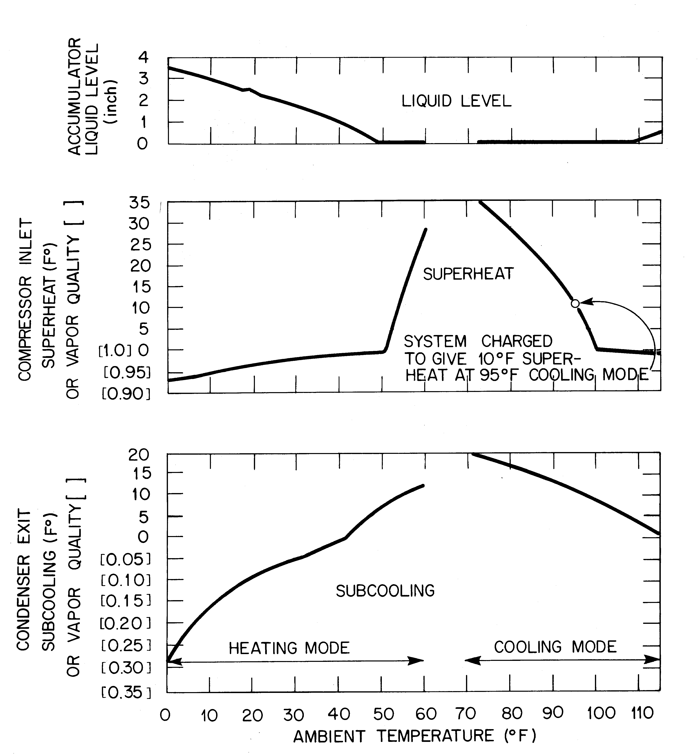
Cap Tube Flow Control -- Fixed Charge w Accum

Slide 20
Flow Control Types
Explicit
  Capillary Tube(s)
    with fixed SH or charge
  Short-Tube Orifice(s)
    with fixed SH or charge
  Thermal Expansion Valve (TXV)
    Fixed Opening
      if fixed SH
    Variable Opening
      if fixed charge

Slide 21
Flow Control Types
Implicit
  SH Control
    fixed charge and SH
  SC Control
    fixed charge and SC (SH may vary widely)
  SH/SC Control
    fixed SC and SH
    (simple way to approx. TXV, TEV)
  SH/SC Programmed Control
    SC and/or SH controlled as F(ambient or speed)
    Useful way to specify known SC/SH trends

Slide 22

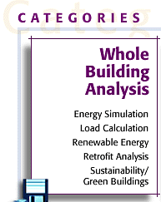


DOE Web Site for Software Tools
Web Address
http://erendev.nrel.gov/buildings/tools_directory/

Slide 23
Web Version of HPDM
Mark V
Single-Speed Only
1-D Parametrics
Online X-Y Plots
Exportable Data
  Input & Output
Web Address
www.ornl.gov/~wlj/hpdm/doehpdm.html

Slide 24
Demo of Web Version
Model Walk Through (shown online)
  Overview of Input Sheets
  Sample Design Run
    View Cycle Output
  Setup Charge/Flow Control Values
  for Off-Design Run
  Run Off-Design Ambient Parametrics
    View Output Options

Slide 25
Web Version of HPDM
Mark V
Single-Speed Only
1-D Parametrics
Online X-Y Plots
Exportable Data
  Input & Output
Click Above To Run
Web Address
www.ornl.gov/~wlj/hpdm/doehpdm.html

Slide 26
Web Release Plans
Mark V
  Updated Web Version, Spring 2001
    Improved Input Screens
    New Output Screen
    Setup Option for Off-Design Analysis
    Off-Design SH/SC Control vs Ambient
    2-D Parametrics and Plotting
    Online Documentation and Related Papers

Slide 27
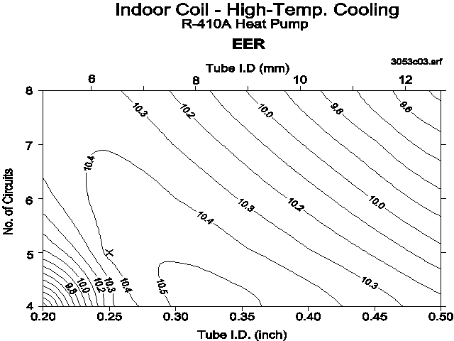
Example of Two-Variable Design Parametrics
EER for a Range of Tube IDs and Circuits

Slide 28
Mark VI Version
More HFC-Capable
  New Props for HFC Mixtures
    Improved Near-Critical and Transport Props for Existing Fluids
  HFC-Suitable Two-Phase H.T.
    U. of I. ACRC Correlations
  HFC-Suitable Flow Controls
    Cap- and Short- Tube Correlations
    Refrigerant-Specific and -Generalized as Avail

Slide 29
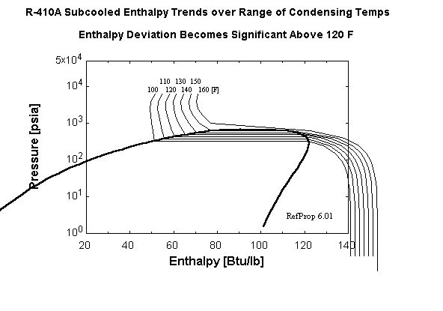
Subcooled Enthalpy Corrections Are Needed
For R-410A at Higher Condensing Temperatures

Slide 30
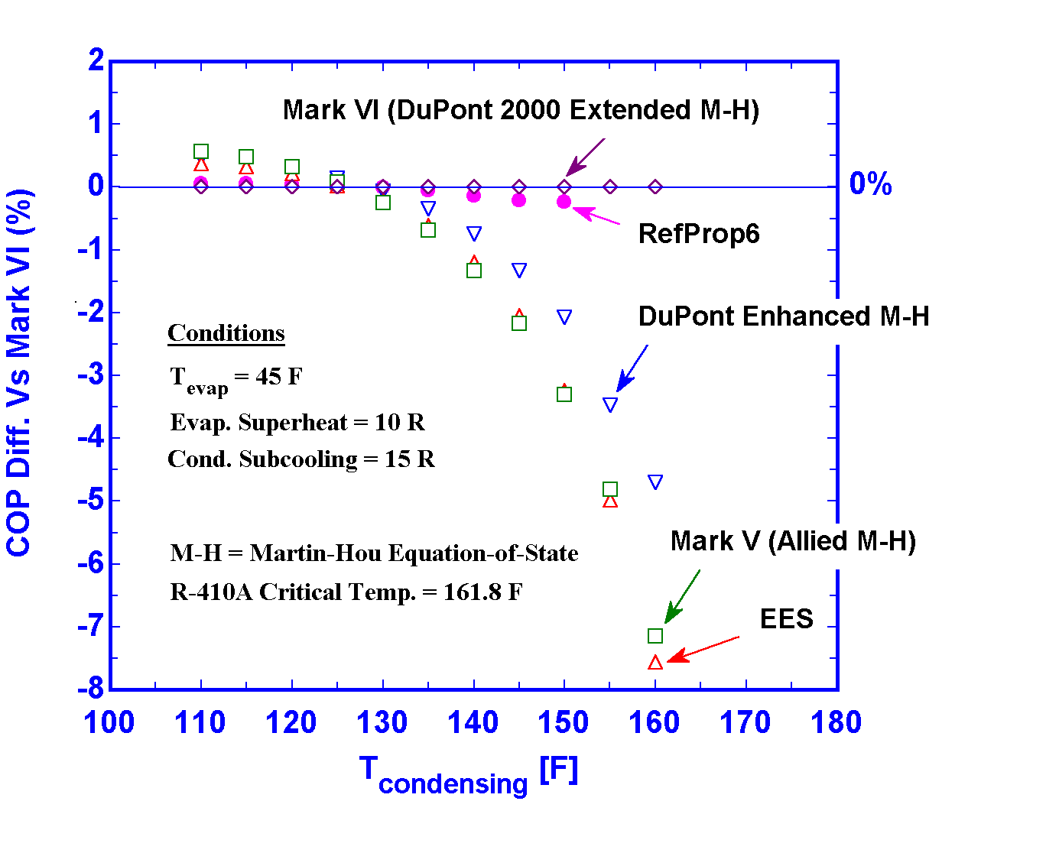
Cooling COP Comparisons for R-410A
Over a Range of Condensing Temps
With Different Property Representations

Slide 31
Mark VI Version
More HX Configurations
  Circuit Branching
    Merging in Condenser Subcooled Region
  Circuit Arrangement
    Initially 1- to N-Row CrossF
    Later Two-Phase with Glide Effect
      Adding CrossCF, CrossPF

Slide 32
Mark VI Version
More Air- and Refr-Side Surfaces
  Air-Side
    All New Correlations for Range of Surfaces
      Default Fin Patterns Built-In
    Extra Fin Area Calculated Explictly
  Refrigerant-Side
    Based on Augmented-Area-Ratio Input
Better Airflow and Fan Power Tracking
  with ambient

Slide 33
Web Release Plans
Mark VI
  Initial Beta Release Web Version,
  Summer 2001
  Official Web Release, Fall 2001
    Link with Compressor Manuf Databases
  R-407C Capability To Follow Later

