Slide 1
Agenda
Desired outcomes from physics classes
National Science Education Standards
Lab activities
Inquiry and scientific research
A. Erzberger April 2000

Slide 2
“DOING Science”
Changing physics education:

Slide 3
National Science Education Standards
Science is for all students
Learning science is an active process
School science reflects the practice of science
Improving science education is part of systemic education reform

Slide 4
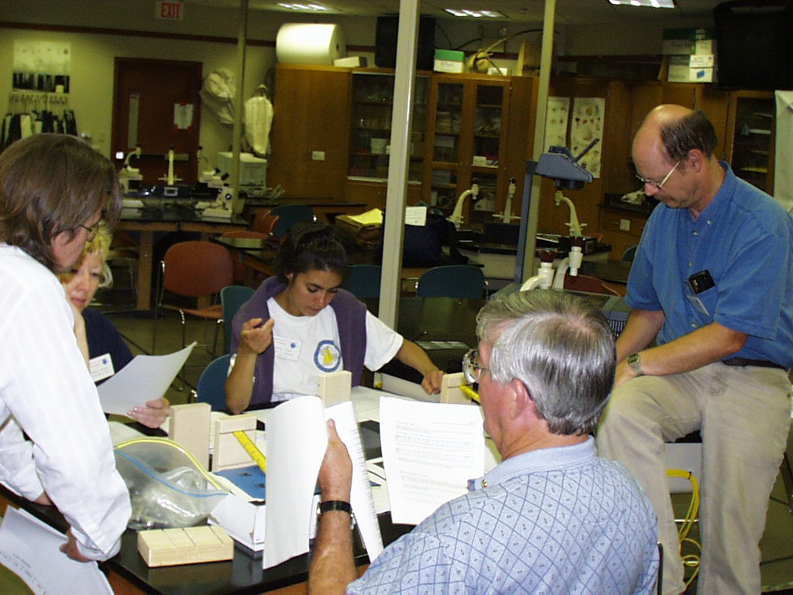
All are involved:
Teaching
Professional Development
Assessment
Content
Program
System

Slide 5
Changing Emphasis in
Teaching Standards:
LESS emphasis on:
  treating students as a whole
MORE emphasis on:
  individual interests, strengths, needs

Slide 6
Changing Emphasis in
Teaching Standards:
LESS emphasis on:
  treating students as a whole
  rigidly following curriculum
MORE emphasis on:
  individual interests, strengths, needs
  selecting and adapting curriculum

Slide 7
Changing Emphasis in
Teaching Standards:
LESS emphasis on:
  treating students as a whole
  rigidly following curriculum
  focusing on student acquisition of information
MORE emphasis on:
  individual interests, strengths, needs
  selecting and adapting curriculum
  focusing on student understanding and use of sc. knowledge, ideas, & inquiry processes

Slide 8
Teaching Standards
LESS MORE
  lecture, text, and demos
  active, extended scientific inquiry

Slide 9
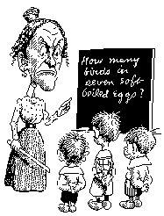
Teaching Standards
LESS MORE
  lecture, text, and demos
  recitation of acquired knowledge
  active, extended scientific inquiry
  scientific discussion & debate

Slide 10
Teaching Standards
LESS MORE
  lecture, text, and demos
  recitation of acquired knowledge
  test for facts at end of unit
  active, extended scientific inquiry
  scientific discussion & debate
  continuously assess

Slide 11
Teaching Standards
LESS MORE
  lecture, text, and demos
  recitation of acquired knowledge
  test for facts at end of unit
  teacher responsible for learning
  active, extended scientific inquiry
  scientific discussion & debate
  continuously assess
  students share responsibility for learning

Slide 12
Teaching Standards
LESS MORE
  lecture, text, and demos
  recitation of acquired knowledge
  test for facts at end of unit
  teacher responsible for learning
  competition in class
  active, extended scientific inquiry
  scientific discussion & debate
  continuously assess
  students share responsibility for learning
  cooperation, shared responsibility, respect

Slide 13
Teaching Standards
LESS MORE
  lecture, text, and demos
  recitation of acquired knowledge
  test for facts at end of unit
  teacher responsible for learning
  competition in class
  teachers work alone
  active, extended scientific inquiry
  scientific discussion & debate
  continuously assess
  students share responsibility for learning
  cooperation, shared responsibility, respect
  teachers work together

Slide 14


LESS MORE

Slide 15
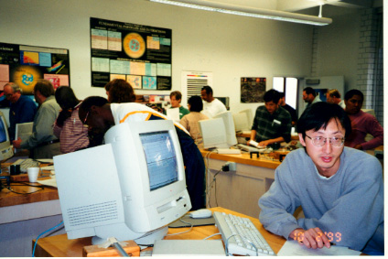
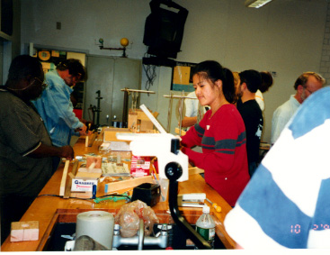
Professional Development
LESS emphasis
on:
  learning sc. by lecture & reading
MORE emphasis
on:
  learning sc. through investigation & inquiry

Slide 16
Professional Development
LESS emphasis
on:
  learning sc. by lecture & reading
  separation of science & teaching knowledge
MORE emphasis
on:
  learning sc. through investigation & inquiry
  integration of sc. & teaching knowledge

Slide 17
Professional Development
LESS emphasis
on:
  learning sc. by lecture & reading
  separation of science & teaching knowledge
  teacher as a technician
MORE emphasis
on:
  learning sc. through investigation & inquiry
  integration of sc. & teaching knowledge
  teacher as intelligent, reflective practitioner

Slide 18
Professional Development
LESS emphasis
on:
  learning sc. by lecture & reading
  separation of science & teaching knowledge
  teacher as a technician
  teacher as individual in classroom
MORE emphasis
on:
  learning sc. through investigation & inquiry
  integration of sc. & teaching knowledge
  teacher as intelligent, reflective practitioner
  teacher as member of collegial professional community

Slide 19
Content
LESS emphasis on:
  knowing sc. facts
MORE emphasis on:
  understanding sc. concepts and developing abilities of inquiry

Slide 20
Content
LESS emphasis on:
  knowing sc. facts
  covering many topics
MORE emphasis on:
  understanding sc. concepts and developing abilities of inquiry
  studying a few fundamental concepts

Slide 21
Content
LESS emphasis on:
  knowing sc. facts
  covering many topics
  separating sc. knowledge & sc. process
MORE emphasis on:
  understanding sc. concepts and developing abilities of inquiry
  studying a few fundamental concepts
  integrating all aspects of sc. content

Slide 22

Inquiry
Curiosity is the centerpiece of inquiry.
We all start our lives as inquirers.
The action of seeking …of asking…
A scientist learns how to ask "good" questions.
It’s a way of thinking, of processing, of operating in the world.
Bounded by repeatability of results, self-consistency, ...

Slide 23
Scientific inquiry
is personally driven.
is concerned with content as well as process.
is as much about asking good questions as getting good answers.
occurs within an existing framework of previous knowledge.
is concerned with gathering evidence.
is developed in scientists through a mentoring over long time.
involves the skills of
  directed observation,
  problem solving,
  analysis, and
  experimentation.

Slide 24
Inquiry Teaching
Not a list of facts and formulas to memorize.
A shift in attitude by teacher, not curriculum change.
Teachers active in practice of inquiry process, too.
Teacher - a sage, not on stage. A facilitator.
Students experience process of inquiry and construct other knowledge.
Not limited to theory; must allow multiple results (NOT most labs!)
Need both content and process.
Not all hands-on; use many resources.

Slide 25
Promoting Inquiry
Activities that investigate & analyze sc. questions.
Longer investigations.
Students involved in designing the investigations.
Students using evidence & strategies for revising explanations.
Science used as argument & explanation.
Communication of scientific explanations.
Process skills used in context, to set up and do the investigation.

Slide 26
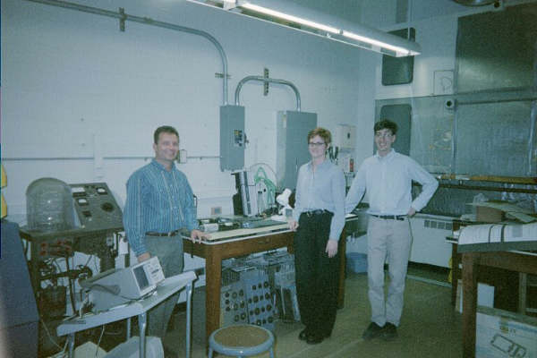
Science is what students do,
not what is done to them.
Inquiry,
as it relates to science education,
should mirror as closely as possible the enterprise of doing real science.

