Slide 1

THE BETTER MOUSE
TRAP
How to protect it with
Patents and Trademarks
Randy Notzen
Notes:
ANY QUESTIONS

Slide 2
INTELLECTUAL PROPERTY
PATENTS
TRADEMARKS
COPYRIGHTS

Slide 3
CRITERIA FOR OBTAINING A PATENT
Invention must be
NEW
USEFUL
NON-OBVIOUS

Slide 4
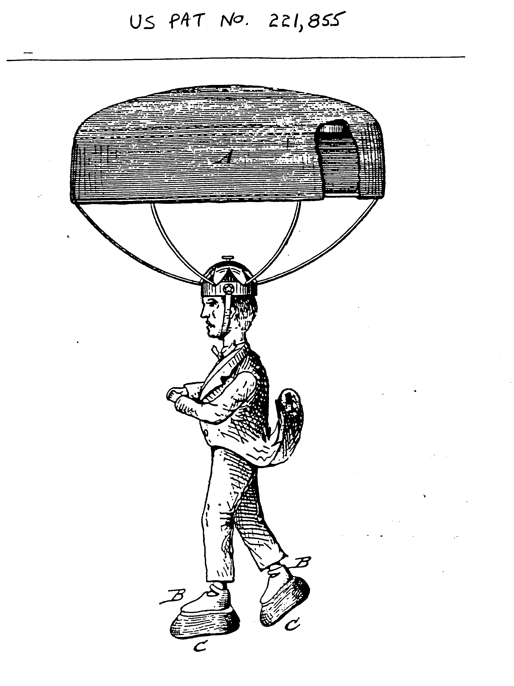
SHORT-RANGE PARACHUTE

Slide 5
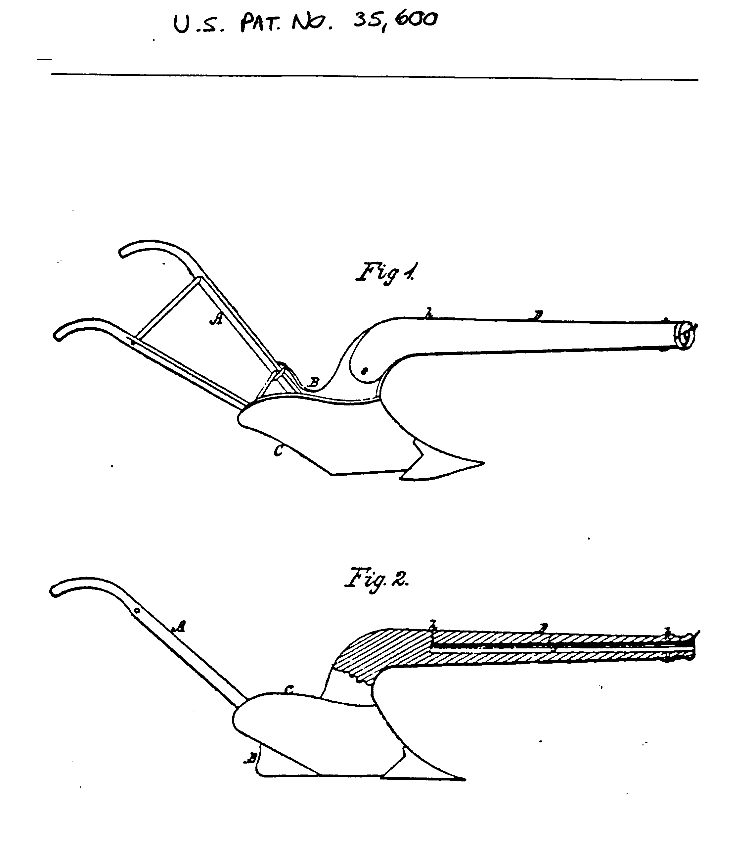
PLOW GUN

Slide 6
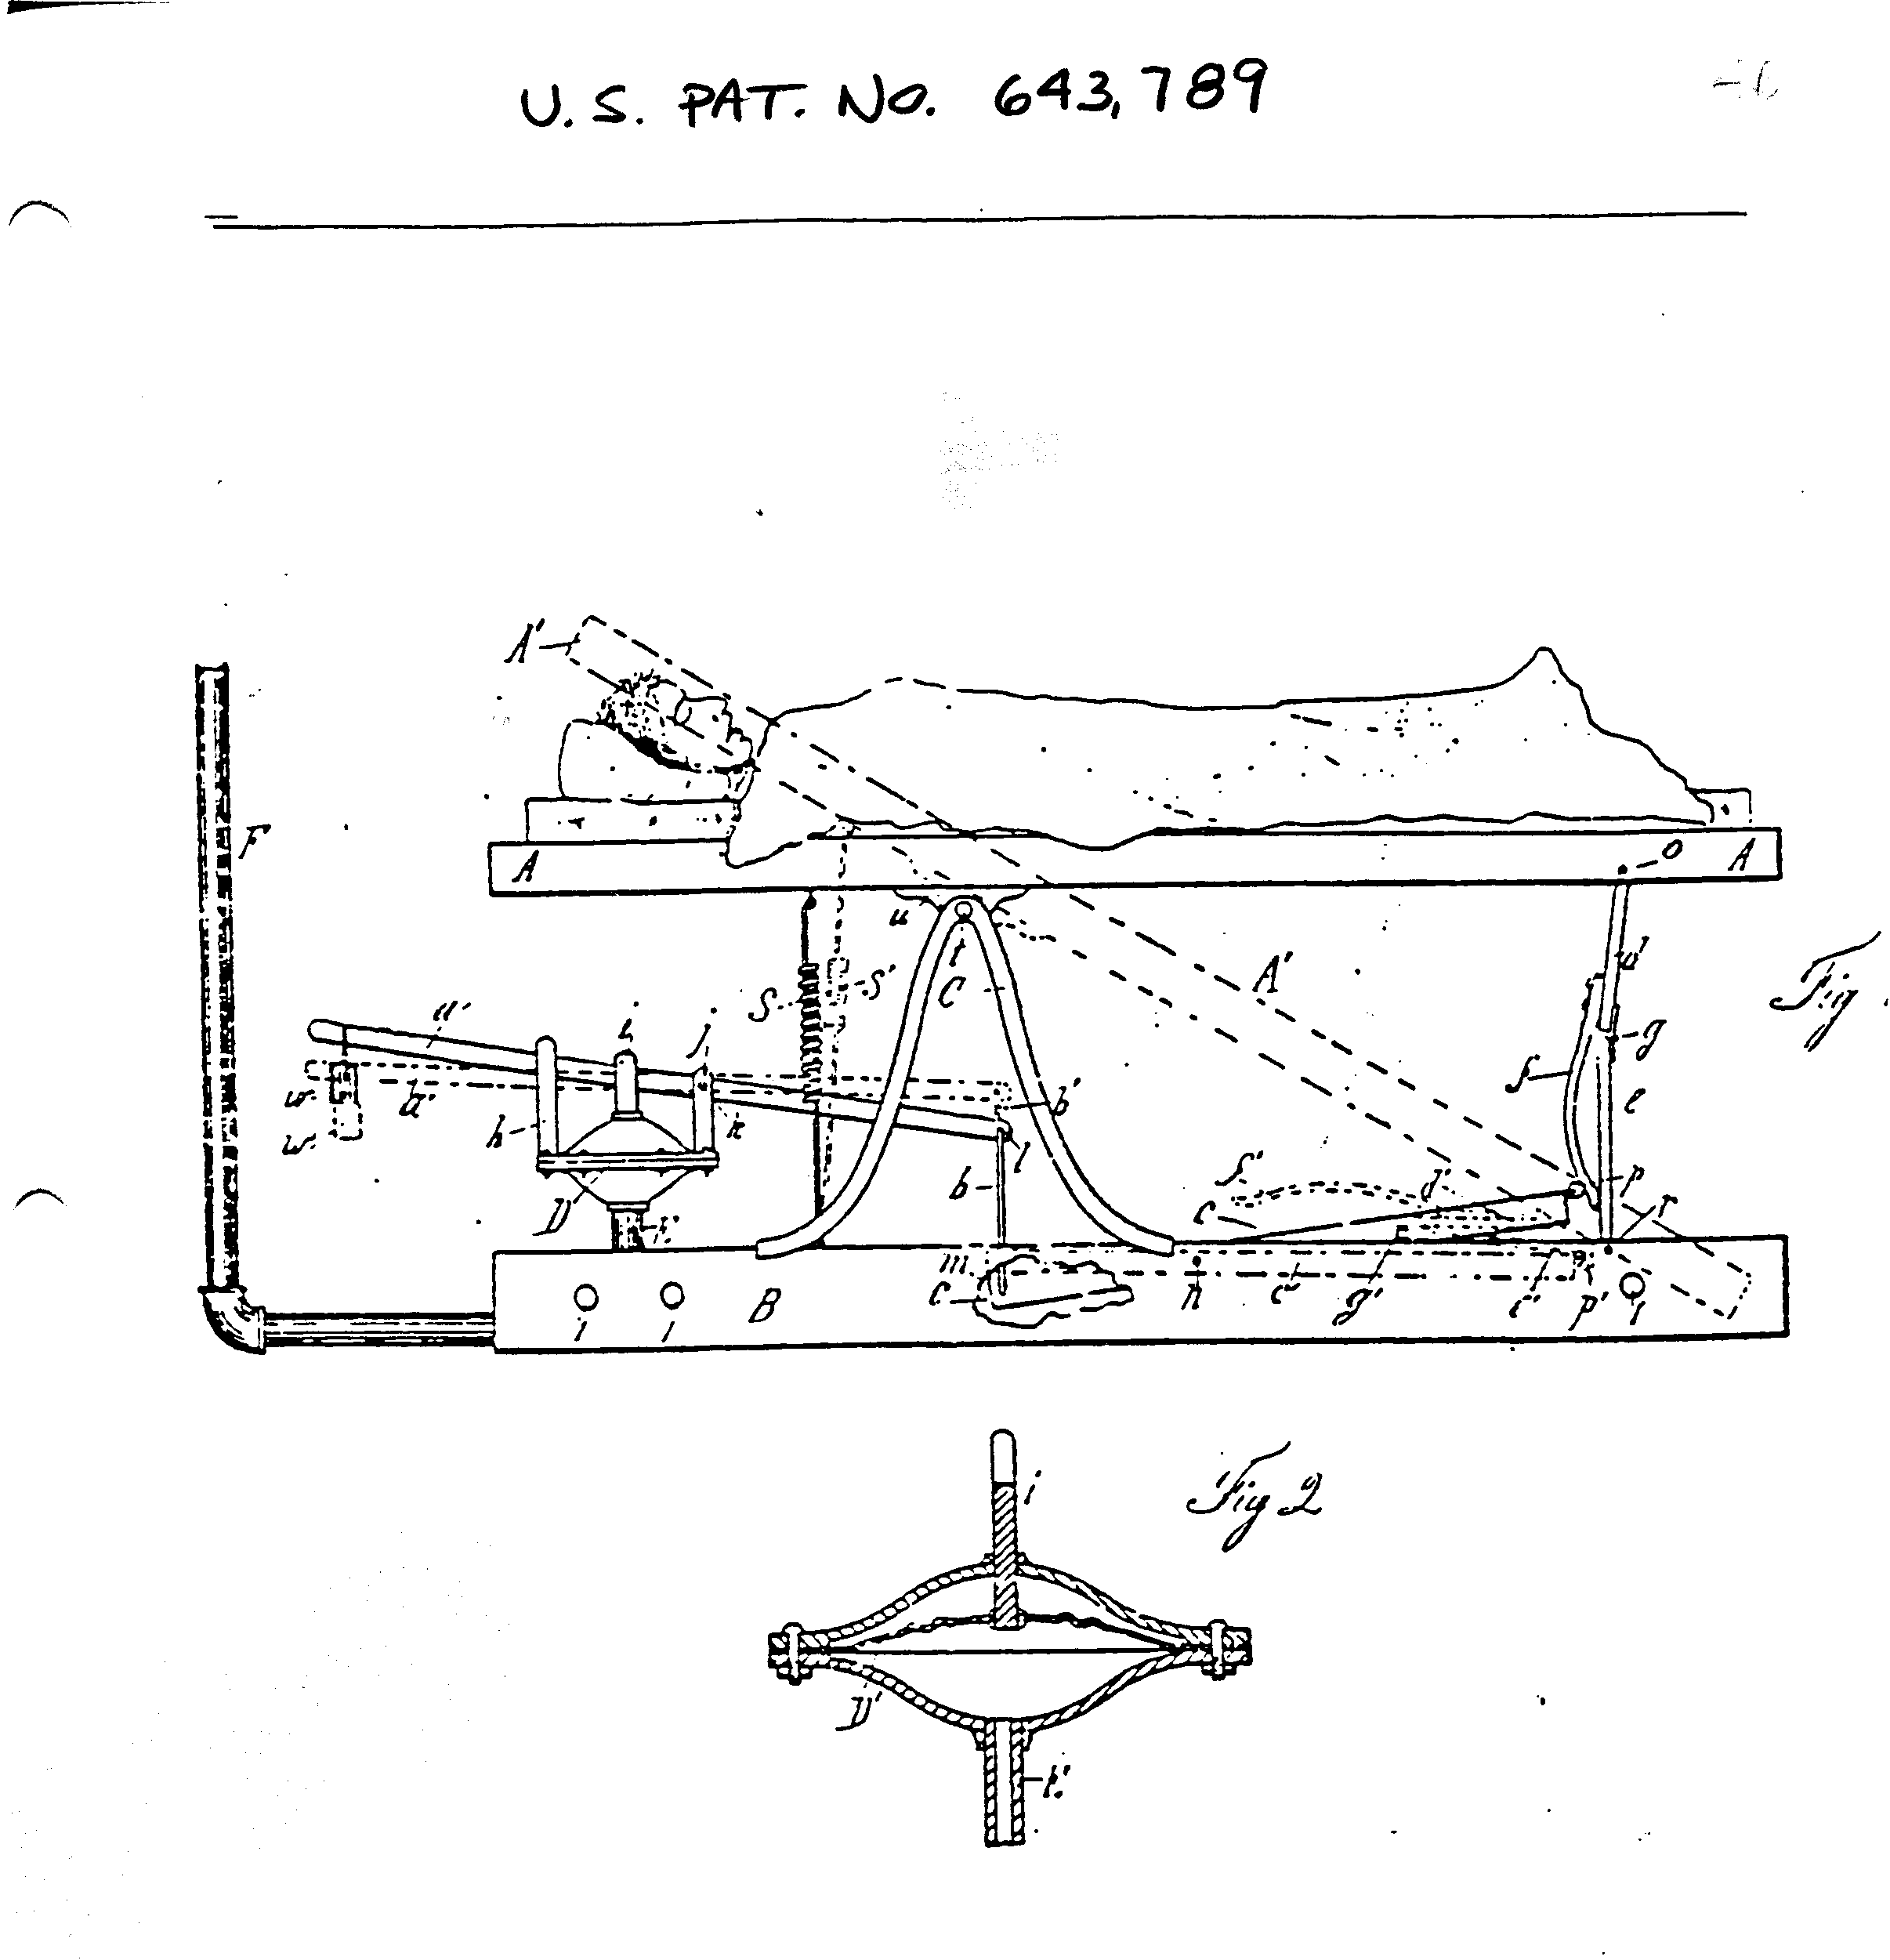
ALARM BED

Slide 7
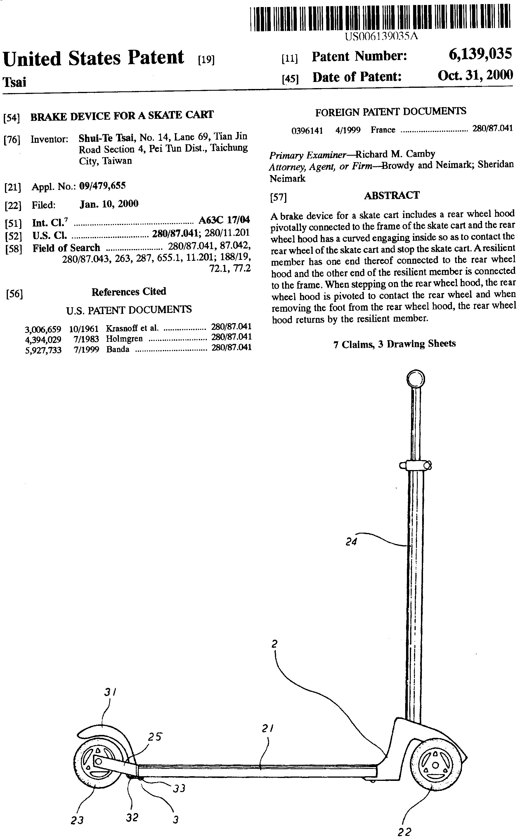
Scooter

Slide 8
TYPES OF PATENTS
UTILITY PATENT
  PROTECTS UTILITARIAN FEATURES
  LIFE OF 20 YEARS FROM 1ST FILING DATE
DESIGN PATENT
  PROTECTS ORNAMENTAL FEATURES
  LIFE OF 14 YEARS FROM ISSUE DATE
PROVISIONAL PATENT APPLICATION
  RESERVES FOR ONE YEAR THE RIGHT TO FILE A UTILITY APPLICATION

Slide 9
WHAT IS A UTILITY PATENT?
A utility patent is a disclosure to the public in exchange for the right from the government to exclude others from making, using, selling, or offering for sale the invention for a period of 20 years from the first filing date.

Slide 10
WHAT CAN BE PATENTED?
Article of manufacture
Apparatus
Process
Composition of Matter
Business Methods
Improvements of any of these

Slide 11
PATENT FEATURES
A U.S. Patent is good only in the U.S.
Ideas from foreign patents may not be patented in the U.S. by others.
Foreign patent coverage generally requires a separate patent for each country.

Slide 12
PATENT PENDING
Okay to mark product after patent application is filed (provisional application also)
May deter potential infringers
Fraudulent to mark without pending application
Marking must be removed if application is terminated

Slide 13
CONTENT OF A UTILITY PATENT
-Background of the invention
-Object of the Invention
-Brief Description of the Drawings
-Description of the Preferred Embodiments
-Claims

Slide 14
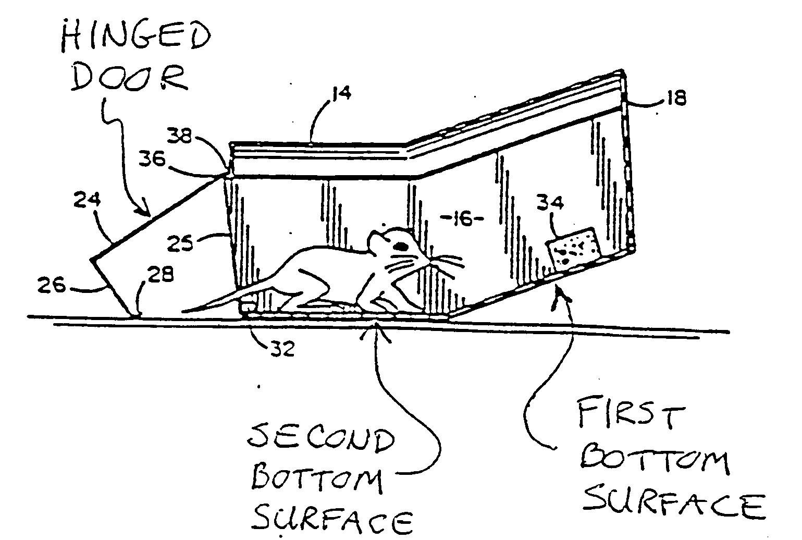
I CLAIM:
1. A rodent trap having an opening for permitting entry by a rodent, said container having a bottom comprising at least two bottom surfaces rigidly connected and oriented at an obtuse angle relative to one another ...

Slide 15
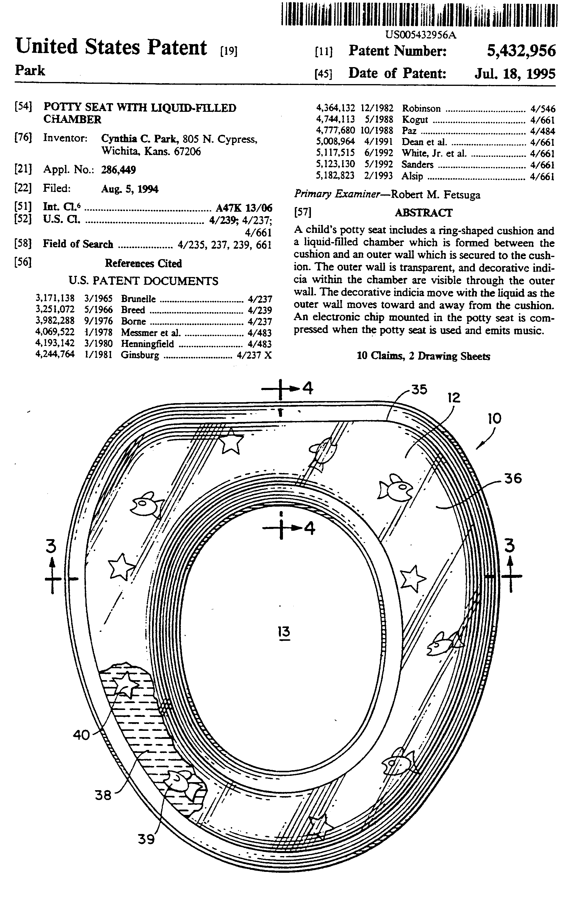
POTTY
SEAT

Slide 16
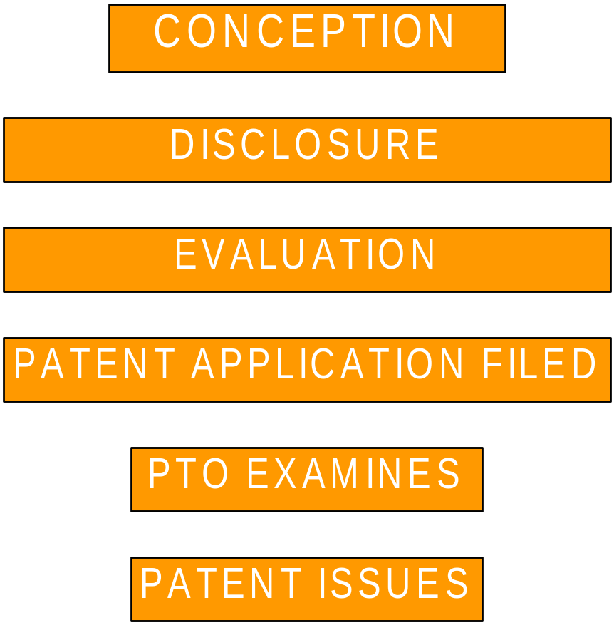
THE PATENTING PROCESS

Slide 17
Scooter

Slide 18
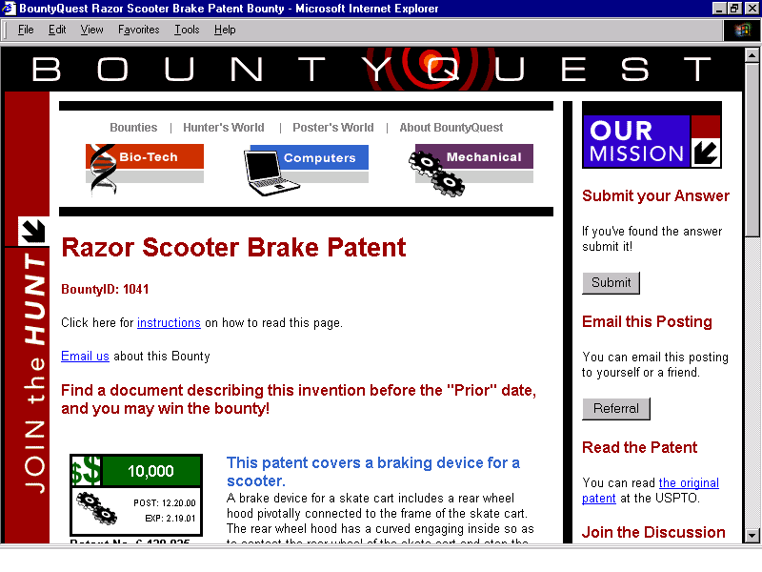
THE PRIOR ART CHALLENGE

Slide 19
OFFENSIVE USE OF PATENTS
DETERS INFRINGERS
LICENSING
ENFORCEMENT TO OBTAIN DAMAGES

Slide 20
DEFENSIVE USE OF PATENTS
BARS OTHERS’ PATENTS
TRADING STOCK

Slide 21
CAN YOU DESIGN AROUND A PATENT?

Slide 22
I CLAIM:
1. A rodent trap having an opening for permitting entry by a rodent, said container having a bottom comprising at least two bottom surfaces rigidly connected and oriented at an obtuse angle relative to one another ...

Slide 23
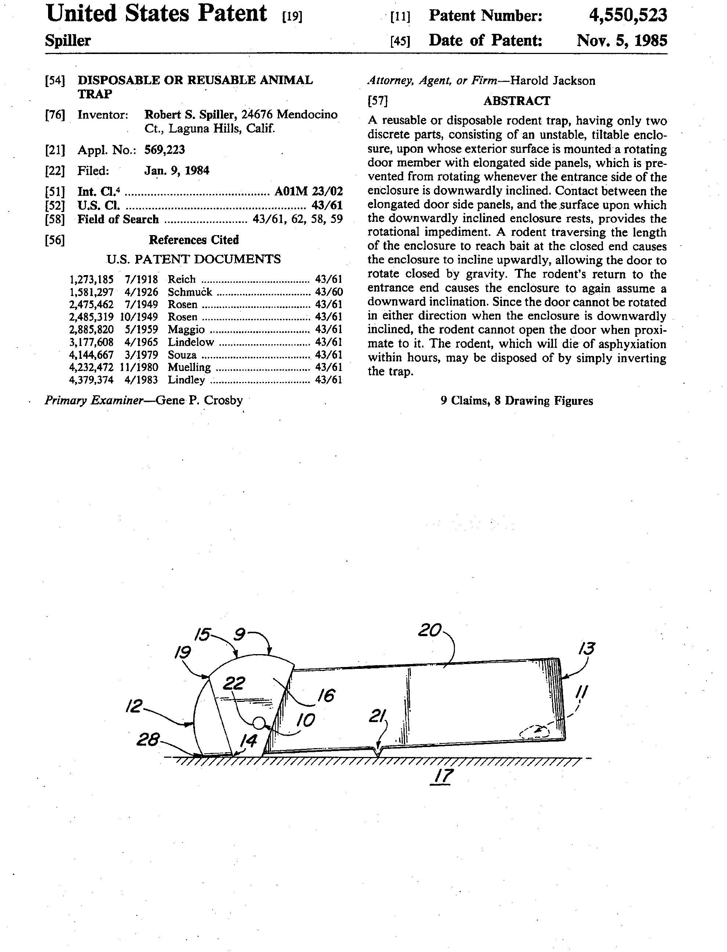
DISPOSABLE OR REUSABLE ANIMAL TRAP

Slide 24
OPTIONS WHEN CLIENT DISCOVERS A PATENT INFRINGER
Have the product evaluated by a patent attorney.
1) If not infringing - done
2) If infringing:
a) send a copy of patent to alleged infringer
b) send a cease and desist letter
c) send a license offer

Slide 25
OPTIONS WHEN CLIENT RECEIVES A CEASE AND DESIST LETTER
Immediately go to a patent attorney for advice
1) The product may not be infringing
2) The patent validity may be attacked
3) Patent could be expired
4) An acceptable license may be available
5) Client may discontinue infringement
Treat Cease and Desist Letter Seriously

Slide 26
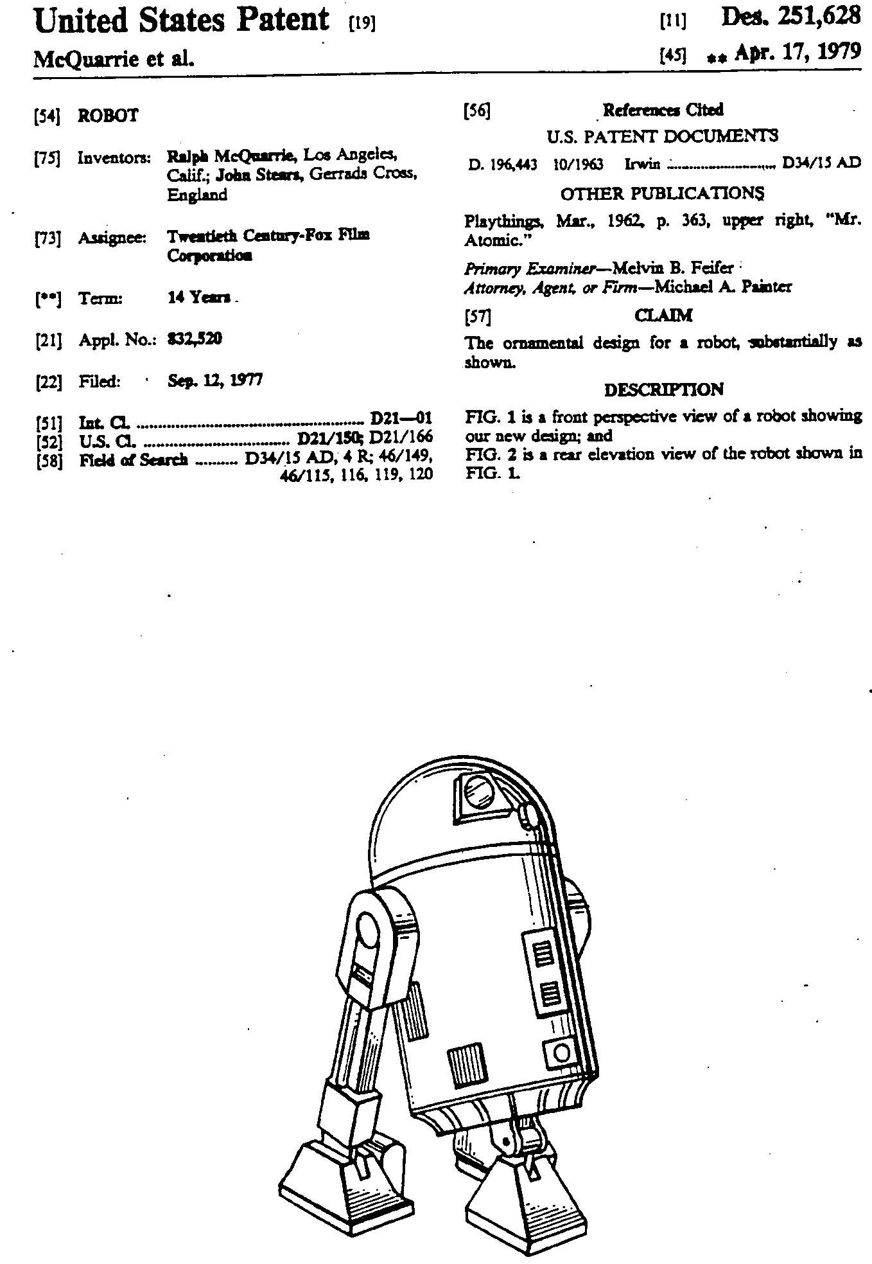
DESIGN PATENT

Slide 27
PITFALLS TO PATENTABILITY
Prior Sales
Public Use
Publication

Slide 28
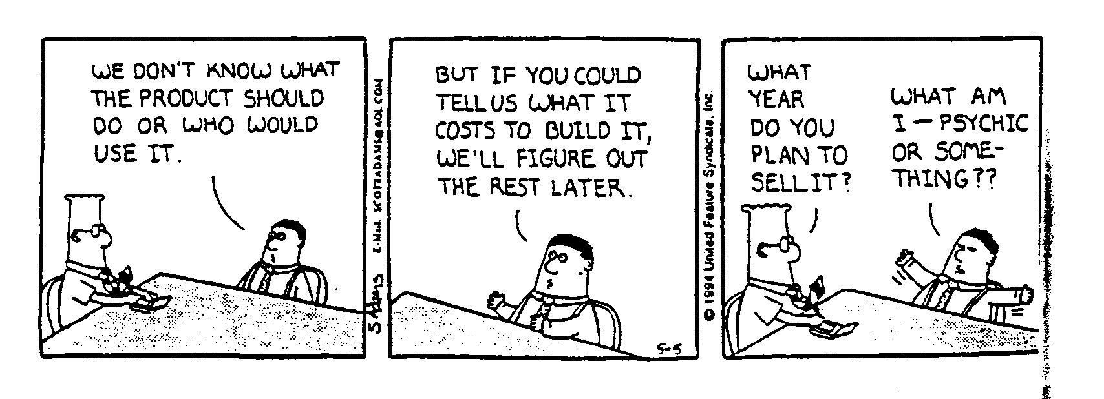
ENGINEERING VS MARKETING

Slide 29
EVALUATE INVENTION
1) How important in the marketplace?
2) Can it be manufactured commercially?
3) How will it be marketed?

Slide 30
INTELLECTUAL PROPERTY
PATENTS
TRADEMARKS
COPYRIGHTS

Slide 31
TRADEMARK
Any word, name, symbol or device used to distinguish one company’s products from the products of other companies.

Slide 32
TRADEMARK EXAMPLES
WORD HAVAHART
NAME FORD
SYMBOL HARLEY DAVIDSON MUFFLER SOUND
SMELL LEMON FRAGRANCE FOR TONER ON LASER PRINTERS
COLOR PINK FOR INSULATION

Slide 33
DIFFERENT TRADEMARK SYMBOLS
TM TRADEMARK
SM SERVICE MARK
® FEDERALLY REGISTERED

Slide 34
QUALITY OF A TRADEMARK
Weakest      Strongest
Generic Descriptive Suggestive Arbitrary Coined
    
Aspirin Holiday Inn Roach Hotel Camel Kodak

Slide 35
TRADEMARK FEATURES
TRADEMARK IN U.S. IS GOOD ONLY IN U.S.
IF POLICED, TRADEMARK LIFE CAN BE FOREVER
U.S. TRADEMARK SYSTEM BASED UPON FIRST-TO-USE

Slide 36
TRADEMARK DISASTERS
NOVA AUTOMOBILE - Translation
FRENCH DRINK - Phonetics
ASPIRIN - Generic
XEROX - Almost Generic

Slide 37
FEDERAL TRADEMARK REGISTRATION PROCESS
Select Mark
Perform clearance search
File application
Application allowed - 30 day opposition
Show use in interstate commerce
Registration issues

Slide 38
TRADEMARK LIKELIHOOD OF CONFUSION
Similarity
  Appearance - Raid vs. Raze Insecticide
  Sound - Easy Spray vs. EZ Spray window spray
  Meaning Hurricane vs. Cyclone fencing
Similar Channels of Trade
Strength of Mark
Buyer Sophistication
Intent

Slide 39
INTELLECTUAL PROPERTY
PATENTS
TRADEMARKS
COPYRIGHTS

Slide 40
Notes:
ANY QUESTIONS

