Slide 1
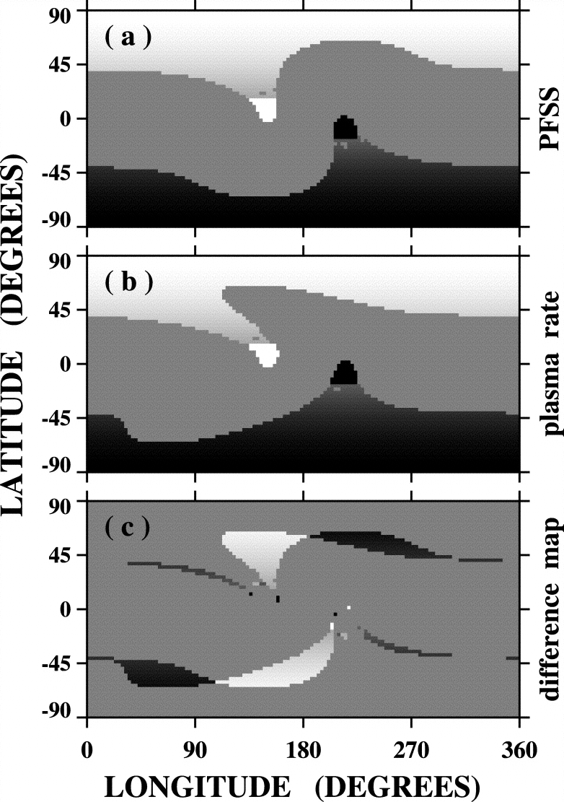
Time Variations of Open Magnetic Flux
N. R. Sheeley, Jr. & Y.-M. Wang
How much interchange reconnection occurs during the evolution of a coronal hole? The amount depends on how the hole evolves. There is less interchange reconnection near sunspot maximum when holes become sheared and lose open flux than toward minimum when they rotate rigidly. For the potential field source surface model, it is easy to determine the change of open flux – one subtracts the open flux at time t₂ from the open flux at the initial time t₁. But how does one determine the amount of open flux that was rearranged during this interval? The figure at the right illustrates how this can be done.
The idea is to let differential rotation act on the photospheric field for a brief interval while you prevent the coronal field lines from reconnecting. Then, after calculating the amount of rearrangement, let the field snap back to its potential configuration.

Slide 2
In this figure, panel (a) refers to the distribution of open flux for the field of an equatorial doublet and an axisymmetric dipole. In panel (b), the coronal holes are temporarily frozen in their sheared state. The difference is shown in panel (c ). Neglecting the relatively slow effects of diffusion and meridional flow, the photospheric field does not change with time, and the holes will return to their initial shapes when the coronal field is allowed to reconnect. Thus, panel (a) represents the final state at time t₂ as well as the initial state at time t₁, and the differences in panel (c ) also represent the change that occurs when the reconnection takes place. By subtracting the absolute value of this change from the change of open flux between times t₁ and t₂ (and then dividing by 2 to avoid counting the same flux twice), we obtain the amount of open flux that changed its footpoints (i.e. the amount of flux participating in the interchange reconnection). Because the initial and final states are the same, there is no change of open flux, and all of the reconnection is due to interchange, as expected for rigid rotation.
The amounts of flux lost and flux interchanged depend on the strength of the polar field and the latitude of the idealized doublet. In the presence of a 1 G polar field, we obtain 0.00 GR² lost and 0.56 interchanged when a 5 G doublet is at the equator, whereas without the polar field, 0.00 is lost and 0.12 is interchanged. On the other hand, when the doublet is at 30 degrees latitude, we find that 0.06 is lost and 0.38 is interchanged when a 1 G polar field is present, but 0.11 is lost and 0.14 is interchanged without the polar field. Thus, interchange reconnection is dominant throughout the sunspot cycle, but flux-loss reconnection is important near sunspot maximum. If coronal inflows are signatures of flux-loss reconnection, this would account for their reduced rates around sunspot minimum.
Wang, Y.-M. & Sheeley, N. R., Jr.: 2004, ApJ 612, 1196.

