Slide 1

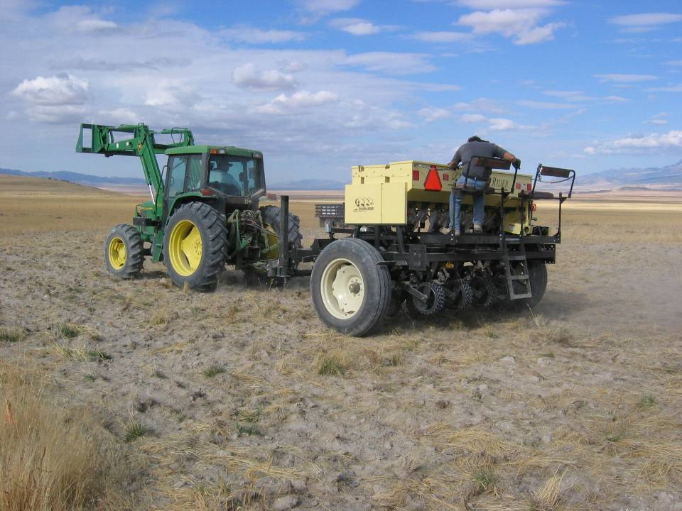
Seed Quality Seeding Rates
Drill Calibration

Slide 2
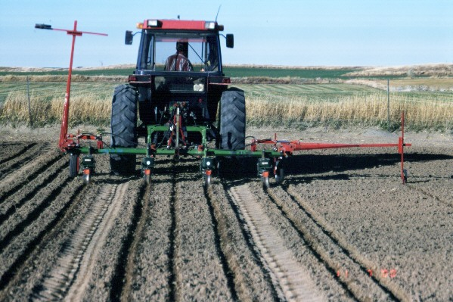
First -
SOME IMPORTANT PLANT MATERIALS DEFINITIONS

Slide 3
Certified Seed - high-quality seed with superior production potential:
1. Known genetic source and identity and seed origin
2. Known genetic purity
3. Known germinating ability
4. Known presence or absence of other crop seed, weed seed, and inert matter
5. Known presence or absence of certain seed-borne diseases
6. Free of noxious weeds

Slide 4
The certification process is accomplished by:
  accurate record keeping
  field and seed cleaning facility inspections
  seed testing by the certifying agency
Certifying agencies:
  Idaho Crop Improvement Association
  Utah Crop Improvement Association
  Nevada Dept. of Agriculture

Slide 5
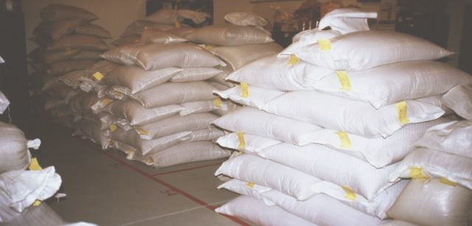
Common Seed - Non-certified seed. May be a named variety but not grown under certification program. Seed that cannot be identified as a variety.

Slide 6
Classes of Seed
Breeder seed - directly controlled by the originating plant breeder or releasing organization to produce Foundation seed.
Foundation seed - progeny of Breeder seed that is handled to maintain specific identity and purity.

Slide 7
Classes of Seed (continued)
Registered seed -
the progeny of Foundation seed
Certified seed -
the progeny of Breeder, Foundation, or Registered seed

Slide 8
Release Alternatives
See “The AOSCA Native Plant Connection"
Source Identified -
natural stands, seed fields, or orchards
no selection or testing of the population
Selected -
progeny of rigidly selected parentage
has promise but no proof of superiority

Slide 9
Release Alternatives (continued)
Tested -
testing for more than 1 generation
multiple sites to verify performance
heritability of desirable traits
proven genetic superiority or distinctive traits
Cultivar -
testing greater than 2 generations
well-known range of adaptation
clearly documented performance/characteristics
demonstrated heritability traits
superior performance

Slide 10

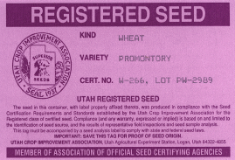
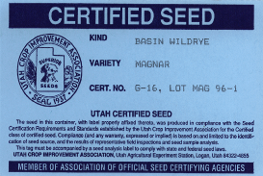

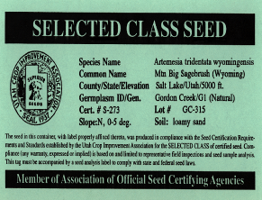

Cultivars (varieties)
Pre-Variety Release Alternatives

Slide 11
SEED TAGS
1) Variety and kind (Species and Common name)
2) Lot number
3) Origin
4) Net weight
5) Percent pure seed
6) Percent germination and date of test

Slide 12
SEED TAGS (continued)
7) Percent inert matter
8) Percent other crop seed
9) Percent weed seeds
    10) Name of restricted noxious seed (# per pound of seed)
    11) Prohibited noxious seeds are not allowed.
12) Name and address of company responsible for analysis (seller)

Slide 13
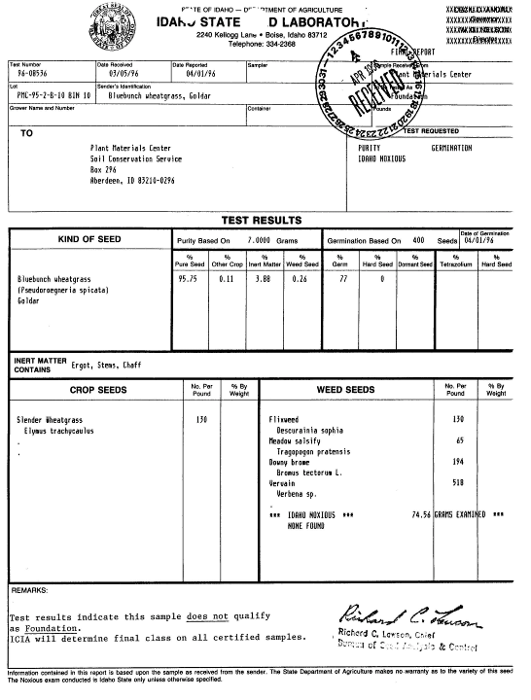

Slide 14
Seed Quality
Seed lots vary widely in quality
Seed lots contain:
  inert material
  undesirable seeds
  immature or injured seeds

Slide 15
Seed Quality
Certified seed provides:
  genetic and mechanical purity
  varietal identity for a uniform seeding
  minimizes introducing weed seed.

Slide 16
Certified Seed
    The use of Certified seed helps protect the buyer!
Purity expresses:
      composition of the seed lot
      degree of contamination by unwanted components

Slide 17
A purity test separates:
    pure seed
    inert matter (plant parts, dirt, damaged seed)
    other crop seed (normally grown crops, < 5 percent)
    weed seed - common and restricted (number per pound of seed)
    {0.05 – 0.5 %}

Slide 18
Germination test:
    Determines capability of the seed lot:
    to initiate growth by the embryo
    to develop a young plant by seed
    Tests are conducted under controlled conditions
      Association of Official Seed Analysts

Slide 19
Germination test:
    Hard seed:
      do not germinate during test
      impermeable seed coat (many legumes and shrubs)
      may or may not germinate in the field

Slide 20
Pure Live Seed
    All NRCS recommendations in pounds of Pure Live Seed (PLS)
    PLS is the percentage of pure seed that will germinate
    Provides a common basis for comparing seed lots

Slide 21
    Percent PLS =
    Percent purity X Percent germination 100
    Example:
'Goldar' bluebunch wheatgrass - 99.01% purity, 87% germination
percent PLS = 99.01 x 87
100
percent PLS = 86.13

Slide 22
Comparing seed costs:
$ per pound PLS = price per pound percent PLS
Example:
Alfalfa seed @ $.90 per pound:
Purity = 99.5% Germ. = 90%
$ per pound PLS = $.90
.8955
$ per pound PLS = $1.01

Slide 23
Comparing seed costs:
Alfalfa seed @ $.70 per pound:
Purity = 93.0% Germ. = 60%
$ per pound PLS = $.70
.5588
$ per pound PLS = $1.25
$.70 bulk = $1.25 PLS > $.90 bulk = $1.01 PLS

Slide 24
Adjusting Seeding Rates
Bulk seeding rate needs to be determined
rate at which the drill will be set
Pounds bulk seeding rate per acre =
Pounds PLS recommended rate per acre
    percent PLS

Slide 25
Adjusting Seeding Rates
Example:
    NRCS recommended seeding rate:
      ‘Magnar' basin wildrye
        7 pounds PLS per acre*
        80 percent PLS
        *See Technical Note No. 24

Slide 26
What is the bulk rate to seed the recommended PLS rate?
pounds bulk seeding rate per acre =
7 pounds PLS recommended rate per acre
0.80 PLS
= 8.75 bulk # per acre

Slide 27
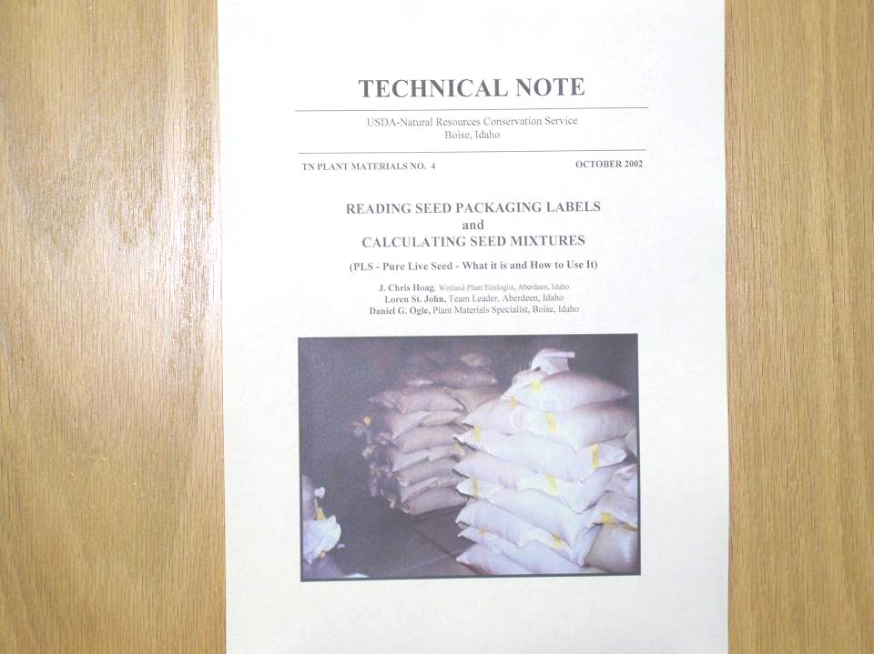

Slide 28
Developing Seed Mixes
1) Site Inventory
Vegetation (pre-disturb)
Soils
Climatic conditions
2) Goals or Objectives
3) Seed mix to meet goals

Slide 29
Loamy, 16-22 inch ppt.
Mountain big sagebrush -
Idaho Fescue
(refer to site description to determine species and percentages)

Slide 30
Seeding Rates for Mixtures
Determine species percentage desired in the mixture:
Percent desired in mix
X
Pounds PLS recommended per acre
= pounds PLS mix per acre

Slide 31
Species Mix % Full Rate #PLS/ac #PLS/ac (mix)
Idaho fescue 45 4 1.8
Bluebunch w.g. 20 7 1.4
Big bluegrass 15 2 0.3
Slender wheatgrass 10 6 0.6
Lewis flax 10 4 0.4
Total 100 4.5
Mountain big sage 0.025 # PLS/ac broadcast
Full rate x Mix % = #PLS/ac mix
See Plant Materials Technical Note 24

Slide 32
Full seeding rate not listed?
<500,000 seeds/lb 20-30 seeds per ft²
>500,000 seeds/lb 40-50 seeds per ft²
Example:
Pearly everlasting (Anaphalis margaritacea)
8,200,000 seeds per pound
45 seeds/ft² x 43,560 ft² /ac = 1,960,200 PLS seeds/ac
1,960,200 = 0.24 #PLS/ac full seeding rate
8,200,000

Slide 33
Multiply pounds bulk seed per acre for each species by acres to be seeded for total bulk seed required
Double rates if broadcast seeding!!

Slide 34
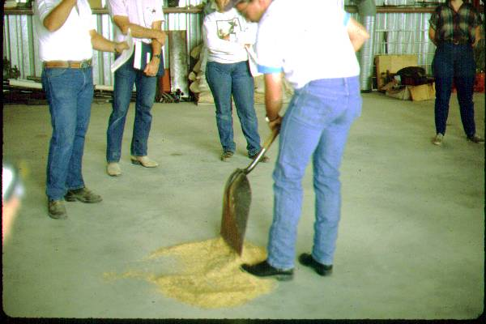
MIXING SEED WITH RICE HULLS
Why use rice hulls?
    keeps grass-legume-forb seed mixtures in constant proportion
    prevents separation during drilling

Slide 35
Why use rice hulls?
    prevents bridging of light, fluffy seed
    allows use of a regular grain drill because the mixture feeds like barley

Slide 36
Rice hulls
    Must be clean and unbroken.
    Recommend #1 grade
    Function as a cup to hold different sized seeds together
    Broken hulls will reduce cupping action

Slide 37
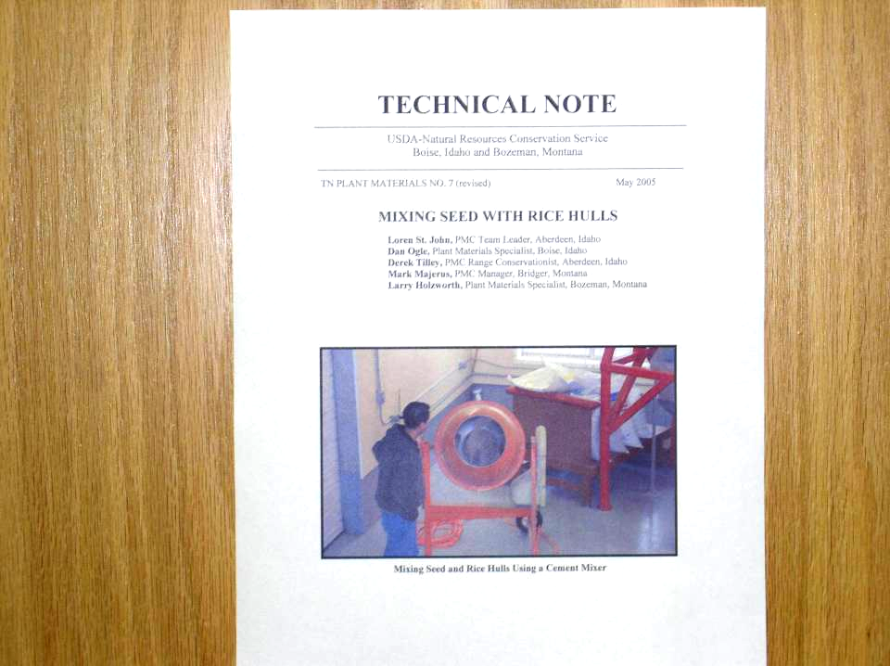

Slide 38
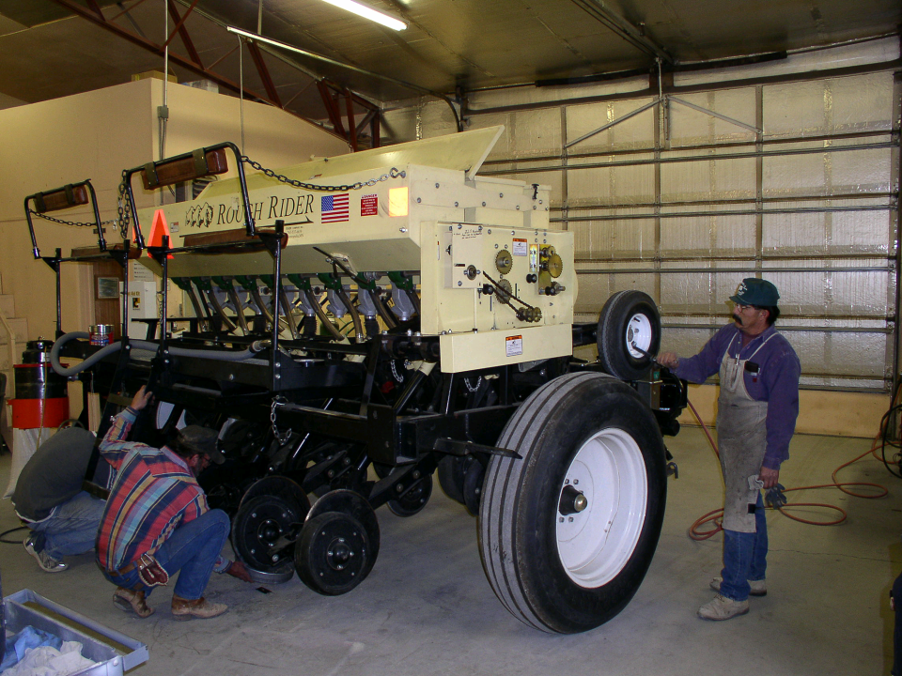
Drill Calibration

Slide 39
Test Drill Calibration (Seed Weight - Distance Method)
    1. Compute area of 100 foot test run based upon drill width
    Drill width (feet) X 100 feet = test run ac. 43,560 ft²/ac.
    Example: 7 foot wide drill
    7 feet X 100 feet = 0.016 acre
43,560

Slide 40
2. Calculate amount of bulk seed and rice hulls for test run
test run area (acres) x bulk seeding rate
Example:
    fourwing 2.28 pounds
    flax 1.00
    globemallow 0.61
    bluebunch 3.52
    bottlebrush 2.17
    Indian ricegrass 2.08
    Rice hulls 4.74
    Total 16.40 pounds
    0.016 ac X 16.4 pounds = 0.26 pounds seed mix for test run

Slide 41
3. Determine amount of seed that will be delivered through each drill spout during the test run
    # mix for test run = # per spout
    # of spouts on drill
Example:
0.26 # mix for test run =0.0325 # per spout
8 spouts

Slide 42
Since a small amount of seed is being weighed, it is desirable to convert this amount to grams
Example:
0.0325 pounds X 454 grams/pound = 14.76 grams per spout per 100 foot test run

Slide 43
4. Measure and stake off 100 feet.
    5. Seed for at least 6 feet before coming to first stake:
      Stop and remove drill spouts from disks
      Place containers under spouts to catch all seed
      Drive at a constant speed over the measured distance

Slide 44
6. Weigh seed from each spout
    7. Check weight of delivered seed with desired amount and make necessary adjustments in drill settings
    8. When within 10 percent of desired rate, check results with a second trial at the same setting

Slide 45
9. Seed 1 acre or more and check the quantity of seed and rice hulls used against the acreage and recommended rate.
    10. Record drill settings for future reference.

Slide 46
Other Considerations
Rice hull mixtures work better in drills with metal flutes.
        Plastic flutes create static electricity causing seed/rice hull mixtures to plug.
        Agitators aid in maintaining a constant flow
        Awn-tipped seed will cause bridging - increase rice hulls to 65 - 70 percent of mixture

Slide 47
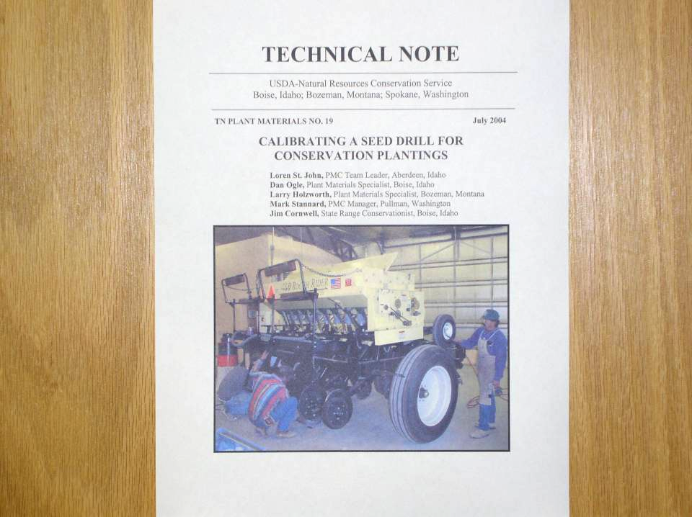

Slide 48
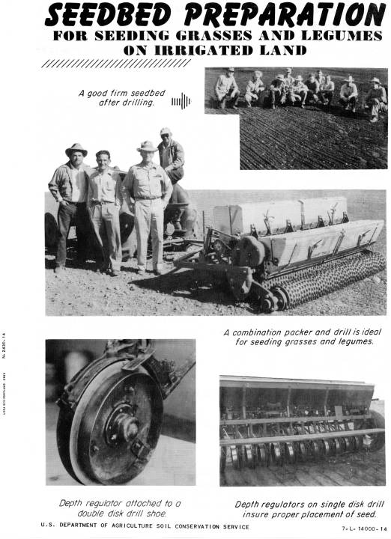

Slide 49
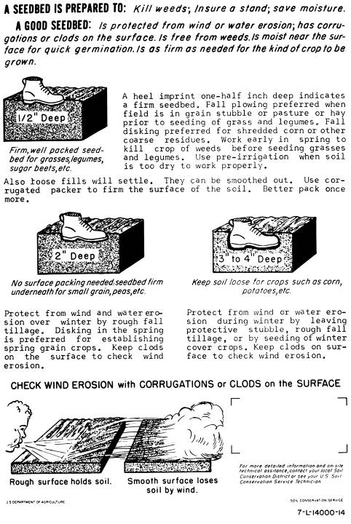

Slide 50
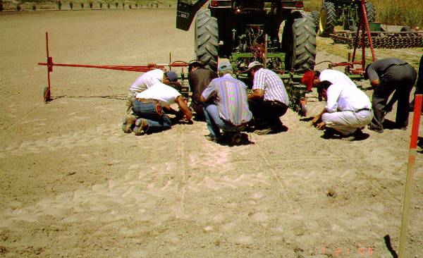
Questions ?

