Slide 1
Solitons in Synchrotrons
Longitudinal, nonlinear, stable waves have been observed in both coasting (CERN 70s) and bunched (SPS, Tevatron, RHIC ) beams.
Transverse stable oscillations have been observed in electron rings (KEK 1999)
In all cases the filamentation caused by incoherent frequency spread is frustrated by collective forces.

Slide 2
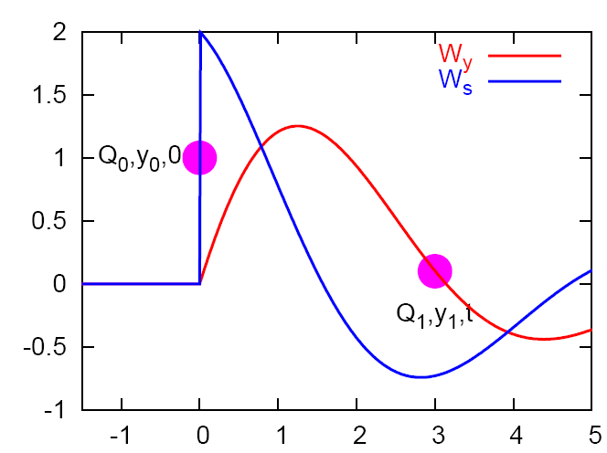
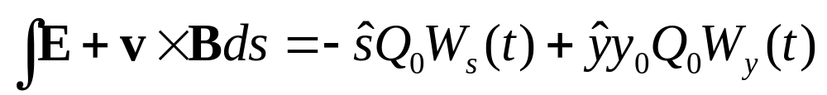
Review of Collective forces
The force on the trailing particle is created by the leading particle.
The customary definition is to use units of voltage to describe the kick.
My personal preference is to use the relative arrival times of the leading and trailing particles as the longitudinal coordinate.
The Green functions are called wake potentials and the integrated kicks are called wake fields.
The kick on the trailing particle due to the leading particle is

Slide 3
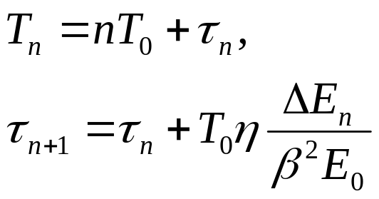

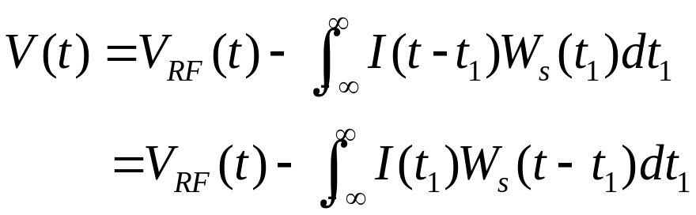
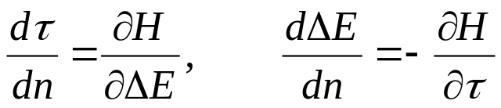
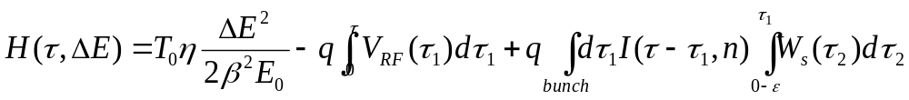
Longitudinal equations of motion
Arrival time and energy after reference azimuth
Voltage per turn
Hamiltonian for short range wakes

Slide 4
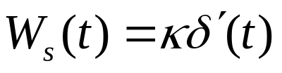

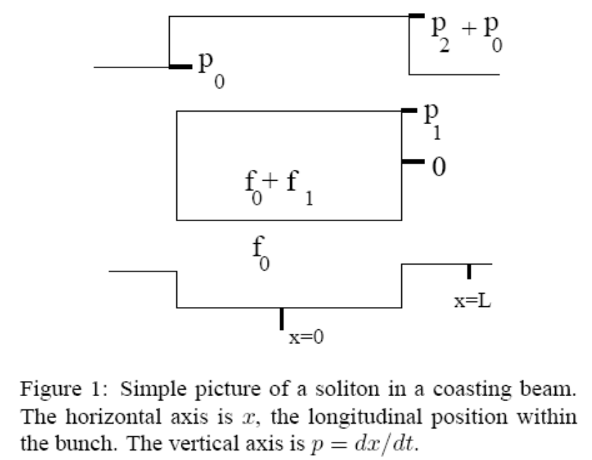
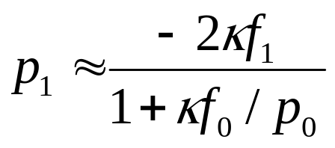

Longitudinal Solitons in Coasting Beams
Theory developed by Sacherer and Raka (70s, hand written notes)
See Schamel, PRL 1997, and Kolscielniak et al PRSTAB, 2001, PRSTAB 044402
Take constant Z/n. ρ>0 is the line density. For initially bunched beam κ>0 increases debunching rate. In bunched beams κ>0 reduces incoherent synchrotron tune.
Assume a solution exists and constrain the distribution (potential WELL)
see a hole with SC below transition

Slide 5
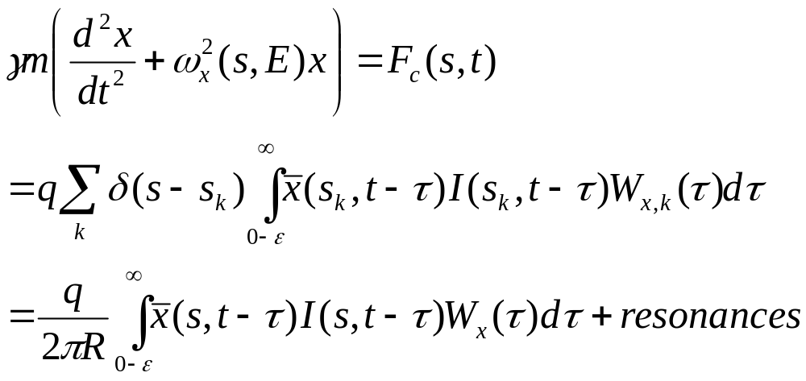
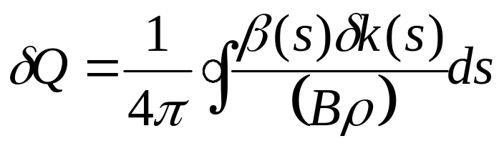
Inclusion of wakes in transverse equations of motion
The horizontal equation of motion for a particle is
The resonance terms are important for half integer tunes or large synchrotron tunes.
The final equation is equivalent to

Slide 6
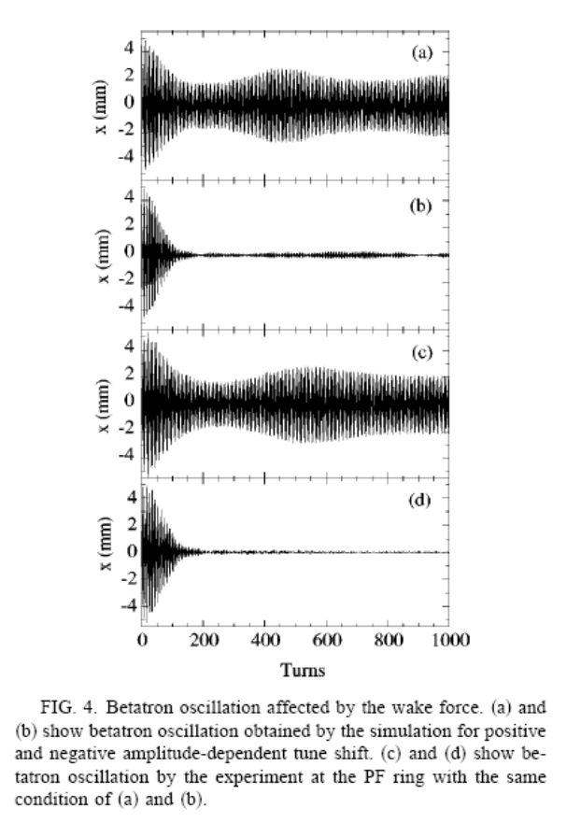
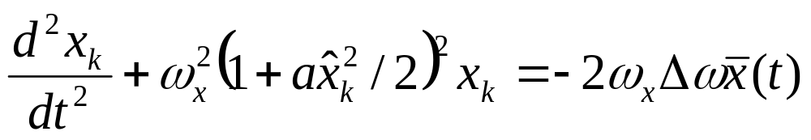
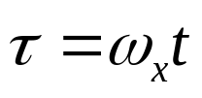
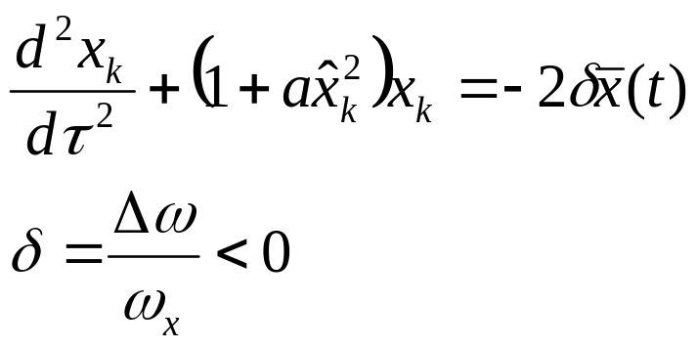
Transverse solitons
Ohmi and Kobayashi Phys Rev E, V 59 # 1, 1999
A bright electron bunch is kicked horizontally with strong octupoles on.
Depending on the sign of the detuning the bunch damps or oscillates at fixed amplitude.
For short bunches and a > 0 get stable oscillations.
Fewer symbols when time is rescaled

Slide 7
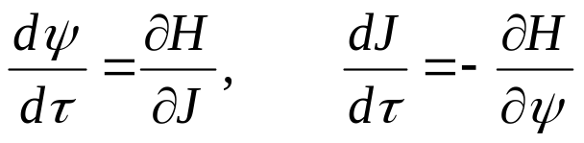
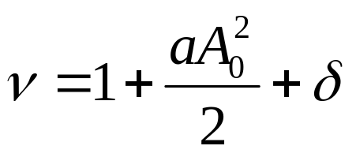


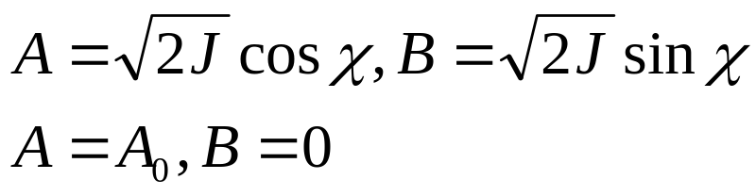
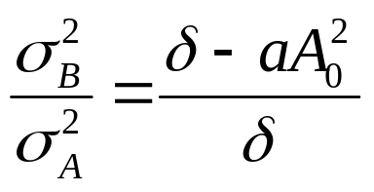
Hamiltonian theory
Hamiltonian
Centroid is a solution
Slow Hamiltonian
Go back to cartesian coordinates
is a stable fixed point
Aspect ratio from curvature near SFP

Slide 8
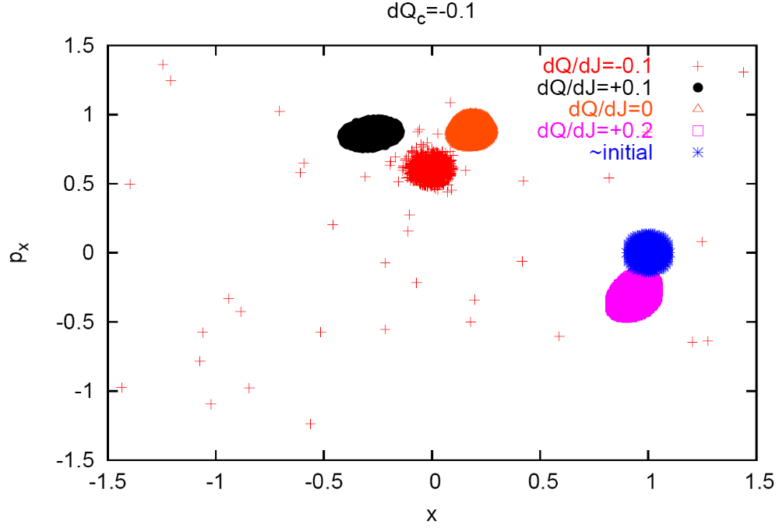
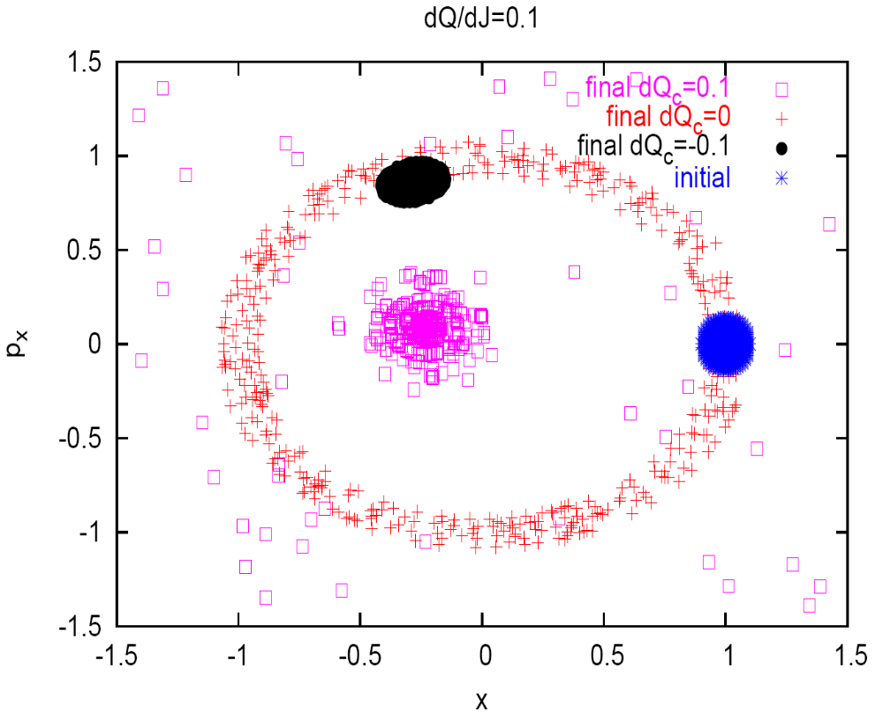
Did simulations with constant dQ/dJ (left) and constant coherent tune shift (right). The agreement is quite good.

Slide 9
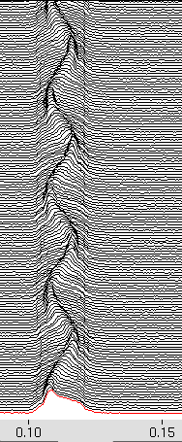
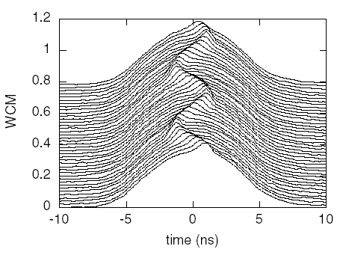
Longitudinal Solitons in Bunched Beams
See persistent, longitudinal hotspots (humps) in proton (and deuteron) bunches.
Data on right after 40 minutes
κ > 0 here so sign disagrees with coasting beam result.

Slide 10

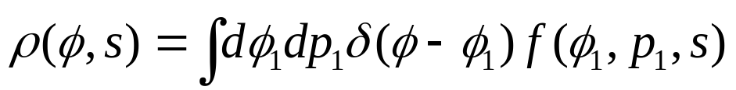

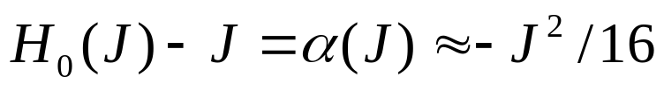
Longitudinal Soliton Theory for Bunched Beams
Spread in synchrotron frequency with amplitude implies a collective effect.
See hotspots with a defocusing impedance (Z/n measurements in EPAC02)
Take a constant Z/n and rescale time.
Line density is related to phase space density by
Switch to canonical coordinates that rotate with the soliton
For a canonical transforrmation
Average over s assuming that the phase space density rigidly rotates

Slide 11
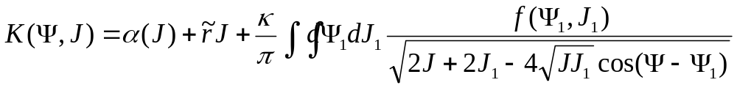


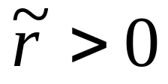
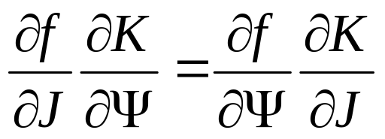
For delta wake the integral is doable and the averaged Hamiltonian is
is the variation in synchrotron tune with amplitude
Notice that the collective part is like the gravitational potential in the plane of a flat galaxy. Lots of old potential theory to take advantage of.
To get a stable fixed point consider
The collective part gives no net force so we need
The Vlasov equation is just the statement that contours of constant f and K coincide

Slide 12
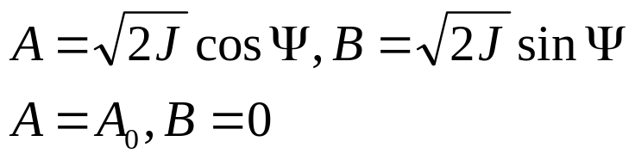
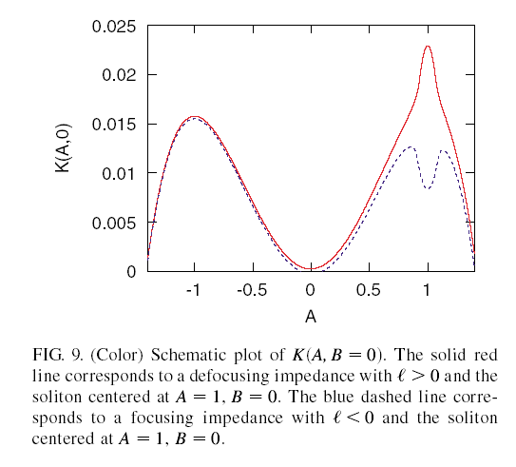
Go back to the A and B coordinates
is a SFP
The unperturbed Hamiltonian looks
like a ring of mountains.
A local hump in the Hamiltonian
is easier to make than a local
hole! This explains the sign
discrepancy between bunched
and coasting beams.
Assuming a parabolic mini-bunch
one can get a good analytic solution.
General bunch shape requires
numerical solution.

Slide 13
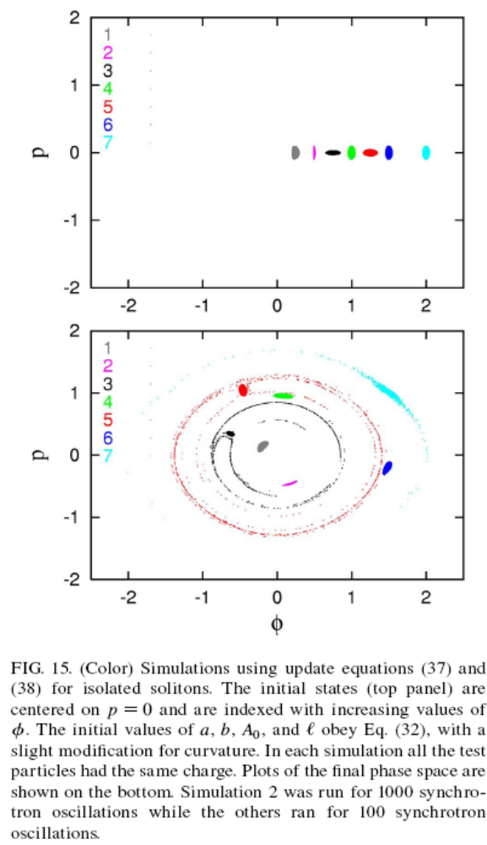
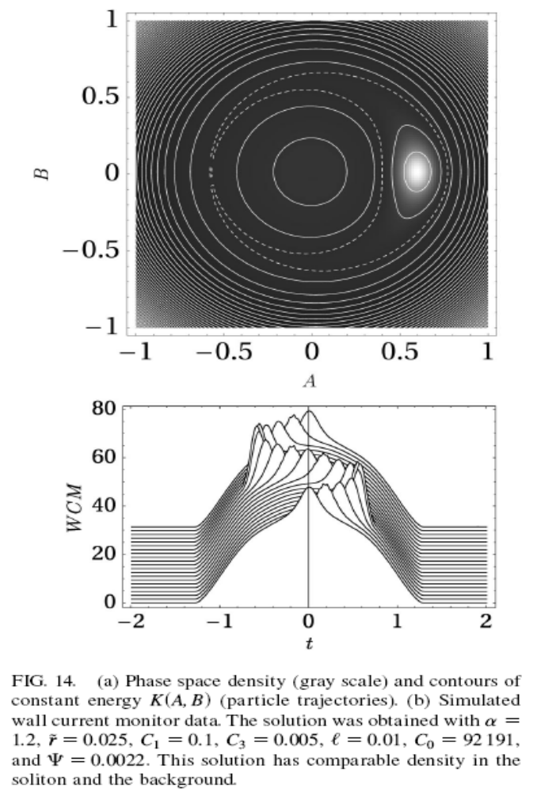
Analytically can have either sign of κ
but κ>0 is more stable in simulations.
For Vlasov solver κ>0 was calculated.
See Blaskiewicz, Wei, Luque, Schamel
PRSTAB 044402 (2004)

Slide 14
Conclusions and Questions
Stable, coherent oscillations exist in both the longitudinal and transverse planes.
Fairly good agreement can be found using first order perturbation theory and simple models.
How does the simple transverse model translate to our machines?
dQ/dJ > 0 augments space charge nonlinearity which appears to help Landau damping (Mohl and Schonauer, or PRSTAB 044202). This is the sign leading to stable oscillations even for large detuning.
“Dressed” IBS and limits of cooling.
Thank you for your attention!

