Slide 1
Assure the Quality of Native Germplasm through...........

Slide 2
PLANT GERMPLASM RELEASE AND
CERTIFICATION PROCEDURES
ESTABLISHED BY THE ASSOCIATION
OF OFFICIAL SEED CERTIFYING AGENCIES
(AOSCA)

Slide 3
TRADITIONAL APPROACH of
Plant Germplasm Release To The Public
CULTIVAR RELEASE--Broad based, widely adapted cultivars with outstanding and/or unique characteristics with stable heritability
GERMPLASM RELEASE -- Minimally developed plant material possessing desirable traits released for use in breeding programs

Slide 4
Reclamation and Restoration
Professionals indicate --
Increasing need for local ecotypes
Superior or unique characteristics are no longer only factors considered
Desire for minimal or no genetic manipulation
Need to insure source and genetic purity for harvested/collected materials

Slide 5
Justification for Pre-Variety Release and
Certification Procedures
Propagation material of natural ecotypes are needed for ecosystem restoration
Inadequate seed sources for species or desired ecotypes
Time frame precludes traditional cultivar development
Limited potential market beyond applicable plant communities

Slide 6
Genetic Status of
Plant Populations
Manipulated
Purposeful genetic manipulation (recurrent selection, hybridization, mutations, synthetic combinations, genetic engineering, etc.) has occurred
Genetic variability of defined plant population has been expanded or narrowed
Natural
No genetic manipulation of the original accession occurred
Full genetic variability of defined ecotype is maintained

Slide 7
Germplasm Source and Identity
Manipulated
Native, naturalized, or exotic germplasm
Origin and genetic status of germplasm accession often not known
Detailed records of parental lines and genetic manipulation procedures required
Natural
Native, naturalized, or exotic germplasm; may be a narrow germplasm accession or broad ecotype collection
Location and characteristics of original collection site documented
Protocols established to minimize involuntary non-purposeful selection during collection, site testing, or reproduction in the field

Slide 8
Germplasm Development and
Potential Release Categories
Germplasm Accession
or
Ecotype Collection
Manipulated Natural
1. (Bulk Populations)* 1. Source Identified Class
2. Selected Class 2. Selected Class
3. Tested Class 3. Tested Class
4. Cultivar/Variety 4. Cultivar/Variety
*development category only

Slide 9
Germplasm Release Procedure I
Manipulated
Natural
Bulk Populations
No Tag
Source Identified Class
Yellow Tag; G1,G2,G3
Unique characteristics not identified
Comparisons with other accessions, ecotypes, or bulk populations unknown
Area of adaptation unknown

Slide 10
Germplasm Release Procedure I cont’d
Manipulated
Natural
Bulk Populations
No Tag
Source Identified Class
Yellow Tag; G1,G2,G3*
Research and development stage
No selection or testing of F1’s
Occasionally released to other breeders
Not released to public for reproduction
Random germplasm accessions
No selection or testing of natural population
Status of majority of wild collected certified seed; may also be field produced
* Generations if planted in field production; a natural stand is by definition G0.

Slide 11
Germplasm Release Procedure II
Manipulated
Natural
SELECTED CLASS
Green tag; G1,G2,G3
SELECTED CLASS
Green tag; G1,G2,G3
Requires comparisons with other accessions, ecotypes, or breeding lines at common sites.
Shows promise of superior and/or unique traits.
Preliminary data on area of adaptation as defined by test conditions.

Slide 12
Germplasm Release Procedure II cont’d
Manipulated
Natural
SELECTED CLASS
Green tag; G1,G2,G3
SELECTED CLASS
Green tag; G1,G2,G3
Germplasm accession selected
from accession pool
May be tagged and marketed as
wild collected or field produced seed
“Untested Seed Orchard” (pink tag)
an accepted subset of Selected
Class for forest tree seed
Early Generation breeding lines
under evaluation
May be released to other breeders
Occasionally reproduced and tagged
for public use

Slide 13
Germplasm Release Procedure III
Manipulated
Natural
TESTED CLASS
Blue Tag; G1, G2, G3
TESTED CLASS
Blue Tag; G1, G2, G3
Seed must be produced from rigidly controlled and isolated natural stands or seed fields
Progeny tested on several sites to demonstrate superior or unique traits for which heritability is stable
Area of adaptation more certain as defined by test site conditions

Slide 14
Germplasm Release Procedure III cont’d
Manipulated
Natural
TESTED CLASS
Blue Tag; G1, G2, G3
TESTED CLASS
Blue Tag; G1, G2, G3
Germplasm accession progeny tested
Advanced generation breeding lines
May be released to other breeders
(traditional germplasm release)
Applied to individual forest trees
or natural stands; may also be field
produced
Occasionally reproduced and tagged
for public use
Tagged for public use where potential
market is limited

Slide 15
Germplasm Release Procedure IV
Manipulated
Natural
CULTIVAR/VARIETY
Foundation (G1) White Tag
Registered (G2) Purple Tag
Certified (G3) Blue Tag
CULTIVAR/VARIETY
Foundation (G1) White Tag
Registered (G2) Purple Tag
Certified (G3) Blue Tag
Clearly distinguished by superior qualities or unique traits
Reproduction is stable and outstanding characters heritable
Naming must comply with federal and state seed law definitions
Broad-based, wide area of adaptation as determined by testing locations
Good market potential perceived

Slide 16
Germplasm Release Procedure IV cont’d
Manipulated
Natural
CULTIVAR/VARIETY
Foundation (G1) White Tag
Registered (G2) Purple Tag
Certified (G3) Blue Tag
CULTIVAR/VARIETY
Foundation (G1) White Tag
Registered (G2) Purple Tag
Certified (G3) Blue Tag
Breeder seed (G0) is defined
and maintained by breeder of
cultivar
Original germplasm accession or
seed collected from a defined ecotype
or natural stand is defined as G0
(equivalent to breeder seed).

Slide 17

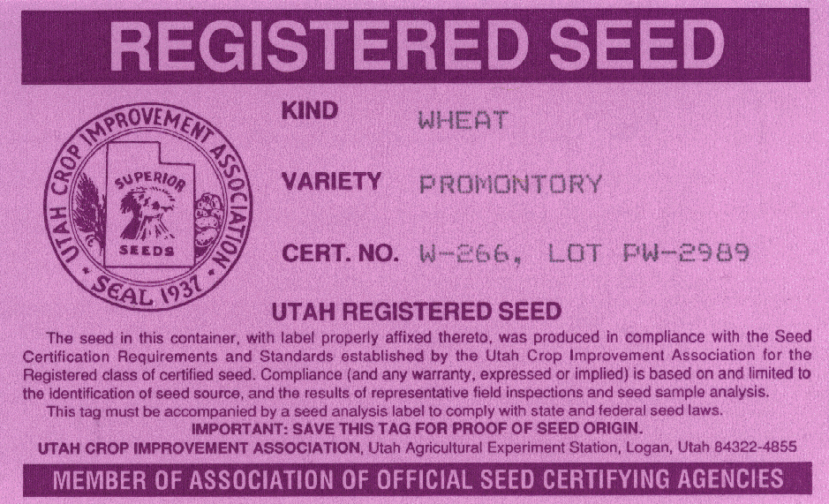
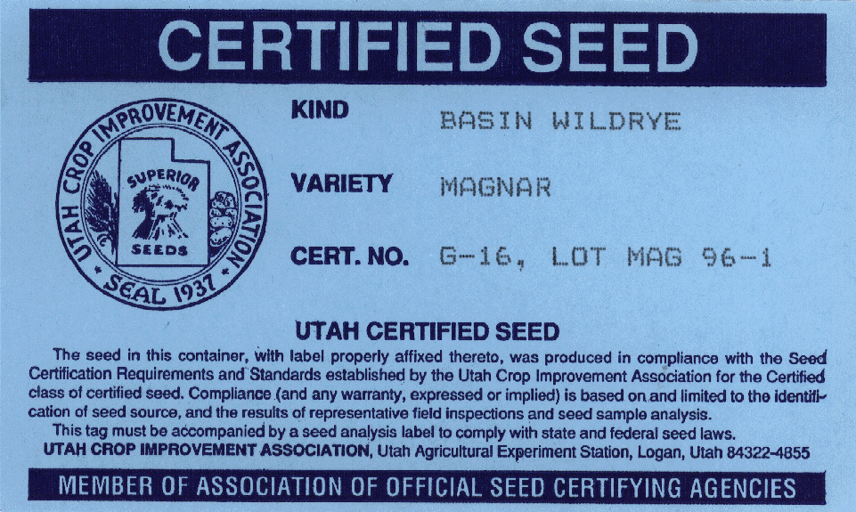
Labeling, Protection, and Marketing of
Certified Seed
Cultivar/Variety
Identified on tag by crop and cultivar (variety) name
Has status of recognized variety under Federal and State seed law
Eligible for protection under the Plant Variety Protection Act
Only seed meeting certification requirements and properly tagged may be represented as certified seed

Slide 18
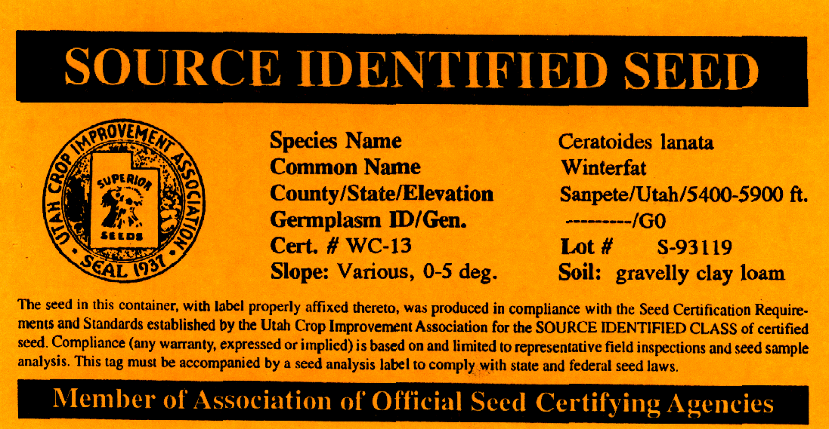
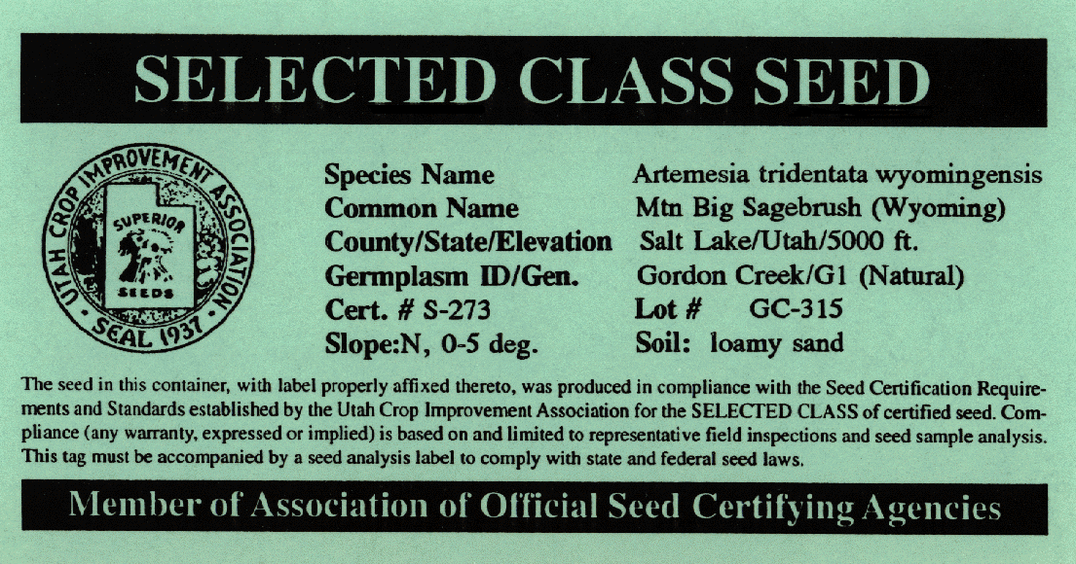
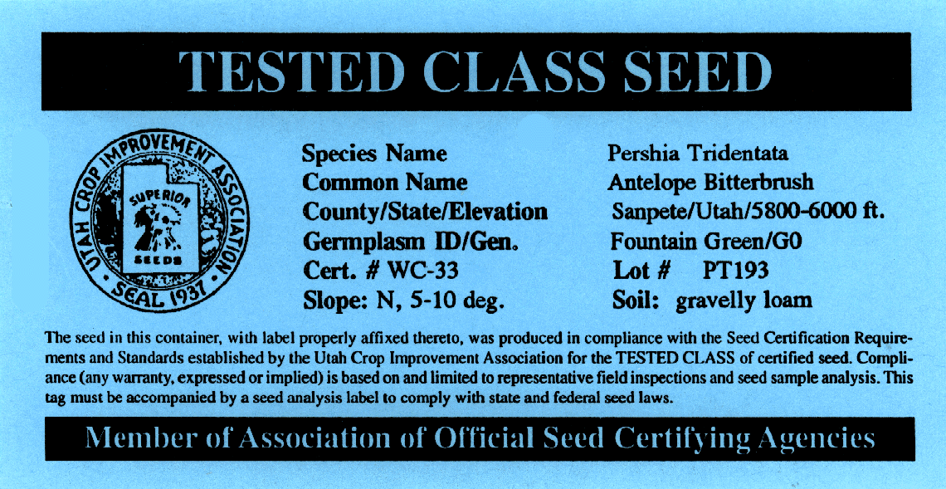
Labeling, Protection, and Marketing of Certified Seed
Pre-Variety Release
Identified on tag by species name
Optional identification (number or descriptive designation) not to be construed as variety name
Tags for Natural germplasms must list geographic location of seed collection site or field production site
Not eligible for protection under the Plant Variety Protection Act
Only seed meeting certification requirements and properly tagged may be represented as certified seed

Slide 19
NRCS Planned Use of
AOSCA Release Classes

Slide 20
NRCS Use of AOSCA Release Classes
Class
Natural
Manipulated
Source Identified
X¹
Selected
X¹
Tested
X¹
Cultivar/Variety
X¹
X²
Germplasm “traditional”
X²
1) NRCS would, generally, use these release classes for “Natural” native species
2) NRCS would, generally, use these release classes for “Manipulated” native species
and plants not native to North America

Slide 21
Source Identified
collected from natural stands, seed production areas, orchards
no selection or testing of parent population
collection site data is specified (i.e. soils, elevation, precip., legal description etc..)
species literature review
documentation usually less than one year (generally not applicable to NRCS PM program)
no limitations on number of generations from natural stands

Slide 22
Uses for Source Identified include:
materials address high priority needs
high potential for immediate use
lack of commercially available adapted materials
a local source is available

Slide 23
Selected
species literature review
phenotypically selected plants of untested parentage with selections based on promise or observed superior performance
documentation, testing and release process may involve several years-i.e. 3 years or less
collected from natural stands, production areas or orchards
for field production, generations cannot exceed four and will be indicated as G1, G2, etc.. for generation one, generation two, etc..
original collection site data (soils, elevation, precip. etc..)

Slide 24
Uses for Selected materials include:
lack of or low availability of adapted commercial materials
commercial sources are not adapted/or have no proven performance to meet identified need
materials address high priority needs

Slide 25
Tested
species literature review
original collection site data
involves initial and advanced evaluations-usually at multiple locations
testing, documentation, and release processes can involve 3-6+ years
progeny whose parentage has been tested and has proven superior performance against other collections and/or cultivars-varieties, heritability of distinctive traits must be stable
for field production, generations are limited to four and indicated as G1,G2, etc.

Slide 26
Uses for Tested materials include:
materials address high priority needs
low numbers of commercially available adapted materials
proven performance and /or superior traits (vs. commercial materials) are needed

Slide 27
Cultivar / Variety
species literature review
original collection site data (soils, legal description elevation, etc.)
documentation, testing, and release processes can require 6-9+ years
selections are based on proven superior performance vs. other collections and/or cultivars-varieties, distinctive traits are heritable and stable

Slide 28
Cultivar cont’d.
involves replicated plantings at multiple locations
for field production, generations are < four and are indicated as breeder (B), foundation (F), registered (R), and certified (C)
range of adaptation and conservation value are determined through field plantings, trials, and demonstration plantings
use of plant breeding methods such as : Mass Selection, Recurrent Restricted Phenotypic Selection (RRPS), etc. will put this in the “manipulated” vs. “natural” release class

Slide 29
Uses for Cultivars/Varieties include:
materials address high priority needs
commercially adapted materials do not exhibit adequate performance within target area
materials are needed, but not available, which have proven performance and broad adaptation

Slide 30
Germplasm
“traditional”
involves materials that have been genetically manipulated; if not, then materials can be released as source identified, selected, or tested
priority, the material was originally intended for, was reduced
has desirable characteristics but does not meet current NRCS priorities
has some limitation that NRCS does not wish to overcome
species literature review and original collection site data
material is intended for other researchers, not for commercial production
infrequent use in the USDA Plant Materials Program

Slide 31
USES for
SOURCE IDENTIFIED: the defined problem or use area is limited to a geographical area with environmental factors similar to the source
SELECTED: the defined problem or use area is generally broader geographically with limited variability in environmental factors
TESTED:the defined problem or use area is larger geographically, i.e. MLRA, with moderate variability in environmental factors

Slide 32
USES for
Cultivar/Variety: The defined problem or use area is usually large geographically, i.e. multistate, with potentially high variability in environmental factors

Slide 33
EXPECTED
PERFORMANCE *
Will Perform
Probably
Will Perform
Cultivar
May Perform
Tested
Source
Identified
Selected
Insufficient
Data
Near/Similar
Far/Dissimilar
Distance from Source/ Environmental Conditions
* graph is based on judgement & experience-NOT actual data

Slide 34
SUMMARY
Pre-Variety release procedures targeted to conservation plants
Intended to fill need for ecosystem
restoration
Expedites use of plant material of assured genetic source and purity

Slide 35
Partners in Developing Pre-Variety Release and Certification Procedures
Association of Official Seed Certifying Agencies (AOSCA)
U.S. Forest Service
Natural Resources Conservation Service
Agricultural Research Service

Slide 36
Presented by
USDA Natural Resources
Conservation Service
The USDA prohibits discrimination in its programs on the basis of race, color, national origin, sex, religion, age, disability, political beliefs and marital and familial status. (Not all prohibited bases apply to all programs). Persons with disabilities who require alternative means for communication of program information (braille, large print, audiotape, etc.) should contact the USDA Office of Communications at (202) 720-2791. To file a complaint, write the Secretary of Agriculture, U.S. Dept. of Agriculture, Washington, D.C. 20250, or call (202)720-7327(voice) or (202) 720-1127 (TDD). USDA is an equal employment opportunity employer.

