Slide 1
Coalition Building
Alvera Stern

Slide 2
In the Culture
Drug use
RISES
when people
do not perceive
- health risks
- social disapproval
associated with use.

Slide 3
In the Culture
Drug use
FALLS
when people
perceive
- health risks
- social disapproval
associated with use.

Slide 4
In the Individual
The more risk factors,
the MORE LIKELY to use.
The more protective factors, the LESS LIKELY to use.

Slide 5
Prevention
Prevention is a proactive process. It empowers individuals and systems to meet the challenges of life events and transitions by creating and reinforcing conditions that promote healthy behaviors and lifestyles.
CSAP 1994

Slide 6
Intervention Spectrum
for Behavioral Disorders
Treatment
Prevention
Maintenance
Case
ID
Indicated-
Diagnosed
Youth
Standard
Treatment
for known
disorders
Selective-
Health Risk
Groups
Compliance
w/ Long-Term
Treatment
CSAP 1994
Universal -
General Population
Aftercare
(including rehab)

Slide 7
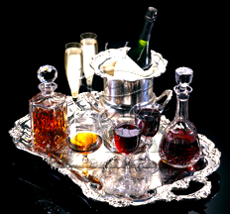

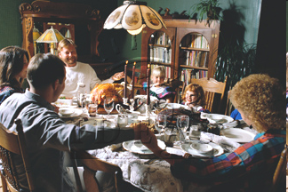
Prevention
A multi-faceted approach
Agent
Host
Environment

Slide 8
Agent Usage
No use
pain
normal
euphoria
Use
pain
normal
euphoria
Abuse
pain
normal
euphoria
Chemical
Dependency
pain
normal
euphoria

Slide 9
People Who Should Not Drink
Those with a family
history of alcoholism
People under 21
Recovering people
People whose work
requires judgment
Couples trying to conceive
Pregnant women
People operating machinery
People under stress
Growing children
C Everett Koop M.D., Surgeon General, 1988

Slide 10
Alcohol abuse is when you harm yourself or others
C Everett Koop M.D., Surgeon General, 1988

Slide 11
The Feeling Chart
Pain
Normal
Euphoria
DISEASE: Chemical dependency (alcholism
and/or drug addiction) is a disease. A disease
has its own symptoms and is describable.
Primary Disease:
Not a secondary symptom of something else.

Slide 12
The Feeling Chart
Pain
Normal
Euphoria
DISEASE: Chemical dependency (alcholism
and/or drug addiction) is a disease. A disease
has its own symptoms and is describable.
Progressive Disease:
Gets progressively worse. Victim becomes
physically, spiritually, emotionally, and
psychologically ill.

Slide 13
The Feeling Chart
Pain
Normal
Euphoria
DISEASE: Chemical dependency (alcholism
and/or drug addiction) is a disease. A disease
has its own symptoms and is describable.
Chronic Disease:
No cure. Recovery must be based on
abstinence from mood altering chemicals.

Slide 14
The Feeling Chart
Pain
Normal
Euphoria
DISEASE: Chemical dependency (alcholism
and/or drug addiction) is a disease. A disease
has its own symptoms and is describable.
Fatal Disease:
Disease can only be arrested. If it is not,
victim dies from it.

Slide 15
Disease Progression
Phase #1: Learning the Mood Swing
(Autonomic Learning)
Pain
Euphoria
A. Learns that chemicals can provide a
temporary mood swing in the direction
of euphoria.

Slide 16
Disease Progression
Phase #1: Learning the Mood Swing
(Autonomic Learning)
Pain
Euphoria
B. Learns that chemicals will provide this
positive mood swing every time they
are used.

Slide 17
Disease Progression
Phase #1: Learning the Mood Swing
(Autonomic Learning)
Pain
Euphoria
C. Learns to trust the chemical and its
effects.

Slide 18
Disease Progression
Phase #1: Learning the Mood Swing
(Autonomic Learning)
Pain
Euphoria
D. Learns to control the degree of the
mood swing by regulating chemical
intake quantity.

Slide 19
Disease Progression
Phase #2: Seeking the Mood Swing
Pain
Euphoria
A. Applies learnings in Phase #1 to own
social, cultural and life situation.

Slide 20
Disease Progression
Phase #2: Seeking the Mood Swing
Pain
Euphoria
B. Uses the chemical at appropriate times
and places.

Slide 21
Disease Progression
Phase #2: Seeking the Mood Swing
Pain
Euphoria
C. Develops self-imposed rules about the
chemical and adheres to them.
“I don’t drink until after 5:00pm.”

Slide 22
Disease Progression
Phase #2: Seeking the Mood Swing
Pain
Euphoria
D. May suffer from hangovers/pain due
to occasional overuse of the chemical,
but no emotional pain.

Slide 23
Disease Progression
Phase #2: Seeking the Mood Swing
Pain
Euphoria
E. Continues ability to control the times,
quantities and outcomes of all chemical
using experiences.

Slide 24
Disease Progression
Phase #2: Seeking the Mood Swing
Pain
Euphoria
F. Social users remain in this phase.
Victims of chemical dependency
progress to Phase #3.

Slide 25
Disease Progression
Phase #3: Harmful Dependency
Pain
Euphoria
A. Begins to experience periodic loss of
control over use. Can no longer
predict outcome once use begins.

Slide 26
Disease Progression
Phase #3: Harmful Dependency
Pain
Euphoria
B. These episodes result in behavior that
violates the user’s value system and, in
turn, creates the first emotional pain.

Slide 27
Disease Progression
Phase #3: Harmful Dependency
Pain
Euphoria
C. Spontaneous rationalizations arise,
hiding these feelings and resulting in
a loss of insight for the victim.

Slide 28
Disease Progression
Phase #3: Harmful Dependency
Pain
Euphoria
D. Negative feelings about self remain
unidentified and unresolvable. This
results in chronic emotional distress.

Slide 29
Disease Progression
Phase #3: Harmful Dependency
Pain
Euphoria
E. Experiences growing anticipation and
preoccupation with chemical use.

Slide 30
Disease Progression
Phase #3: Harmful Dependency
Pain
Euphoria
F. Lifestyle begins to change and revolve
around the chemical.

Slide 31
Disease Progression
Phase #3: Harmful Dependency
Pain
Euphoria
G. Specific times for chemical use are
now established and rigidly held.

Slide 32
Disease Progression
Phase #3: Harmful Dependency
Pain
Euphoria
H. Self-imposed rules developed in
Phase #2 are now broken regularly .

Slide 33
Disease Progression
Phase #3: Harmful Dependency
Pain
Euphoria
I. Chemical tolerance increases causing
victim to develop ingenious ways to get,
use and keep chemical. (hiding stash)

Slide 34
Disease Progression
Phase #3: Harmful Dependency
Pain
Euphoria
J. Projections of self-hatred onto others
begin to occur.

Slide 35
Disease Progression
Phase #4: Using To Feel Normal
Pain
Euphoria
A. Using chemicals to survive rather than
to feel euphoric.

Slide 36
Disease Progression
Phase #4: Using To Feel Normal
Pain
Euphoria
B. Blackouts occur more frequently.

Slide 37
Disease Progression
Phase #4: Using To Feel Normal
Pain
Euphoria
C. Tolerance built in Phase #3 breaks.

Slide 38
Disease Progression
Phase #4: Using To Feel Normal
Pain
Euphoria
D. Physical addiction can occur.

Slide 39
Disease Progression
Phase #4: Using To Feel Normal
Pain
Euphoria
E. Paranoid-like thinking is present.

Slide 40
Disease Progression
Phase #4: Using To Feel Normal
Pain
Euphoria
F. Geographic escapes are made.

Slide 41
Disease Progression
Phase #4: Using To Feel Normal
Pain
Euphoria
G. Loss of desire to live and a complete
spiritual bankruptcy.

Slide 42
Disease Progression
Phase #4: Using To Feel Normal
Pain
Euphoria
G. Loss of desire to live and a complete
spiritual bankruptcy.

Slide 43
Environmental Institutions
Family
Church
Media
School
Community
Legislative system
Probation
Police
Court System
Treatment system
Aftercare system

Slide 44
Host Strategies
Information
Education
Alternatives
Social Policy
Early Intervention
Assessment
Treatment
Aftercare
(AA Alateen Alanon)

Slide 45
Agent
Usage
Environmental
Institutions
Host Strategies
No use
Family
Church
Media
School
Community
Legislative system
Probation
Police
Court System
Treatment system
Aftercare system
Information
Education
Alternatives
Social Policy
Early Intervention
Assessment
Treatment
Aftercare
Use
Abuse
Chemical
Dependency
AA
Alateen
Alanon

Slide 46
Risk Factors
Risk factors occur prior to the onset
of substance abuse and are associated with an increased probability of drug abuse.
A risk-focused approach seeks to prevent drug abuse by eliminating,
reducing or mitigating its precursors.

Slide 47
Community
Risk Factors
School
Early antisocial behavior
Academic failure
Low commitment to school
Hawkins & Catalano, 1991

Slide 48
Protective Factor Research
Brook et al
1. Strong parent - adolescent attachment
2. Strong adolescent-father attachment
3. Adolescent conventionality
4. Positive maternal characteristics
5. Marital harmony

Slide 49
Protective Factor Research
Garmezy
1. Child’s own positive temperament.
2. Supportive family milieu.
3. External support system that energizes
and refines child’s coping efforts.

Slide 50
Protective Factor Research
Social
Bonding
1. Strong attachment to parents.
2. Commitment to schooling.
3. Regular involvement in church activities.
4. Belief in expectations, norms and
societal values.

Slide 51
Individual/Peer
Risk Factors
Alienation or rebelliousness.
Antisocial behavior early in adolescence.
Friends who use drugs.
Favorable attitudes toward drug use.
Early first use of drugs.
Hawkins & Catalano, 1991

Slide 52
Community Risk Factors
Economic and social deprivation.
Low neighborhood attachment and
community disorganization.
Transitions and mobility.
Community laws and norms
favorable to drug use.
Availability of drugs
- Price
- Placement
- Packaging
- Promotion
Hawkins & Catalano, 1991

Slide 53
Family
Risk Factors
Family history of alcoholism.
Family management problems.
Parental drug use and positive
attitudes toward use.
Hawkins & Catalano, 1991

Slide 54
RISK FACTORS
Adolescent Problem Behaviors
KIDS AT RISK
-
ROP
BUSE
ELINQUENCY
EEN
D
UT
IOLENCE
UBSTANCE
REGNANCY
O
A
T
CHOOL
V
S
D
P
S
Community
Availability of Drugs and Firearms
X
X
Community Laws and Norms
Favorable Toward Drug Use,
X
Firearms, and Crime
Transitions and Mobility
X
X
X
Low Neighborhood Attachment
and Community Disorganization
X
X
X
Extreme Economic and Social
Deprivation
X
X
X
X
X
Family
Family History of High Risk
Behavior
X
X
X
X
Family Management
Problems
X
X
X
X
X
Family Conflict
X
X
X
X
X
Parental Attitudes and Involvement
X
X
X
School
Early and Persistent Antisocial
Behavior
X
X
X
X
X
Academic Failure in Elementary
School
X
X
X
X
X
Lack of Commitment to School
X
X
X
X
Individual/Peer
Alienation and Rebelliousness
X
X
X
Friends Who Engage in a Problem
Behavior
X
X
X
X
X
Favorable Attitudes Toward the
Problem Behavior
X
X
X
X
Early Initiation of the Problem
Behavior
X
X
X
X
X

Slide 55
Protective Factors
Protective factors mediate or moderate
the effects of exposure to risk.
Invulnerability
Resiliency

Slide 56
External
Protection
1-8
Family support
Parents as social resources
Parent communication
Other adult resources
Other adult communication
Parent involvement in school
Positive school climate
Parental standards
P.L. Benson (1991)

Slide 57
External
Protection
Parental Discipline
Parent Monitoring
Time at Home
Positive Peer Influence
Involved in Music
Involved in Community Orgs
Involved in Church/Synagogue
Involved in Extra-Curricular
9-16
School Activities
P.L. Benson (1991)

Slide 58
Internal Protection
Achievement Motivation
Educational Aspiration
School Performance
Homework
Values Helping People
Concerned About World Hunger
Cares About Others’ Feelings
1-7
P.L. Benson (1991)

Slide 59
Internal Protection
Values Sexual Restraint
Assertiveness Skills
Decision-Making Skills
Friendship Skills
Planning Skills
Self-Esteem
Positive View of Personal Future
8-14
P.L. Benson (1991)

Slide 60
Generation 1
Individual Strategies
Direct delivery of services to meet
an immediate need.

Slide 61
Generation 2
Community Development
Community potential is realized
through education, organization,
and the introduction of new
technology. The scope of the
project is the neighborhood, town,
or county.

Slide 62
Generation 3
Sustainable Systems Development
Third-generation strategies look beyond the individual community and seek to change specific state, regional, and national policies and institutions. Communities at this stage have well developed individual, family and community information bases.

Slide 63
Generation 4
People’s Movement
Fourth-generation strategies to change national and global norms, policies and institutions.

Slide 64
Generation
First
Second
Third
Fourth
Problem
Definition
Institutional & Policy
constraints
Inadequate mobilizing
vision
Shortage
Local inertia
Time Frame
Immediate
Project life
10-20 years
Indefinite future
Scope
Individual or
Family
Neighborhood or
Village
Region or Nation
National or Global
Chief Actors
NGO +
community
All relevant public
and private institutions
Loosely defined
networks
NGO
NGO Role
Doer
Mobilizer
Catalyst
Activist/educator
Management
Orientation
Coalescing and
energizing self-
managing networks
Logistics
management
Project
management
Strategic
management
Development
Education
Community
self-help
Constraining
policies and
institutions
Starving
children
Spaceship Earth

Slide 65
Group Exercise

Slide 66
Coalition Meetings

Slide 67
W.C. Fields on Institutional Change
“Walking through a wall of human flesh backward, dragging a goat
and a canoe.”

Slide 68
Stages of Community
5
4
Action!
Figure It Out!
3
2
Dish It Up!
1
Take It!
Avoid It!

Slide 69
Meeting Logistics List
Questions To Ask
Whom will you invite?
What will your purpose be?
Where and when will you meet?
How will you invite potential
planning group members?
What else will you need to consider?

Slide 70
Planning Coalition’s Logistics
What is the
Meeting’s Purpose?
Desired
Outcome?
To design and implement a
comprehensive risk-focused
program to reduce the adolescent
problem behaviors of substance
abuse,delinquency, teen
pregnancy, school drop-out and
violence.
Meeting
Goal?
Meeting
Agenda?

Slide 71
Determining Coalition Leadership
1
1
1
+10
+10
+10
Money
Political Power
Interest

Slide 72
Prioritizing Coalition
Invitees
3 - 15
16 - 24
Begin recruitment efforts
with people in the
center circle and work
your way out.
Scores of 25
and above

Slide 73
Invitee Name
Sample Participant
Commitment Form
Yes, I want to be involved
No, I cannot at this time
but keep me informed
Other people who may want to be involved:

Slide 74
Projected Participation
Invite 100 potential participants
80 RSVP affirmatively
66 actually attend orientation meeting
48 agree to participate in coalition activities
40 people ultimately join coalition

Slide 75
Timeline
2 weeks
before meeting
Send out a reminder
letter with a copy of the agenda.

Slide 76
Timeline
By second
meeting...
Have chairperson selected and
coalition curriculum prepared for
two hour training.

Slide 77
Coalition Training Curriculum
Be sure to cover the following:
Information
Skills
Alternatives
Policy
Intervention

Slide 78
Timeline
Third
meeting...
Treat this as a planning meeting.
Establish goals and objectives.

Slide 79
Timeline
Fourth
meeting...
Review goals and objectives.
Develop group action plan.
Hold as a group retreat.

Slide 80
Retreat Meeting
(4th Meeting - Action Planning)
What is the
Meeting’s Purpose?
Desired
Outcome?
To design and implement a
comprehensive risk-focused
program to reduce the adolescent
problem behaviors of substance
abuse,delinquency, teen
pregnancy, school drop-out and
violence.
Meeting
Goal?
Meeting
Agenda?

Slide 81
Plan-Writing Committee Meeting
Logistics Continued
Where
is the meeting?
When
is the meeting?
Who does the
invitation letter
come from?

Slide 82
Setting up the Prevention
Planning Committee
Who Comes?
Criteria
Prevention philosophy
Purpose of plan
Source of money
Requirements of grant
Time available
Turf issues
Political pressures
Who is talking to whom?
Cardinal Rule:
Always invite the
people you are
NOT talking to!

Slide 83
Activity to follow

Slide 84

Model Action Committee Roles
Conductor
Specialties
Sets meeting agendas.
Delegates tasks.
Supervises implementation.
Coordinates participants.

Slide 85
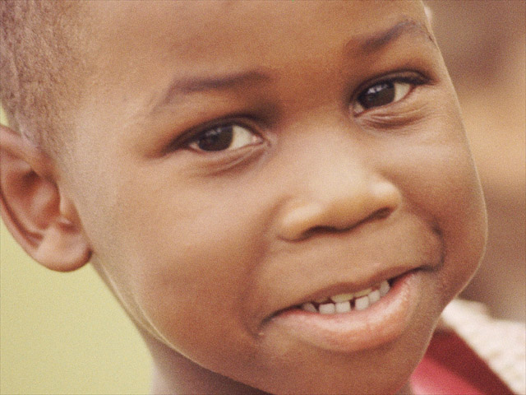
Model Action Committee Roles
Cheerleader
Specialties
Encourages participation.
Generates optimism.
Praises performance.
Builds unity.

Slide 86

Model Action Committee Roles
Assembler
Specialties
Keeps group on task.
Translates ideas into action.
Maintains practical
perspective.

Slide 87

Model Action Committee Roles
Soldier
Specialties
Works.
Sees that difficult tasks get
completed.
Focuses on details.

Slide 88

Model Action Committee Roles
Sleuth
Specialties
Knows key people.
Finds and gets resources.

Slide 89

Model Action Committee Roles
Electrician
Specialties
Generates creative ideas.
Synthesizes / refines ideas.

Slide 90
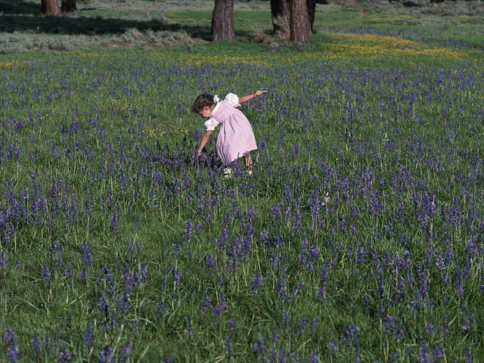
Model Action Committee Roles
Prophet
Specialties
Has a vision of the
committee’s goals/potential.
Sees previously unseen
opportunities.

Slide 91

Model Action Committee Roles
Word Wizard
Specialties
Communicates activities
to the community.
Builds public relations.

Slide 92
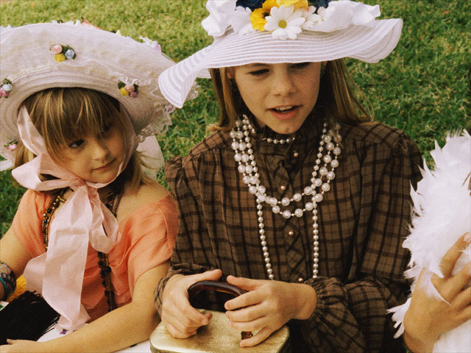
Model Action Committee Roles
Social
Director
Specialties
Understands people’s
needs.
Plans social components
of events.
Serves as host/hostess.

Slide 93
Evaluating Your Coalition
Alvera Stern

Slide 94
Vision
General
Mission
Goal
Goals
Objectives
Specific
Action Step

Slide 95
A Vision statement is a global, long
term goal which serves as a focus for goal setting and strategy development. It is a rallying point for community members.

Slide 96
“Our community will be clean,
drug free, and safe for our
families and neighbors.”

Slide 97
A Mission statement describes who a group is and why it exists. The mission statement provides overall direction to the group.

Slide 98
“We are the Prevention Task Force. Our primary mission is to reduce substance abuse. We are here to provide community members with opportunities to make healthy choices and lead healthy lives.”

Slide 99
A Goal, in general, states intent and
purpose, and supports the vision and
mission statements:
“To reduce the incidence and
prevalence of substance abuse among
community members by 25 percent
within 12 months.”

Slide 100
An Objective is specific, measurable,
and sets a time frame.
“To reduce the number of youth in our
community who smoke at age 10 from
18.5 percent to 10 percent by 2000.”

Slide 101
Outcome
A change in knowledge, attitudes,
motivations, or community conditions
as a result of one or more prevention
programs.
Prevention First, 1995

Slide 102
How do you organize
objectives/action steps
to get multi-sector/multi-strategy comprehensive programs
for your coalition?

Slide 103
Organizing Objectives/Action Steps
1
Use Domains:
Individual
Family
School
Community

Slide 104
Organizing Objectives/Action Steps
2
Use Strategies:
Information
Skills-building
Alternatives
Social Policy
Environmental Policy
Early Intervention

Slide 105
Objectives
Expected Outcomes
Relate to goals
Measurable
Consistent w/ local data
Achievable
In time line
Logically
relate to risk
and protective
factors

Slide 106
Outcomes
Who or what will change?
How much?
What time?
Who will effect change?

Slide 107
Coalition Logic Model

Slide 108
Measure long-range outcomes
Identify long-range goal
Assess
community risk factors
Select strategies and implement
Measure
Indicators
Identify baseline data indicators
Select desired outcome

Slide 109
Assess
community risk factors
1
Identify long-range goal
2
Identify baseline data indicators
Select strategies and implement
3
4
Measure
Indicators
5
Select desired outcome
6
Measure long-range outcomes
7

Slide 110
Getting to Outcome Measures
Goal
Objective
Indicator
Activity
Parents: initiate parent
ed in all 4th & 5th
grade classes.
Schools: initiate parent
& school newsletter.
Businesses: initiate
lunch time parent ed classes.
Media: produce 3 PSAs
for radio and papers.
Reduce
substance
abuse by
10% in
2000
Age of first
use is 12.5
in FY98
Individual:
increase age
of first use
by 10%
in 2000

Slide 111
Getting to Outcome Measures
Objectives
Risk Factor
Outcome
Measures
Impact
Goal
Indicators
Activity
Individual
Increase favorable
attitudes toward
problem behavior
Disapproval of
alcohol, tobacco and
marijuana
Media campaign
(four strategies)
-
or
+
Family
Divorce
Police reports of
abuse
Parent education
(four strategies)
-
or
+
ATOD
Inc
and
Prev
ATOD
Inc
and
Prev
Family
conflict
School
School truancy
School test scores
Graduation rates
School climate
Total Quality
Mgt. Initiative
-
or
+
Academic
failure
Community
Trends
perceived
by 12th graders
Sales
Consumption per
capita
Policy
Parent collaboration
on teen sales
-
or
+
Availability of
alcohol, tobacco
and other drugs

Slide 112
Drug-Free Communities Support
Program Evaluation Framework
Baseline
Activities
(Processes)
Outcomes
Impact
Enhanced/
Strengthened
Coalitions:
Increased
Coalition
Capabilities
Increased
Citizen
Participation
Increased
Interagency &
Inter-
governmental
collaboration
Collaborative,
data-driven
prevention
planning
Community
Risk and
Protective
Factors
Goal:
Reduction
in
Substance
Abuse
Enhanced
Prevention
Efforts:
Comprehensive,
Research-Based
Strategies that
Address
Identified
Needs
Improved
Immediate
Outcomes
of
Prevention
Efforts
Reduced
Risk Factors
and
Increased
Protective
Factors
Reduced
Substance
Abuse
Incidence
and
Prevalence
of
Substance
Abuse
Contextual/Environmental Factors

Slide 113
Community-Based Prevention Planning
The prevention plan is based on solid theory
and research.

Slide 114
Community-Based Prevention Planning
Individual, family, community and cultural risk and protective factors are assessed; changes in these factors are targeted as outcome measures. Programs and programs activities are selected only after this assessment is made and the outcome measures are targeted.

Slide 115
Community-Based Prevention Planning
Success is determined by movement from the
baseline data assessment data to the desired
outcome measurement.

Slide 116
Fidelity
Being faithful to
research design
Intensity
Session length
Dosage
Number of sessions
The time period over
which sessions run
Duration

Slide 117
Teen Pregnancy
School
Dropout
Generic
Prevention
Delinquency
Violence
Alcohol and
Other Drugs
Adapted from
John Swisher, 1978

Slide 118
Steps To Ethnic Competence
Clarify Values
1
Identify one’s values and
assumptions regarding personal
development, family relationships
and the relationship between
family and community.
Hanson, Lynch & Wayman, 1990

Slide 119
Steps To Ethnic Competence
Gather Ethnographic
Information
2
Analyze ethnographic information
with emphasis in five areas: country
of origin, language and dialect, social
organization, belief system, history,
and access to services.
Hanson, Lynch & Wayman, 1990

Slide 120
Steps To Ethnic Competence
Understand Transcultural
Identification
3
Know the degree to which the group
modifies its customs and activities
to blend with the dominant culture.
Hanson, Lynch & Wayman, 1990

Slide 121
Steps To Ethnic Competence
Consider Family
Practices
4
Understand the family’s cultural
values and practices regarding
childrearing and apply this
information to interventions.
Hanson, Lynch & Wayman, 1990

Slide 122
Reference Guide to Principles of Prevention:
Interim Gudiance on Federal Program Standards
D
OCUMENT
L
OCATION
A
GENCY
P
HONE
C
OMMENTS
1999 National Drug
http://www.whitehousedrugpolicy.gov/policy/ndcs.html
ONDCP
National Drug
Goal 1,
Control Strategy
Clearinghouse
Objective 9
1.800.666.3332
1999 National Drug
http://www.whitehousedrugpolicy.gov/policy/pme.html
ONDCP
National Drug
Goal 1,
Control Performance
Clearinghouse
Objective 9
Measures
1.800.666.3332
Principles of U.S. Demand
http://www.whitehousedrugpolicy.gov/drugabuse/2d.html
ONDCP
National Drug
Reduction Effort
Clearinghouse
1.800.666.3332
Prevention Principles for
http://www.health.org/pubs/prev/PREVOPEN.html
NIDA
NCADI
Adolescents and Children
1.800.729.6686
Principles of Effectiveness
Final SDFSCA Principles of Effectiveness
Dept of
1.877.4.ED.PUBS
for Safe and Drug Free
http://www.ed.gov/legislation/FedRegister/announcement
Education
Schools
s/1998-2/060198c.pdf
Non-Regulatory Guidance on SDFSCA Principles
http://www.ed.gov/offices/OESE/SDFS/nrgfin.pdf
Science-Based Substance
http://www.whitehousedrugpolicy.gov/prevent/progeval.
HHS
Draft to be posted on
Abuse Prevention
html
ONDCP site in prevention
area.
Science-Based Practices in
http://www.whitehousedrugpolicy.gov/prevent/progeval.
CSAP
Draft to be posted on
Substance Abuse
html
ONDCP site in prevention
Prevention
area.
Prevention Enhancement
http://www.health.org:80/pepspractitioners/
CSAP
NCADI
Practitioners, Community,
Protocols (PEPS)
http://www.health.org:80/pepscommunity/
1.800.729.6686
and Family
http://www.health.org:80/pubs/pepsfamily/index.htm
Blueprints for Violence
http://www.colorado.edu/cspv/blueprints/index.html
OJJDP
Juvenile Justice
Prevention
Clearinghouse
1.800.638.8736
Meta-Analysis of Drug
http://www.nida.nih.gov/pdf/monographs/monograph170
NIDA
NCADI
Abuse Prevention
/download170.html
1.800.729.6686
Programs
Cost-Benefit/Cost-
http://www.nida.nih.gov/pdf/monographs/monograph176
NIDA
NCADI
Effectiveness Research
/download176.html
1.800.729.6686
UN Guiding Principles of
http://www.undcp.org/resolution_1998-09-08_1.html
United
UN
Dag
UN International Drug
Drug Demand Reduction
Nations
Hammarskjold
Control
Programme

