Slide 1
Super Star Trackers for MAXIM and Stellar Imager
Several future missions will require a stable reference at the level of 30 μas
  MAXIM Pathfinder, Stellar Imager
Eventually, missions will need a stable reference at the level of 30 nano-arcsecs!
  MAXIM, Gamma ray lens, ARISE
Must be held stable for hours~days
Absolute astrometry not necessary
Should also be useful for Beacon centroiding in the formation flying solution
Replace SIM modules

Slide 2
Contacts
Keith Gendreau/662
  MAXIM
Ken Carpenter/681
  Stellar Imager
Kate Hartman/420
  MAXIM
Jesse Leitner/571
  MAXIM, SI
Landis Markley/571
  MAXIM

Slide 3
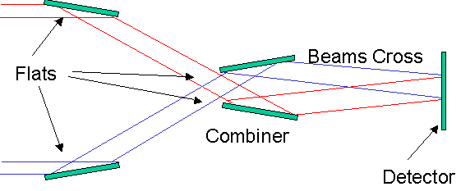
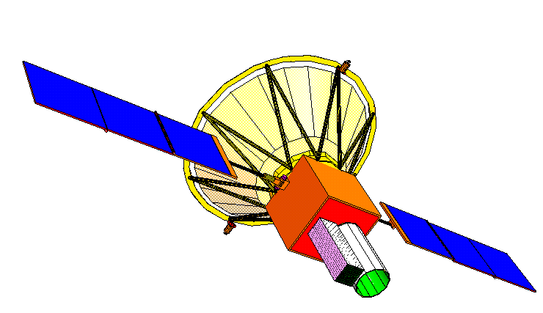
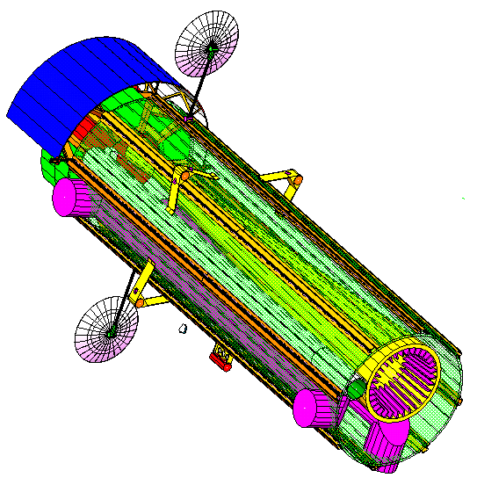
MAXIM Pathfinder Overview
Objectives
  Demonstrate X-ray interferometry in space as pathfinder to full up MAXIM
  Image with 100 micro-arc second resolution using a 1-2 m baseline
  1000 times improvement on Chandra
    Coronae of nearby stars
    Jets from black holes
    Accretion disks
Two spacecraft flying in formation:
  Telescope spacecraft with all the optics
  300 micro arc sec pointing control
  30 micro arc sec knowledge
  “Detector spacecraft” positioned 50-500 km ±10 m and laterally aligned ± 2 mm from Telescope spacecraft to make fringes well matched to detector pixels
  Detector and optics fit within medium class launch vehicle (e.g., Delta IV H)
http://maxim.gsfc.nasa.gov
Detector
Spacecraft
L=50-500 km!
Optic Spacecraft

Slide 4
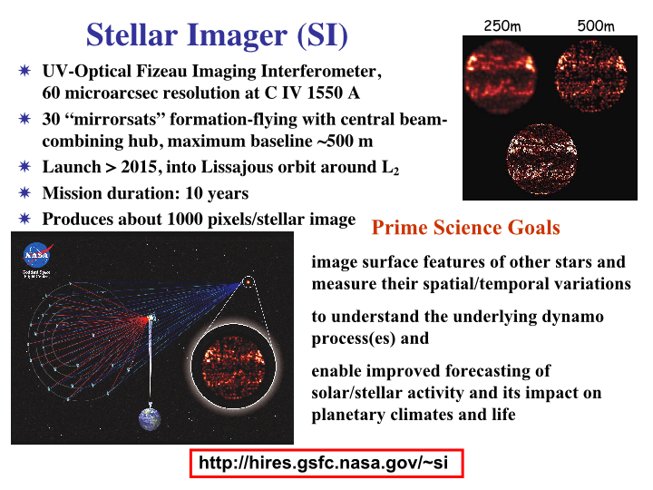

Slide 5
In 1-D we have:
3 unknowns: θd, θo, dx
But laser interferometers
Only give us 2 measurements:
Dred, and Dgreen
Two Laser interferometers can make the two spacecrafts virtually rigid- but we still need a tie-in to the celestial sphere-> we still need a star tracker.
Interference pattern from optics space craft laser interferometer→ Dred
θo
dX
Interference Pattern from Detector Space craft laser interferometer→ Dgreen
θd

Slide 6
Using a “Super Startracker” to image reference stars and a laser beacon.
Super Star Tracker Sees both
Reference stars and the beacon of the other space craft.
It should be able to track relative drift between the reference and the beacon to 30 microarcseconds.
θo
dX
Laser Beacon with Divergence > θo
Must control Optics space craft to have tilts less than the laser beacon divergence or such that the beacon moves by less than an angular resolution element over the system focal length-which ever is smaller
θd

Slide 7
Strawman Idea
Make a star tracker with a big enough aperture so that in a reasonable amount of time, we can collect enough photons from a star to centroid the stars position to ~30μas
  #photons/sec on an aperture “r” cm across ~10⁷πr²10^{m/5}
  Diffraction limit for “r” @ wavelength λ: ~ λ/r
  Position determination with N photons: Δθ ~ λ/(r √N)
  Position determination with a magnitude “m” star in “t” seconds
    Δθ ~ 10⁻⁴ λ/r² 10^{m/5}/ √t radians
Have 2 or more of these to compensate for proper motion, etc…
Would be great for seeing a beacon on another space craft
Consider the “Quartz Telescope” of GP-B
  Will use 5th mag star HR5110
  5” telescope-> 0.1 marcsecs

Slide 8
Some Details
There are a limited number of stars bright enough to do this, so high precision gimbals (30μas) are needed to point the SST or a pick-off mirror at available stars.
What kind of focal plane will this have?
  Is it a CCD? What will the FOV be? Beware of full well capacity!!
How stable will/should the platform be?
  NGST will use bandwidths of 1-10 Hz or so
Use of “Coarse” Star trackers to get SST close. How to hand off coarse to fine
Registration of the Fine tracker
Use of Gyroscopes to make use of fainter stars…?
How fine can we centroid? 1/100th of a pixel? More?
Stars move
  Aberration of light (can be ~20 arcsec in a year…or 40 microarceseconds in a minute!)
  Parallax effects can be as large as 30 microarcseconds a day for stars 0.5 kpc away
  Proper Motion in Galactic Potential
  Wobble from planets
  Motion of features on the stars
Other?

Slide 9
A non-professionals view of the dependencies
Mirror Aperture
See a Bright
Enough Reference
Star
Super
Gyros
Stable Reference
At 30μas Level
For ~1 Day
How Well Can
Centroid?
Pixel Size
Field
Of
View
Array Size
Accommodate
Stellar Motion Due to
Parallax and Stellar
Aberration
Gimbals

Slide 10
Detector Options: Imagers
CCD
  Gimbal requirements softened if wide enough FOV
  How small a pixel?
  Do we need to worry about full well capacity of CCD?
  Power?
  Would allow us to track beacon on other satellite
  Lifetime? Radiation Hardness? (SI)
CIDs
  Too noisy now?
Others?

Slide 11
Detector Options: Non-Imagers
Quad Cell (Quadrant Detector)
  Requires gimbal
  Low power
  Limited use.. Track a star or a beacon.
Lateral Effect Photodiode
  FOV Like a CCD- but less power
  Not really imaging
  Accurate enough?

Slide 12
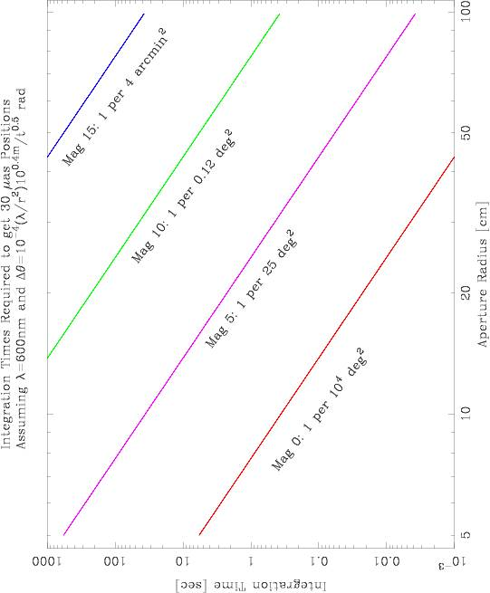

Slide 13
Super Gyroscopes?
What kind of gyroscope will help us to descope the telescope size?
  Need 30 μarcsec resolution and drift over tracker integration time
Mechanical Gyroscopes
  Still the most accurate gyros available
GP-B Gyro has a drift of 1/3 microarcsecond/day!!
  Needs cryogen
  Maybe a future ISAL run where we look at using high T_{c} superconductors

Slide 14
Super Gyroscopes?
Non-Mechanical Gyroscopes
Kilometric Optical Gyroscope (KOG)
  Uses Sagnac Effect with light- precision ~λ/perimeter
    For λ = 630 nm, 4 km perimeter should be adequate
  Maybe have lock-in problem for “0” rotational velocity
  Proposed for StarLight, but cost and technical issues
Atomic Interferometric Gyroscope
  Sagnac Effect with reduced wavelength
  “Way” out there, but see the ESA mission concept:”Hyper” http://sci.esa.int/pdf/hyper.pdf (200 Watts, 200 kg)

Slide 15
Goals of this Study
Get a good handle on mass/power/cost/size for input into an IMDC study for SI or MAXIM Pathfinder, where 30 microarcsecond Line-of-Sight knowledge is needed.
  At least better than the WAG we have made in the past IMDC runs
  Define “other” requirements- jitter, thermal,..
Understand the scaling laws to make this eventually work for a more complex mission needing 30 nas line-of-sight knowledge
Identify required technologies:
  1) to make possible
  2) to make cheaper
See what studies are currently under way (eg look through NASA Technology Inventory,…) Where does this fit in?
  Eg. This should also be a part of the VISNAV system
Bring some awareness of these types of issues for our more challenging imaging missions to GSFC people.
Better define the problem- the usual “scientist does not quite know how to describe the needs to engineer” difficulty….

Slide 16
Way Out Ideas
Rigel
Regulus
Free flying star tracker?
Vega
Star Tracker Spacecraft stays pointed so as to capture a strategically chosen collection of guide stars.
It is “virtually” rigidly connected to the interferometer array via laser interferometers.
Advantages: can make reasonable sized star trackers for bright stars, simple ACS system,
simple mechanical structure multi-mission… possible part of the L2 public utilities…
Disadvantages: Need satellite bus, com system, power, etc…
How does this trade against having it attached to one satellite
In the array?

Slide 17
Calibration: GP-B Solution
Aberration to the Rescue: Nature's Measuring Rod
The gyroscope and telescope output signals are not angles but voltages. That fact raises two issues. First, how to match the readouts -- so that a given spacecraft pointing error causes identical voltage changes in each. Second, how to calibrate the final subtracted output -- so that observed voltage can be translated into an angle, the angle in milliarc-seconds between the gyro axis and the line to Rigel.
Matching is achieved by a technique known as dither. The spacecraft is forced to swing slowly through a small angle back and forth across the line to Rigel, and the resultant oscillatory signals in the two readouts are adjusted until equal.
Calibration would be extraordinarily difficult were it not that Nature herself supplies the means through the phenomenon known as aberration of starlight. As the satellite orbits the Earth, and the Earth orbits the Sun, the apparent position of the star, tracked by the telescope, becomes periodically displaced by exactly known amounts (+-5 arc-seconds during the orbit, +-20.148 arc-seconds during the year). These displacements serve as "measuring rods" for the relativity signals.
So a wandering motion, which to its discoverer James Bradley in 1729 seemed disturbingly aberrant, saves Gravity Probe B. Surprisingly, it is only by an application of the equations of special relativity (a step not taken until 1980) that the aberration can be determined to the precision needed. Einstein would have liked that point.
http://www.onr.navy.mil/02/c0241e/GPB6.htm

