Slide 1
L0 and L1 Structure Deflections During Installation of Silicon Sensors
C H Daly
8/24/2003

Slide 2
L0 structure.
The worst load case is when the first line of sensors in installed on the A-layer. These sensors have a larger contact area with the structure and thus need a larger load as the pressure is kept constant at 3.43 kPa (35 g/cm²). Also, the structure’s stiffness is at its minimum at this time. As each azimuth of sensors is added it does add significantly to the bending stiffness. FEA was used to find the deflection of the structure due only to the pressure applied during sensor installation. The calculation was done first with the sensor stiffness turned off (by greatly reducing the elastic modulus of the sensor material) and then with this stiffness included for all sensors.
The first three figures show the results with the sensor stiffness turned off. The next three show results with the stiffness on. The graphs show the deflection as a function of distance along the centerline of the sensors.
The maximum sagitta with no sensor stiffness was 37 μm. This was reduced to 25 μm when the stiffness was turned on.
The structure was supported at the 6 holes used to hold the sapphire pins that locate it to L1. The deflection of the pins was not included.

Slide 3
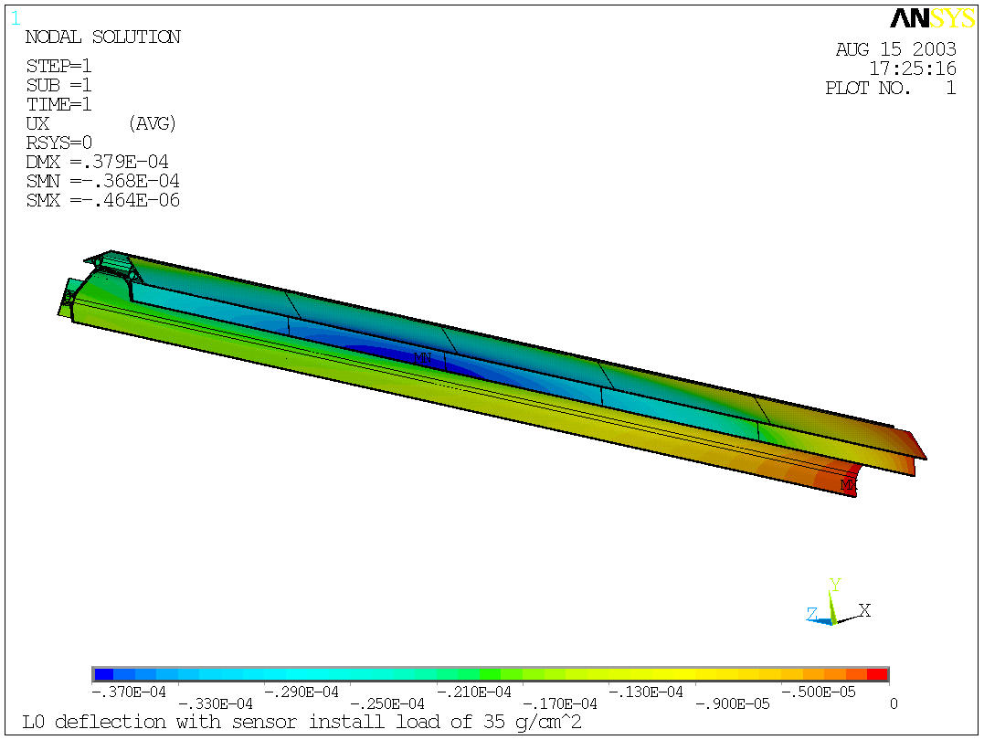
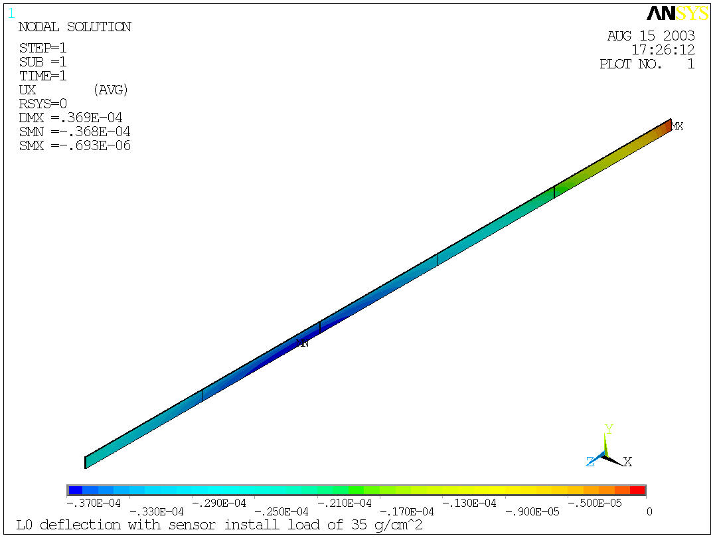

Slide 4
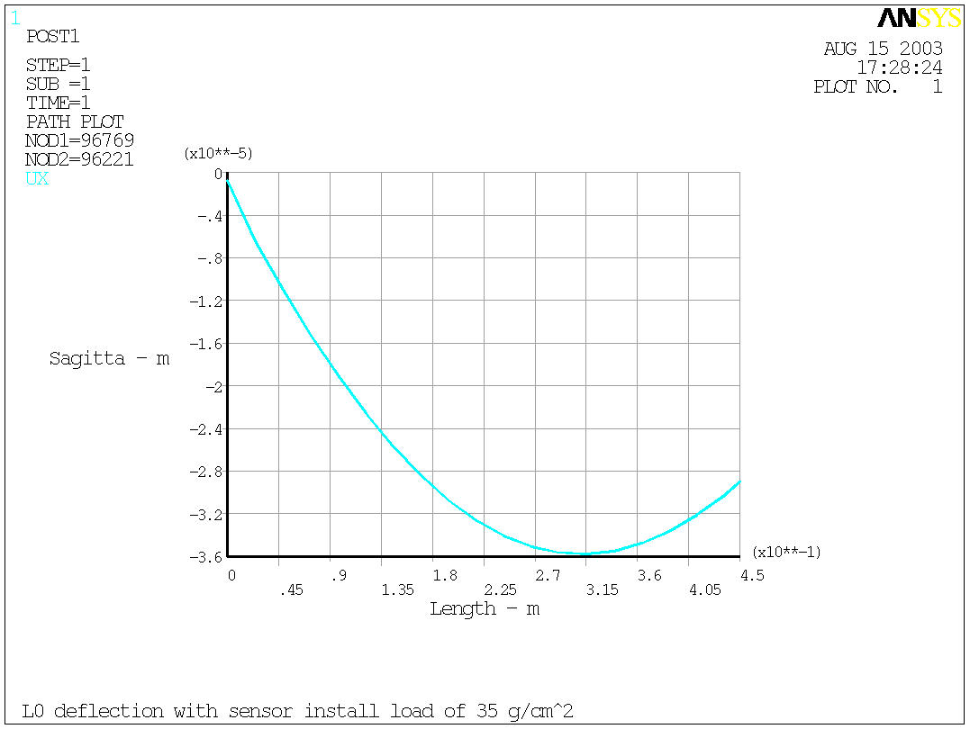
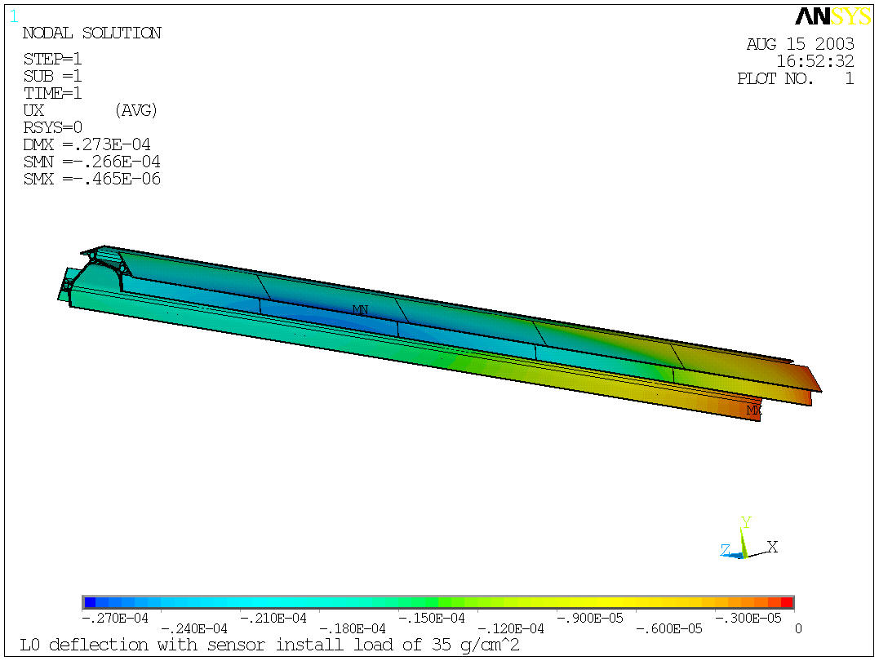

Slide 5
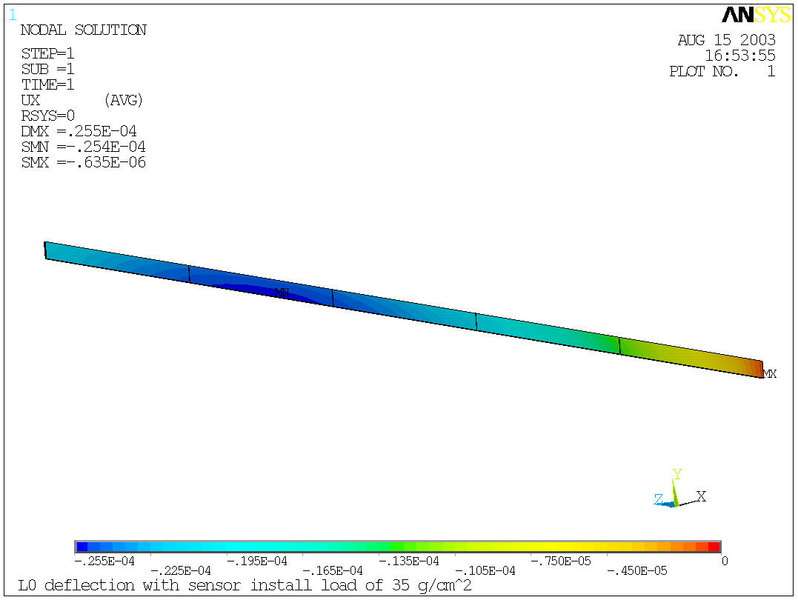
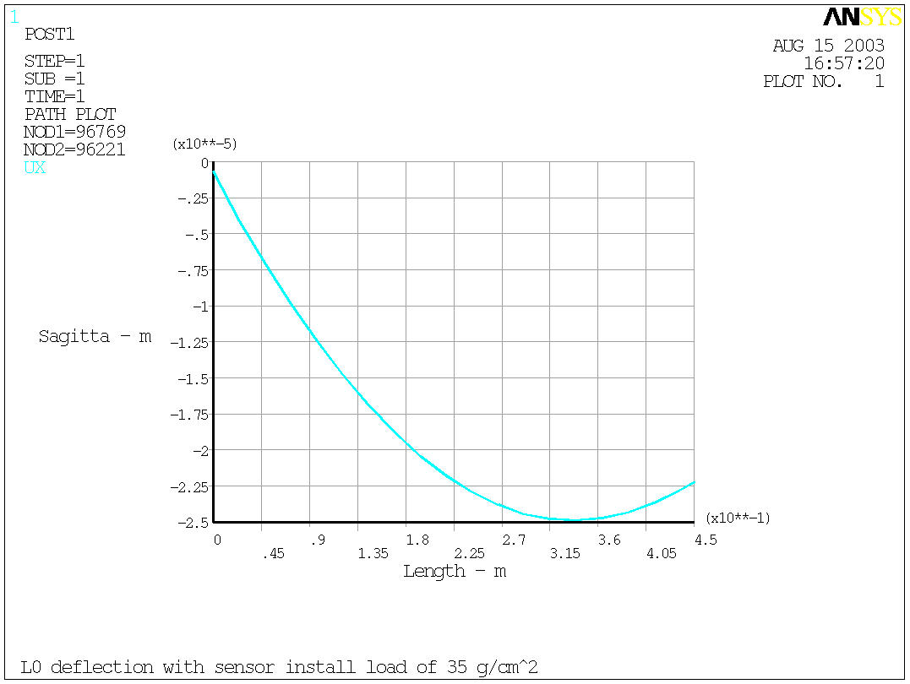

Slide 6
L1 structure.
The worst load case is when the first line of sensors in installed on the A-layer. These sensors have a larger contact area with the structure and thus need a larger load as the pressure is kept constant at 3.43 kPa (35 g/cm²). Also, the structure’s stiffness is at its minimum at this time. As each azimuth of sensors is added it does add significantly to the bending stiffness. FEA was used to find the deflection of the structure due only to the pressure applied during sensor installation. The calculation was done first with the sensor and hybrid stiffness turned off (by greatly reducing the elastic modulus of the sensor material) and then with this stiffness included for all sensors and hybrids.
The next three figures show the results with the sensor and hybrid stiffness turned off. The final three show results with the stiffness on. The graphs show the deflection as a function of distance along the centerline of the sensors.
The maximum sagitta with no sensor or hybrid stiffness was 49.6 μm. This was reduced to 28.8 μm when the stiffness was turned on.
The structure was supported at the 6 holes used to hold the sapphire pins that locate it to L2. The deflection of the pins was not included.

Slide 7
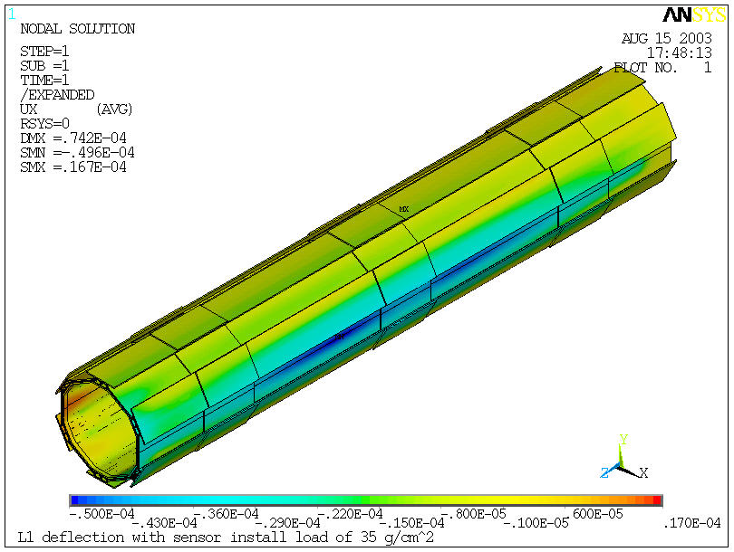
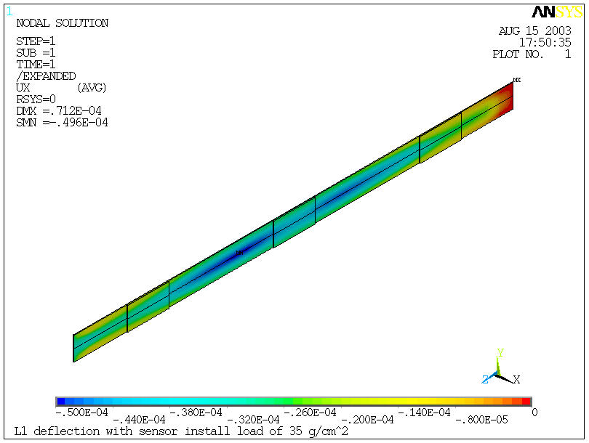

Slide 8
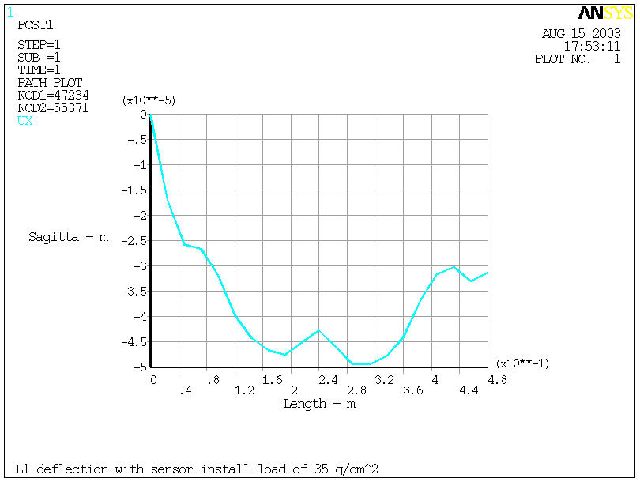
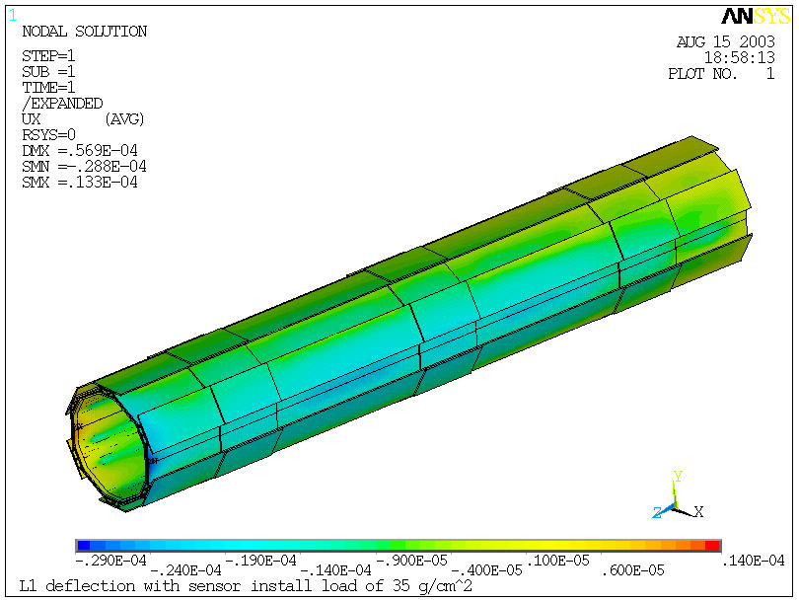

Slide 9
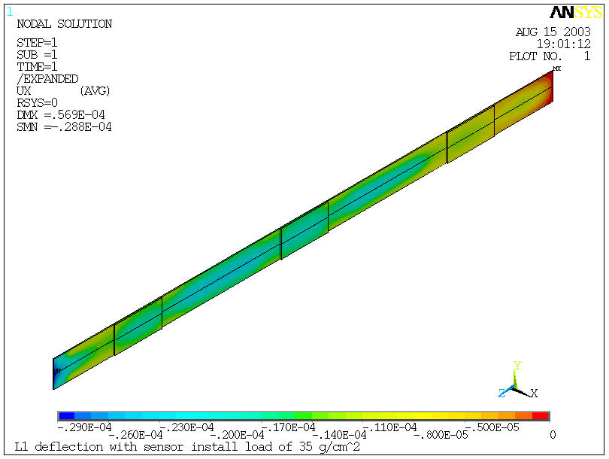
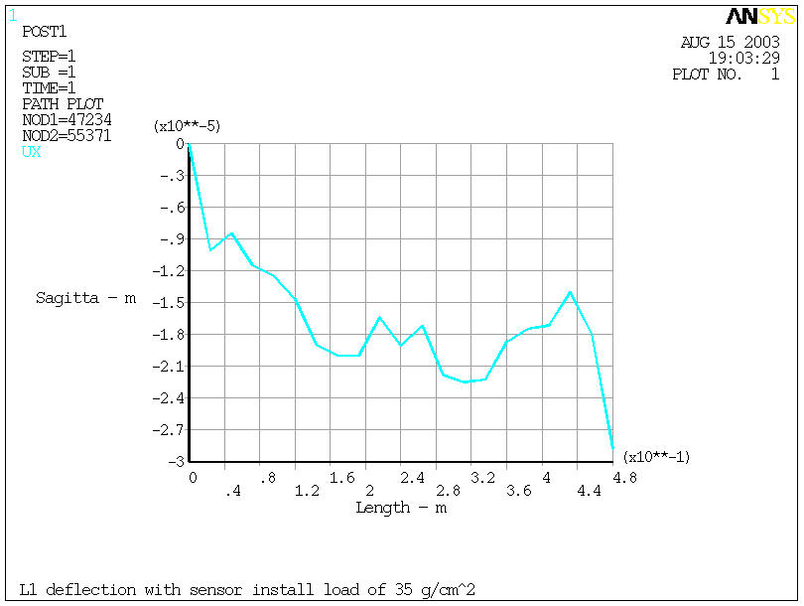

Slide 10
Proposal to use the carbon fiber inner shell mandrel as both an assembly and sensor installation tool.
During sensor installation, the carbon fiber structure has to be supported precisely and rigidly. It is also necessary to be able to rotate the assembly is precise 30° increments. While the sapphire pins and jewels do provide a precise location, they have marginal strength and using them to handle the 4.2 kg sensor installation load would be very risky. There is also the problem of the carbon fiber structure deflection shown above. The needed tension rod forces are quite high and applying them to the structure would also be potentially risky.
However, the mandrels used to create the inner carbon fiber shells are very strong and rigid and can be easily adapted for use as installation tools. The biggest question here is how well the structure is located by the mandrel. Remember that the mandrel is used not only to make the inner shell but also as the jig used to assemble the inner and outer shells. These shells are pushed very firmly against the mandrel while the epoxy is cured during this assembly stage. As a result, the carbon fiber structure is a very snug fit on the mandrel and no significant relative motion occurs between these pieces. The other question is that of the deflection of the mandrel under its own weight and under the sensor installation pressure.
An FEA study was done with the L0 carbon fiber shell assembly fitted onto the steel mandrel. The mandrel was simple supported at its ends. Contact elements were used between the mandrel and the inner shell to allow axial sliding. Otherwise the overall bending stiffness would be overestimated. The results are shown below for just the gravity load and with the sensor install pressure added.
The sagitta is 10.4 μm for gravity only and 18.0 μm when the pressure load is added.

Slide 11
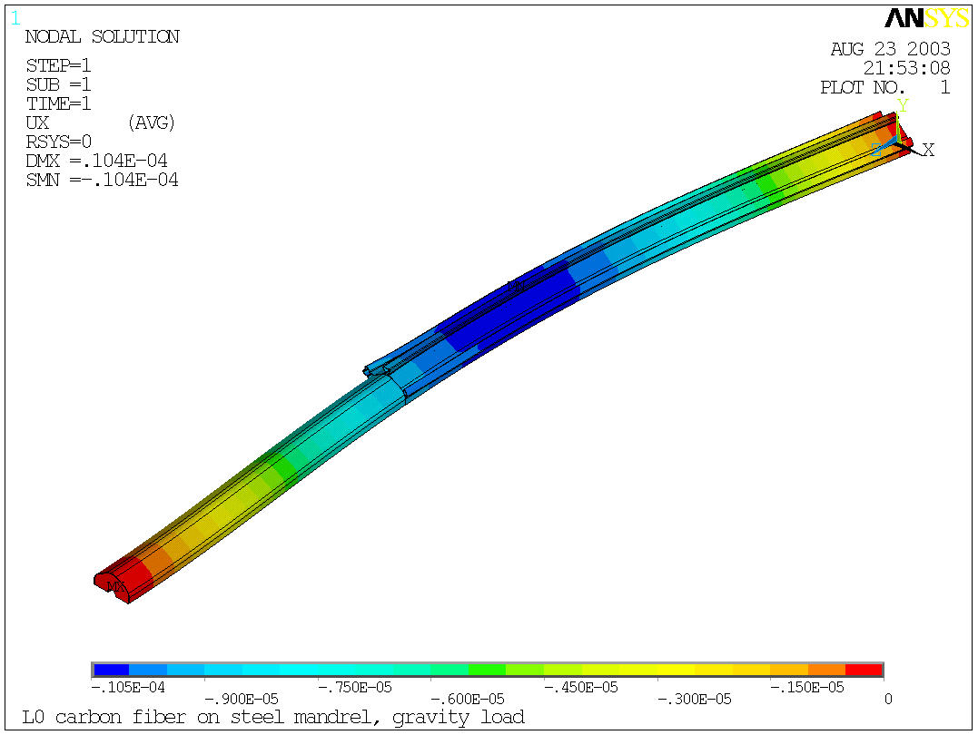
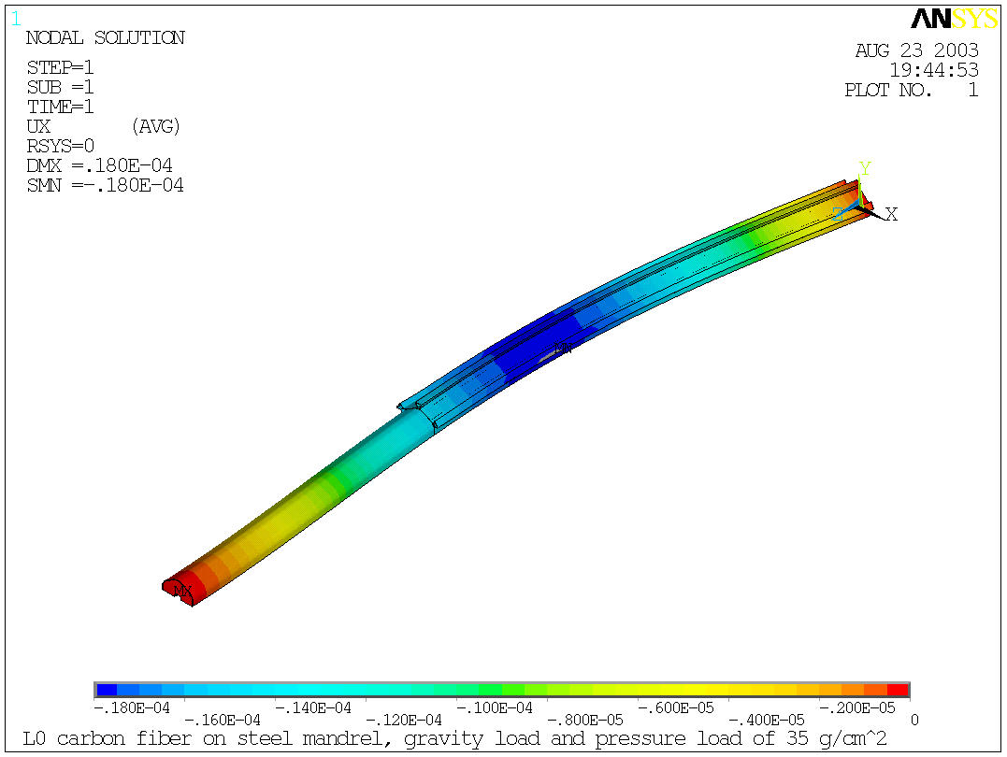

Slide 12
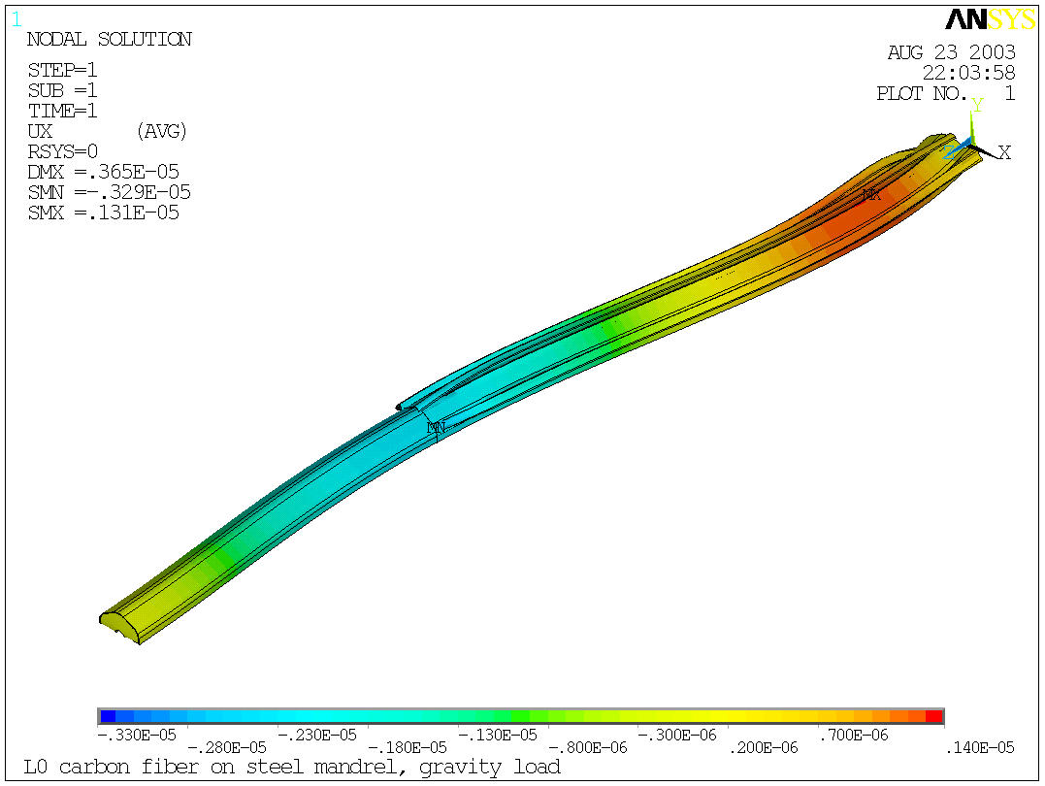
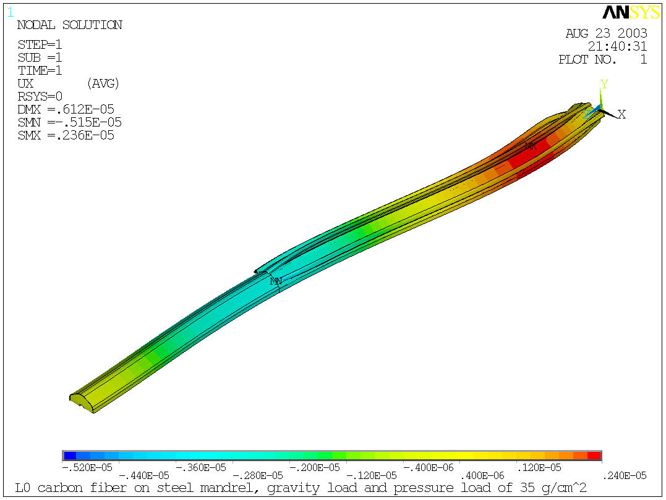
Using a tension rod that passes through the mandrel and is offset from the centerline applies a moment to offset the bending loads. The effect of this for the load cases is shown below. The sagitta is reduced to a range of 4.6 μm for gravity only and 7.5 μm when the pressure is added.
Tension rod force = 235 N
Tension rod force = 393 N

