Slide 1
Buckling analysis of the
Vacuum Subsystem elements
(KOPIO experiment)
A. Ryabov, A. Soldatov, S.Chernichenko (IHEP, Protvino)
V.Demitchev, A.Timofeev
(RDP Corp. KOMPOZIT, Korolev)

Slide 2
General remarks about analysis
This work concerns the numerical simulation of the structural behavior of the KOPIO Vacuum Subsystem under external pressure. An ANSYS™ Program is used for the analyses.
The work has carried out at IHEP (Protvino) in close contact with specialists from the KOMPOZIT Corp. (Korolev).
Two types of the analysis have been performed:
  Nonlinear Buckling analysis allows us to determine critical pressure at which geometrical instability of a structure begins to develop. From this analysis a stability safety factor of the structure can be calculated. It is defined as a ratio of the critical pressure to the nominal one (1 atm).
  Static Structural analysis of the vacuum subsystem under the nominal external pressure of 1 atm. At this stage the stress safety factors can be determined. These factors show the reliability of the structure with respect to material failure.

Slide 3
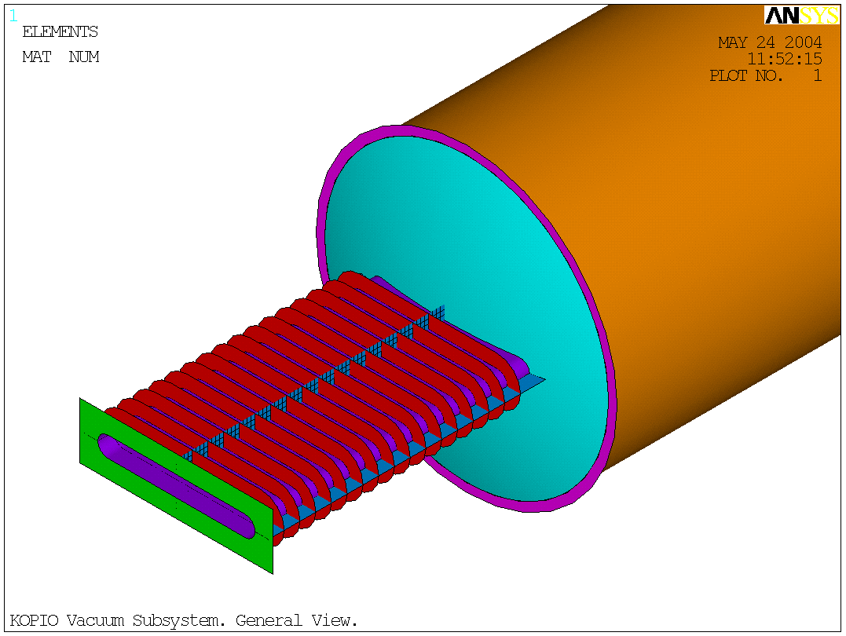
FE Model: General View
Vacuum Vessel (Cylinder):
D=3.2m, L= 4m,
t=12.7mm (1/2”)
Cover (Dome)
t=12.7 mm (1/2”)
Beam Pipe: t=6.35mm(1/4”)
Reinforcing Ring
t=19.05mm (3/4”)
Pipe Flange
t=19.05mm (3/4”)
Ribs: t=9.525mm (3/8”)

Slide 4
Materials used in the analyses
Two approximations of the composite materials have been used in the FE analyses. The mechanical properties of these materials were presented by the KOMPOZIT Corp.
Monolayer Composite Material (MM) based on carbon fibers with unidirectional monolayer properties. Mechanical properties are:
Young’s Modulus E, GPa: along the fibers (E₁) across the fibers (E₂) | 150 10
Shear Modulus G₁₂, GPa | 6
Major Poisson’s ratio ν₁₂ | 0.25
Density ρ, g/cm³ | 1. 5
2. Isotropic Composite Material (IM) may be used for simulation of multi-layered composite material with complex layer configurations. Mechanical properties are:
Young’s modulus E = 75 GPa, Poisson’s Ratio ν₁₂ = 0.25

Slide 5
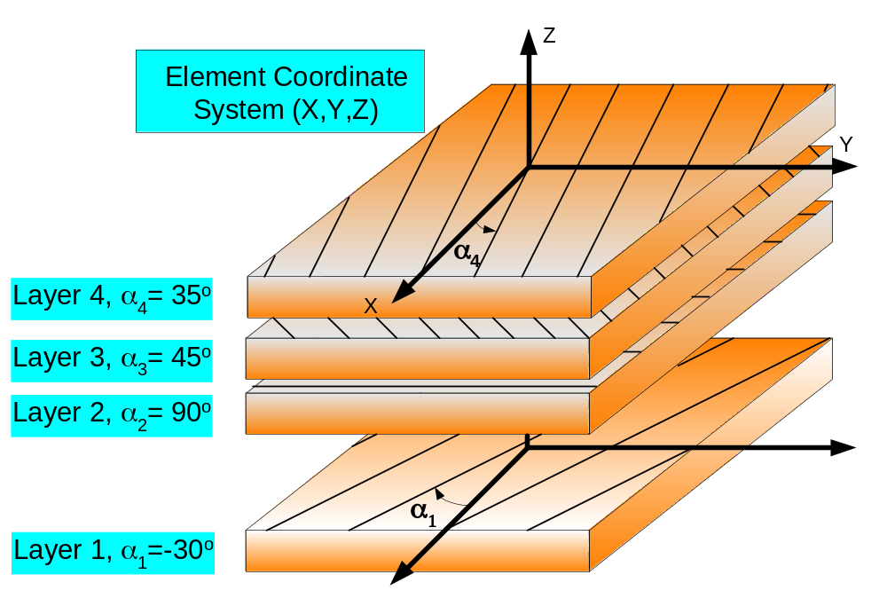
About multi-layered materials
Multi-layered composite element consists of a few mono-layers. Fibers in each mono-layer are oriented in a direction which is defined by an angle α with respect to X-axis of the Element Coordinate System. So, a Layer Configuration is defined as a sequence of the angles: LC=(α₁, α₂, α₃,…). The thickness and material properties for each layer are also defined.
The Layer Configuration shown in the picture is:
LC=(-30°,90°,45°,35°)

Slide 6
About Layer Configurations
This table demonstrates an effect of layer configuration of the dome material on the maximal displacements of dome points. Calculations were carried out at nominal boundary and loading conditions. In all tests the total thickness of dome wall was 12 mm, the layers had equal thickness.
Number of Layers | Layer Configuration | Maximal Displacement, mm
1 | (0°) | 15.
1 | (90°) | 17.
2 | (0°,90°) | 7.3
2 | (35°,-55°) | 7.7
2 | (40°,-50°) | 6.6
2 | (55°,-35°) | 6.0
2 | (45°,-45°) | 5.6
2 | (50°,-40°) | 5.3
4 | (0°,-45°,45°,90°) | 4.8
8 | (0°,-22.5°,-45°,-67.5°,22.5°, 45°,77.5°,90°) | 4.7

Slide 7
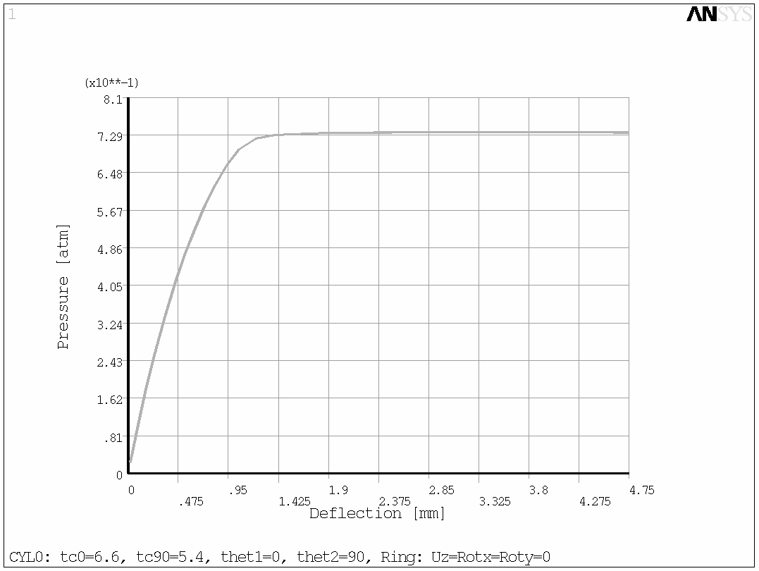
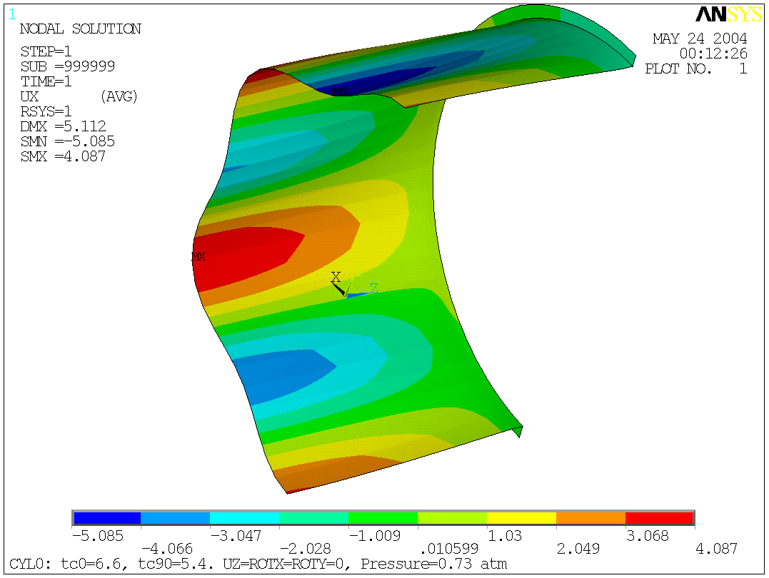
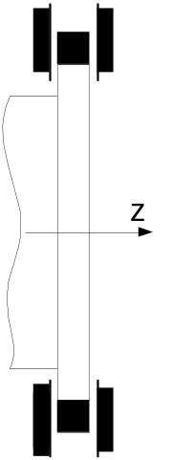
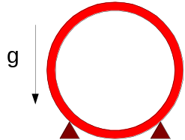
CYL: Buckling Analysis, test_1
Conditions: UZ=0 on Rings; Gravity; CPV weight (360kg);
Two-point Ring’s support; Monolayer Material; Layer Configuration (0°,90°)
Pic. 1: Load-Deflection Curve
Pic. 2: Radial Displacements at P_{cr}=0.73atm
Result: Critical Pressure is about 0.7 atm

Slide 8
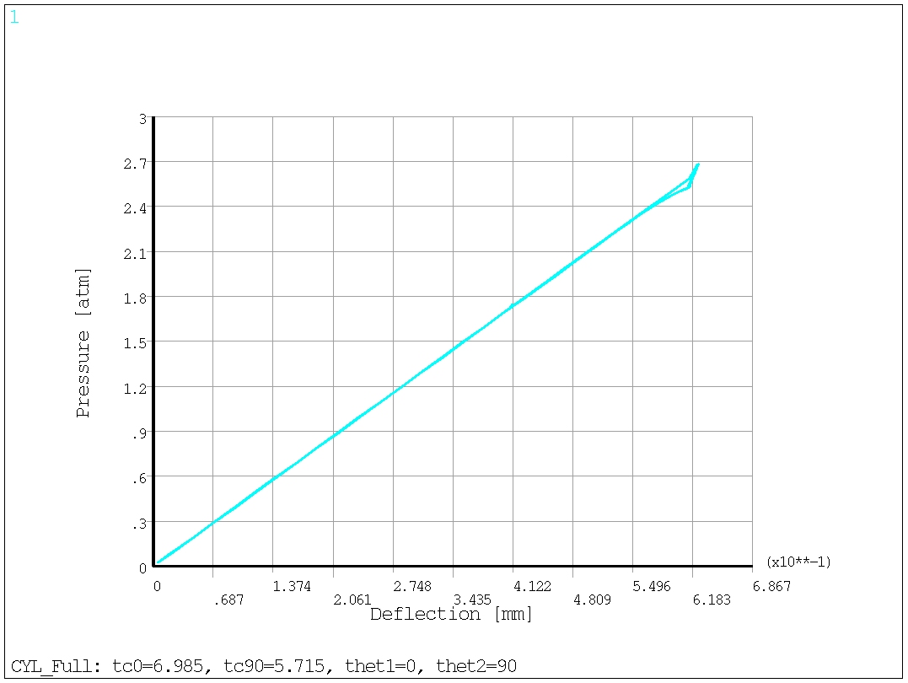
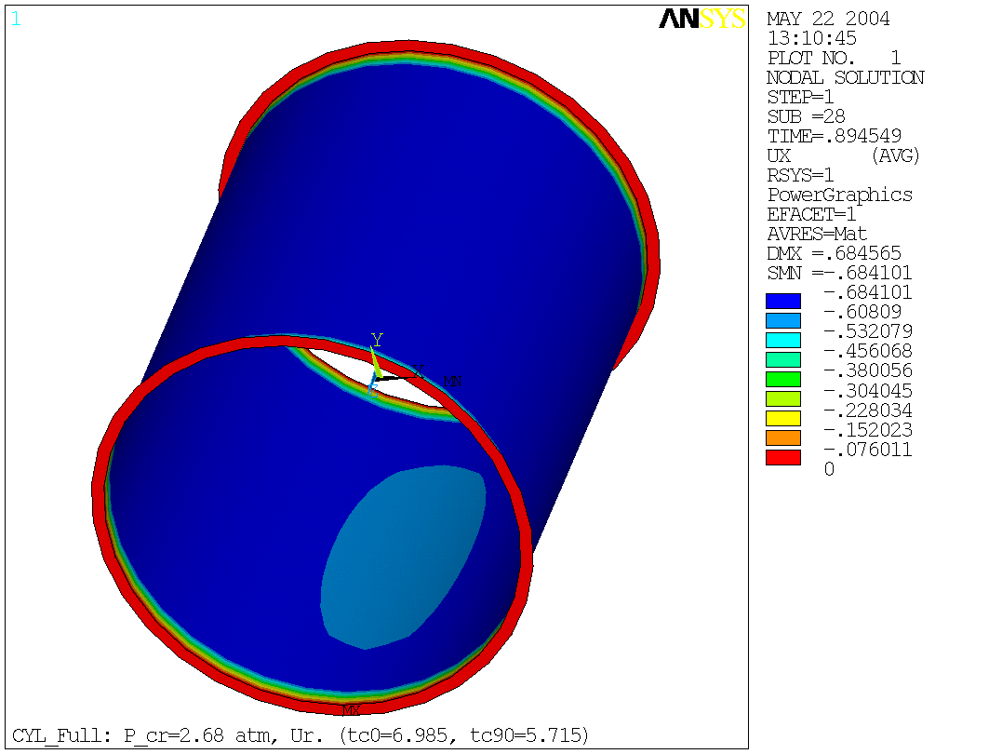
CYL: Buckling Analysis, test_2
Conditions: Fixed Rings; Gravity; CPV weight (360kg);
Monolayer Material; Layer Configuration (0°,90°)
Pic. 1: Load-Deflection Curve
Pic. 2: Radial Displacements at P_{cr}=2.7 atm
Result: Critical Pressure is not less than 2.7 atm

Slide 9
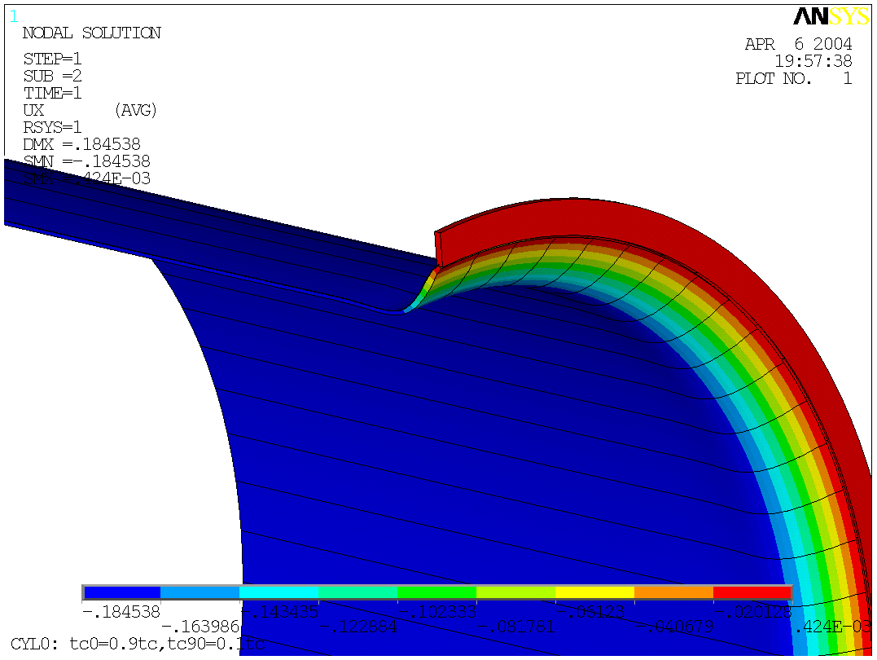
CYL: Displacement U_{r} (Static)
Conditions:
Fixed Rings;
P = 1 atm;
Monolayer Material;
Gravity;
Distributed weight of 360kg (CPV).
Max U=0.185 mm. t₀=10.8 mm, t₉₀=1.2 mm

Slide 10
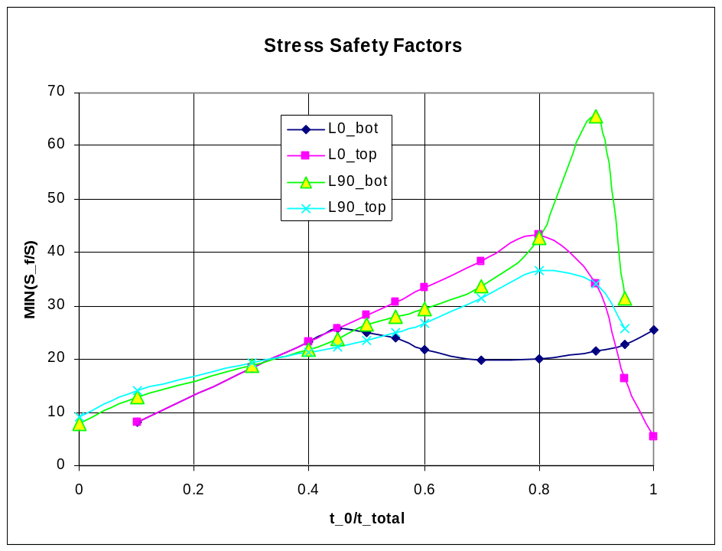
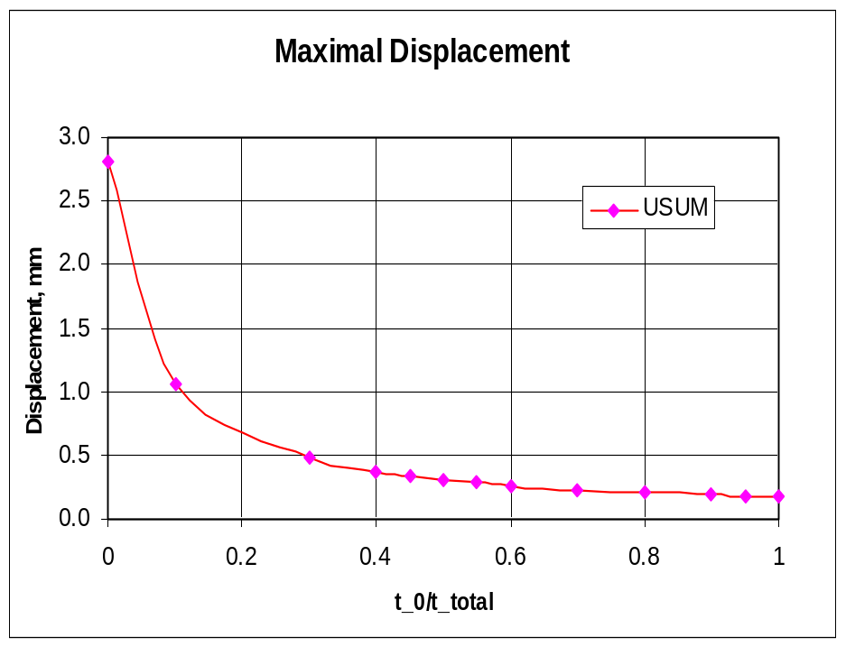
CYL: Dependences on t₀/t_{total}
Good work zone
L90_top
r
z
t_{total}=1/2”
ϕ
Layer 90º
t₀
Layer configuration of the Cylinder composite material: NL=2, LC=(0°,90°)
Layer 0º
L0_bot

Slide 11
CYL: Conclusions
Stability is the main problem for the Cylinder.
Free rotations of the Rings in cross-plane should not be allowed, because the geometrical instability begins to develop under the pressure less than 1 atm.
Fixing of the Rings rigidly to an outer massive frame helps to avoid an instability of the cylinder up to external pressure of 2.7 atm.
Stress safety for the cylinder material is not a problem. Safety factor is very large – of about 20.

Slide 12
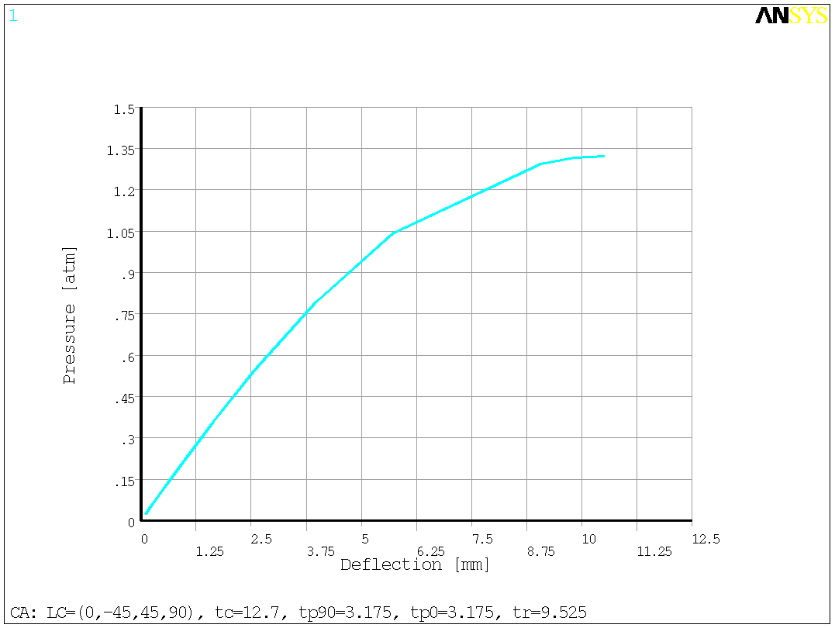
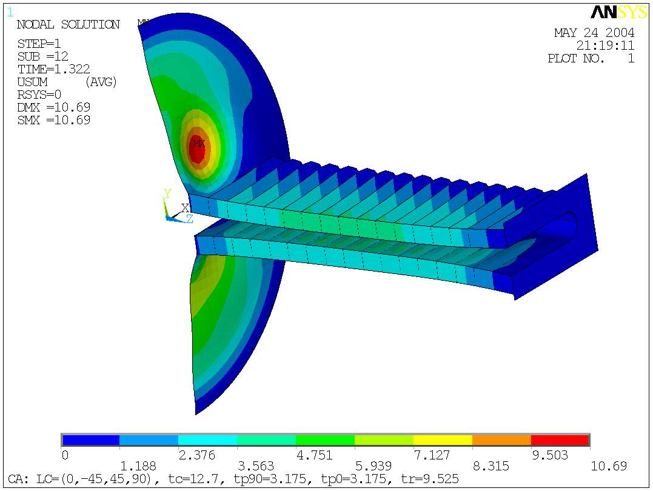
D&BP(MM): Buckling Analysis 1
Conditions: Fixed Dome’s edges and pipe flange; Gravity; CPV weight on pipe (90 kg); Monolayer Material; Dome’s Layer Configuration is (0°,-45°,45°,90°)
Critical Zone
Pic. 1: Load-Deflection Curve
Pic. 2: USUM Displacements at P_{cr}=1.3 atm
Result: Critical Pressure is about 1.3 atm

Slide 13
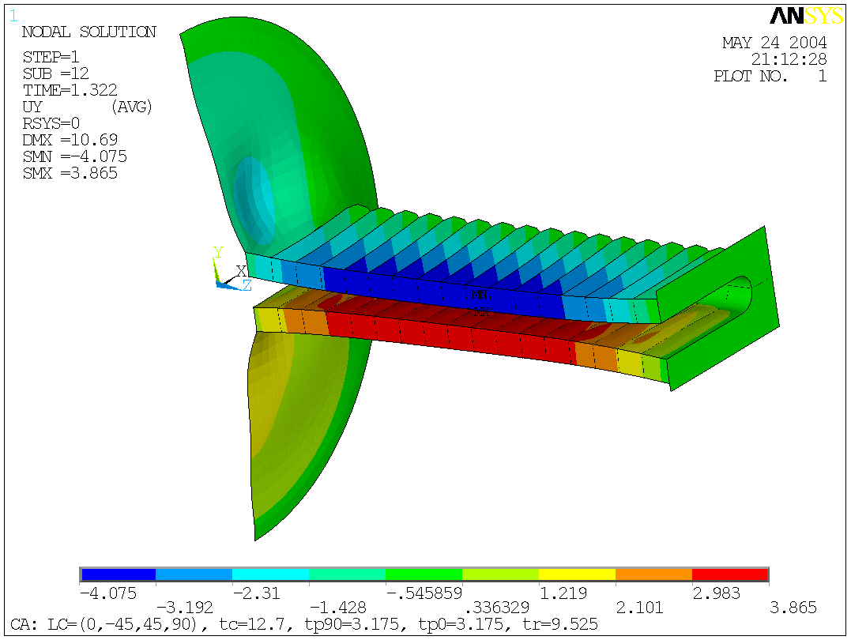
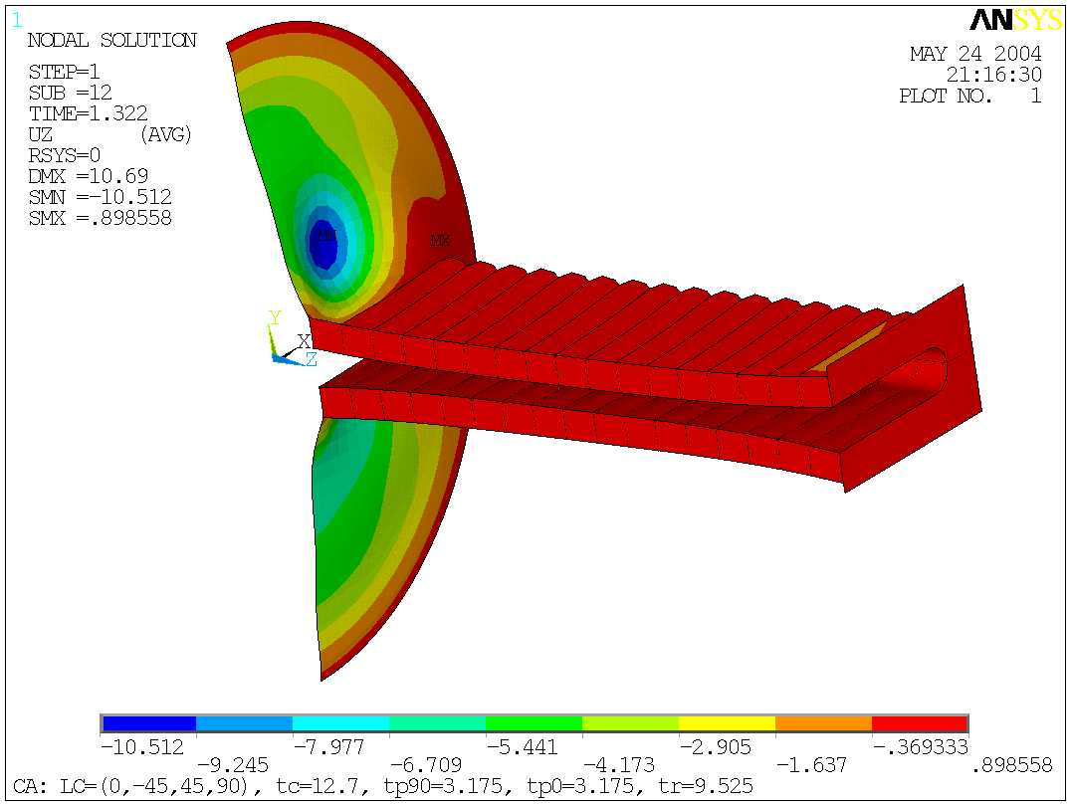
D&BP(MM): Buckling, _1, Displ.
Result: Maximal vertical displacements are reached at the middle parts of the pipe and equal to ≈4 mm at the P_{cr}=1.3 atm.
Result: Maximal axial displacements are reached at the weak place of the Dome. U_{z} for the pipe is not greater than 1 mm

Slide 14
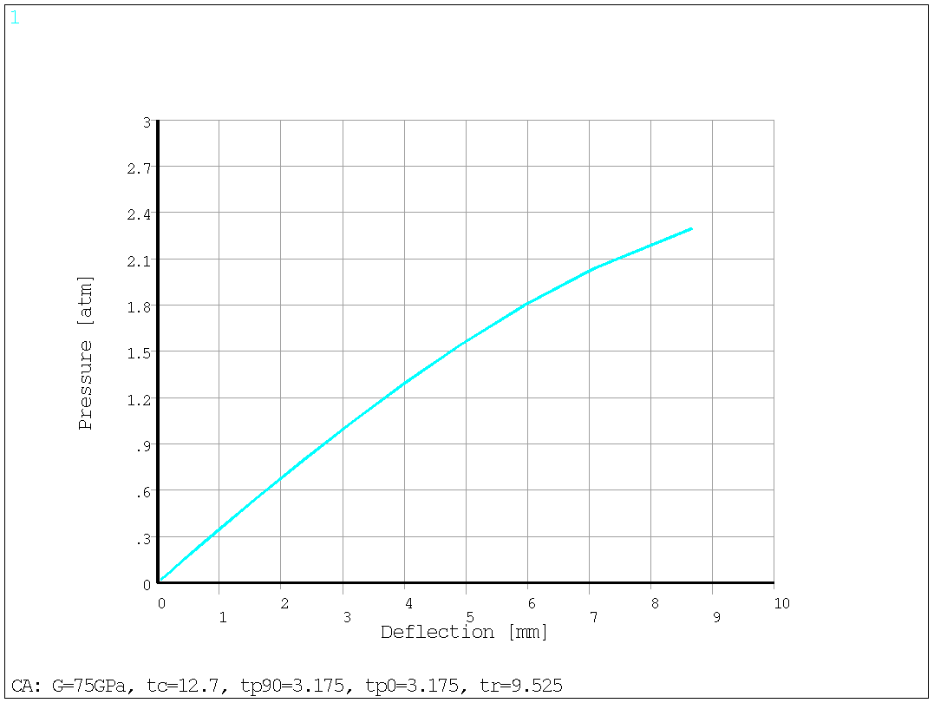
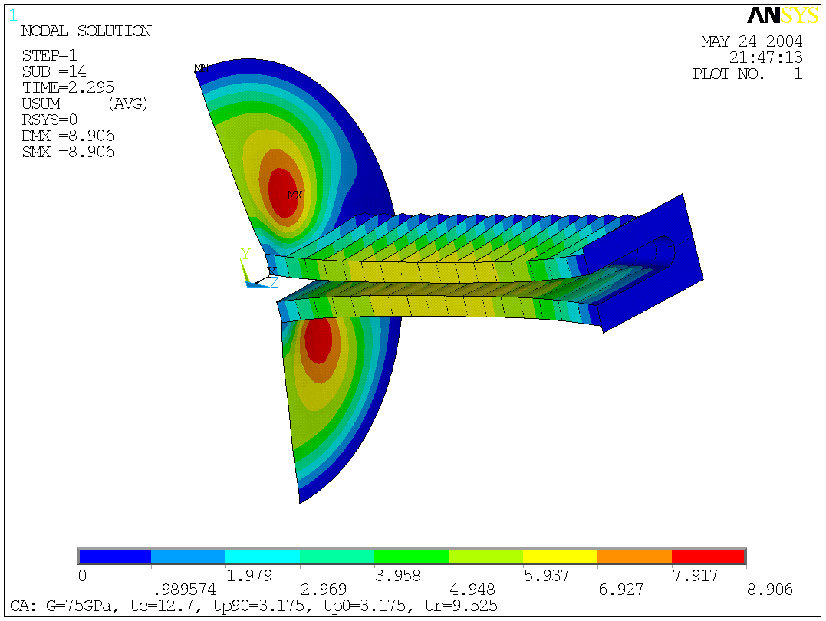
D&BP (IM): Buckling Analysis_2
Conditions: Fixed Dome’s edges and pipe flange; Gravity; CPV weight on pipe (90 kg); Isotropic Material for Dome, Monolayer Materials for other parts.
Critical Zone
Pic. 1: Load-Deflection Curve
Pic. 2: USUM Displacements at P_{cr}=2.4 atm
Result: Critical Pressure is not less than 2.4 atm

Slide 15
D&BP: Conclusions
The Dome should be fabricated from the multi-layered composite material with isotropic properties. In this case a stability safety factor is at least 2.4.

