Slide 1

Software Overview
Technical Managers Training (TMT)
October 2005
Presented by: Barbara Pfarr
Barbara.B.Pfarr@nasa.gov
Associate Chief, Information Systems Division
Goddard Space Flight Center
Modified from Presentation by Mike Stark, “Mission Software for Project Managers”

Slide 2
Goals
Describe the projects and activities of the Information Systems Division
Describe best practices for software development
Provide understanding of software issues
Notes:
Talk to pay me now, pay me later --
Avoid problems by
Making good decisions wrt software during formulation
Using good processes & sufficient resources throughout

Slide 3
ISD: End-to-End Information Systems Providers
Joe Hennessy - Chief, Martha Chu, Barbara Pfarr- Associates, Julie Loftis – Assistant for Technology
Branch
Functional Area/Products
Services
581/Systems Integration & Engineering
Margaret Caulfield, vacant
End-to-end data systems engineering of ISC mission systems development activities.
Mission directors, ground sys/flight ops management, sys. eng., flight prep support, SW eng, Sys I&T, AO prep
582/Flight Software
Elaine Shell, Ray Whitley, Kequan Luu, Yvonne. Lue
Embedded spacecraft, instrument and hardware component softwares; FSW testbeds
End-to-end FSW development; simulation s/w; spacecraft sustaining engineering
583/Mission Applications
Henry Murray, Scott Green
Off-line mission data systems (e.g., Command man., s/c mission and science P&S, GN&C, NCC
Sys. eng.& implementation, COTS application, testbeds for concept proof/prototyping in ops environment
584/Real-Time Software Engineering
John Donohue, Ryan Turner
Real-time ground mission data systems for I&T and on-orbit ops (e.g., s/c command & control, launch and tracking services)
Sys. eng.& implementation, COTS application, simulators, testbeds for concept proof/prototyping in ops env.
585/Computing Environments & Technology
Howard Eiserike, Steve Naus
Tools and services in support of information management
Network manage., business/support tool develop, WWW applications
586/Science Data Systems
Tom Flately, Bob Lutz
Science data systems including data processing, archival, distribution, analysis & info man.
Sys. eng.& implementation, COTS application & integration, testbeds, prototyping
587/Advanced Data Management and Analysis
Jim Byrnes
Advanced concept development for archival, retrieval, display, dissemination of science data
Next-gen req. development, testbed for sys evaluation, prototype products
588/Advanced Architectures & Autonomy
Vacant, Barbie Brown-Medina
Technology R&D focused on space-ground automation and autonomy sys, advanced architectures, and advanced scientific tools and systems
Sys. eng & implementation, human-computer eng., technology evaluations, concept prototypes, sw eng. methods
589/Wallops System Software Engineering
Pam Pittman
Mission application prototypes, including development I&T, sys engr., software engr. supporting BPO, RMMO OSB
Provide unique mission software applications, and project formulation services

Slide 4
Mission Software: Architecture
End-to-end data systems engineering of mission systems
Embedded spacecraft, instrument and hardware component software
Real-time ground mission data systems for spacecraft integration and on-orbit ops (e.g., S/C command & control, launch and tracking services)
Science data systems including data processing, archival, distribution, analysis & info mgmt.
Off-line mission data systems (e.g., command mgmt., S/C mission and science planning & scheduling, guidance & navigation, network scheduling)
Notes:
Highlight end to end architecture, key categories of mission software

Slide 5
Different Domains of Software Each Reflect A Different Emphasis
Flight Software
driven by limited S/C life, asset survival, & mission science program
continuous critical real-time ops, e.g. attitude control, H&S monitoring
fixed & constrained environment
minimize risk with a never fail mindset
constrained maintenance opportunities
Mission Control Ground Systems
driven by limited S/C life, asset health, and observatory user demands
episodic real-time & near-time ops, from command uplink to system state evaluations
open to needs based augmentation
risk adverse with a fail soft/over mindset
full shadow maintenance capability
Science Data Management & Data Processing
data retention & integrity driven
near-time and later ops, from raw archival to signature calibrations and analysis
flexible & extendable environment
data fail soft mindset
- shadow mode and add-on maintenance
Science Data Dissemination
science evolution & user driven
near-time and later ops
large user communities
evolving user interfaces & access demands
timely data delivery mindset
shadow mode and add-on maintenance
… Domain Tailored Development & Qualification Approaches

Slide 6
GSFC Project Life-cycle
NASA
Phases
FORMU-
LATION
APPROVAL
IMPLEMENTATION
Project Life Cycle
Phases
Formulation
Software Development
S/C Integration & Test
Operations &
Maintenance
Project
Timeline
Contact
IV&V
SRR
OCR
PDR
CDR
Box
I & T
S/C
I & T
1st
CPT
Launch
IOC
Flight SW
Mission
Control Ground
System
Science
Data Capture/ Distrib.
SRR
PDR
CDR
STRR
Acc.
Test
SW
Launch
Readiness
SW mgt
(product)
plan
Test
Plan
SRR
PDR
CDR
1st
I &T
build
Acc.
Test
Last
Pre-launch
Delivery
(~L-120)
SRR
PDR
CDR
SIPS Int.
I & T build
ICD
updates
Acc.
Test
SW Launch
Readiness
Notes:
Early deliveries of smp/pp and test plan

Slide 7
Agenda: Formulation Phase
Key Documents and Deliverables
Mission Software Architecture & Requirements
Acquisition
Cost estimation
Software related trades

Slide 8
Key Documents / Deliverables
Cost & Schedule Estimates
  Input to SW management plan/product plan
Flight and ground software requirements
Interface requirements documents
System operation concept
Trade studies
Engineering analyses
NEW! Software Assurance Classification Assessment & Report
  New requirement defined by NPR 7150.2
  Prepared by Project, independent assessment by Software Assurance

Slide 9
Flight Software Requirements Drivers
#1
Mission and Project Requirements
Spacecraft, Instruments, Operations, Performance
Schedule, Funds
#9
Pre-launch and Launch Reqmts.
Launch-unique Configurations
Launch Vehicle Separation
In-orbit Sun Acquisition
#2
Mission Systems Engineering
Flight Hardware Redundancies
Onboard Autonomy
Onboard Failure Handling Philosophy
Flight
Software
#8
Special Hardware/Software I&T Reqmts.
Direct ground commanding of flight hardware
#3
Guidance, Navigation & Control
GN&C Hardware Decisions, Specs. & ICDs
Control Modes, Control Algorithms, Control Options
#7
FSW Test, Maintenance &
Remote Troubleshooting Strategies
Diagnostics, Flight Database, Loads, Dumps
#4
Science Instruments
Data Rates, Interfaces to s/c, Data Handling, Data Processing, Algorithms
Event Handling
#6
Electrical Subsystems
Flight Data System Architecture
Specs. and ICDs
(RF, CPUs, memory, buses, data storage, power)
#5
Science & Mission
Operations
Data Flows
Planning/Scheduling
Ground Contact Strategies
Notes:
Key is large number of deliverables

Slide 10
Simplified Flight SW Architecture
HW Interface
HW Interface
HW Interface
HW Interface
Guidance,
Navigation,
& control
Command &
Data handling
Power system
electronics
Scientific
Instruments
Flight software applications communicate across bus
Each application has similar architecture
  Layering limits pervasiveness of change
Application Architecture
Application component
System services
HW Interfaces

Slide 11
What’s Complex About Flight Software?
Schedule Compression
  Requirements & Operations Concepts mature late
    Flight SW is more tightly coupled to hardware than ground SW
    Can’t finalize requirements until flight hardware is fully characterized
  Major Demands during I&T and Launch Preparations
Software’s flexibility is both a blessing and a curse
  FSW can often accommodate late requirements changes or compensate for hardware problems during I & T or on-orbit if and only if one plans the sufficient funds for testbeds, well defined regression tests, and staff
    Under full cost accounting, contingency funds must be planned at the beginning of the project; changes are not “free” anymore.
Notes:
Software team will estimate impact of changes as they occur, not free anymore
MAP = 6 CPU XTE = 4 CPU HST = 12 CPU after SM4 Swift BAT = 2 CPU
More commands, telemetry, events, flight data, code, diagnostics, ICDs, anomalies, ...

Slide 12
SDO Electrical Architecture
28V Power to ACS sensors, actuators &heaters
Ka
XMTR A
ACE A
HMI
HMI Optics
& CEB
High Speed
Data Ka Band
Power Switching
RT
DC/DC Converter
Ka
XMTR B
CSS
DC-DC Converter
HMI Inst Electronics
from Ka Comm B
Waveguide
Switch
RT
BC
Bulk Memory &
DC/DC Converter
to Up/Down B
ACE SDN
AIA
RT
S/C Processor
Synchronous
Serial Bus
RWA I/O
GT’s
RT
Uplink/Downlink
S Band SDN
to High
Gain
Antennae
EVE
to S- Band
Prop Pyro board
AEB
4 Optics
& CEB
ESP
DC-DC Converter
H/W decoded cmds
Engine Valve
Driver boards
MEGS
EVE IEM
(incl. SDN)
Pwr Switching
28V power
Thermistors,
HGA sensors
RT
CDH A
GCE
IRU
RT
Pwr Switching
Propulsion
ST #1
RT
1553 Bus
DC-DC Converter
ST #2
RT
RT
Gimbal Interface
RW #1
from Instruments
Housekeeping SDN
RW #2
RW #3
RW #4
to
Ka- Band
Housekeeping SDN
Engine Valve
Driver boards
RT
RT
RT
Gimbal Interface
CDH B
Prop Pyro board
RT
High Speed
Data Ka Band
to
Up/Down
A
DC-DC Converter
Deploy Circuits
Solar Array Module
PSE SDN
Solar Array Module
Battery Module
3 Output Modules
PSE SDN
RWA I/O
DC-DC Converter
3 Output Modules
DC-DC Converter
DC/DC Converter
Pwr Switching
CSS
ACE SDN
Bulk Memory &
DC/DC Converter
28V Power to
Gimbal drives, Instrument Module thermal control
PSE
BC
S/C Processor
Synchronous
Serial Bus
DC-DC Converter
RT
RT
Power Switching
Uplink/Downlink
S Band SDN
H/W decoded cmds
ACE B
28V power
28V power
DC-DC Converter
S
XPNDR A
3 dB
Hybrid
Solar
Array
Solar
Array
Pwr Switching
S
XPNDR B
28V Power to ACS sensors,
actuators & heaters
to Omnis
Battery
28V power to SBC, Ka Comm, S XMTR
from S Comm A
Multiple processors, buses and interfaces

Slide 13
Ground Software Requirements Drivers:
Mission Operations Requirements
Ground software is integral to testing as well as operations
Spacecraft complexity
  “Observatory class” spacecraft with multiple instruments, and large telemetry/command databases, usually require more complex ground systems than “explorer” class spacecraft.
  Highly constrained flight data system resources (CPU, memory) increases ground system complexity, especially in the area of planning & scheduling
  Spacecraft with lower degrees of redundancy and autonomy usually require more complex ground systems.
Notes:
Mission functionality & complexity is essentially constant (zero sum) between flight & ground.

Slide 14
Mission Control Ground System:
Simplified MOC Architecture
Main MOC applications
  Telemetry & Command system
  Flight Dynamics
  Command Management, including Planning & Scheduling
  Trending
Level 0 processing (LZP) of science data is moving to the MOC
Real Time
Applications
Ground or
Space network
T & C system
Real-time
Flight dynamics
DATA
SERVER
“Offline”
Applications
Flight Dynamics
System
CMS/P &S
Trending/
Plotting
Notes:
BIG FOUR:
Planning & Scheduling / Command Management System
Telemetry & Command
Trending
Flight Dynamics

Slide 15
Ground Software Requirements Drivers:
Science Data Processing Requirements
Mission Science Requirements/Instrument observation requirements
  Instruments with targeted observation needs, tight pointing requirements introduce complexities into planning/scheduling system.
Data rates
  Very high (10-100’s Mbps) average and peak downlink rates require custom hardware/software systems to support
Data Latency and completeness requirements
  In general, as data latency decreases, and data completeness requirements increase, ground system complexity increases

Slide 16
Science Data Processing:
Level Zero Processing
Level zero processing creates data sets of CCSDS packets, separated by data source, from raw downlink
CCSDS standards minimize need for mission-specific SW
HW architecture needed for LZP dependent upon mission data rate
  Smaller missions (< 1 Mbps on average) can perform front end processing and data set preparation using workstations
  Larger missions (e.g, EOS, SDO) require special purpose VLSI equipment and dedicated high-speed computers
Front End
Processing
Raw Telemetry
Real Time TLM
Receipt
Removal of communication artifacts
Packet extraction & storage
Q/A
Ground or
Space network
CCSDS packets
Q/A data
DATA
SERVER
Data Set
Preparation &
Delivery
CCSDS packets
Time ordering
by source
Removal of
redundant data
Create quality
and accounting
data by dataset
Electronic delivery
to customers
Assembled Data Sets
Q/A data

Slide 17
Developing Requirements in GSFC Science Environment
Collection of independent researchers who explore a wide variety of scientific disciplines
  Generally small focused teams; limited resources
  Requirements manager is part-time role of another full-time position
Most requirements are gleaned in informal settings, particularly through workshops and individual discussions
No “one size fits all”
  Requirements engineering and development methodologies for one project will be very different on another
Most projects have some way to adjust for change
Each project has some form of documentation; not all projects have ways of tracing requirements
COTS tools are desirable, but not affordable
Notes:
These are the two areas that the software engineers are assigned. They are very
different.
Software engineers going to 600 and 900 will work in intimate settings, across
many missions.
Software engineers going to 400 generally work on a big development project
In a specific area for a specific period of time (even if that is forever--like
in EOSDIS.)

Slide 18
What’s Complex About Ground Systems?
Mission Control Ground Systems
Real-time ground system components often have high reliability, 1 minute restoral-of-service requirements
  May not be running continuously, but needs to be reliable during contact time.
  Significant test time needed to ensure requirements satisfied
Must be highly automated/support unattended operations
  Required to ensure reasonable operations costs for missions
Application & operations complexity
  E.g. flight dynamics for constellation missions
Changes late in lifecycle (I & T or operations) are quite common
  Usually cheaper to change & test ground than flight system.
Notes:
Planning & scheduling can also get complex

Slide 19
What’s Complex About Ground Systems?
Level Zero Science Data Processing (LZP)
High data rates (10s – 100s Mbps) and low delivery latency (< 2-3 hours) requirements drive architectural complexity
  Special purpose hardware/multi-CPU platforms needed
  Reduction in ability to re-use previously developed software
Number of data sets created per day
  Function of the number of sensors on-board spacecraft, and timespan per data set
  As the number of data sets created increases, quality/accounting and data set management/delivery software complexity increases
“Compromises” to accepted telemetry standards (CCSDS)
  Mission-unique software development required if CCSDS standards are not rigidly adhered to in flight system.

Slide 20
What’s Complex About Ground Systems?
Science Data Processing Beyond LZP
Issues in further capturing, processing and archiving science data, esp. at instrument level
  Numerous components & interfaces involved - many stages of processing
  Components may involve execution of scientific codes at multiple sites using heterogeneous hardware platforms & operating systems
  Each stage may involve different teams of developers
  Very different quality standards may exist -- many science data processing codes developed by the scientists themselves
  Factors to consider: Real time data needs, Science data parameters, Metadata standards, Science data format, instrument calibration, instrument specific processing
Key to success is having robust interfaces between components
  Interface control documents are critical
  Must coordinate activities among teams

Slide 21
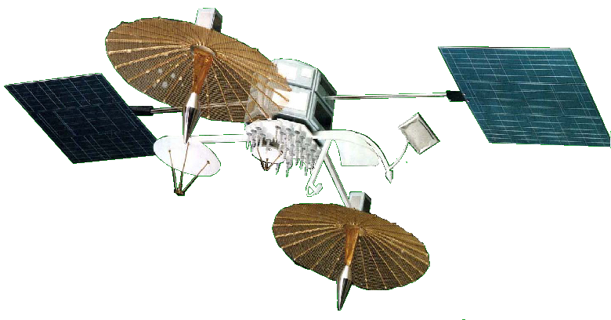
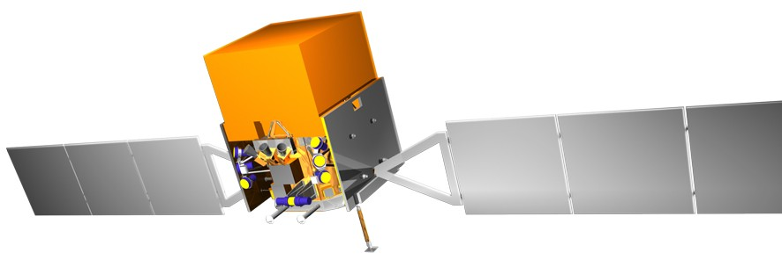
Ground System Architecture: GLAST
GPS
GPS Timing &
Position Data
TLM: Ku-band @ 40 Mbps
S-band @ 1,2,4,8 kbps
CMD: S-band @ .25, 4 kbps
TDRS
TLM: S-band @ 2.5 Mbps
CMD: S-band @ 2 kbps
GLAST
RT HK Telemetry
Alerts
Sci & HK Data Dumps
Command Data
RT HK Telemetry
Command Data
HK Data Dumps
White Sands Complex
Ground Stations
e.g. Wallops, MILA, USN
T&C Data Flows
Launch
Site
Mission
Operations
Center
Orbit Support
KSC
Test & Sim Data
Sustaining Eng Data
FDF
Spacecraft
I&T
Facility
GSFC
Burst Alerts
GSFC
Level 0 Data
Observing Plan
ToO Orders
As-Flown Timeline
Gamma-Ray
Coordinates
Network
Level 0 Data
Contingency Cmd
As-Flown Timeline
Level 0 Data
Contingency Cmd
As-Flown Timeline
Burst Alerts
Spectrum Astro
Level 1/2 Data
LAT Commands/Loads
GLAST
Science
Support
Center
Level 1/2 Data
GBM Commands/Loads
GSFC
LAT
Instrument
Ops Center
GBM
Instrument
Ops Center
GSFC
Archive
Data
GCN Notices
Science
Products
SLAC
MSFC/NSSTC
Science Community
HEASARC
GSFC
Notes:
Distributed w/ many interfaces
MOC is central, but not only, part of ground system.

Slide 22
Mission Control Ground System:
GLAST MOC Architecture
Extensive COTS & GOTS usage in MOC

Slide 23
“Acquisition” is Used in a Variety of Ways
Rapid Spacecraft Development Office (RSDO) missions
  Key issue is whether catalog components cover requirements
Contracted development
  SW as an independent contract or as part of system contract
    Need sufficient deliverables to manage project
    Can be some or all of the different types of software for a mission
    “COTS” often used to describe this type project; but contracted development includes the services needed to configure COTS
Purchase of COTS software for use on in-house software development
  Different activities when developing software using COTS
  Maintenance and upgrade issues
Best Practice: Designate a Software Manager to assess the Project's scope and to tailor the acquisition requirements
Notes:
Depending on the mission (spacecraft, instrument, other), the elements of software (and related hardware) to be procured may include some or all of the following:
- Embedded Flight Software (FSW)
- Software Development & Validation Software (supports the generation and testing of the FSW)
- Testbed(s) with flight-like microprocessors
- Ground Support software for Integration & Test (I&T) activities
- Operations ground software for OCC operations

Slide 24
Cost Estimation:
Rules For Ballpark Development Cost Estimation
Provided by experienced software managers
  Some examples
    Spacecraft flight SW: 50-80 staff years (MAP was 75)
    Mission Control Ground SW: Great Observatory 60-80 staff years, Small Explorer 25-35 staff years
General approach
  Comparison with previous missions
  Adjust based on technical & management risk factors
  Example: Flight Software Branch feature-by-feature complexity estimation
    Experienced developers rate complexity of each feature using previous missions as guide
    Rationale for ratings should be documented
    Scores assigned to complexity correlate with effort

Slide 25
Cost Estimation:
Causes of Flight SW Cost Growth Explained
Planning
  Specific Project pressures to reduce cost estimates due to cost constraints, in some instances never allowing a true estimate to be baselined
  Post-PDR mandatory cost reductions across the board
  Unrealistic dependencies within delivery schedule (e.g., inputs to reqts. not provided as scheduled, hardware not available as scheduled)
  Planning to reduce perceived overhead doesn’t pay off
    Minimized production or review of documentation
    Minimized formal and informal review activities
Requirements
  New requirements often levied in late mission design or I&T phase, as systems personnel become more knowledgeable
  Incomplete requirements
  Development and test ramifications are not fully understood

Slide 26
Cost Estimation:
Causes of Ground SW Cost Growth Explained
Planning
  Project pressure to reduce overall cost estimates
  COTS capabilities not functioning as planned/advertised
Requirements
  Maturity of requirements limits accuracy of preliminary cost estimates
  Disparity in completeness of functional requirements (e.g., telemetry and command requirements are often well understood, while science processing requirements are left incomplete until late in mission lifecycle)
Testing
  Insufficient emphasis on test plan completeness
  Application of additional testing as primary risk mitigation
Staffing
  Launch delays result in funding and maintaining “marching army”
  Lack of adequate dedicated staffing early in project lifecycle

Slide 27
Software Related Trades
Selection of Ground System (telemetry & command)
  Issue: GSFC GOTS are designed with flight SW test in mind, many COTS ground systems are not
Hardware architecture of flight data system
  Issues: sufficient hardware capacity, complexity of testing distributed systems, capabilities of operating systems, compilers and related tools
Sufficient testbed resources
  Issue: Relying on flight hardware as a testbed is not sufficient. What is needed is a full ETU version of all Flight Data System components (high fidelity testbed).
Allocation of functionality between flight & ground systems
  Issue: Many operations activities can be performed either by flight or ground segment. Assigning functionality to flight software in a prudent manner will decrease complexity of ground software development and operations
Interface compatibility between ground system components
  Issue: Standard interface methods (data formats, frequency of message exchange, etc.) do not currently exist between key ground system components.
Degree of onboard science data processing
  Issue: May be able to exploit more capable flight hardware and operating systems
Notes:
Examples are STOL test procedures, logging utilities, memory load/dump tools
SDO has 200,000 lines of STOL scripts for its test procedures.

Slide 28
Formulation Phase:
Summary of Best Software Practices
Software team needs to be fully integrated into the formulation process
Plan for sufficient development tools, testbeds & simulators
Plan cost growth of 20% from PDR to launch readiness
Question reuse assumptions, evaluate COTS software carefully
Make sure RFP is complete with respect to deliverables, metrics, and development processes
Start software development with attention to
  Organizational structure
  Software management plan / product plan
Notes:
Note that some issues are unique to FSW (or GSW), others like requirements process generalize.
NOTE: POSSIBLY ADD MORE ON ACQUISITION!

Slide 29
Agenda: Software Development Phase
Key Documents and Deliverables
Software Development Considerations
  Software Development Life Cycle
  Reviews, Inspections & Walkthroughs
  Testing Considerations
  Assurance Considerations
Managing Software Development
  Project Planning
  Risk Management
  Project Monitoring and Control
  Post-development support
Technology Development
Improvement Initiatives

Slide 30
Key Documents / Deliverables (More Than Code)
Software life-cycle products include
  Product Plan / Software Management Plan (may include Configuration Management Plan, Risk Management Plan, Security Plan, or they can be separate documents)
  Software Requirements Document (SRD)
  Interface Requirement Document(s) (IRDs) & Interface Control Documents (ICDs)
  Software Quality Assurance Plan
  Software Requirements traceability matrix
  Functional and Detailed Design Documents
  Source code
  Software Test Plan(s)
  Test and Verification Matrix
  Software User’s Guide
  Release Letters
  Delivery, Installation, Operations, and Maintenance Plan(s)
  Software Safety Plan (can be part of System Safety Plan or separate)
  Derived planning information (includes build plans allocating functions to build, progress tracking spreadsheets)
Boldface indicates CCB control
Notes:
Source code is under CCB control after test & delivery -- before that its team CMVC.

Slide 31
Software Development Life Cycle: Description
Most projects use iterative life-cycles, but all show some form of “requirements-design-build-test.”
Most life-cycles are depicted as GANTT-type schedules.
Software life cycles have intermediate milestone reviews and deliverable products that provide completion and coordination points with other project elements or other sub-processes
  Build: A version of a system or component that incorporates a specified subset of the capabilities that the final product will provide.
  Release: a version that is made available for use outside the development team
Alternate life-cycle models include prototyping, spiral modals, and agile methods (such as XP). These models are useful when used correctly, but they can be misused to circumvent sound software development practices; SW lead can advise on their use

Slide 32
Software Development Life Cycle:
Software Life Cycle in Project Context
Ops
Concept
Review
FLIGHT SOFTWARE LIFE-CYCLE
(In-House Missions)
Start Box I&T
Start S/C I&T
1st
CPT
End S/C I&T
Project
Milestones
S/C SRR
S/C PDR
S/C CDR
Launch
IOC
FSW Test Plan
FSW STRR
FSW
Acceptance Test
FSW
Launch
Readiness
FSW
Milestones
FSW SRR
FSW PDR
FSW CDR
FSW Team
Requirements & Design
Requ. Analysis
Prelim. Design
Critical Design
Breadboard Lab.
FSW Team
Development,
Unit Test, &
Integration
onto H/W
Build 0 ->
Build 0 R/D/C/U
IT
(R/D/C/U = Requirements Analysis/ Design/ Code/ Unit-test)
Build 1 ->
Build 1 R/D/C/U
IT
(IT = Build Integration Test)
.
.
.
.
.
.
Build n ->
0
Build n R/D/C/U
IT
Cleanup Build(s) ->
1
Cleanup Build R/D/C/U
IT
n
Cleanup Builds...
FSW Specialist Testing
Build 0 ->
Prep.
Build 0 Test
Build 1 ->
Prep.
Build 1 Test
.
.
.
.
.
.
C
C
Build n ->
Prep.
Build n Test
Cleanup Build(s) ->
ETU Testbed
Regression Tests...
System ValidationTest ->
System Test Preparation
System Test
Regression Tests...
FSW Maintenance Prep.
Maint.
End-to-end Ops. Testing ->
SIM Prep./Dry Runs
Mission SIMs
Flight SW example, ground is similar

Slide 33
Software Development Life Cycle:
Software Build Planning Considerations
Integrate early, integrate often
  Plan builds at 3-6 month intervals
  Testable increments of functionality
  Early detection of interface issues
  Early validation of development and test practices
Consider hardware & software test schedule dependencies
  Ground system & testbed delivery schedule for flight SW
  Meet schedule to support flight data system box testing
Consider risk
  Put higher complexity software in early builds
  Defer incomplete or unstable requirements to late builds
  Have early flight SW build with full closed-loop operations
  Focus on interfaces between COTS or GOTS products

Slide 34
Reviews, Inspections & Walkthroughs:
Milestone Reviews
Purpose
  Baseline key work products
  Present budget, schedule & risk status
    Estimates should be updated based on available information
    Expect cost growth of 20% between PDR and launch readiness
Hold software review after corresponding system level review (SRR,PDR,CDR)
  Flight SW depends on system & HW architecture decisions
  Ground SW depends on command & telemetry definitions
Preparing for review helps
  Team understanding of the product being developed
  Communications within team and with other groups
Notes:
Prep effort benefits team

Slide 35
Reviews, Inspections & Walkthroughs:
Inspections & Walkthrough Processes
Inspections are concerned with discovering defects; Walkthroughs are concerned with team reaching common understanding of product (e.g. requirements)
Participants are: Author of requirements, design, code, test plan, Peer reviewers from development or test team, collaborators from relevant disciplines, quality assurance personnel
A study of inspections at NASA (2001) interviewed project personnel and found: Improved communication between developers, training benefit, defect detection
Early defect detection yields cost savings (JPL data)
  Inspections cost 0.7 hrs / defect,
  testing ranges 5 to 18 hours / defect
  Inspections caught over 70 per cent of defects
Software Inspections & Walkthroughs meet GSFC
Engineering Peer Review Requirements (GPR8700.6)

Slide 36
Testing Considerations:
Flight Software Test Activities
During Software Development
  Developers perform unit and build integration tests
  Test team performs requirements driven build verification tests, and operational scenario driven system validation tests.
  Acceptance test is last run of full system test suite.
    Flight SW is ready to run in operational environment (on spacecraft)
    Complete by the first Comprehensive Performance Test (CPT)
After Software Release
  Make changes in response to non-conformance reports
  Run regression tests
    Regression tests involve unit, build, and system test activities
    Test change, subset of previous tests to uncover new errors in SW
Need breadboards for integration of first build; need Engineering Test Units (ETUs) for subsequent builds

Slide 37
Testing Considerations:
Ground Software Testing
Test environment
  Key interfaces need to be tested early and thoroughly
    Is correct data being passed between facilities?
    Is the system performance meeting requirements?
  Target computer is often same as development system
    Subsystems can often be tested thoroughly on development machines
    “Soft real time” performance requirements
  Acceptance tests still must reflect operational environment
Flight operations team and science teams operating instruments are key to successful testing & deployment of ground system
  Start FOT training early as initial builds are delivered
  Need operator feedback on procedures, user interfaces
Notes:
Architecture diagrams show the number of interfaces needed

Slide 38
Assurance Considerations:
Comparing Software Quality and IV&V
Software Quality
IV&V
Provides Center-level services
Focuses on ALL Project software
Emphasizes compliance to standards and procedures
Reviews, monitors and audits all Project processes and products for completeness and accuracy
Matrixed to the Project as part of the Project Team and provides daily insight/oversight
Reports to Project and Center Director through OSSMA
Provides Agency-level services
Focuses on MISSION CRITICAL Project software
Emphasizes completeness and correctness of the product
Reviews, analyzes, and provides in-depth evaluations of life cycle products which have the highest risk
Independent from the Project and provides analyses and evaluations per IV&V priorities
Reports to Project, GPMC, and NASA Headquarters
Notes:
For reference!!!!!!!!!!!!

Slide 39
Assurance Considerations: Software Safety
Software Safety
  Entails identifying, analyzing, tracking, mitigating and controlling software hazards and hazardous functions (data and commands) to ensure safer software operation within a system
  Done as part of system safety analysis
  Software is safety critical even if there is hardware backup
  Adheres to the requirements specified in the NASA Software Safety Standard, NASA-STD-8719.13B
  Safety “Litmus Test”, found in 8719.13B, will help in determining the criticality of the software and its contribution to the safety of the system
Software Safety is a function of System Safety!
Notes:
Can’t look at independently of hardware and ops procedures
Leveson “Safeware”

Slide 40
Project Planning:
Software Product Plan
All code 580 in-house software development activities shall have a Software Product Plan
  Product Plan may serve as SW Management Plan
ISO 9000 requirement – equivalent of Hardware Work Authorization (WOA)
  Outline for the plan is on the web at http://isd.gsfc.nasa.gov/iso9k/iso9001.htm
  Major areas of the plan:
    Customer Agreement
      Overview of goals & objectives for software product
      Source documents for software requirements
      Resources required (CS labor, contractor labor, other costs)
      Receivables & deliverables
      Software team placement & reporting relationships
      Acceptance criteria (pointers to acceptance test plans)
      Customer training
      Post delivery maintenance
    Management Approach
    Technical Approach
    Product Assurance

Slide 41
Risk Management
Inherent uncertainty in estimation methods can be handled by producing worst, most likely and best case estimates
“I forgots” can be handled using standard processes and products (standard WBS, checklists, document templates, cost estimation procedures,…)
  Example: Is SQA and IV & V in budget?
“Unknown unknowns” can be handled by keeping a management reserve
  Example: late SW requirements change as HW workaround
Look at what problems have occurred in the past
  For example, Flight Software Branch risk tool includes a list of “generic risks” based on previous projects; flight software lead can select which ones apply
“Known unknowns” can be handled by identifying, analyzing and mitigating risks. Examples:
  Late and changing requirements
  Compressed schedule
  Late hardware deliveries / untested hardware
  Inadequate test beds
  Inadequate COTS -- buggy, doesn’t cover requirements
  New technology

Slide 42
Project Monitoring and Control:
Is There Enough Information to Judge?
Are metrics vague and high level, or are objective measurements being used?
  “we are 90% done”
  Good metrics provide objective data to judge progress
Do status reports always sounds the same?
  “we are 90% done”
  There are specific alarm signs one should look for
    Requirements, management, process, schedule
The Big Question
“Why do you think you will be able to deliver on time? ”
Notes:
Metrics and warning signs complement each other in monitoring

Slide 43
Project Monitoring & Control:
Required Metrics
Progress tracking data
  Includes cost, staff effort & scheduled completion of work
  Track planned progress against actual performance
Defect data
  Open, closed, and total number of discrepancy reports
  Number of defects found in inspections or walkthroughs
  Effort spent in inspection, walkthrough & testing activity
Number and impact of requirements changes
Current & projected use of system resources
  Main memory, secondary storage, bus & CPU cycles,…
Notes:
Cost, schedule and defect data should be compared ACROSS projects to indicate organizational improvement

Slide 44
Project Monitoring & Control:
Progress Tracking for Subsystem Development
Sample 5-month Project
700
600
500
Points
400
300
200
100
0
1/12
1/26
2/9
2/23
3/8
3/22
4/5
4/29
5/3
5/27
Date
Total Planned Total Actual Baseline Points
Each module (165) assigned 4 points: 1-designed; 2- coded; 3-inspected; 4-integrated

Slide 45
Project Monitoring & Control :
Defect Reports and Product Quality
Notes:
Can also break down by severity or criticality

Slide 46
Project Monitoring & Control :
Alarms to Monitor
Ask questions related to potential problems
  Requirements, management, process or schedule
  Each alarm has associated corrective actions
Consequences of ignoring alarms:
  Quality is sacrificed
    “we’ll cut testing to get back on schedule”
    Cut out walkthroughs & inspections to keep earned value on track
      Progress should be recorded only on completion of steps
  Work is deferred, costs soar
    Moving to later builds will require resources not in original plan
  Major staff increases to meet schedule

Slide 47
Project Monitoring & Control: Alarms
Is there a mismatch between requirements and budget?
Are the requirements mature and stable?
Do you have the right personnel?
Is there sufficient communication with software teams?
Are processes being executed correctly or evaded?
Is the development team suffering from schedule compression?
  Are builds being combined to “reduce overhead”? Are capabilities being moved to later builds? Are early build mature enough to support implementation of later ones?
  Are hardware and algorithms needed by software team delivered on time?
  Do developers have time for all activities, including support for other groups?
  Is planned documentation being produced?
Is the test team suffering from schedule compression?
  Are testbeds delivered to meet the test schedule?
  Are multiple builds being tested simultaneously?
  Are planned tests being cut out to match resources?
  Are the test procedures and expected results stable?
  Does test team have enough time to analyze results?

Slide 48
Project Management Considerations:
Summary Recommendations for Development
Recognize that there is more to software than code
Monitor the same items for contracted and in house development
Allow time in schedule for reviews, inspections & walkthroughs
  Problems detected early are less costly to fix
  “Testing in quality” is far more expensive; not an appropriate approach to software development
Have frequent, testable builds with incremental functionality
  Help find interface / integration problems early
Keep estimates up to date
  Cost & schedule
  Underlying assumptions

Slide 49
Post-Development Support:
Post-Acceptance Deliverables and Activities
Once software is accepted and delivered, discrepancies and changes shall be tracked using NCRs.
Support of delivered software through in-orbit checkout
  Spacecraft Integration & Test
  Mission Simulations
  Launch & early orbit checkout
Software maintenance (sustaining engineering post-IOC)
  Identify, prioritize, design, implement & test changes
  Regression testing
Acceptance Tested Software is ready
to run in operational environment

Slide 50
Post-Development Support:
Key Recommendations
Schedules and dependencies
  Flight SW acceptance test should be complete before first spacecraft Comprehensive Performance Test
  Ground elements should be ready in a similar time frame
Plan late-phase resources at the start of the project
  Software team support for flight operation, hardware I & T, and observatory/payload I & T teams.
  On-orbit sustaining engineering
  Licenses for and upgrades to COTS products
  All software will need maintenance.
    Maintenance must be included in planning.
    What and how much depends on the use of the software.

Slide 51
ISD Technology Research & Development
Goal is to infuse new technologies and/or new approaches into mission control and science systems.
Ideas are generated through
  Strategic technology planning
  Meeting with Goddard missions and scientists
  Review of NASA Strategic Plans
Potential technologies are found via literature research, conferences, educational opportunities, and market awareness.
Most efforts are funded on a yearly basis. The goal is that at the end of each funding year a useful prototype will be completed.
Teams are small, normally 1 to 3 people.

Slide 52
ISD Technology R & D Process
Review technology proposal calls and develop proposals to respond to those calls
  Calls are both internal and external to Goddard
  Submitted proposals normally have a potential customer associated with the concept who has agreed to beta test the developed software
Upon proposal selection develop project plan in accordance with funding source requirements.
Development plan uses the iterative prototyping approach
  Normally projects have a quarterly builds that are reviewed by customer advocate.
  Customer feedback is fed into the design phase for the next build.
Projects have bi-monthly meetings with branch management to ensure that they are staying aligned with NASA strategic objectives.
Most proposal funding sources require yearly project reporting.

Slide 53
ISD Technology Projects
Adaptive Sensor Fleet (ASF) is a supervisory control system that is designed to use a collection of heterogeneous robotic platforms to optimally perform observations of dynamic environments driven by high-level goals.
Instrument Remote Control (IRC) is a cross-platform, distributed control framework for instrument that provides remote configuration, control, monitoring, and analysis
Multipurpose Exoterrain for Robotic Studies (MERS) is a facility available to test robots, sensors and advanced exploration concepts in a semi-realistic environment
Science Algorithm Visualization and Networking Tool (SAVANT) is a graphical tool for creating "visual programs" by assembling and executing flowcharts (graphs) of web services.
Science Goal Monitor (SGM) is a tool used to improve both the science data acquisition and data quality of a mission by automatically responds to science-related events.
Virtual Feel is a prototype tool set that will accomplish the typical assembly/disassembly tasks needed for the Hubble Robotic Repair mission through a new approach which will significantly reduce the risk of failure.

Slide 54
Improvement Initiatives
Process Initiative
  GSFC Software Process Improvement Project
    Point of contact: Sally Godfrey
    http://software.gsfc.nasa.gov
Technology Initiatives
  Flight Software Reuse
    Point of contact: Jane Marquart
  GSFC Mission Services Evolution Center (GMSEC)
    Point of contact: Dan Smith
    gmsec.gsfc.nasa.gov
What’s in it for Projects?
  Projects can leverage these improvement investments for better, more cost effective systems.
Notes:
Details of technology initiatives is in the informational slides

Slide 55
Improvement Initiatives:
Software Process Improvement
Support of NASA Software Improvement Initiative
  GSFC response is the SPI Project, carried out by the Engineering Process Group (EPG)
  ISD processes are the initial focus, as the division is responsible for the majority of GSFC mission software
    ISD personnel lead the SPI Project and the EPG.
GSFC SPI phases
  Phase 1 (FY02) -- pilot appraisals, EPG startup
  Phase 2 (FY03-07) -- staged process improvement
    All ISD mission software will be at CMMI Maturity Level 3 by the end of FY07 (i.e. Software projects rely on organizational process assets to carry out their work, achieving more consistent performance)
  Phase 3 (FY08 onward) -- sustain continuous improvement

Slide 56
ISD Initiatives: Flight Software Reuse
Object Model of Mission-independent Core FSW Elements
  Multi-mission FSW Requirements Analysis
  Separate mission-unique and common FSW Requirements
  Baseline Generic FSW Executive Architecture Definition
Develop Common Architecture & Development Tool Set
  Make the tools satisfy FSW needs
  Improve FSW Documentation
Validate, Measure Performance, Evaluate and Refine Re-use
Train for re-use
Planned instead of ad hoc reuse

Slide 57
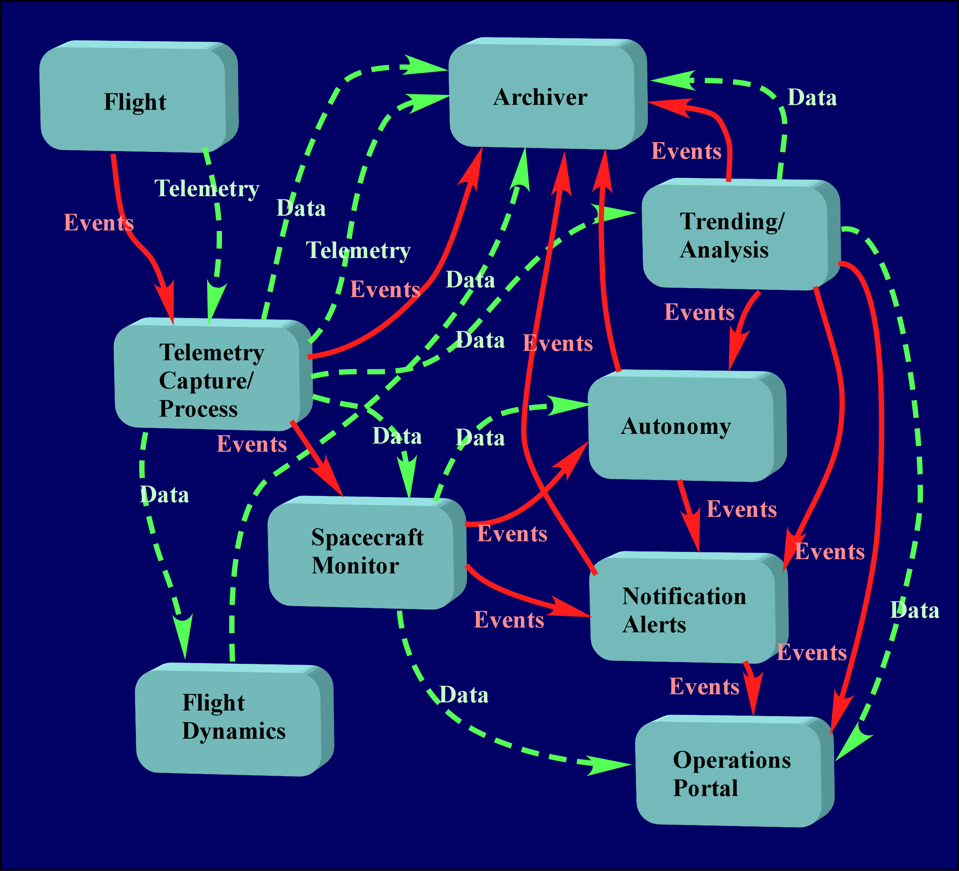
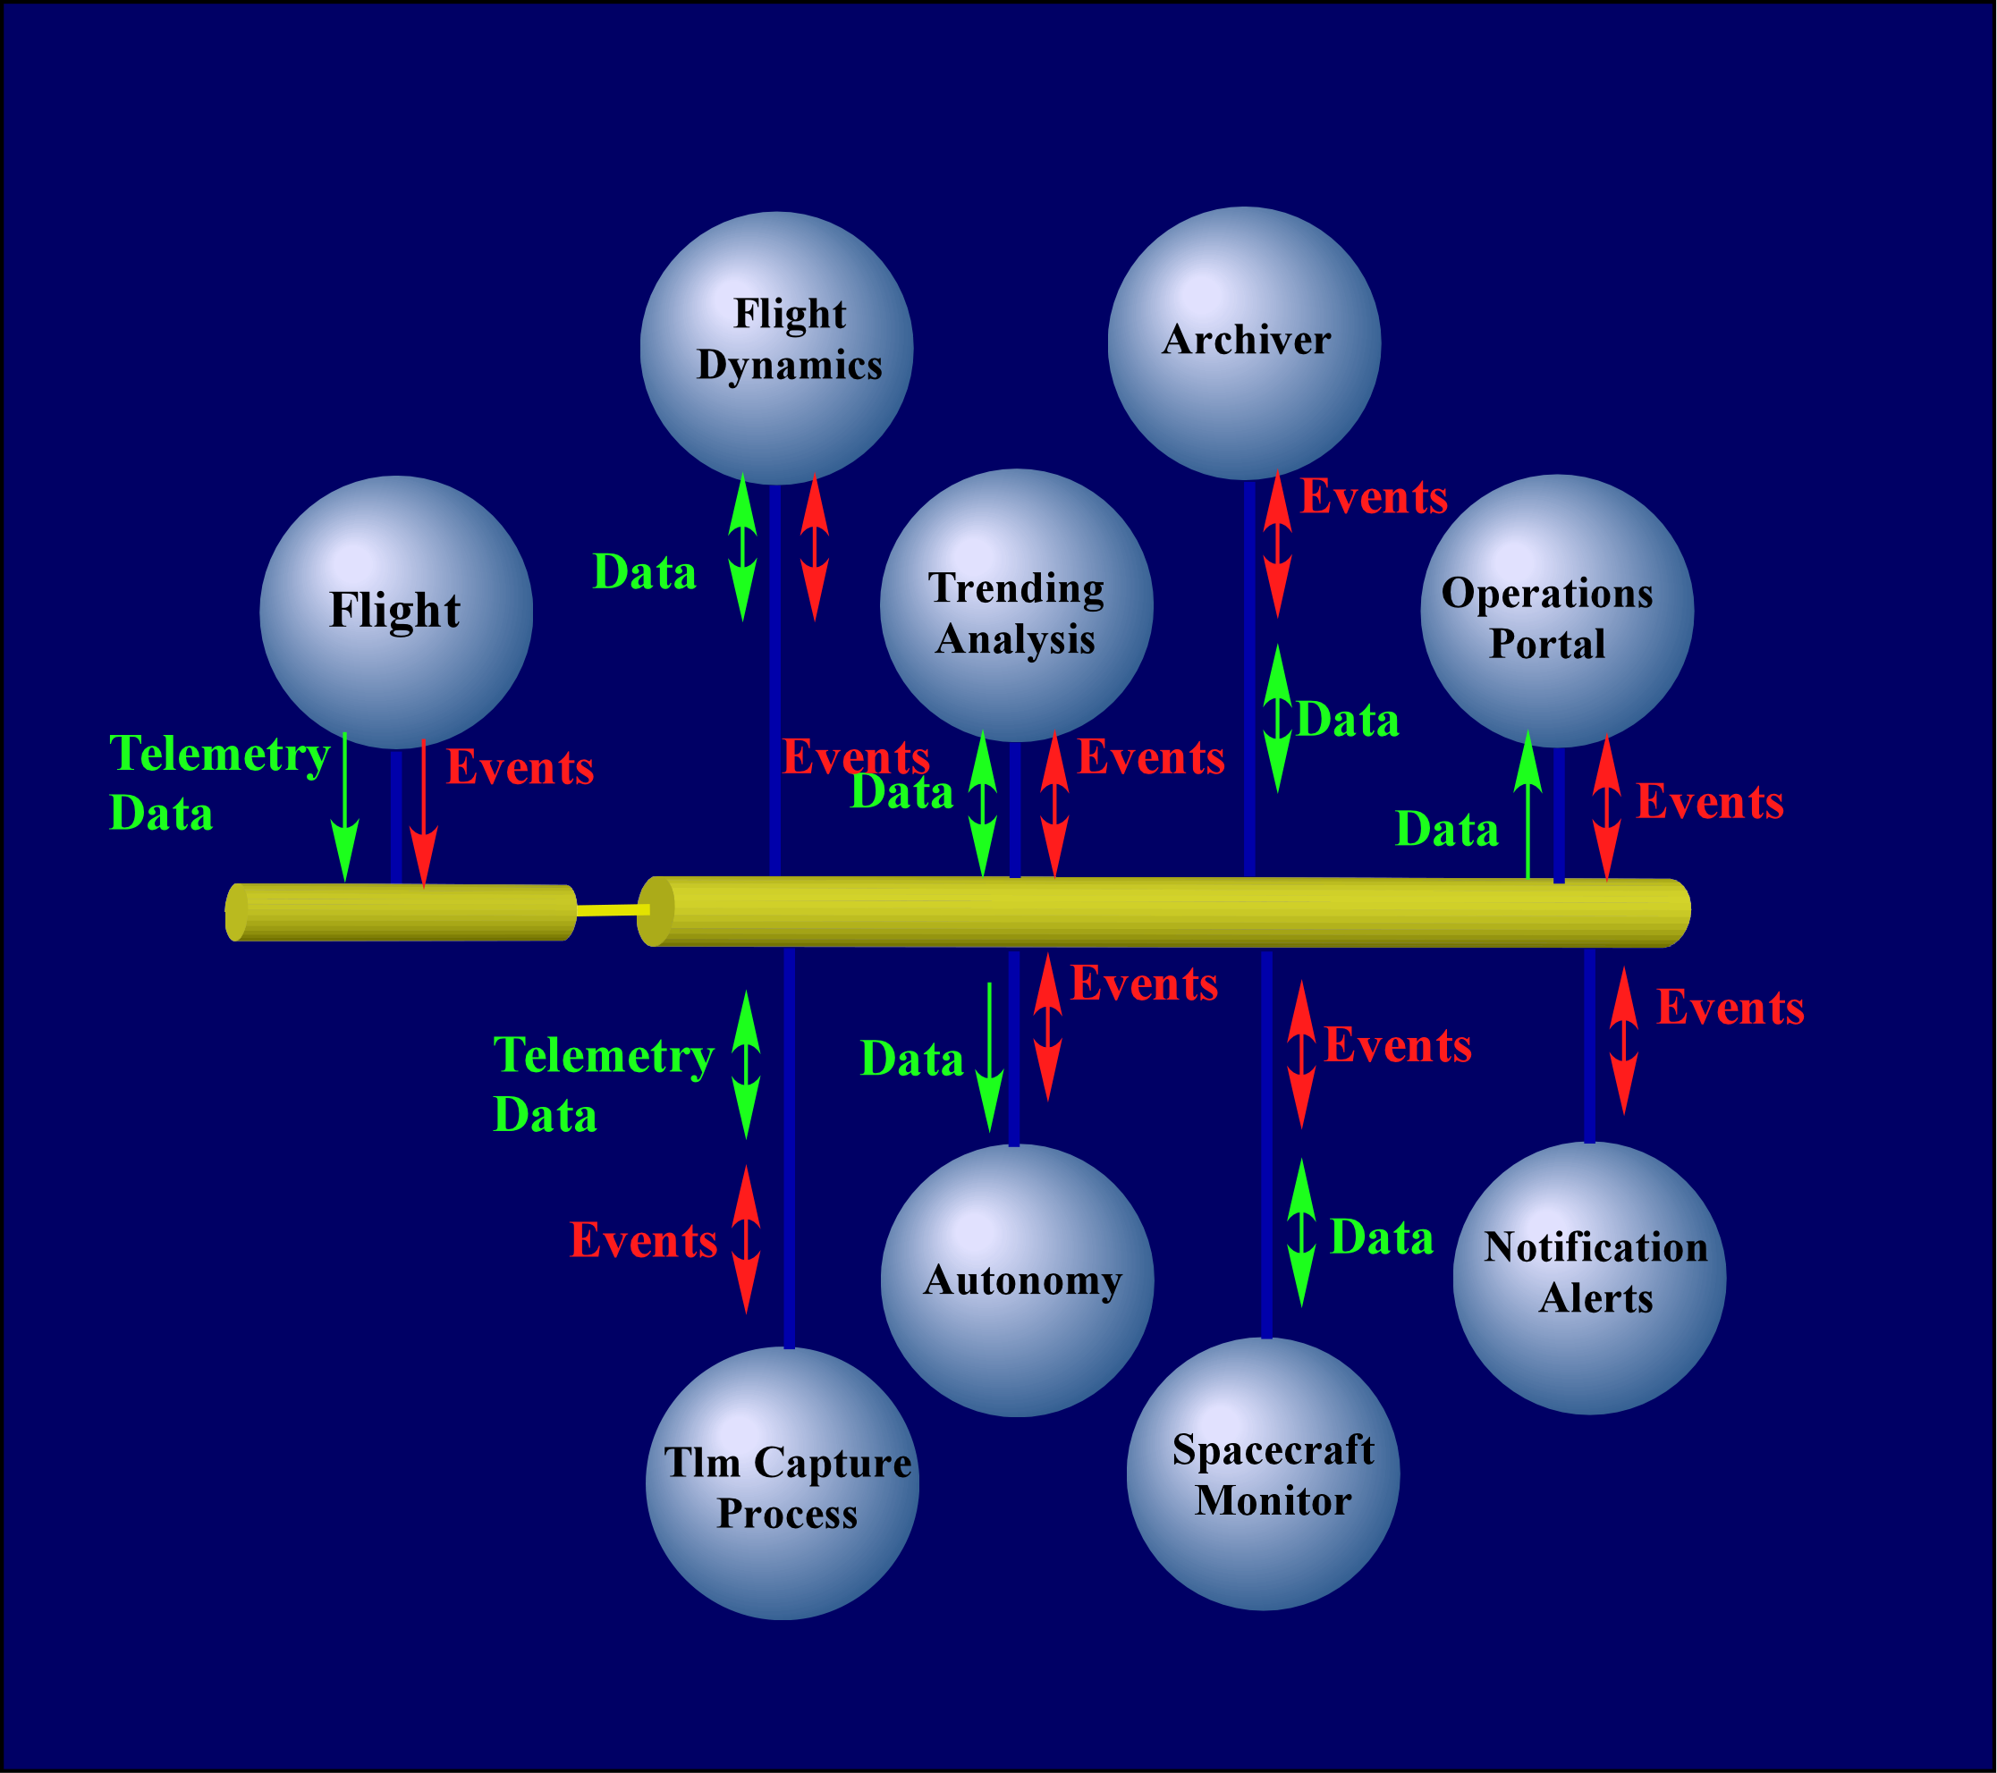
ISD Initiatives:
GSFC Mission Services Evolution Center (GMSEC)
Introduction
GMSEC was established in 2001 to coordinate ground and flight data systems development and services at GSFC.
Goals
  To simplify initial integration/development
  To facilitate technology infusion over time
  To allow for additional operations concepts
  To establish a structure which can grow to enable future GSFC missions
Concepts
  Standardize Interfaces – not Components
  Middleware infrastructure w/ publish/subscribe
  User Choices – GMSEC doesn’t decide which products are best
  GMSEC “Owns” the Architecture and Interfaces – NASA AETD Branches still own their domain areas
Traditional “socket-based” system designs require complex interfaces and integration.
The GMSEC “Information Bus” approach has allowed some components to integrate on the first try.
  Status
  Architecture developed in FY02; Lab established and demonstrations held in FY03
  COTS industry has helped develop message standards, see great advantages to GMSEC
  NASA ARC, MSFC, JPL and APL are interested in collaborating with GMSEC approach
Notes:
Example of event messages and data only. Just a subset of the flow.
Changeout of components is simplified. Number of connections in spaghetti diagram reduced to one.
Facilitates automation because all applications can see any message they want. Infinite fanout possible.

Slide 58
Summary: To Strike Fear in the Heart …
The often cited Standish Group 1998 Study on large software projects in the late 1990s reported:
  53% either delivered late or exceeded budget
  31% were cancelled
  16% were successful
Failed projects average
  189% of the original estimated cost
  222% of original schedule
  61% of original functionality
Only 41% of IT managers believe there are fewer failures now than five years previously!
Notes:
BREAKDOWN OF MANAGERS BELIEFS:
The Standish Group recently performed a survey of IT managers:
27% believe there are now significantly more software failures
21% believe there are somewhat more failures
11% believe things haven’t changed at all
19% believe there are somewhat fewer failures
22% believe there are significantly fewer failures

Slide 59
Goddard is not exempt from software problems…
EOS Flight Operations Segment (FOS) control center architecture
  Reuse and COTS less effective than expected
  Schedule metrics and requirements poorly defined
  Consequence: Terra launch delayed a year
Flight systems: IRAC instrument software, EO-1 Command & Data Handling Software
  Poor control over requirements
  Reliance on flight hardware as high fidelity testbed
  Late involvement of Flight Software Branch
  Consequence: 65% cost growth on EO-1, 245% on IRAC

Slide 60
…but we generally do well, and we want to do better still
Over the 5 years to July 2002 GSFC held responsibility for well over 25 missions or well over 125 mission critical SW elements
GSFC has experienced 3 significant problems, computing to less than a 2.5% significant problem rate:
  EOS FOS, EO-1 FSW, and IRAC FSW
  Each was significant and drew a lot of attention
No GSFC software problem has directly contributed to in-flight damage; to the contrary, software is routinely used to compensate for problems on-orbit
To further improve performance and to reduce hero mode dependence, pragmatic improvement steps can be taken
If the process works…improve it

Slide 61
ISD Recommendations for
Mission Success
Involve software personnel from the beginning
  Software experts’ inputs improve cost estimates, trade studies, and acquisition plans
Produce a Software Management Plan / Product Plan (SMP/PP)
  Make sure “Customer Agreement” is acceptable to all
Follow the processes defined for the Project in the SMP/PP
  Cutting corners only helps you lose your way
Track the software development against the plan
  Keep an eye on the potential alarm signs
Notes:
Checklist software managers need to follow

