Slide 1
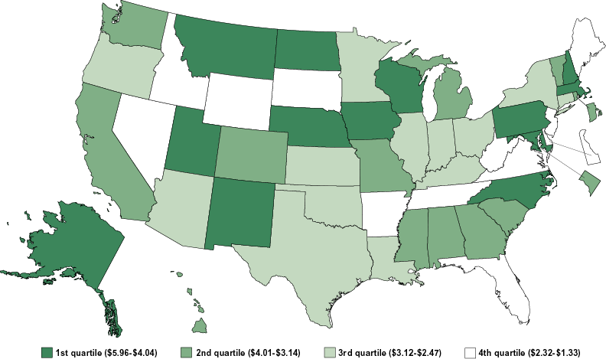
Academic R&D per $1,000 GSP: 2001
Notes:
1

