Slide 1
Analysis of Gossamer Space Structures Using Assumed Strain Formulation Solid Shell Elements
Keejoo Lee and Sung W. Lee
Department of Aerospace Engineering
University of Maryland College Park
Gregory V. Clarke
Goddard Space Flight Center
2002 FEMCI WORKSHOP

Slide 2
Motivation
Because of zero-gravity environments involved in conducting experiments, greater emphasis may be placed on computational analysis of gossamer space structures.
Length ( ~ 100 m) to thickness (~1 micron) ratios, L/t, are very large (~ L/t=10⁸).

Slide 3
Objective
The purpose of this work is to investigate the applicability of assumed strain formulation solid shell elements to gossamer space structures.
Shell elements suffer from locking as thickness decreases – it is necessary to determine the range of L/t for which the assumed strain formulation solid shell elements perform with precision.

Slide 4
Solid Shell Formulation
Treats shells as 3-dimensional solids.
No rotational angles are used.
  - All kinematic variables are vectorial.
  - All kinematic variables are based on a global coordinate system.
  - Allows transverse shear deformation.
  - Stretchable in the thickness direction.

Slide 5
Assumed Strain Formulation
Assumed displacement formulation
- Susceptible to element locking.
Assumed strain formulation
  - In addition to the assumed displacements, assumed strain field, independent of the assumed displacements, introduced to avoid element locking.
- Assumed strain parameters eliminated at element level.

Slide 6
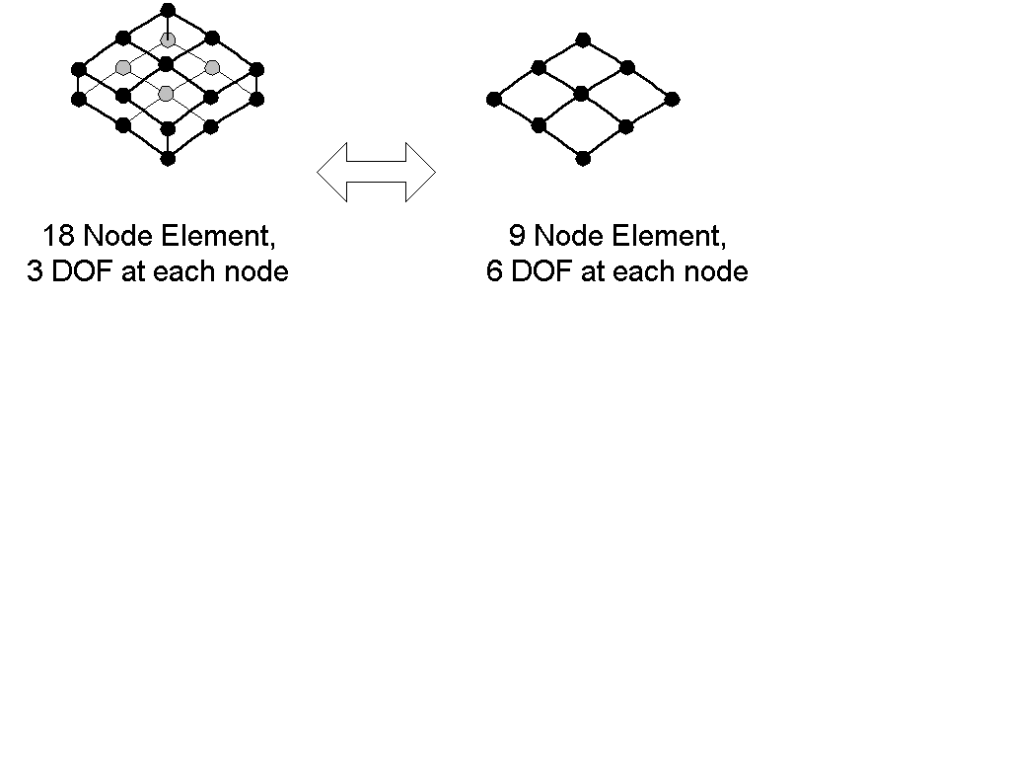
54 DOF Elements
18 Node Version
3 DOF/NODE
9 Node Version
6 DOF/NODE

Slide 7
Numerical Tests
To investigate the applicability of the assumed strain formulation solid shell elements to extremely thin structures under the following conditions:
- Geometrically linear and nonlinear.
- Linear elastic materials.
- Static loadings .

Slide 8
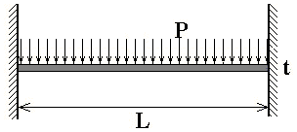
The Effect of Element Locking
Linear analysis of a beam under uniformly distributed load is carried out to appreciate the effect of element locking.

Slide 9
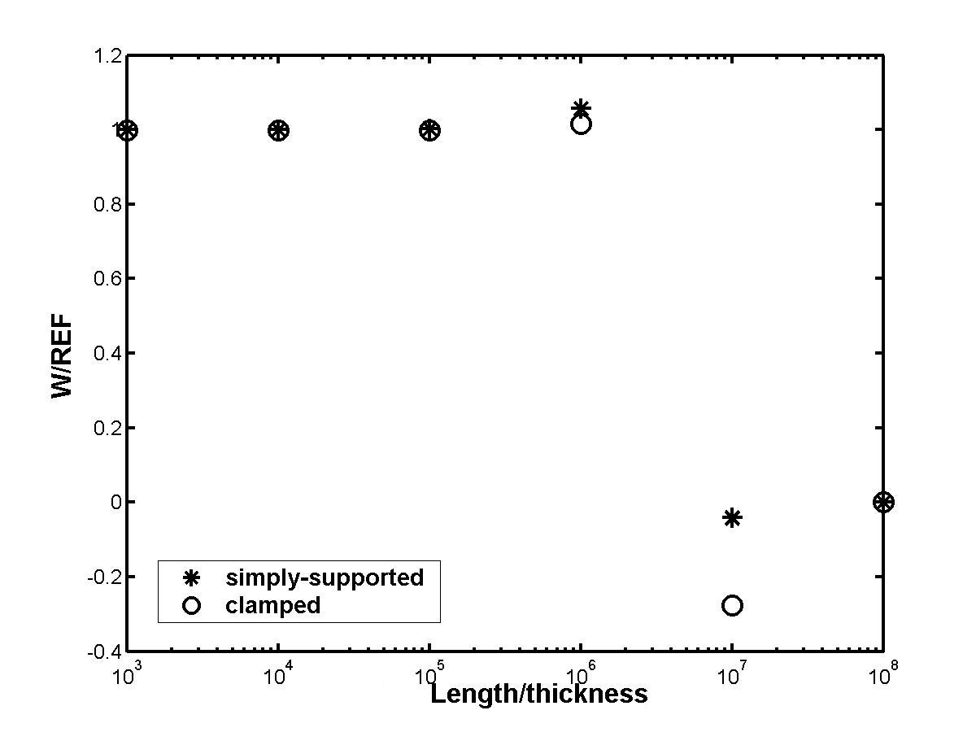
Locking Tests

Slide 10
Modified Moduli
To increase the effective range of length/thickness ratio, one may introduce modified moduli for the beam as follows:

Slide 11
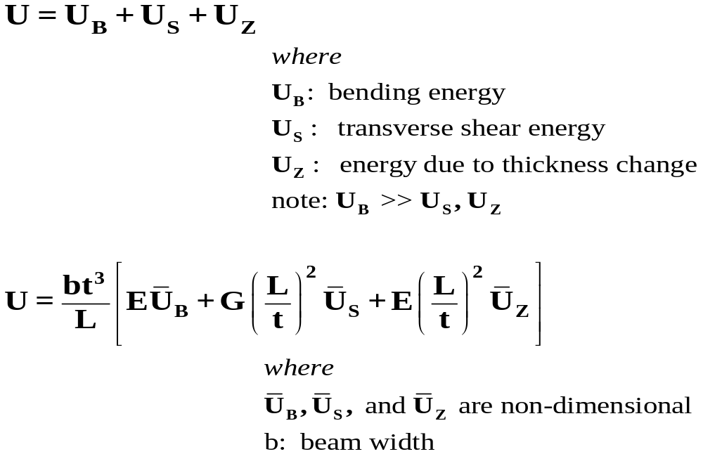
Excluding the contribution of membrane energy, the total strain energy U can be expressed as

Slide 12

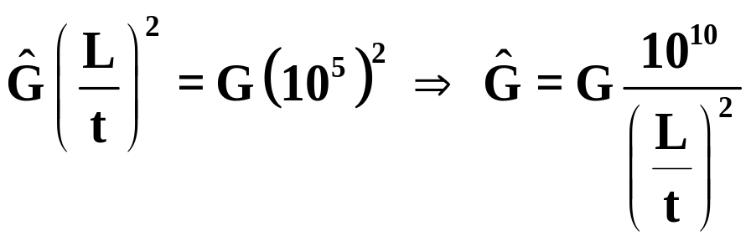

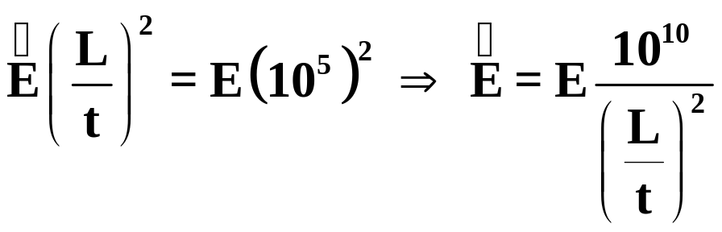
For the transverse shear energy part,
one may introduce modified shear modulus, as follows:
Similarly, one may introduce modified Young’s modulus,
corresponding to the thickness change as follows:

Slide 13
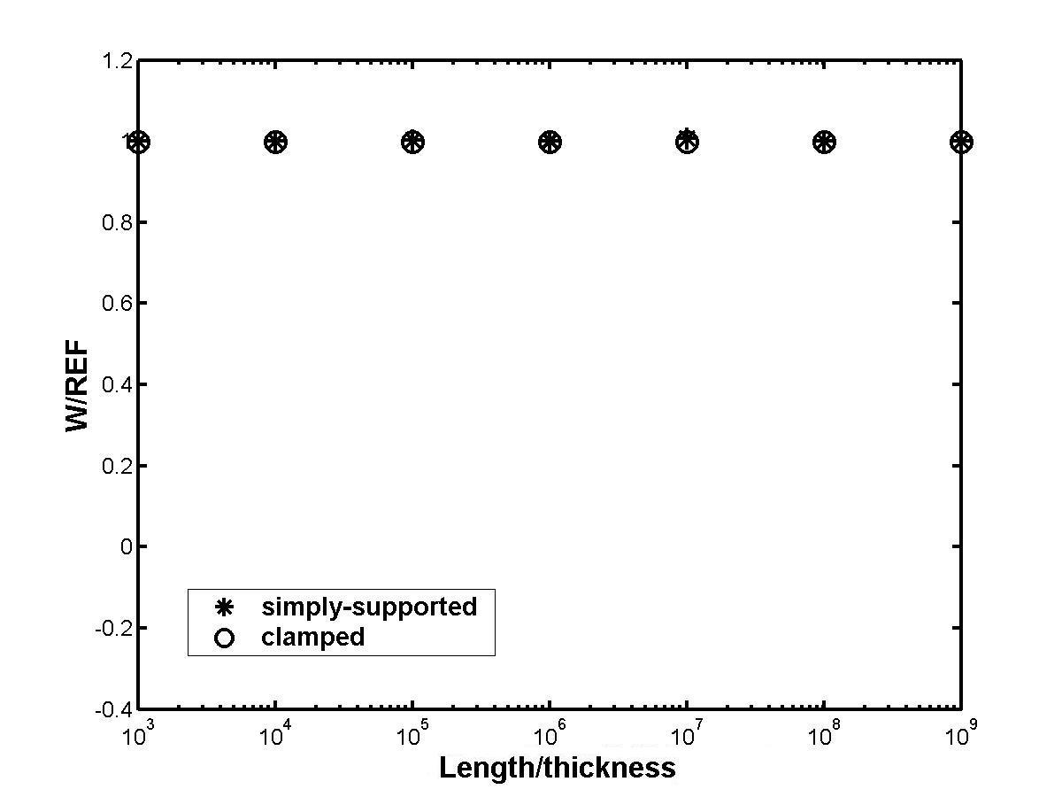
With Modified Moduli

Slide 14
Quadruple Precision
One may numerically extend the effective range of length-to-thickness ratios using the quadruple precision.
- Double precision ~ 15 decimal digits.
- Quadruple precision ~ 30 decimal digits.

Slide 15
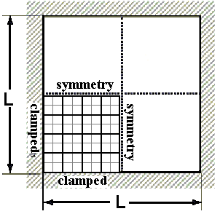
Geometrically Linear Analysis

Slide 16
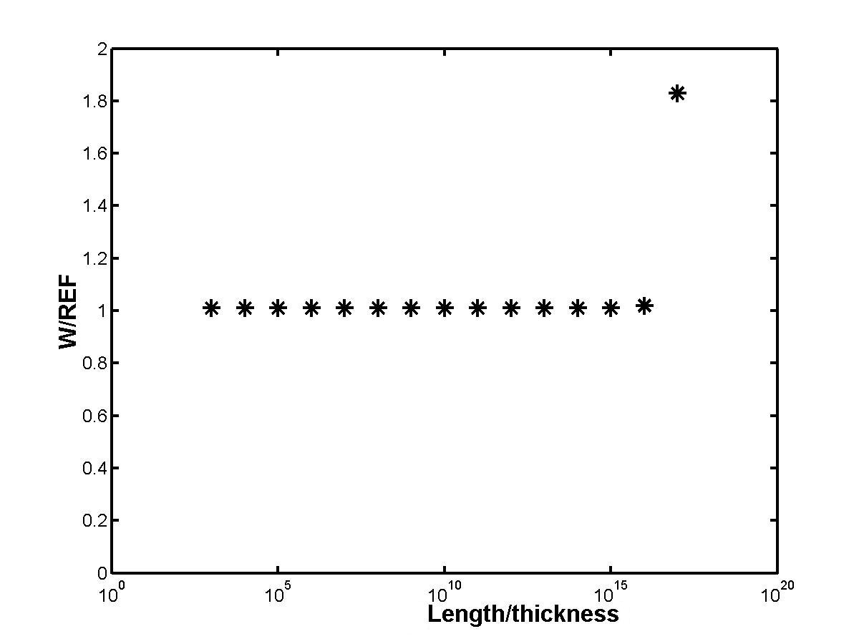
With No Modification to Moduli

Slide 17
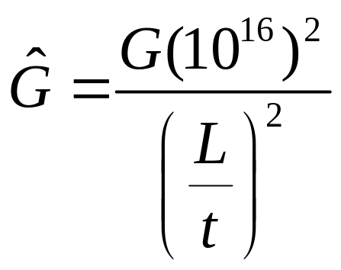
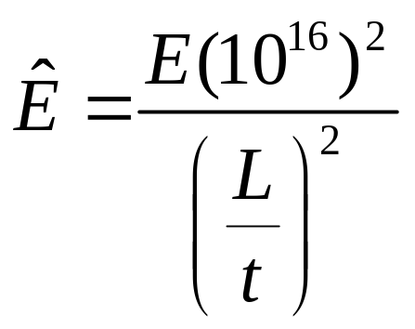
Modified Moduli

Slide 18
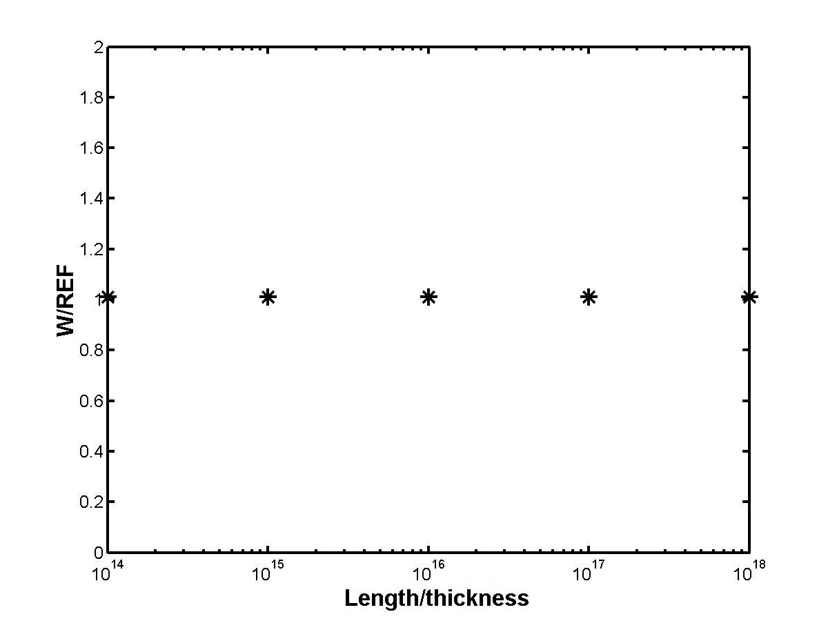
With Modified Moduli

Slide 19
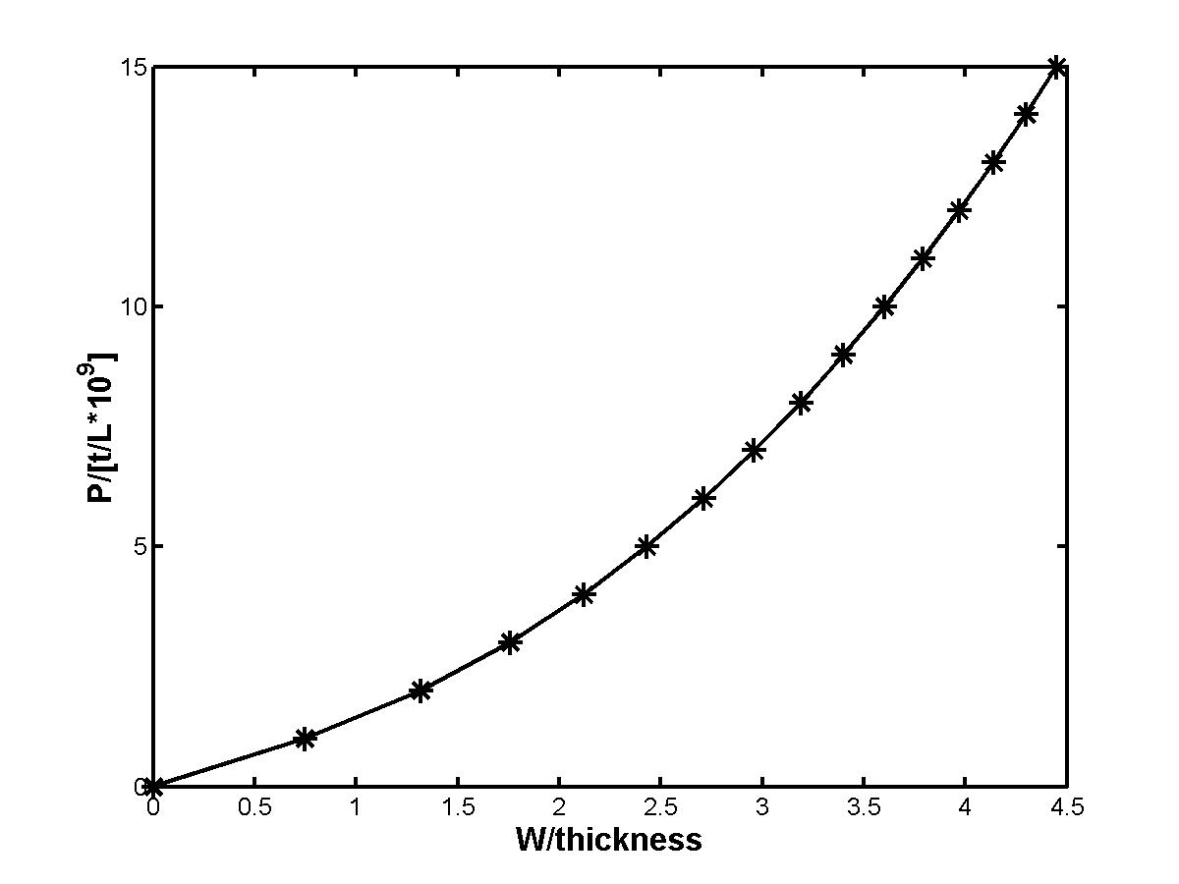
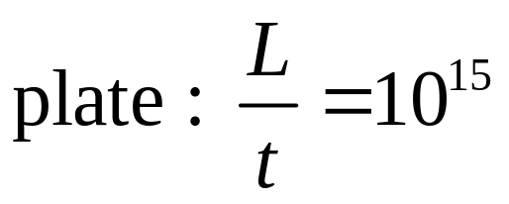
Geometrically Nonlinear Analysis

Slide 20
Wrinkling
Gossamer structures are susceptible to wrinkling.
To predict details of wrinkles such as shapes and amplitudes, one may use a dynamic scheme that includes the effect of mass and fictitious damping.

Slide 21
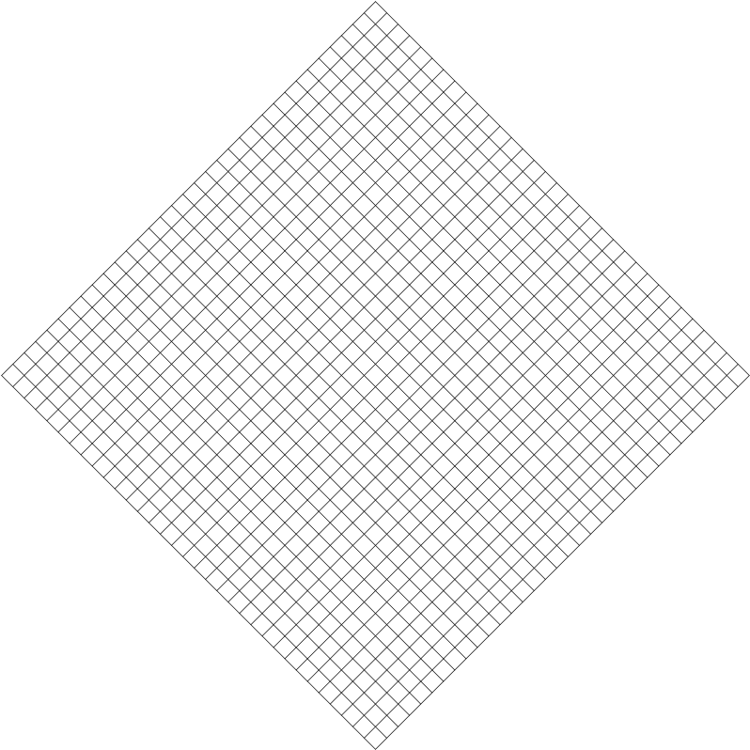
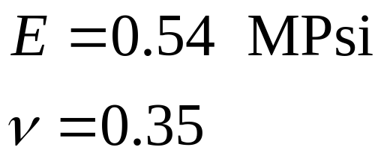
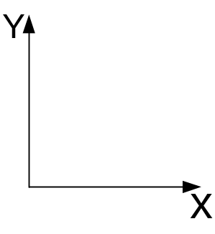
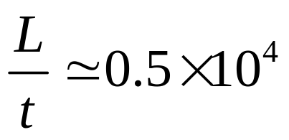
A Square Membrane
P
Material: Kapton
(1)
(2)
(2)
Boundary Conditions
- (1): u=0
- (2): v=w=0
(1)
P

Slide 22
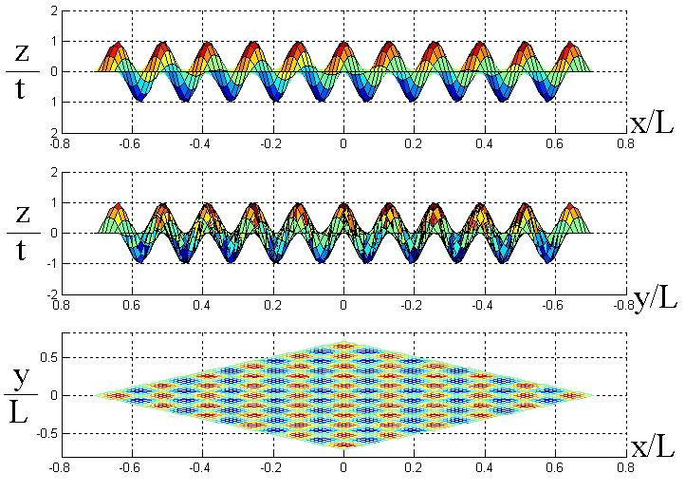
Assumed Imperfection
Notes:
J. Arbocz, “ The imperfection data bank”

Slide 23
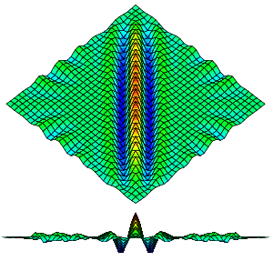
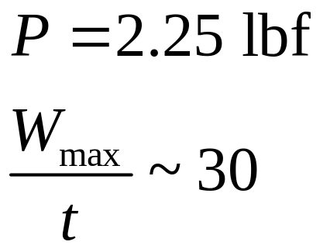
Wrinkling Formation

Slide 24
A Square Membrane
P
0.1P
0.1P
P

Slide 25
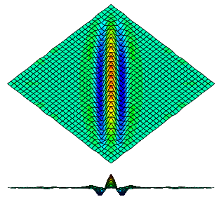

Wrinkle Formation

Slide 26
Observations (1)
From the numerical tests, Max. L/t ranges are
- Double precision w/o modification ~ 10⁵
- Double precision with modification ~ 10⁸
- Quadruple precision w/o modification ~ 10¹⁶
- Quadruple precision with modification ~ 10¹⁸

Slide 27
Observations (2)
The use of quadruple precision, combined with the modified moduli significantly increases the effective range of length-to-thickness ratios for assumed strain solid shell elements.
Also, it appears that the wrinkling formation of membranes can be simulated via a geometrically nonlinear analysis, incorporating the fictitious damping and initial geometrical imperfections.

