Slide 1
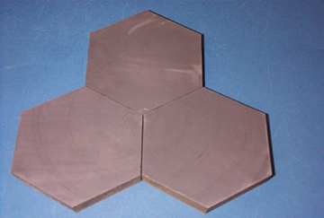
Small
Business
Innovation
Research
SOPHI: Segmented Optics Phase Integration
Applied Mathematical Physics Research, Inc.
Lexington, MA
INNOVATION
Building segmented primary mirrors from small identical segments will allow the construction of large, active, inexpensive optical telescopes. SOPHI is a segmented optics breadboard with new and forefront optical metrology that utilizes AMP Research’s exact solution to the segmented optics membrane phasing problem for adaptive optics (software implementation called AMPERES).
The segmented mirror of stiff CSiC segments and nano response actuators combined with the results from AMPERES and proprietary optical metrology yield a linear physics solution.
ACCOMPLISHMENTS
The cm-scale breadboard is a working scale model as well as a template for linear scaling to near-meter scale segments.
New and forefront optical metrology; real-time generated kinoform holograms.
Successful real-time phasing sparse apertures for arbitrary geometric configurations.
Two wavefront sensors on board provide calibration of new wavefront sensor innovation.
Space qualifiable, optical quality.
Commercialization of SOPHI is being transacted by AMP Research spinoff: Ampware.com, Inc.
COMMERCIALIZATION
SOPHI software module of AMPERES available in 2002; capability to optimally configure, design, and phase linear segmented optical systems
Real-time beam steering using diffractive optics.
SOPHI hardware targeting prototype for amateur astronomer market.
SOPHI originally funded by Origins program/NASA as a space-qualified, optical metrology, lightweight telescope design alternative should an NGST not come on line in the near term.
SOPHI CSiC mirror segments
GOVERNMENT/SCIENCE APPLICATIONS
Directed energy adaptive optics applications for low-power and especially high-power applications.
Near IR to be included in design, increasing domain of use for imaging where ultra-lightweight optics needed.
Agile optical beam steering capability in development.
Wavefront sensor calibration and design or evaluation tool.
NGST and Gossamer breadboard prototype fulfilling target optical quality specs with ultra-low budget.
Breadboard completion in Fall 2001.
International commercial and government funds being developed.
Marshall Space Flight Center
Subtopic: 8.16, Innovative Optics Technology
September 2001
Contacts: MSFC, Tom Knight: 256-544-5353
AMP Research, S. Enguehard: 781-862-6357
1992 Phase II: NAS8-40166
Phase III: NAS8-00108
Notes:
1

