Slide 1
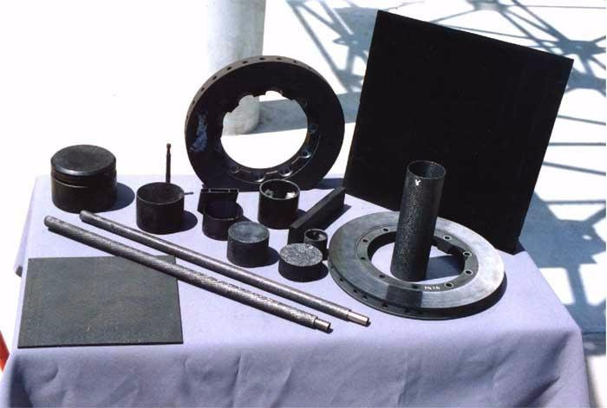

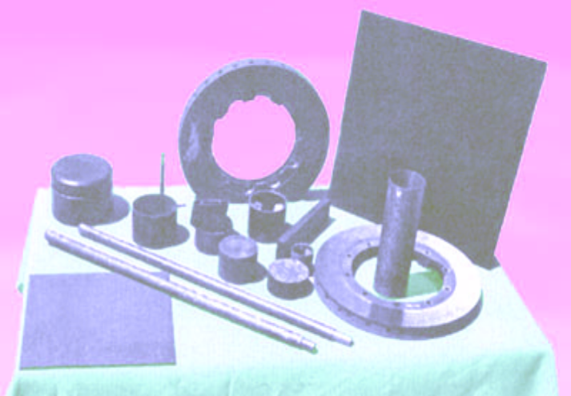
Carbon-Carbon (C-C) Composites
for Dual-Use Aerospace and
Commercial Applications
Innovation
Carbon matrix precursors are coupled with molding operations that permit one- to two-step processing to produce high-density C-C composites. Typical state-of-the-art processing requires up to ten reimpregnation steps.
Accomplishments
The one- to two-step process can reduce C-C composites to well under $50/lb. compared to prices of several hundreds to thousands of dollars per pound for conventional C-C composites.
Commercialization
The low cost C-C composite process has been applied to fabricating components for a variety of applications. The applications include aerospace components for reusable launch vehicles, leading edges, rocket/missile nozzles, and automotive components for engines and friction components. These include valves, blocks and pistons, brakes and clutches.
Economical C-C composite prescursors for reinfiltration with metals are utilized for the same aerospace and automotive applications as well as thermal management materials for electronics and heat exchangers.
MER has invested significant capital of its own in the technology.
MER’s capital, plus additional private capital has lead to joint ventures and consortiums for producing C-C components in transportation.
C-C Components Produced by Low-Cost Processing
Government / Science Applications
The low cost C-C composite technology has led to other government-sponsored R&D contracts for rocket nozzles, thermal management, controlled low-expansion materials and fusion energy applications.
Ultra lightweight space application components for Gossamer and other programs such as solar sails.
PY1994 SBIR Phase II
MER Corporation
7960 S. Kolb Road, Tucson, AZ 85706
Dr. J.C. Withers, 520-574-1980
www.mercorp.com

