Slide 1
III. Solar Sail Flight System Technology
Session Facilitator:
Gregory P. Garbe

Slide 2
Outline
Executive Summary
Solar Sail Capabilities to be Validated by ST9
Solar Sail TCA/Mission-Level Validation Objectives for ST-9

Slide 3
Executive Summary
Workshop Addresses Following Technology Areas
  Sail system design metrics & scaling
  Controlled sail deployment in an orbital/space environment
  In-space characteristics of the deployed sail and structure
  Sail system design metrics & scaling
  Controlled sail deployment in an orbital/space environment
  In-space characteristics of the deployed sail and structure
  Sailcraft attitude control
  System propulsion performance
  Design approach and processes
Sessions Topics
  Future space science mission needs
  Desired workshop products
  Technology splinter session discussions
  Needs/potential capabilities assessments
Splinter Session Topics
  Modeling and Simulation of Deployed Solar Sails
  Solar Sail Material Qualities and Environmental Characteristics
  Pointing, Control, and Navigation Technology for Solar Sails
  Solar-Sail Packaging Deployment, and Structure Technologies

Slide 4
Executive Summary (continued)
Key Observations and Recommendations
  Need the corroboration between quantitative models and ground testing for all major subsystem
  Scale of validation flight needs to be no smaller then 1/3 of future science mission
  Two most important Solar Sail Figure of Merits are:
    Root Sail Area (L_{RSA}):
      Square root of sail’s reflective area
    Sail system areal density (σ_{S}):
      Mass sail system (e.g., membrane, trusses, GNC, Diagnostics, etc.) divided by reflective area
Recommendations for ST-9 Flight Experiment
  Need comprehensive diagnostic package that quantitatively measures the system performance and interaction with its environment
  L_{RSA} should be minimum of 50 m

Slide 5
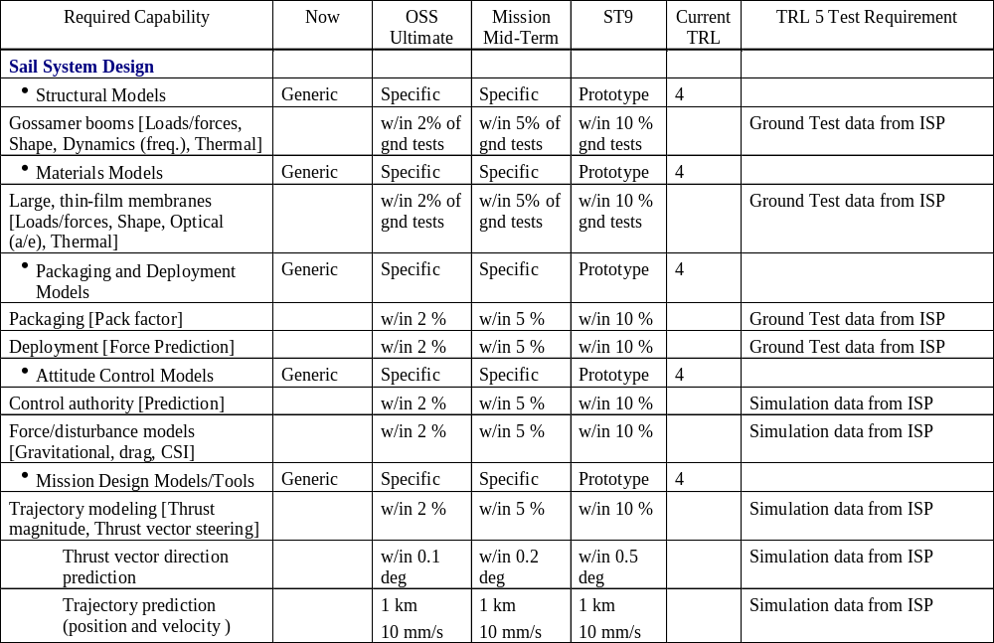
Solar Sail Capabilities to be Validated by ST9 (1 of 2)

Slide 6
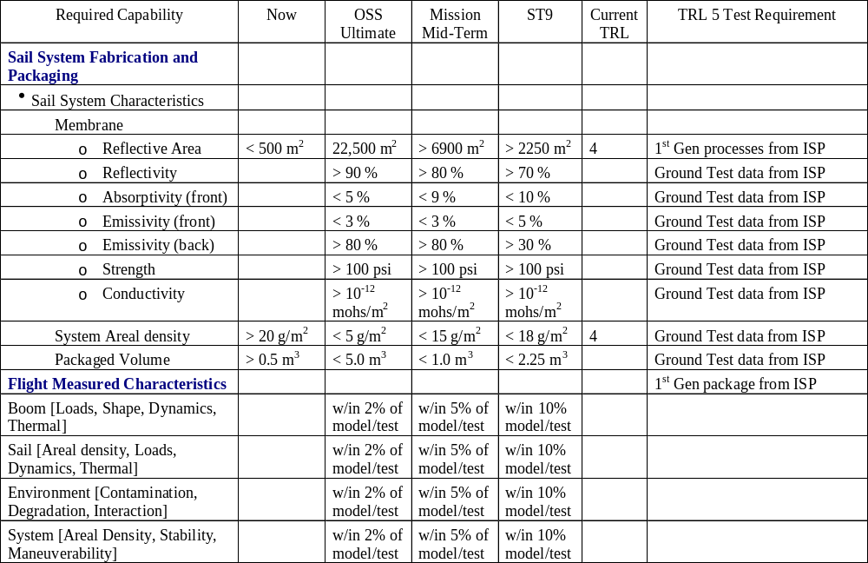
Solar Sail Capabilities to be Validated by ST9 (2 of 2)

Slide 7
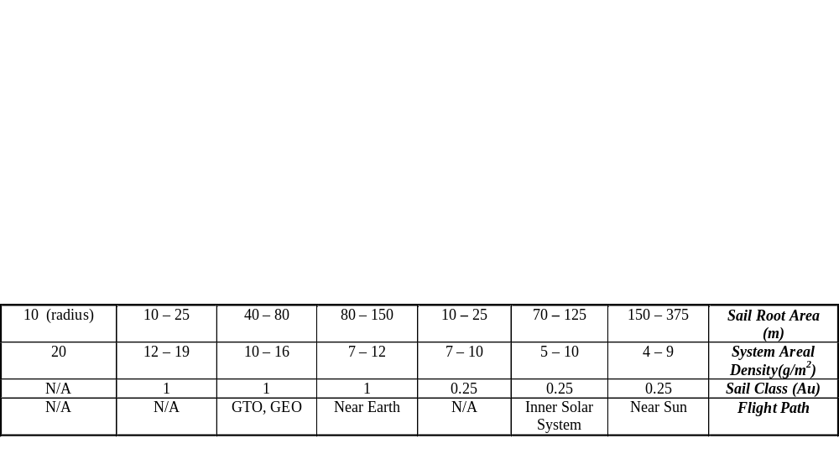
Solar Sail Technology & Mission Implementation Roadmap
NOAA/USAF
MISSIONS
Enabled by Solar Sail Propulsion
Geostorm 1 (0.98 AU)
Pole Sitter 1 (210 R_{E} X 485 R_{E} )
Geostorm 2 (0.945 AU)
Pole Sitter 2 (140 R_{E} X 323 R_{E} )
Launch 2007 - 2010
Launch 2011 - 2013
NASA
MISSIONS
Enabled/Enhanced by Solar Sail Propulsion
Launch 2009 - 2012
Launch 2013 - 2015
L1 - Diamond
Solar Polar Imager
CSSR
Particle Acceleration Solar Orbiter
Titan Explorer
Saturn Ring Observer
New Millennium
Program
* Future Flight Validation
* ST 9 Phase B - D
ST 9 Phase A
In-Space
Propulsion
Program
1 Au GNC HWiL
1Au Architecture
Lightweight Bus
.25 Au GNC HWiL
.25 Au Architecture
Cycle 3 NRA
Cycle 6 NRA
Nano Diagnostic System
0.25 Au Ground Demo
High Fidelity Models
Diagnostic System
1 Au Env. Testing
Cycle 2 NRA
Cycle 5 NRA
AEC Able Ground Demo
L’Garde Ground Demo
JPL Integrated s/w Toolkit
0.25 Au GNC Software Development
0.25 Au Subsystem Development
Cycle 1 NRA
Cycle 4 NRA
NASA Technology Development
2003
2005
2007
2009
2011
2013
2015
1 AU Tech Development
1 Au
Mission Validation
1 AU
Science
Missions
.25 AU Tech Development
.25 Au
Mission Validation
.25 AU
Science
Missions
NMP Gossamer

Slide 8
Solar Sail Figures of Merit required capabilities for Science Missions
Sail System Areal σ_{S}(g/m^2)
Total Sail Loading σ_{T} (g/m^2)
Sail Root Area (m)
Background signifies Ground Testing
Background signifies scaled goal
45.00
450
35.00
350
Areal Density (g/m^2)
Sail Root Area (m)
25.00
250
15.00
150
5.00
50
Demo¹
SPI
PASO
CSSR²
Explorer²
Ground
ISP
Scalable
Titan
ISP
Goals
Diamond
L1
Mission
Notes: 1) ISP Ground Demo σ_{T} assumes non-sail system mass of 10 kg
2) Solar Sail Propulsion is being studied to determine its viability to SSE Missions

Slide 9
Solar Sail TCA/Mission-Level
Validation Objectives for ST-9
Sail Validation Objectives
  Validate sail system design metrics & scaling
  Validate controlled sail deployment in an orbital/space environment
  Validate in-space characteristics of the deployed sail and structure
  Validate sailcraft attitude control
  Validate system propulsion performance
  Validate design approach and processes

Slide 10
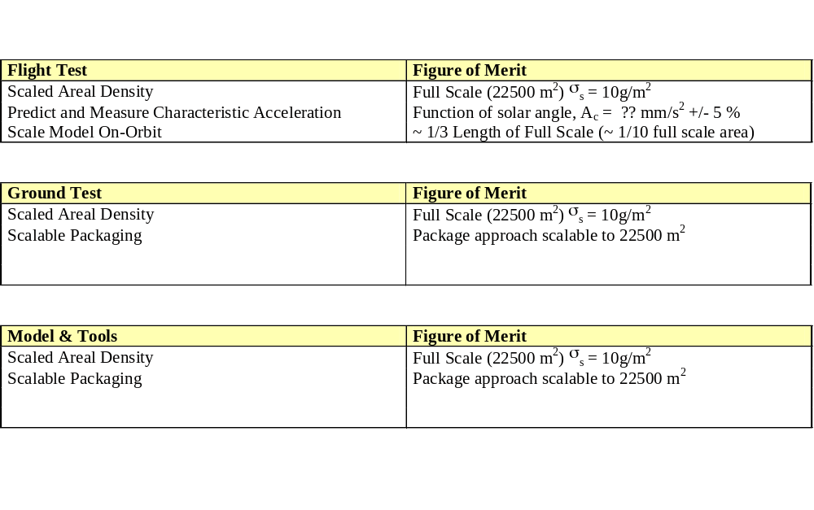
Objective 1. Validate Sail System
Design Metrics and Scaling
Splinter Session A4
Solar Sail Packaging, Deployment, and Structure Technologies

Slide 11
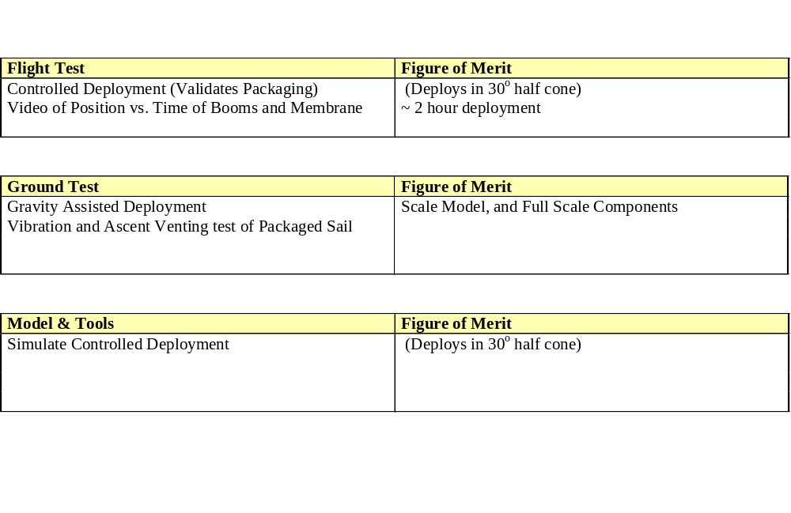
Objective 2. Validate Controlled Sail Deployment in an Orbital/Space Environment
Splinter Session A4
Solar Sail Packaging, Deployment, and Structure Technologies

Slide 12
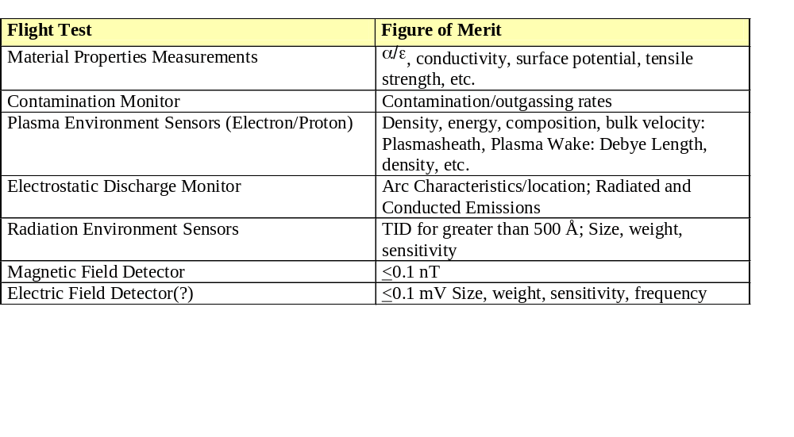
Objective 3. Validate In-Space Characteristics of the Deployed Sail and Structure
Splinter Session A2
Solar Sail Material Qualities and Environmental Characteristics

Slide 13
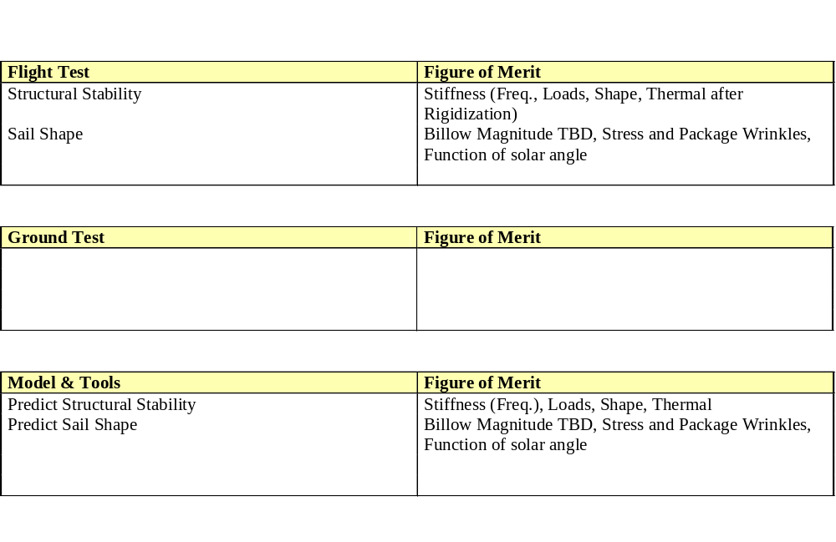
Objective 3. Validate In-Space Characteristics of the Deployed Sail and Structure
Splinter Session A4
Solar Sail Packaging, Deployment, and Structure Technologies

Slide 14
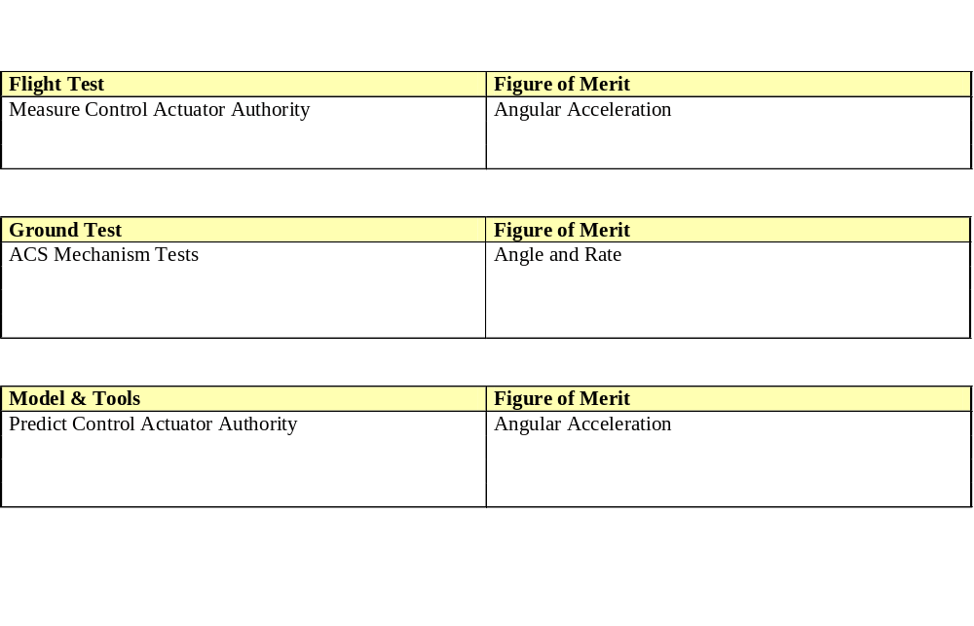
Objective 4. Validate Sailcraft Attitude Control
Splinter Session A4
Solar Sail Packaging, Deployment, and Structure Technologies

Slide 15
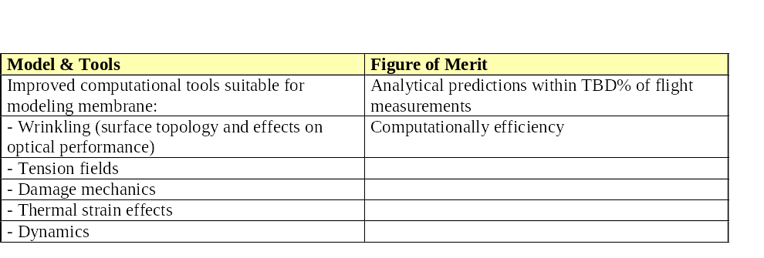
Objective 5. Validate System Propulsion Performance
Splinter Session A1-S2
Modeling and Simulation of Deployed Solar Sails

Slide 16
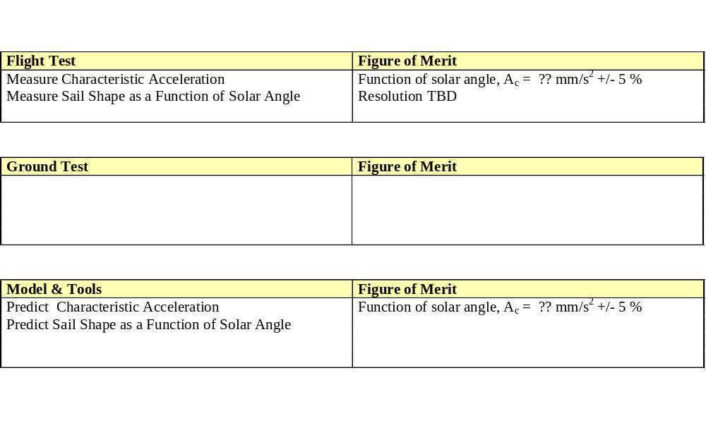
Objective 5. Validate System Propulsion Performance
Splinter Session A4
Solar Sail Packaging, Deployment, and Structure Technologies

Slide 17
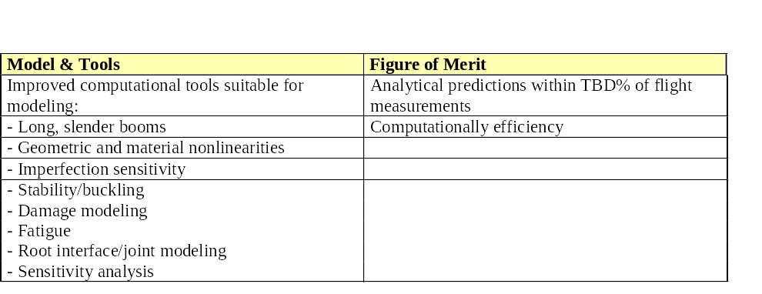
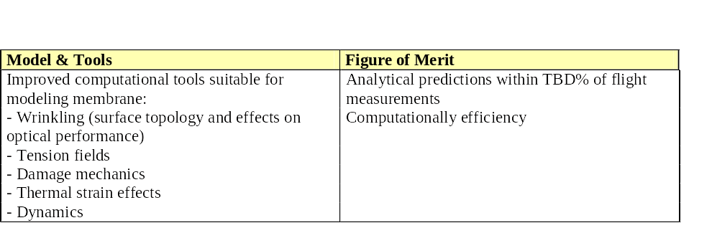
Objective 6. Validate Design Approach and Processes
Splinter Session A1-S1
Modeling and Simulation of Deployed Solar Sails
Splinter Session A1-S2
Modeling and Simulation of Deployed Solar Sails

Slide 18
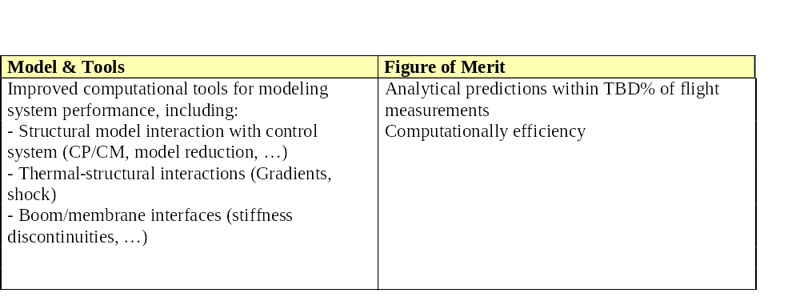
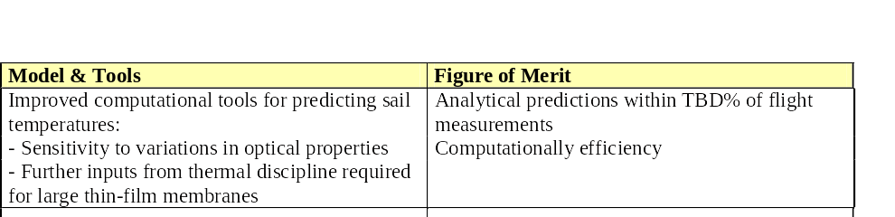
Objective 6. Validate Design Approach and Processes
Splinter Session A1-S3
Modeling and Simulation of Deployed Solar Sails
Splinter Session A1-S4
Modeling and Simulation of Deployed Solar Sails

Slide 19
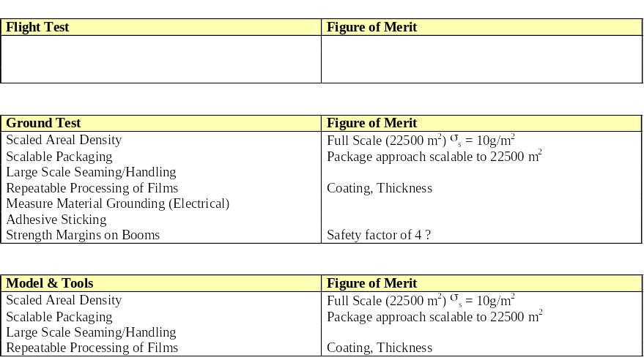
Objective 6. Validate Design Approach and Processes
Splinter Session A4
Solar Sail Packaging, Deployment, and Structure Technologies

Slide 20
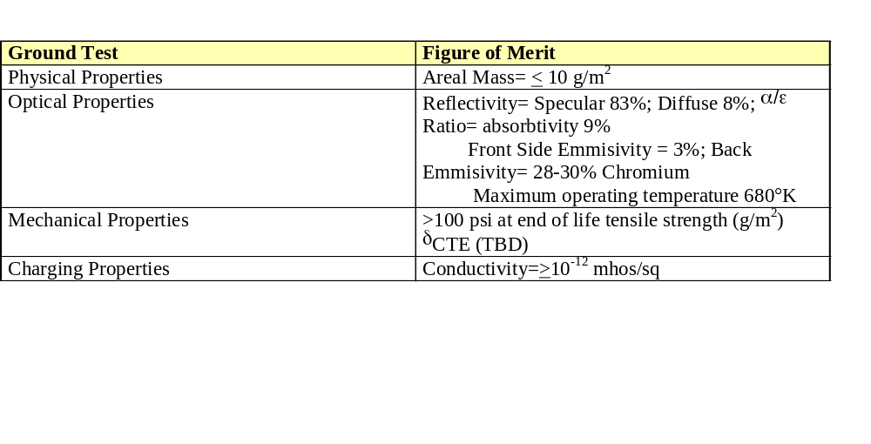
Objective 6. Validate Design Approach and Processes
Splinter Session A2
Solar Sail Material Qualities and Environmental Characteristics

Slide 21
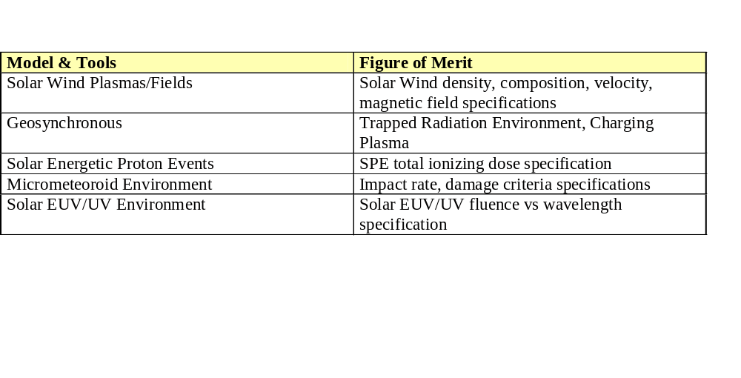
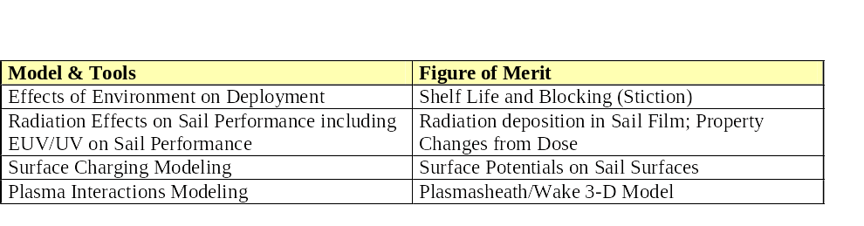
Objective 6. Validate Design Approach and Processes
Splinter Session A2
Solar Sail Material Qualities and Environmental Characteristics

